Slide 1
Representation of Nature in Defoe’s Robinson Crusoe: An Ecocritical Study
Course: ENG 416
Session: 2019-20
Name: Abdullah Al Masum
Registration: 2019236017
Supervisor: Professor Dr. Hossain Al Mamun

Slide 2
Overview
Robinson Crusoe through Ecocritical Lens.
Focus on the Representation of Nature.
Crusoe’s Interaction with Nature(shifting from anthropocentrism to eco-centrism)
Nature as Savior and Destroyer
Ecocritical Approach, Close Textual Analysis and Ecological Ethics as Methodology

Slide 3
Objective
To examine the portrayal of nature in Robinson Crusoe from an ecocritical Perspective.
To explore Crusoe's literary techniques contributing to an eco-critical reading of the novel.
To highlight the significance of the Novel’s ecocritical representation in the broader context of environmental studies.

Slide 4
Literature Review
Traditional Analysis: Focus on colonialism, ecological imperialism, economic individualism and general idea of nature.
Gap in Scholarship: ( ethical dimension, ecological resilience and environmental degradation)

Slide 5
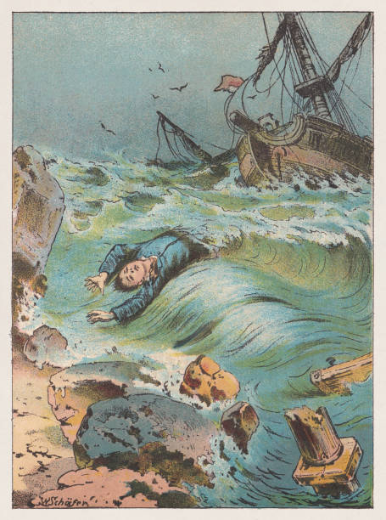
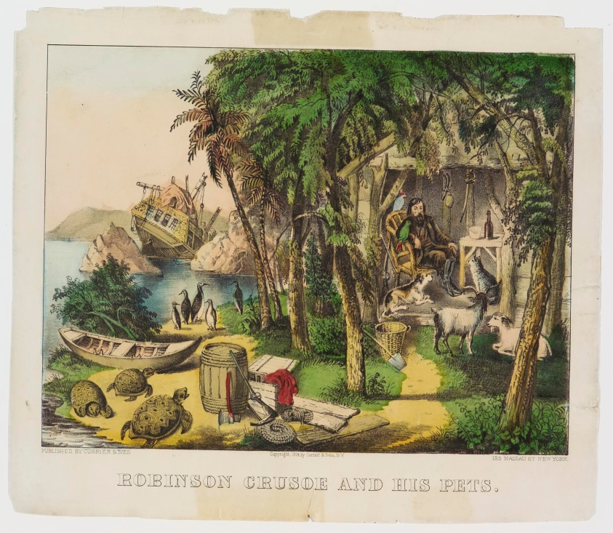
Representation of Nature
Rich geography, flora and fauna
Survival, human ingenuity
Nature’s dual role(adversary and ally)
Utilitarian exploitation to Stewardship, intrinsic value of nature, colonial exploitation of natural landscapes.

Slide 6
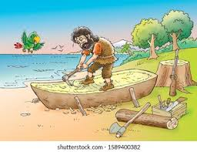
Ecocritcal Interpretation
Colonial exploitation and environmental degradation
Question ethical implications of altering landscapes
Ethical shifting from exploitation to stewardship reflects growing ecological awareness

Slide 7
Ecological Ethics, Morality and Contemporary Relevance
Mastery vs. Stewardship
Moral reevaluation
Criticism of anthropocentrism
Moving towards eco-centrism
Realization of intrinsic value of all living beings and ecosystems.
Preservation of nature mirrors modern environmental concerns

Slide 8


