Slide 1
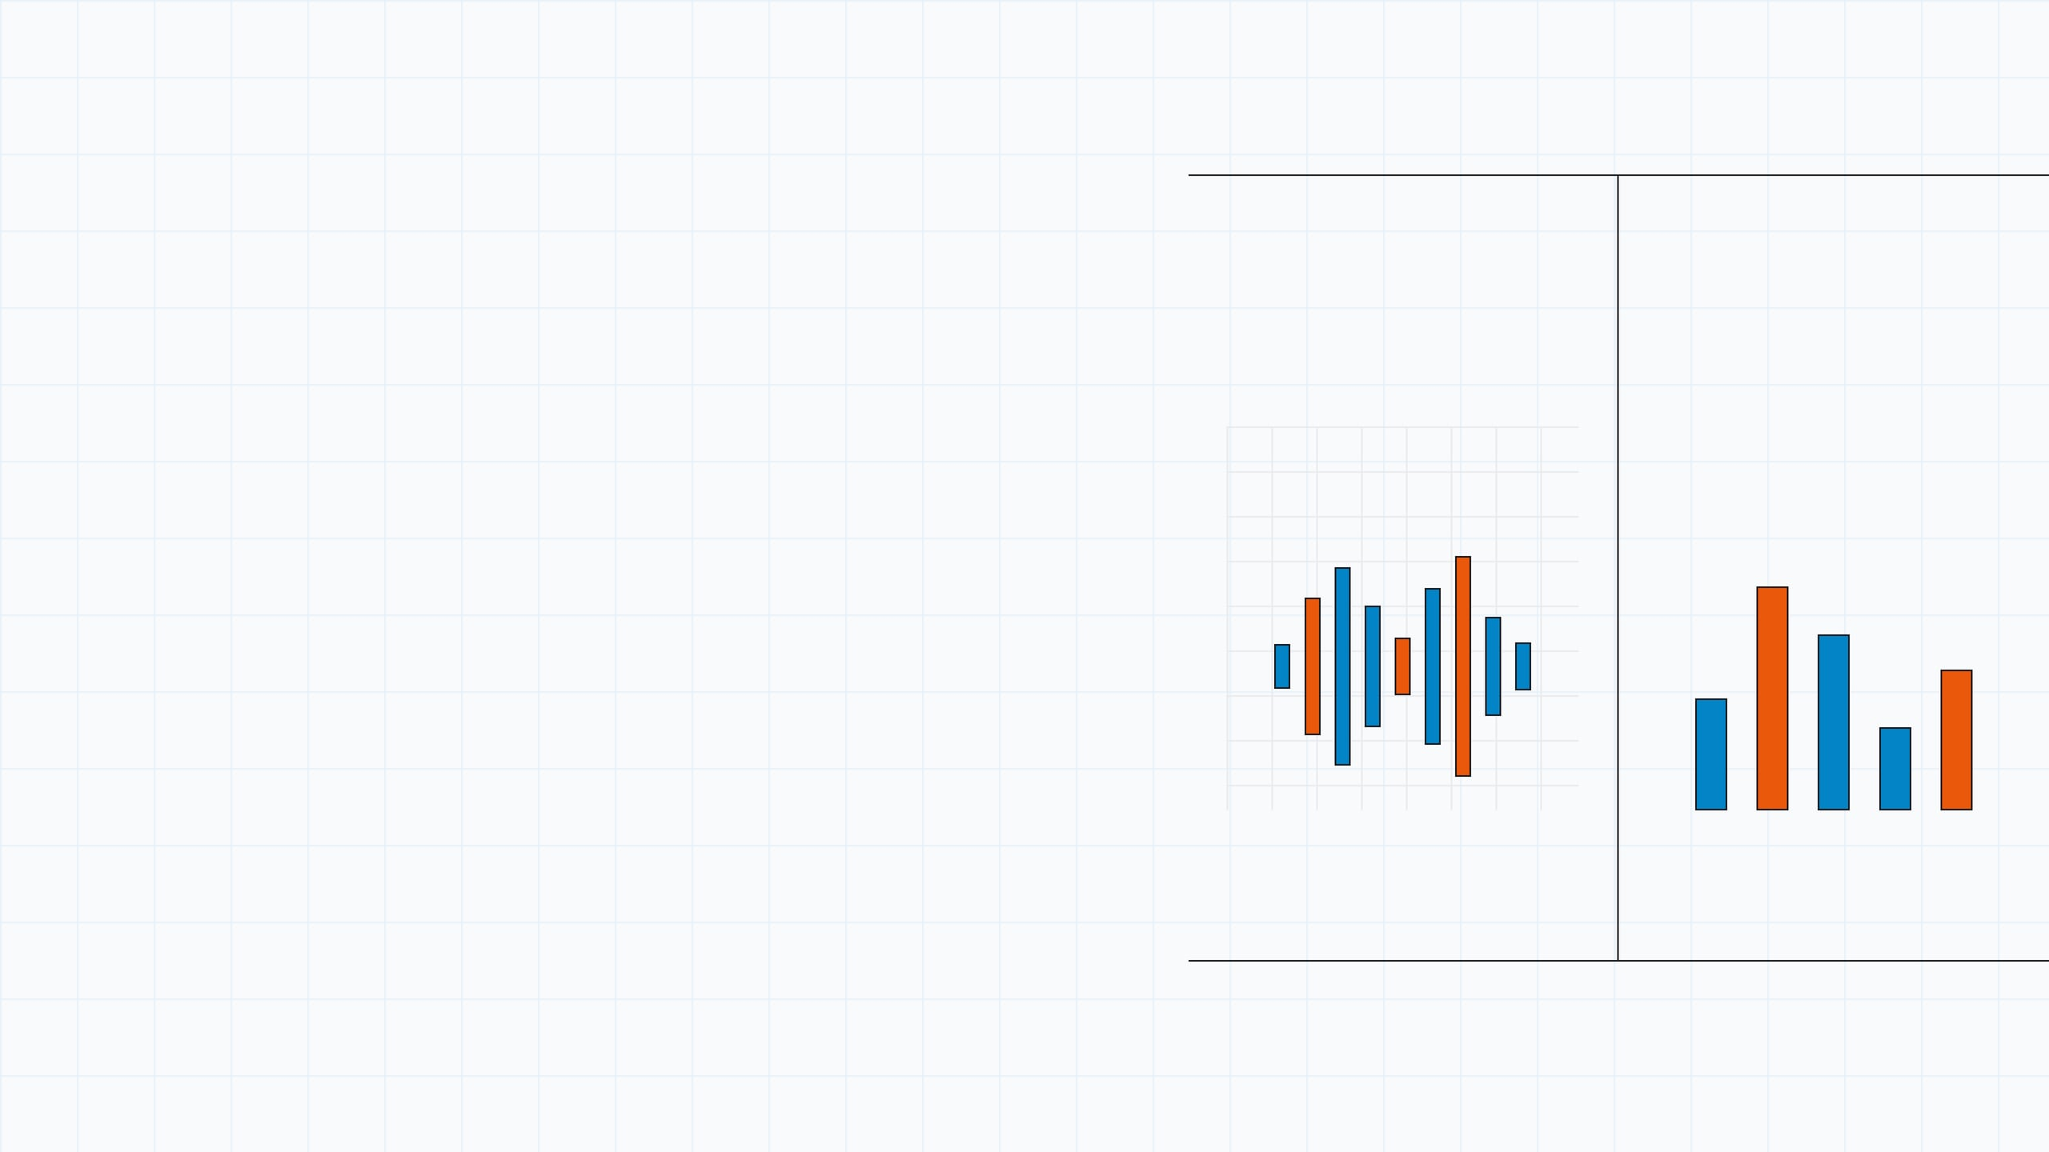

Author: Tan Chee Xiang
Made with: Manus 1.6 Lite
BEGINNER STORY FROM SCRATCH
Signal view A → waveform
Signal view B → ingredients
Why Frequency Domain Matters
TIME DOMAIN
FREQUENCY DOMAIN
An intuitive guided explanation of signals, Fourier’s idea, harmonics, filtering, and compression for a first-time learner.
Why do we need a frequency domain if signals already exist in time?
music
voice
images
physics
Signals look messy in time, but frequency reveals the recurring pieces hidden inside.
Summary:

Slide 2
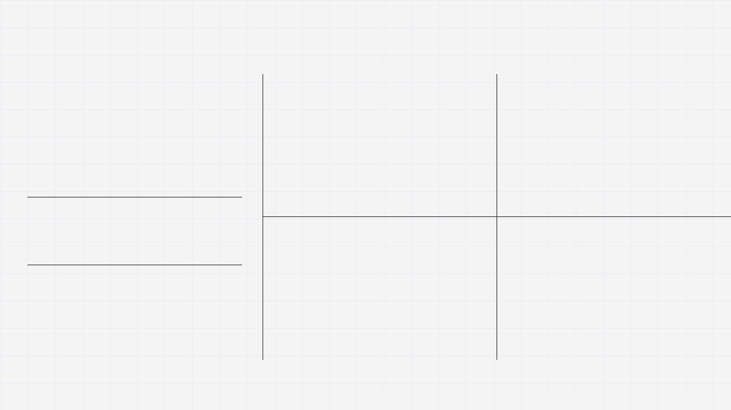
GENERAL IDEA
Once we stop thinking “signal = audio,” the idea becomes a way to describe many physical patterns.
A signal is anything that changes over time or space
A signal is simply a changing quantity. The quantity might change across seconds, meters, pixels, or distance.
SOUND
TEMPERATURE
Air pressure rises and falls as a voice or instrument creates waves.
A room warms and cools through the day, creating a pattern over time.
~
Δ
changes over time
changes across space
LIGHT IN AN IMAGE
VIBRATION
Brightness changes from pixel to pixel across space, forming edges and textures.
A string or beam bends and rebounds, creating a measurable oscillation.
This broad definition is what lets one language describe speech, weather, light, vibration, and many problems in physics.
#
/\/
Key idea: Signal processing is the study of structured change.

Slide 3

WHY PHYSICS FITS
Physics and signal processing keep asking the same question: what structure is hidden inside a changing pattern?
Much of physics is really the study of evolving signals
HEAT FLOW
VIBRATING STRING
CIRCUITS & WAVES
When a physical system changes in time or across space, it can be analyzed as a signal.
≋
/\/
∿
Temperature spreads through material. The pattern smooths and evolves, so we ask how fast and at what scale the variation changes.
A plucked string never moves as one perfectly simple shape. It contains multiple modes of motion at once.
Voltages, currents, and traveling waves respond differently to slow and fast changes, making frequency a natural lens.
That is why the same mathematical ideas appear in acoustics, heat flow, circuits, optics, and vibration. The language changes, but the pattern-reading problem stays remarkably similar.
What parts are broad trends, and what parts are fine fluctuations?
Which modes dominate, and which decay quickly?
Which frequencies pass through, and which are weakened?
Takeaway: Frequency thinking is not just for audio—it is a general way to analyze physical behavior.

Slide 4
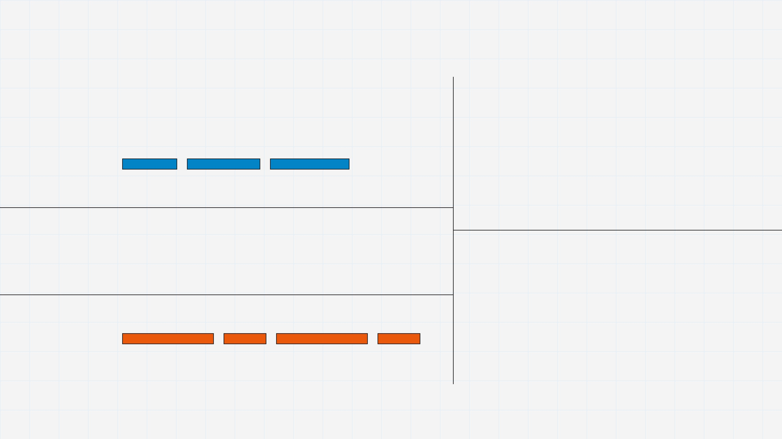
THE CORE DIFFICULTY
The big problem is that time-domain signals mix everything together
In the time view, useful pattern and unwanted clutter are often superimposed.
One waveform can contain many kinds of structure at the same time
TREND
A single curve may simultaneously contain slow change, repeating oscillation, sharp details, and random disturbance. The plot is honest, but it is not always easy to interpret.
~
~
~
~
~
~
So the question becomes: how do we untangle the mixture?
REPETITION
We want a representation that separates slow from fast, dominant from weak, and meaningful structure from noise. That desire is what makes the frequency domain so valuable.
NOISE
Problem statement: Time shows the whole motion at once, but not the hidden ingredients in a clean way.

Slide 5
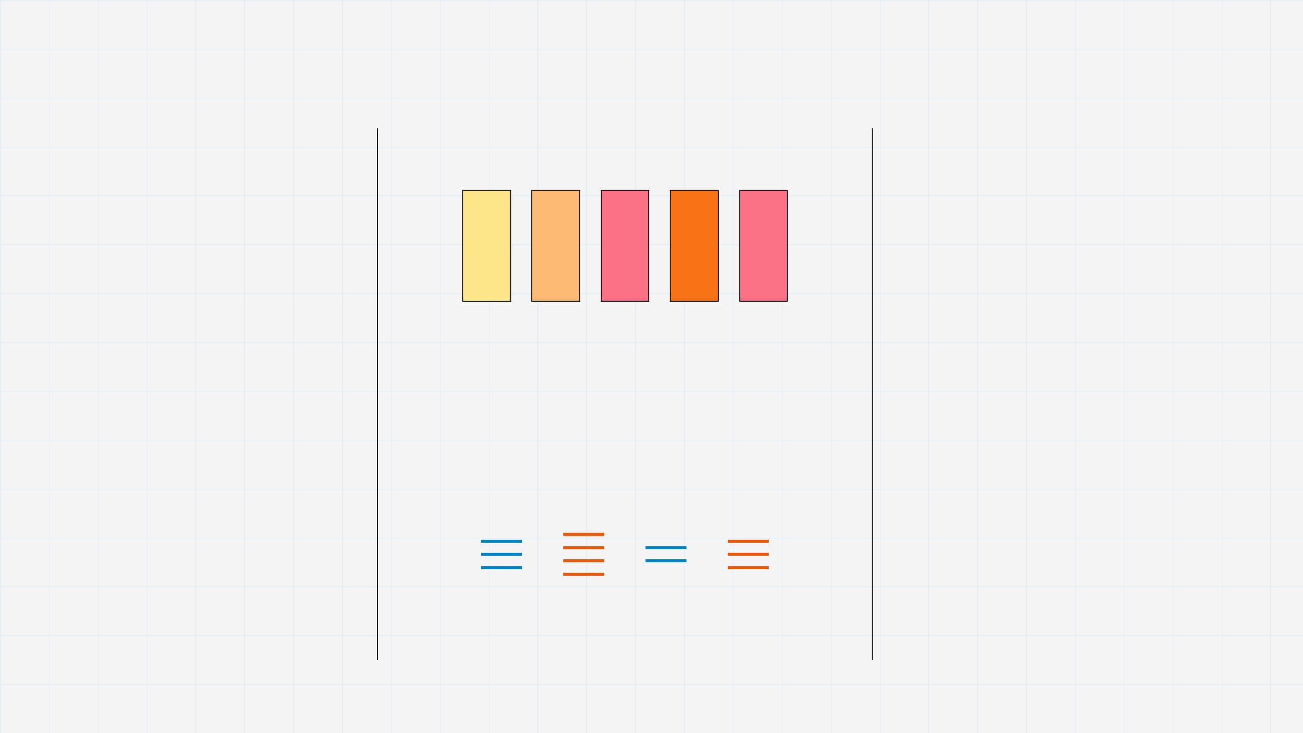
HISTORICAL MOTIVATION
Fourier's breakthrough came from heat, not from music
HISTORICAL CLUE
The crucial insight was not “music is made of notes,” but complex patterns can be decomposed into simple components.
1807 → 1811
Fourier’s early work developed from studying how heat spreads through matter. Historical accounts connect his decomposition ideas to manuscripts on heat that were later expanded in his analytic theory of heat. [1]
Complex physical pattern → rewrite it as simpler wave-like pieces that are easier to study
That idea made hard physical problems easier to analyze. Later, the same logic became essential in audio, imaging, communications, and modern physics. [1][2]
[1] IEEE Pulse: Highlights in the History of the Fourier Transform
https://www.embs.org/pulse/articles/highlights-in-the-history-of-the-fourier-transform/
[2] MathWorks: Practical Introduction to Frequency-Domain Analysis
https://www.mathworks.com/help/signal/ug/practical-introduction-to-frequency-domain-analysis.html

Slide 6
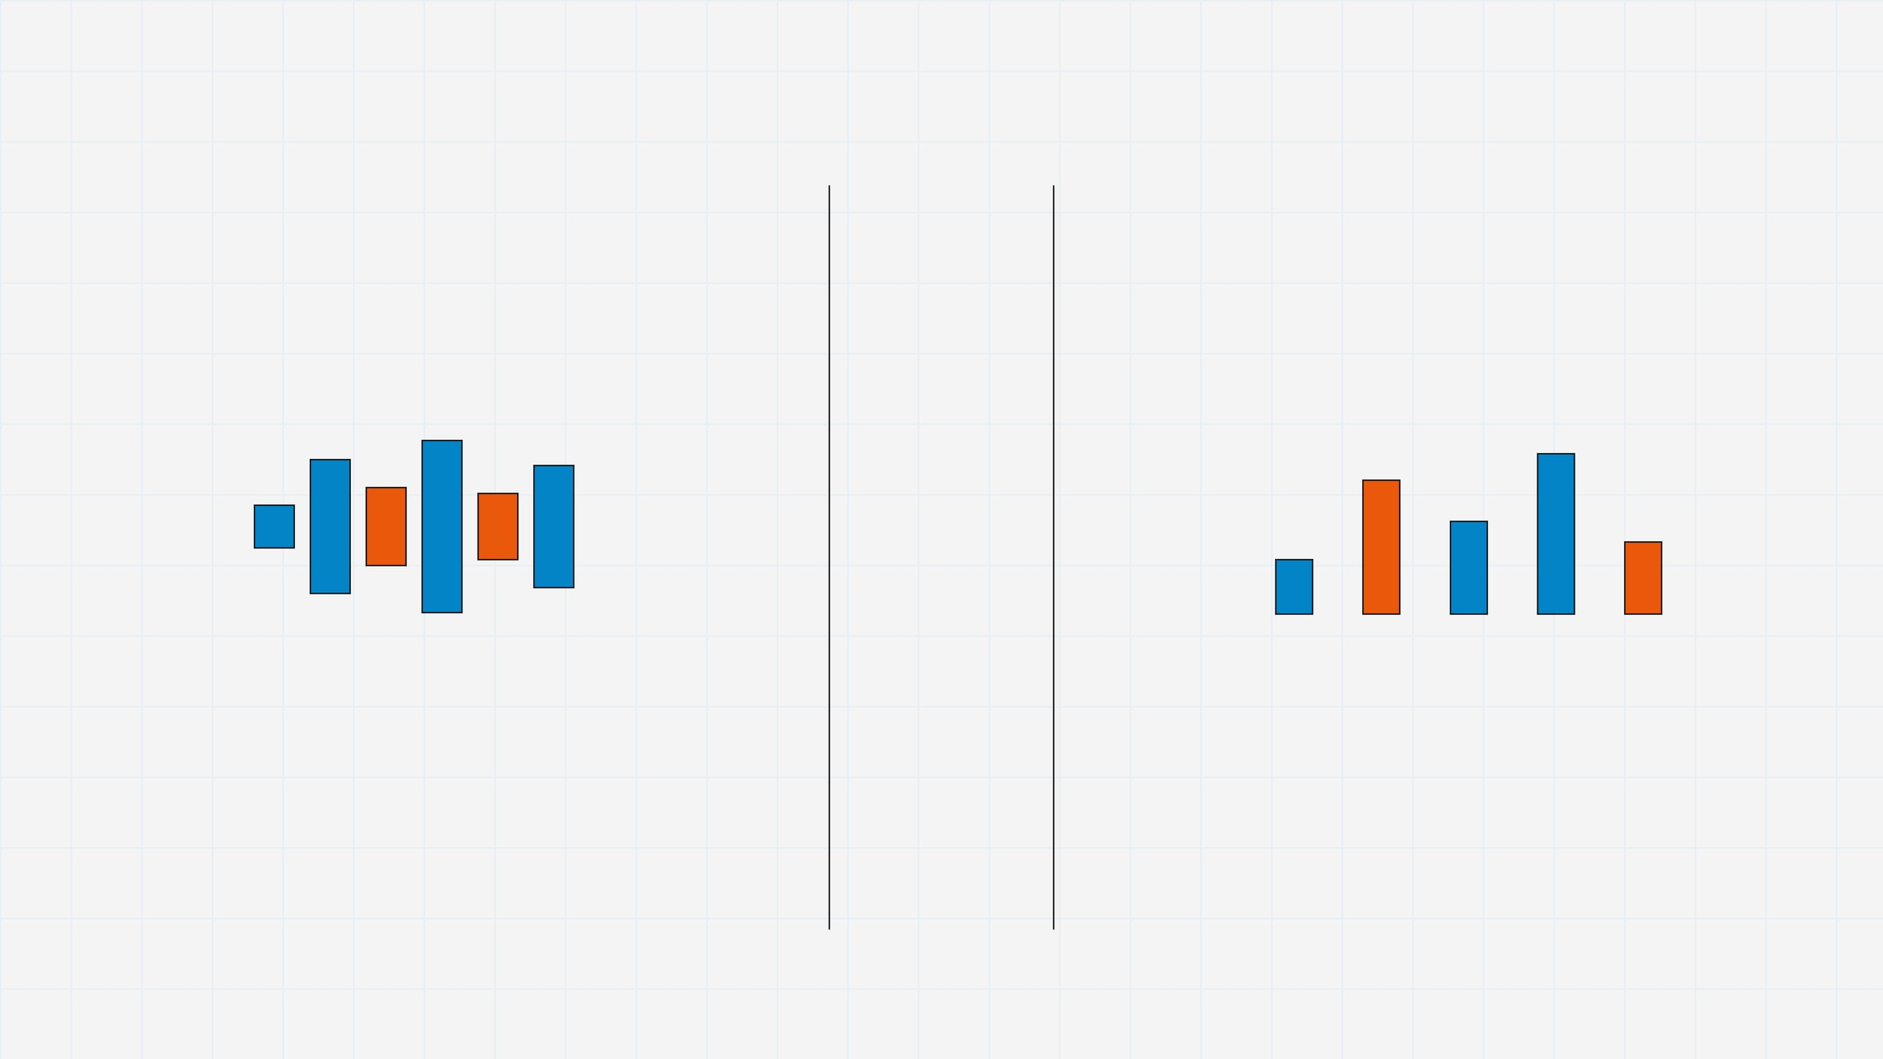
THE CORE INTUITION
The frequency domain tells us what a signal is made of
TIME DOMAIN
FREQUENCY DOMAIN
Fourier transform
Shows what happens as time passes: the overall motion, shape, and order of events.
Shows what it is made of: repeating components and how strong each one is. [2]
Analogy: Time domain is the soup you taste; frequency domain is the ingredient list that explains the flavor.

Slide 7
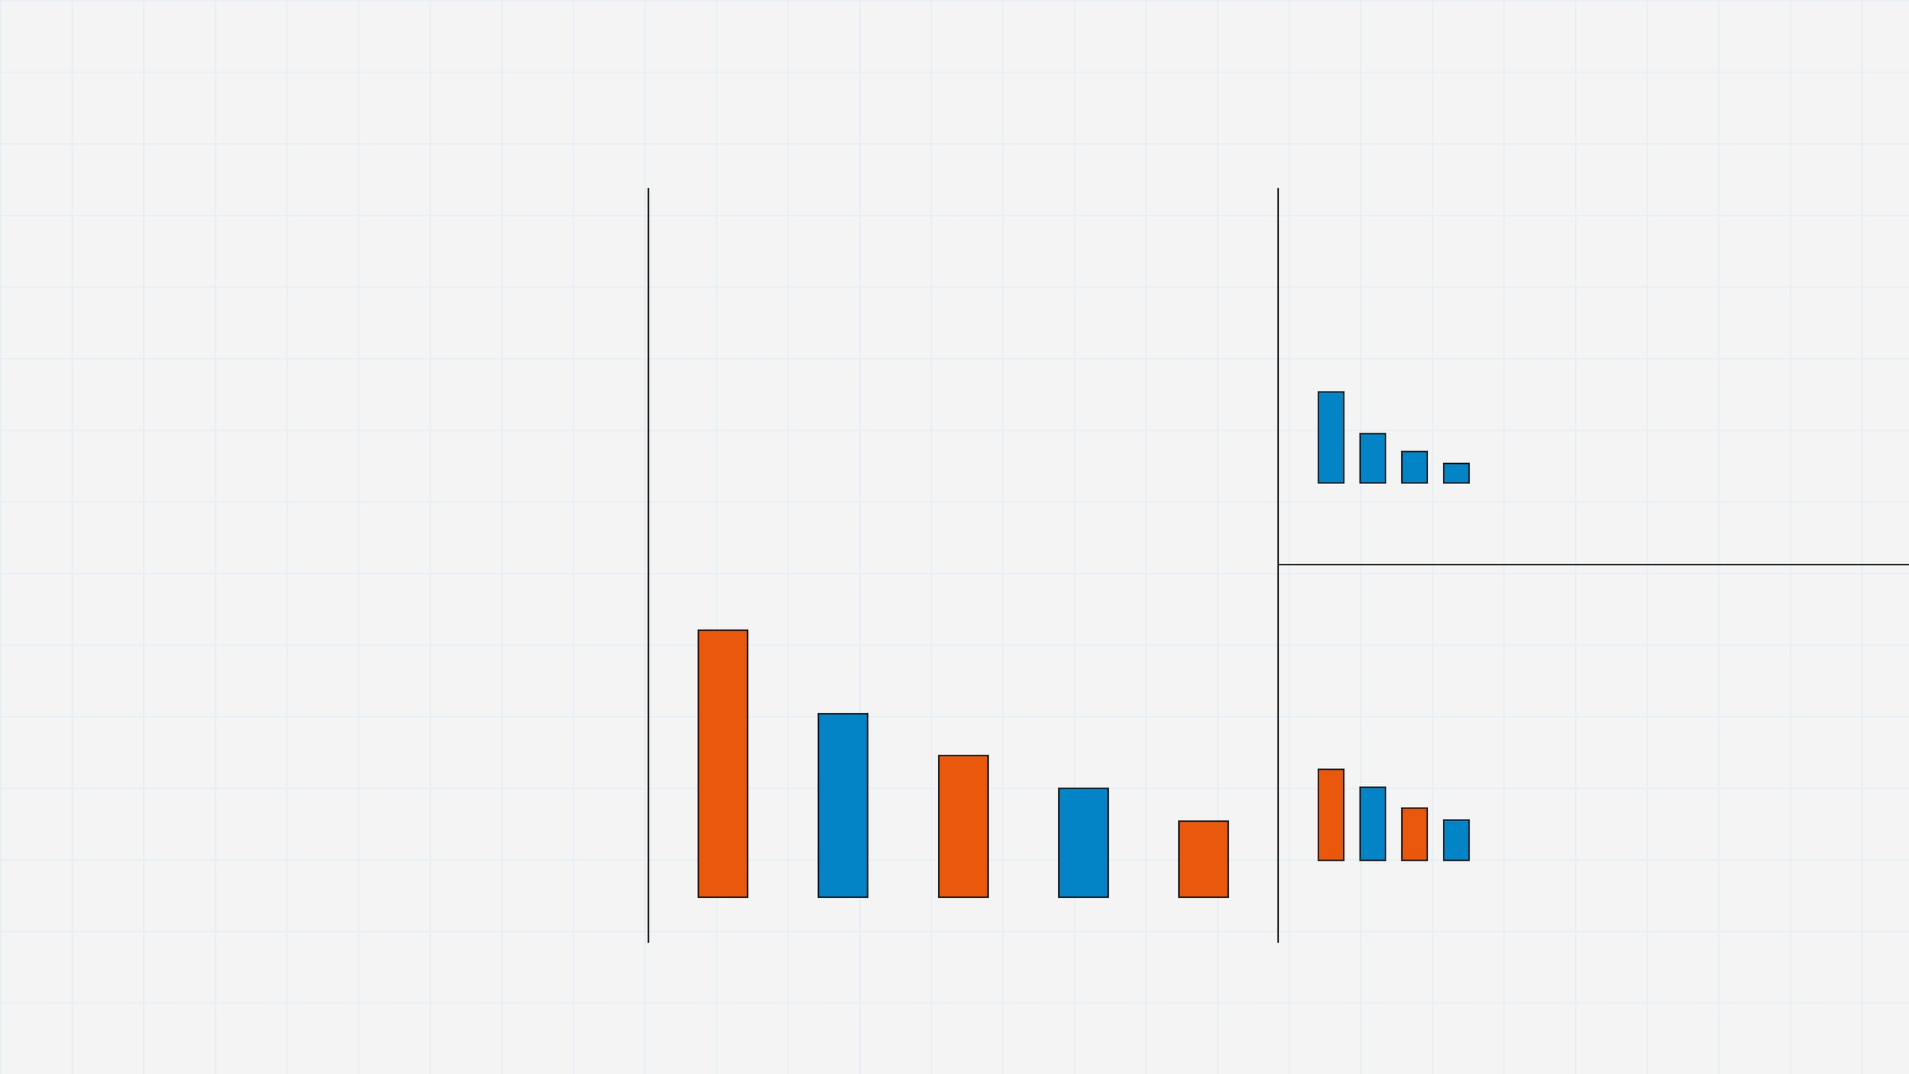
HARMONICS
Real instruments contain families of frequencies, not one pure note
ONE NOTE AS A FAMILY OF COMPONENTS
INSTRUMENT A
A musical note has a fundamental plus higher multiples called harmonics.
Stronger first harmonic, weaker upper harmonics → smoother tone.
These extra components shape tone color, or timbre. That is why two instruments can play the same pitch but still sound completely different.
INSTRUMENT B
Same pitch, but more upper harmonics → brighter spectral signature.
1f
2f
3f
4f
5f
Key idea: Frequency analysis reveals the hidden recipe that makes one instrument sound unlike another.

Slide 8
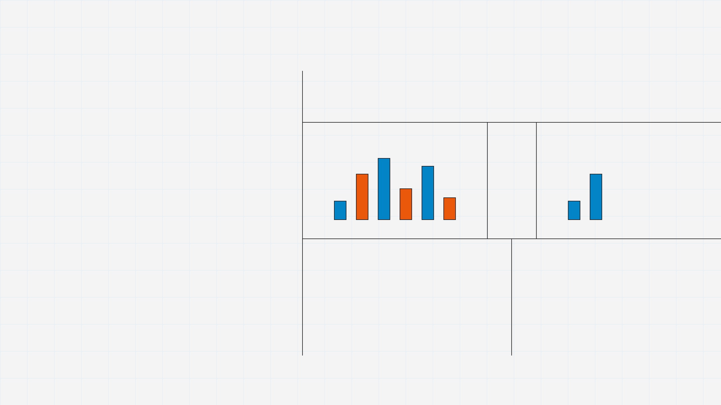
WHY ENGINEERS USE IT
In the frequency view, filtering and system analysis become simpler
The frequency domain is useful because it turns a mixed pattern into parts that can be handled more independently.
BEFORE FILTERING
AFTER REMOVING SELECTED FREQUENCIES
keep ↓
A filter can often be described as “keep this range, weaken that range.” This is easier to think about than editing the entire tangled waveform directly.
remove ↑
FILTERING
SYSTEM BEHAVIOR
Engineers also like this view because many system operations that look messy in time become simpler relationships in frequency, including the famous idea that convolution becomes multiplication.
Select the frequency range you want to keep, suppress, or amplify.
Ask how the system treats slow versus fast components instead of wrestling with the whole waveform at once.
Important: Frequency does not replace time—it reveals structure that time alone may hide.

Slide 9
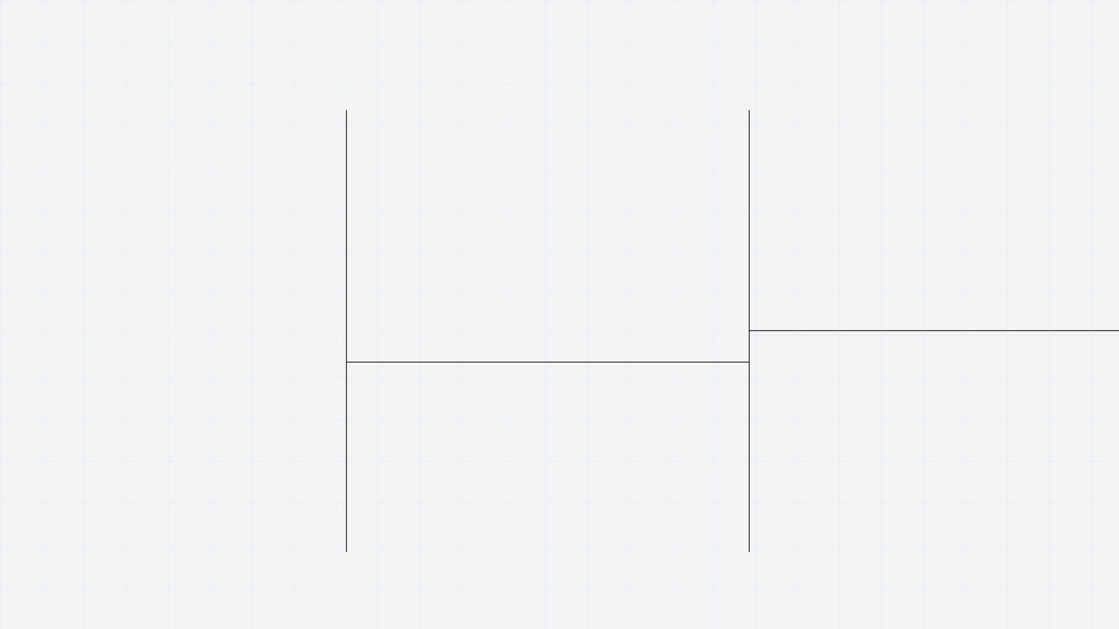
DETAIL AND TEXTURE
High frequencies often carry sharp detail, texture, and noise
High frequencies are often where fine change lives.
SKETCH ANALOGY
IN SOUND
Upper frequencies contribute brightness and crispness, but they may also include hiss or harshness.
LOW FREQUENCY IMPRESSION
__ /\\ __
They can sharpen an image, brighten a sound, and add crisp edges. They can also carry hiss, grain, or small random fluctuations. So high frequency is not “good” or “bad” by itself—it is often where detail and noise coexist.
Broad strokes give the overall shape, but not the fine texture.
IN IMAGES
HIGHER FREQUENCY DETAIL
Higher spatial frequencies often correspond to edges, texture, and fine details that make pictures look sharp.
//// /\/\\ //// // /\\/ ///
Small rapid variations add sharpness, grain, and surface richness.
Intuition: High frequencies are often the place where realism becomes vivid—but also where noise becomes visible.

Slide 10
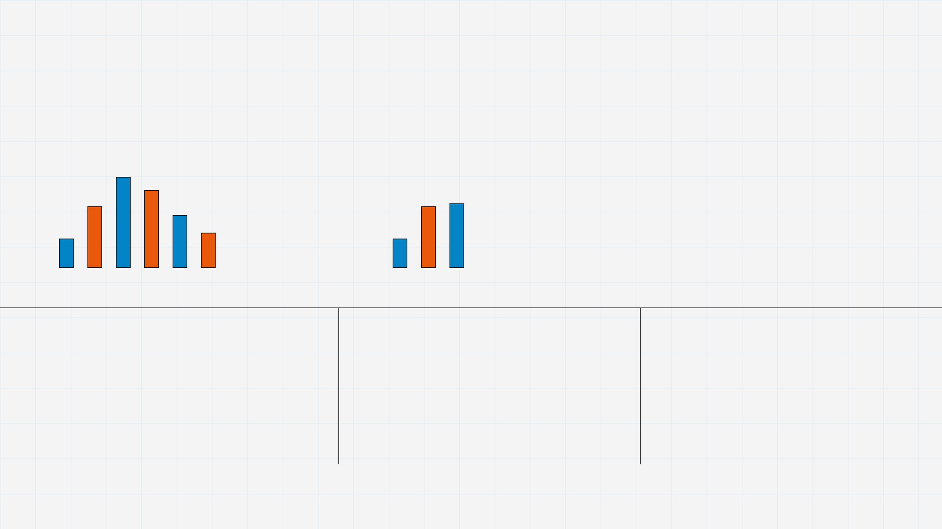
COMPRESSION
Compression removes some detail because perception is selective
FULL DETAIL
COMPRESSED FORM
PERCEPTUALLY SIMILAR
smaller file similar experience
→
→
WHY IT WORKS
WHAT IS OFTEN REDUCED
THE TRADEOFF
Human hearing and vision do not treat every tiny detail as equally important. Compression exploits that fact.
Some less noticeable detail, often including parts of high-frequency content, can be removed or represented more coarsely.
You gain storage and transmission efficiency, but the result is no longer perfectly identical to the original.
Compression is a choice: Keep what people notice most, spend fewer bits on what matters less.

Slide 11

IMPORTANT CORRECTION
The right choice depends on the application, not on a fixed rule
It is not always correct to remove high frequencies.
Removing some high-frequency content may reduce file size or noise, but too much removal can make music and speech sound dull.
AUDIO
Frequency-domain thinking is useful precisely because it helps us decide what to preserve, what to suppress, and why. The answer depends on the goal: realism, clarity, diagnosis, storage, or measurement.
Smoothing can remove grain and save space, yet too much smoothing also erases edges and fine visual detail.
IMAGES
MEDICAL & SCIENTIFIC DATA
Fine detail may contain diagnostically important structure, so aggressive removal can hide exactly what a scientist or clinician needs to see.
Principle: The best frequency choice is the one that serves the purpose of the signal.

Slide 12
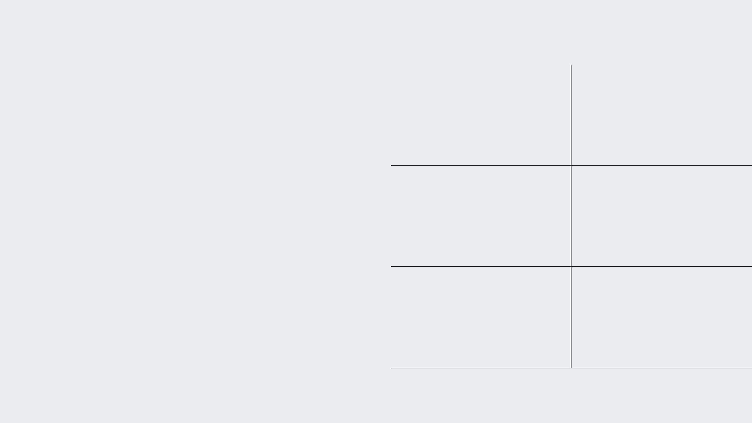
BIG PICTURE
WHERE THIS IDEA SHOWS UP IN THE REAL WORLD
Fourier transform is the bridge between events and ingredients
MP3 / AUDIO CODING
JPEG / IMAGE CODING
Represent sound in frequency components and spend fewer bits on less noticeable detail.
Separate coarse structure from fine detail so visual information can be stored efficiently.
Time domain shows what happens. Frequency domain shows what the pattern is made of.
NOISE FILTERING
MRI & IMAGING
Reduce unwanted ranges while preserving the frequencies most relevant to the task.
Frequency-based representations help reconstruct and analyze complex measured signals.
COMMUNICATIONS
PHYSICS
That is the “aha” moment: one signal can be viewed as a changing event or as a collection of components. Fourier analysis lets us move between those two views.
Understand bandwidth, interference, and how systems affect different signal components.
Study heat, waves, vibrations, and many other evolving patterns through simpler modes.
Final Thought:
The frequency domain matters because it turns tangled patterns into understandable structure.

