Slide 1

Cloud & Infrastructure
Tuesday 13 October
15:40
Room B
Treasure Hunting in Azure with KQL as Your Map
Kusto Query Language (KQL) combined with Azure Resource Graph provides a fast, powerful way to explore, analyze, and gain insights across your cloud environment.
Emanuel Palm
Cloud Specialist & Microsoft MVP @ Unwonted

Slide 3




Emanuel Palm
Cloud Specialist & Microsoft MVP @ Unwonted
💙 Everything-as-Code
📦 Makes modules & tools
📃 Fan of Open Source
🏃🧗🥏🍰🧙
@PalmEmanuel

Slide 4

What’s a pirate’s favorite Azure service? 🏴‍☠️

Slide 5

ARG!
Please raise your hand at any point if you have a question!

Slide 6

Azure Resource Graph
Query the Azure management plane
  Across management groups and subscriptions
Uses Kusto Query Language (KQL)
  A subset of the KQL supported by
  Azure Monitor/Log Analytics, Data Explorer, Sentinel
Based on Azure RBAC with your own permissions
Flexible usage through tooling

Slide 7
Azure Resource Graph Explorer

Slide 8
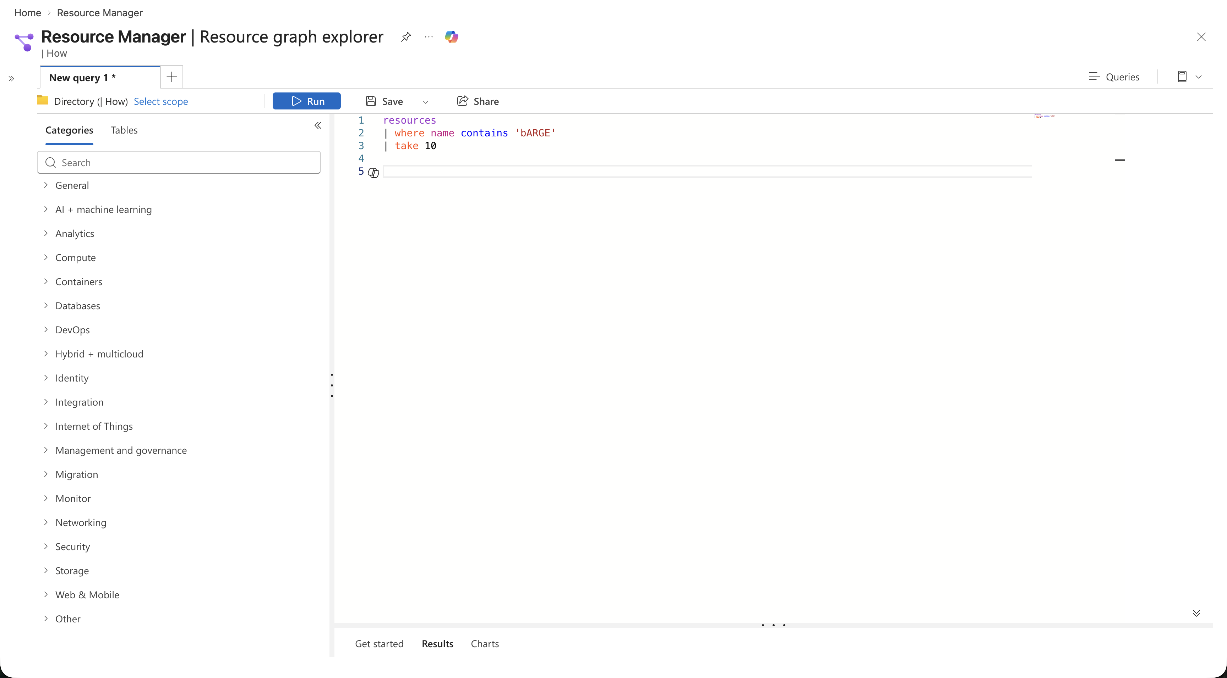
Azure Resource Graph Explorer

Slide 9
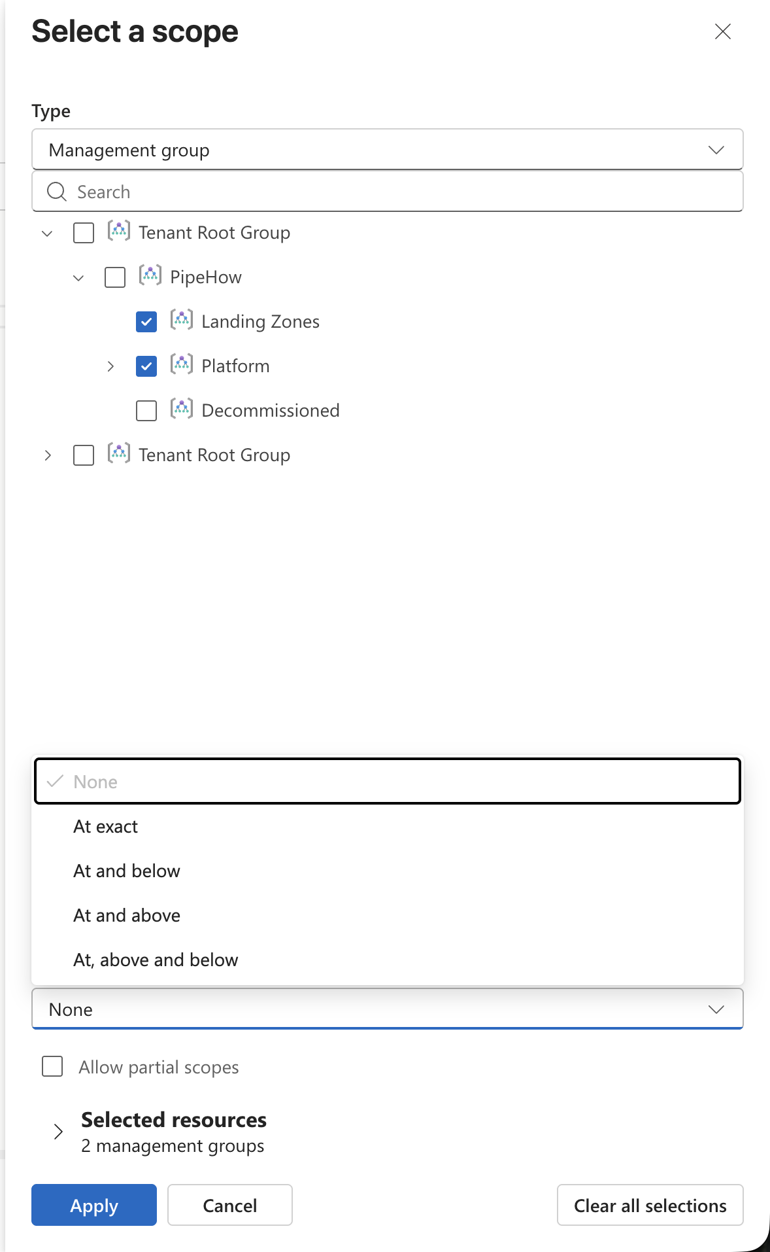
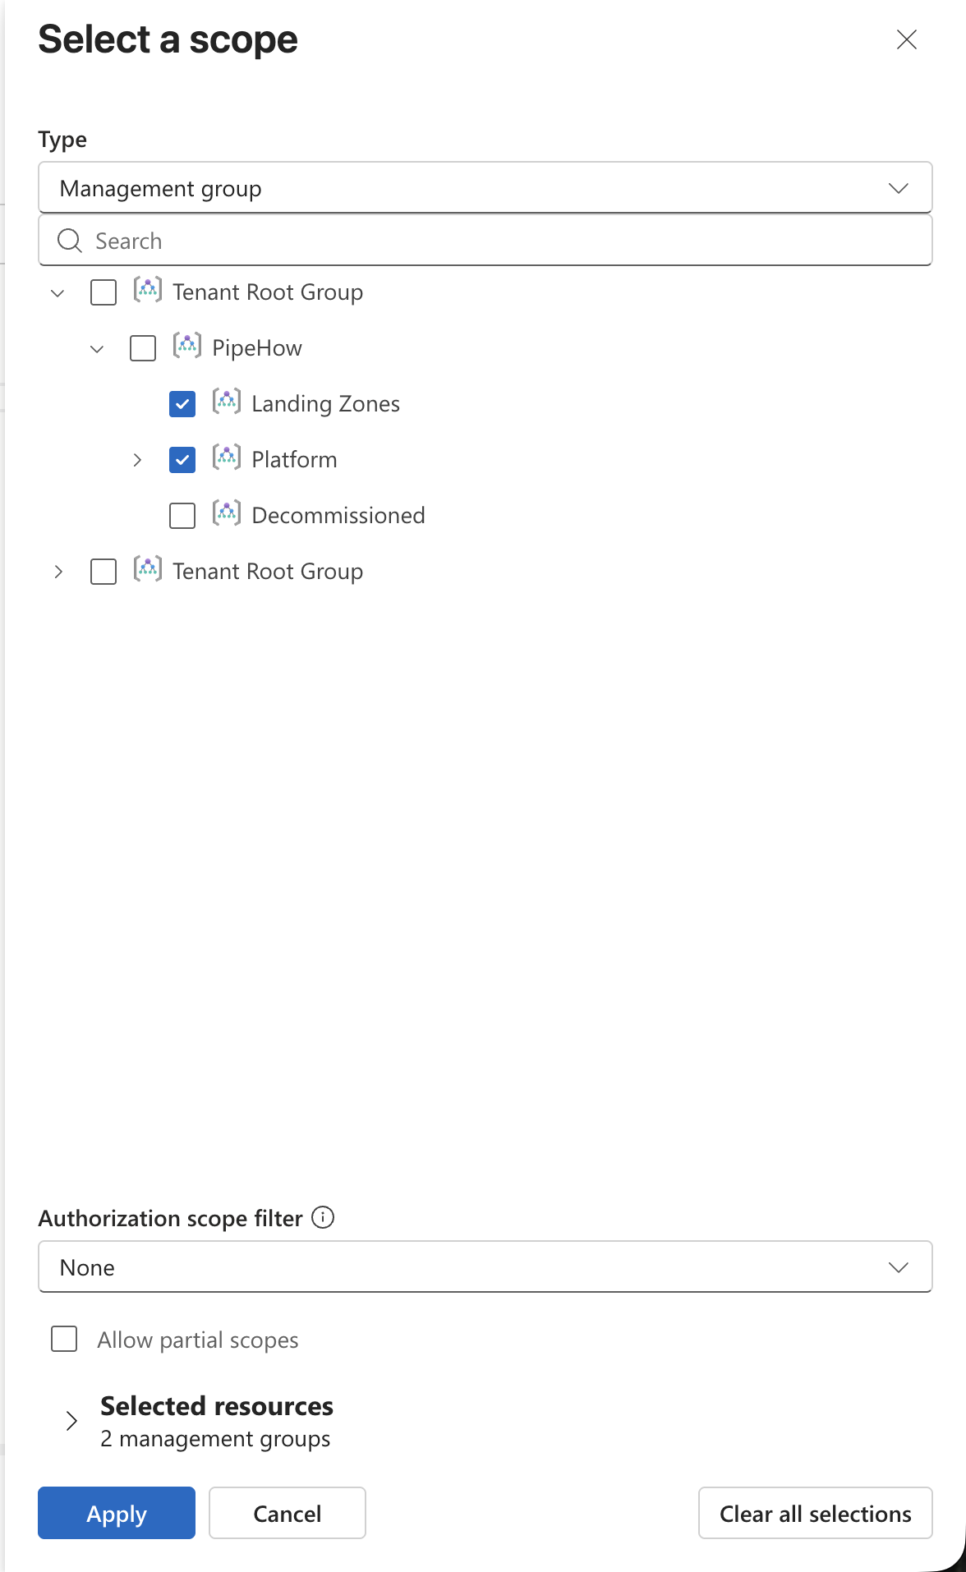
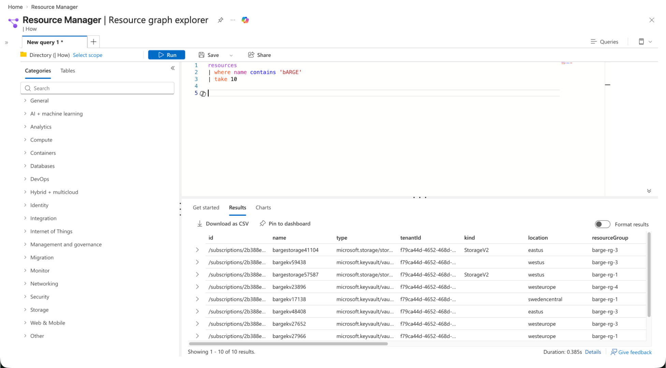
Azure Resource Graph Explorer

Slide 10


Azure Resource Graph Explorer

Slide 11

Azure Resource Graph Explorer
boosted
IntelliSense for ARG KQL
Syntax highlighting
Visualized result tables
Built-in documentation
Entra ID identity lookups
Row comparison
Excel-like data filtering
AI tooling in VS Code

Slide 12
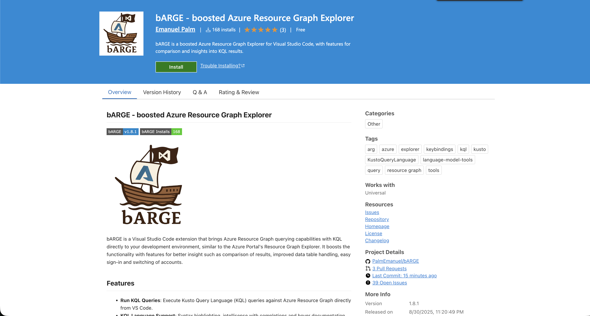

Slide 13

Ways to use Azure Resource Graph
Azure Portal
PowerShell & CLI
REST API
VS Code

Slide 14
ARG KQL Syntax
Tables
ResourceContainers
AuthorizationResources
PolicyResources
Functions
tostring()
isnotempty()
rand()
Resources
not(
)
Operators
project
join
Keywords
or
by
on
where
and
and
contains

Slide 15
Example Query
| type == ‘microsoft.keyvault/vaults’
name ‘kv’
tags[‘env’] == ‘prod’
Resources
where
and
contains
and
not(
)

Slide 16
Example Query
| type == ‘microsoft.keyvault/vaults’
name ‘kv’
tags[‘env’] == ‘prod’
Resources
where
and
contains
and
not(
)

Slide 17
Example Query
| type == ‘microsoft.keyvault/vaults’
name ‘kv’
tags[‘env’] == ‘prod’
Resources
where
and
contains
and
not(
)

Slide 18
Example Query
| type == ‘microsoft.keyvault/vaults’
name ‘kv’
tags[‘env’] == ‘prod’
Resources
where
and
contains
and
not(
)

Slide 19
Querying ARG – Setting sail!

Slide 20
Unsupported KQL Syntax in ARG
let - No variables or temporary tables
No data sources, only resource tables allowed
No complex math, graphs, data things
A bunch of other unsupported things too
There’s unfortunately no list of exactly what is supported :(

Slide 21








Sharing Queries
*ish
Resource Graph
Queries
Git Repository
Log Analytics
Query Packs *
.KQL files
Microsoft.ResourceGraph/queries
Microsoft.OperationalInsights/queryPacks/queries

Slide 22
Tips & Tricks
The Resources table is the default, no need to specify it
Hidden SystemData property for resource metadata
  If supported by the resource – Check API version
Shared queries can be used inside queries with {{ }} syntax
You can use ARG from Log Analytics with arg(“”).Resources
  But not yet* with bARGE
Notes:
https://learn.microsoft.com/en-us/azure/governance/resource-graph/concepts/query-language#resource-graph-tables
https://learn.microsoft.com/en-us/azure/azure-monitor/logs/azure-monitor-data-explorer-proxy#query-data-in-azure-resource-graph-by-using-arg-preview
https://learn.microsoft.com/en-us/azure/azure-monitor/logs/azure-monitor-data-explorer-proxy#azure-resource-graph-cross-service-query-considerations
https://learn.microsoft.com/en-us/azure/governance/resource-graph/concepts/query-language#resource-graph-custom-language-elements

Slide 23
Alerts with Azure Resource Graph
Don’t forget Azure Policy
  Alerts are reactive
Examples of potentially interesting ARG alerts
  FinOps – Someone creates allowed, but high-cost resources
  Operational – ResourceChanges in sensitive scopes
  Security – Resource-related events, permissions and roles
Alerts need access permissions for ARG
Limitations
  Cannot join multiple ARG tables, union works
  Only 1000 records
Notes:
https://learn.microsoft.com/en-gb/azure/governance/resource-graph/alerts-query-quickstart?tabs=azure-resource-graph
https://learn.microsoft.com/en-us/azure/azure-monitor/logs/azure-monitor-data-explorer-proxy#query-data-in-azure-resource-graph-by-using-arg-preview
https://learn.microsoft.com/en-us/azure/azure-monitor/logs/azure-monitor-data-explorer-proxy#azure-resource-graph-cross-service-query-considerations

Slide 24
Alerts with ARG

Slide 25
ARG Limitations
1000 records per query response
  Implement pagination
15 queries / 5 seconds / User
  x-ms-user-quota-remaining
10 000 subscriptions limit for wide queries

Slide 26
ARG GET/LIST API
4000 queries / Minute / User / Subscription
Redirect ARM API requests to ARG
  &useResourceGraph=true
  &useResourceGraph=true
https://management.azure.com/subscriptions/{subscriptionId}/resourceGroups/{resourceGroup}/providers/{providerNamespace}/{resourceType}/{resourceName}?api-version={apiVersion}
Notes:
https://learn.microsoft.com/en-us/azure/governance/resource-graph/concepts/azure-resource-graph-get-list-api

Slide 27
ARG in Dashboards

Slide 28
Dashboards with ARG

Slide 29
Navigate the cloudy sea
  ARG lets you query at scale
Find hidden treasures
  Identify differences, misconfigurations, details
Hoist your sails anywhere
  Use from Portal, VS Code (bARGE), CLIs, dashboards, alerts and more
@PalmEmanuel

Slide 30
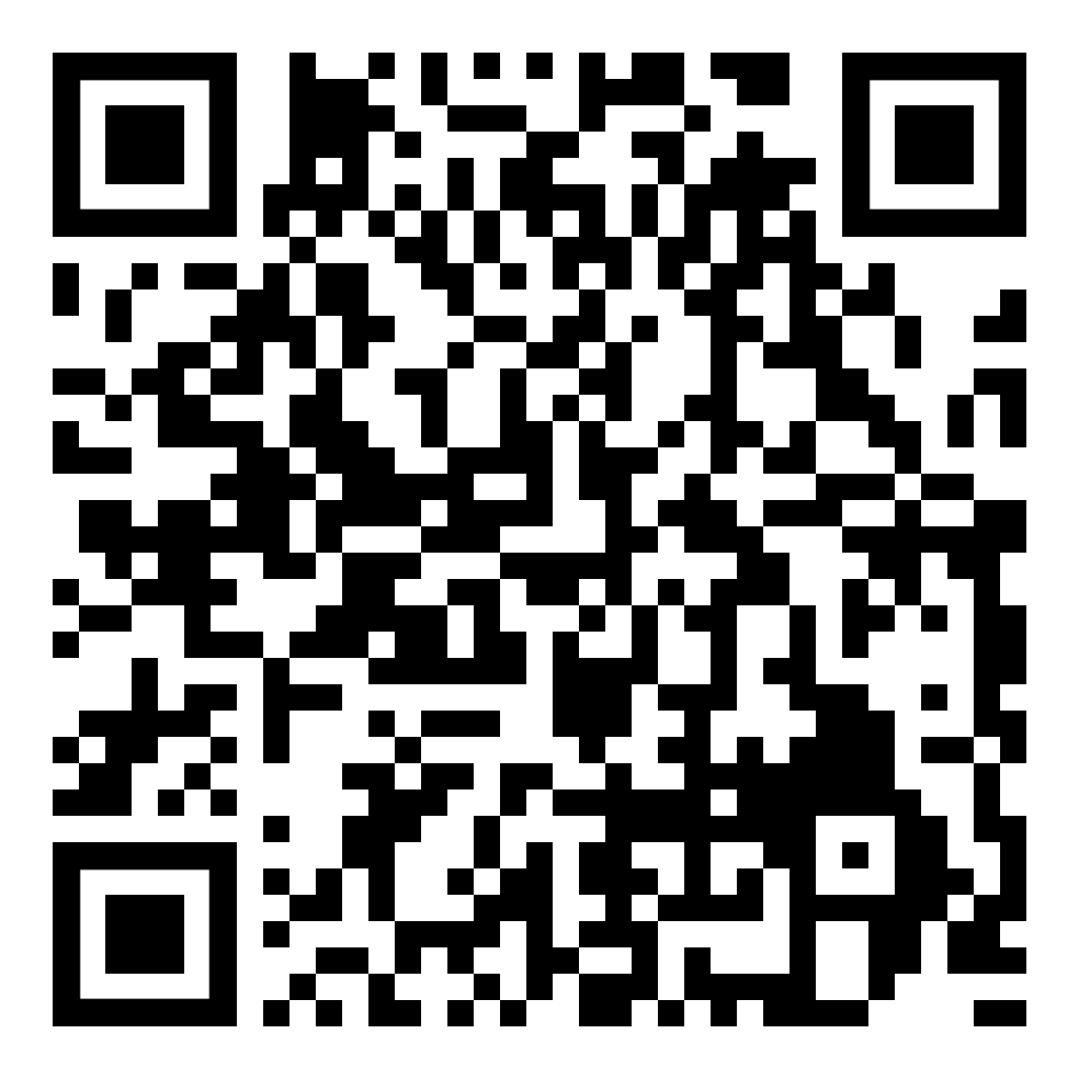
Install bARGE here
if you’re curious
@PalmEmanuel

