Slide 1

GET YOUR func ON WITH AZURE FUNCTIONS
pipe.how>
func init presentation

Slide 2

Emanuel Palm
Consultant at Advania - Knowledge Factory
pipe.how>
💙 Code - .NET PowerShell C#
⚡ Event-driven
📦 Makes modules & tools
📃 Fan of Open Source
☁️ Blogs at pipe.how
Get-Hobby –Count 5
🧙🍰☕🧗🥏
pipe.how>
func new -n agenda
Notes:
Event-driven (ie I’m a speaker – I love coming out to conferences to talk about stuff I’ve learned, and connect with the community)

Slide 3
Agenda
Azure Functions What are they?
Bindings Built-in integrations.
Tooling Function Core Tools, VSCode, VS, Azurite, PowerShell ...
Demo Developing functions.
Recap What have we learned?
Q && A foreach (var q in questions) TryAnswer(q, out _);

Slide 4
Azure Functions
pipe.how>
func start
Serverless Code
Scaling & Cost
App Service flavor
Care less about the infrastructure.
Scale based on demand, pay-per-use.
Same platform, extended by WebJobs.
Event-driven
Multiple Languages
Integrations
Notifications, data processing, mini-APIs.
C#, JavaScript, Python, Java, PowerShell ...
Out-of-box integrations using bindings.

Slide 5
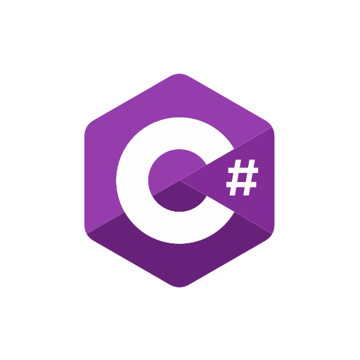







Bindings & Triggers
✉️
Input
Output
Trigger
function.json
Extension bundle
✉️
Storage Blob
HTTP Trigger
Service Bus
Timer
Trigger
🕚
⚡
⚡
⚡
Cost Management
📄
✉️
✉️
Storage Table
Storage Table
Input
Output
Azure SQL
📚
Function
Storage Queue
Function
Function
Function App
Function App

Slide 6
Notes
Extension Bundles for non-dotnet (ie non-C#)
Behind the scenes everything is a nuget package anyway
NuGet Packages for C#
Real-life example?
Azure Function Demo Bicep template Shared ASP, Consumption Two in C# Timer Trigger, Get Cost Management API (System-Assigned), Post to Queue (Binding) Queue Trigger, Post item to Table (Binding) One in PowerShell HTTP Trigger, Get Table results (Binding), HTTP Response

Slide 7









Q && A
var qr = new QuestionReader(questionStream); while (!qr.EndOfStream) if (TryGetAnswer(qr.Read(), out var result)) Answer(result); else Improvise(result);
https://pipe.how

