Slide 1
README
BURN AFTER READING
about_SlideDeck
The actual presentation starts with slide 6 ("Session title"). The first five slides have a purely organisational purpose. During the break before your session, you should start the presentation with slide 2 ("Next up"), so that the audience knows that they are in the right room. It's fine if you start chatting with the audience during this break, but we need a precise starting point for your presentation in terms of editing your video. That means:
The recording of your presentation will start after the countdown. Please (RE)START talking after the countdown, not during it! Otherwise your recording will start with a half sentence.
It is not necessary to explicitly signal to the PA operator, this is your signal!
Finally, do you have to use this slide deck? No, you are free to present the way you like it. But you are asked to use the intro slides: countdown, session title, sponsor slide. Beyond that, use what is good for the cause – from no slides to sketches from your children, from Jupyter to $youNameIt.
You will find additional information in the notes below.
Sincerely, your hosts!
Dear Speaker, we are thrilled and honored to have you with us in Wiesbaden in 2026. Take your time and read this before you prepare your session.
Since most of you have been with us before, you will already know a lot about PSConfEU. You know that we try to capture all sessions carefully and publish your work on YouTube. There are a few easily avoidable stumbling blocks that we would like to draw your attention to:
Your screen resolution should be 1920x1080 px (FullHD)
You should provide a full size HDMI socket
Mirror your screen
Disable "Presenter View" in PowerPoint
Using MAC or Surface book? Be aware of HDCP!
Disable the ‘Night Light’ Mode
Enable the presentation setting (presentationsettings.exe in Windows)
If you present sensitive information on web portals, consider using something like "CloudCloak"
Notes:
The fine print (additional information)
Why should you care about HDCP?
"High-bandwidth Digital Content Protection (HDCP) is a form of digital copy protection developed by Intel Corporation to prevent copying of digital audio and video content as it travels across connections. Types of connections include DisplayPort (DP), Digital Visual Interface (DVI), and High-Definition Multimedia Interface (HDMI), as well as less popular or now deprecated protocols like Gigabit Video Interface (GVIF) and Unified Display Interface (UDI)."
https://en.wikipedia.org/wiki/High-bandwidth_Digital_Content_Protection
Some notebooks ignore the HDCP standard, some vendors comply with the standard. Apple and Microsoft are somehow famous for strictly following the HDCP guidelines. Sadly, we will not be able to guarantee, that your session can be recorded in the latter case.
But you can do simple things, to overcome these problems. It is also very likely that you presented with your notebook before. So you will know, if this worked fine.If you are in doubt and if the agenda allows, try a dry-run a day before and connect everything.
In general you can easily bypass HDCP restrictions with a cheap splitter (the cheaper the better), just like the one you see below. This is an example device that we bought for 16 euros (in Germany).
Ask us, we will lend you such a device.
Thorsten also gave a whole presentation about "Broadcasting yourself" - easy steps to record yourself and create a (backup) session recording on your own. If you want to invest your time and dive deeper, take a look at his recordings and notes:
https://vimeo.com/thorstenbutz/byourself
This is of course completely voluntary, but perhaps you will find it helpful.

Slide 2
Next Up:
Emanuel Palm

Slide 3
3
3

Slide 4
2

Slide 5
1

Slide 6
Building Open Source Modules in C#
Emanuel Palm

Slide 7
Previous PSConfEU sessions
2023
Creating your first PowerShell module in C#
Emanuel Palm & Justin Grote
Write PowerShell modules without conflicts - Introducing Assembly Load Contexts
Emanuel Palm
Building a PowerShell module for Bicep in C# - almost 1.000.000 downloads later
Emanuel Palm & Simon Wåhlin
Resolving PowerShell Module Assembly Dependency Conflicts
Andy Jordan
2025
Creating My First C# Module: Lessons Learned
Andree Renneus
Defeating the assembly conflict dragon with Assembly Load Contexts
Jordan Borean

Slide 8
Many thanks to our sponsors:

Slide 9





Emanuel Palm
Cloud Specialist @ Unwonted
💙 Everything-as-Code
📦 Makes modules & tools
📃 Fan of Open Source
🏃🧗🥏🍰🧙
https://www.powershellgallery.com/packages/Bicep https://www.powershellgallery.com/packages/AzAuth https://www.powershellgallery.com/packages/AzBobbyTables

Slide 10
Ways to Write a Module
Script modules (.psm1)
Binary modules (.NET)
Hybrid modules (both)

Slide 11
Why?
.NET ecosystem
NuGet packages & SDKs
Not re-inventing the wheel
Features not available in PowerShell
Type safety
Generic methods
Interfaces
Proper Classes and Inheritance
…
Fun fact - You can build them in F# :)
Or VB.NET :(

Slide 12
Examples of C# Modules
Pester
Most of Microsoft’s official modules
More modules than you expect
Some of my modules
Bicep, AzAuth, AzBobbyTables

Slide 13
What tooling do we need?
.NET SDK
PowerShell
Editor
Visual Studio Code + Extensions
… but you can also use Visual Studio
… or others like Jetbrains Rider

Slide 14


Version Targeting
PowerShell 5.1+ .NET Standard 2.0
PowerShell 7.6+
.NET 10
Notes:
https://learn.microsoft.com/en-us/powershell/scripting/install/powershell-support-lifecycle#powershell-end-of-support-dates

Slide 15
Version | Release Date | End-of-support | .NET Version
PowerShell 7.7 (preview) |  |  | .NET 11.0
PowerShell 7.6 (LTS) | 18-Mar-2026 | 14-Nov-2028 | .NET 10.0
PowerShell 7.5 | 23-Jan-2025 | 10-Nov-2026 | .NET 9.0
PowerShell 7.4 (LTS) | 16-Nov-2023 | 10-Nov-2026 | .NET 8.0
PowerShell 7.3 | 09-Nov-2022 | 08-May-2024 | .NET 7.0
PowerShell 7.2 (LTS) | 08-Nov-2021 | 08-Nov-2024 | .NET 6.0
PowerShell 7.1 | 11-Nov-2020 | 08-May-2022 | .NET 5.0
PowerShell 7.0 (LTS) | 04-Mar-2020 | 03-Dec-2022 | .NET Core 3.1
PowerShell 6.2 | 29-Mar-2019 | 04-Sep-2020 | .NET Core 2.1
PowerShell 6.1 | 13-Sep-2018 | 28-Sep-2019 | .NET Core 2.1
PowerShell 6.0 | 20-Jan-2018 | 13-Feb-2019 | .NET Core 2.0
[System.Runtime.InteropServices.RuntimeInformation]::FrameworkDescription
Notes:
https://learn.microsoft.com/en-us/powershell/scripting/install/powershell-support-lifecycle#powershell-end-of-support-dates

Slide 16
Just target .NET Standard 2.0
Unless you need new .NET APIs or your dependencies do
Notes:
https://learn.microsoft.com/en-us/powershell/scripting/install/powershell-support-lifecycle#powershell-end-of-support-dates

Slide 17
Advanced Functions vs Cmdlets
function Get-Example {
}
[Cmdlet(VerbsCommon.Get, "Example")]
class GetExampleCmdlet : Cmdlet
{
}

Slide 18
Advanced Functions vs Cmdlets
function Get-Example {
[CmdletBinding()]
param()
}
[Cmdlet(VerbsCommon.Get, "Example")]
class GetExampleCmdlet : PSCmdlet
{
}

Slide 19
Advanced Functions vs Cmdlets
function Get-Example {
[CmdletBinding()]
param(
[Parameter(
Mandatory, ValueFromPipeline
)]
[String]$Name
)
}
[Cmdlet(VerbsCommon.Get, "Example")]
class GetExampleCmdlet : PSCmdlet
{
[Parameter(
Mandatory = true, ValueFromPipeline = true
)]
public string Name;
}

Slide 20
Advanced Functions vs Cmdlets
function Get-Example {
[CmdletBinding()]
param(
[Parameter(
Mandatory, ValueFromPipeline
)]
[String]$Name
)
begin {}
process {}
end {}
}
[Cmdlet(VerbsCommon.Get, "Example")]
class GetExampleCmdlet : PSCmdlet
{
[Parameter(
Mandatory = true, ValueFromPipeline = true
)]
public string Name;
protected override void BeginProcessing() {}
protected override void ProcessRecord() {}
protected override void EndProcessing() {}
}

Slide 21
Advanced Functions vs Cmdlets
function Get-Example {
[CmdletBinding()]
param(
[Parameter(
Mandatory, ValueFromPipeline
)]
[String]$Name
)
begin {}
process {
Write-Object "Hello $Name"
}
end {}
}
[Cmdlet(VerbsCommon.Get, "Example")]
class GetExampleCmdlet : PSCmdlet
{
[Parameter(
Mandatory = true, ValueFromPipeline = true
)]
public string Name;
protected override void BeginProcessing() {}
protected override void ProcessRecord() {
WriteObject($"Hello {Name}");
}
protected override void EndProcessing() {}
}

Slide 22

What are we making today?
A messaging module with SDK Azure.Storage.Queues…
… open source in a public repository on GitHub
… with a pipeline for Build/Test/Release
… using Sampler, Pester
… in 30~ish minutes?
… after some prep

Slide 23

Demo time! The demo setup has already...
… executed New-SampleModule
… removed some files
… added some files
InvokeBuild Task
.NET compilation
GitVersion config
GitHub Workflow
… created an Azure Storage Queue
$ModuleSplat = @{
ModuleName = 'AzPigeon’
ModuleDescription = 'A PowerShell module to read and write
messages in Azure Storage Queues.’
ModuleVersion = '1.0.0’
ModuleAuthor = 'Emanuel Palm’
LicenseType = 'MIT’
DestinationPath = Resolve-Path '..’
ModuleType = 'SimpleModule’
}
New-SampleModule @ModuleSplat

Slide 24
Struggles & Lessons Learned & Takeaways & What have we done

Slide 25
It’s not all ☀️ and 🌈, but
Assembly Conflicts ☹
The truth is that ALCs are a necessity
Overengineering is Easy
Base cmdlet inheritance
Parameter sets
Common services
Taking dependencies
Less code needed ☺
More updates needed ☹
Utilize the available tooling
Community tools for PowerShell Modules
Pipelines – Automate Build / Test / Release!
GitHub Copilot & Dependabot
Binary modules aren’t scary ☺

Slide 26
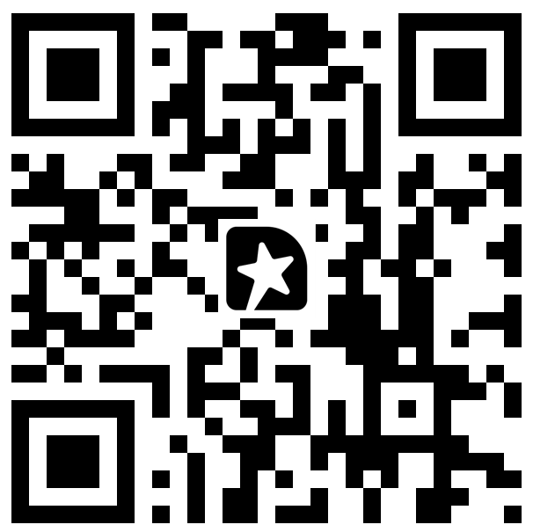
Q & A & Feedback!
powershellgallery.com/packages/Bicep powershellgallery.com/packages/AzAuth powershellgallery.com/packages/AzBobbyTables powershellgallery.com/packages/AzPigeon

