Slide 1
README
BURN AFTER READING
about_SlideDeck
The actual presentation starts with slide 6 ("Session title"). The first five slides have a purely organisational purpose. During the break before your session, you should start the presentation with slide 2 ("Next up"), so that the audience knows that they are in the right room. It's fine if you start chatting with the audience during this break, but we need a precise starting point for your presentation in terms of editing your video. That means:
The recording of your presentation will start after the countdown. Please (RE)START talking after the countdown, not during it! Otherwise your recording will start with a half sentence.
It is not necessary to explicitly signal to the PA operator, this is your signal!
Finally, do you have to use this slide deck? No, you are free to present the way you like it. But you are asked to use the intro slides: countdown, session title, sponsor slide. Beyond that, use what is good for the cause – from no slides to sketches from your children, from Jupyter to $youNameIt.
You will find additional information in the notes below.
Sincerely, your hosts!
Dear Speaker, we are thrilled and honored to have you with us in Wiesbaden in 2026. Take your time and read this before you prepare your session.
Since most of you have been with us before, you will already know a lot about PSConfEU. You know that we try to capture all sessions carefully and publish your work on YouTube. There are a few easily avoidable stumbling blocks that we would like to draw your attention to:
Your screen resolution should be 1920x1080 px (FullHD)
You should provide a full size HDMI socket
Mirror your screen
Disable "Presenter View" in PowerPoint
Using MAC or Surface book? Be aware of HDCP!
Disable the ‘Night Light’ Mode
Enable the presentation setting (presentationsettings.exe in Windows)
If you present sensitive information on web portals, consider using something like "CloudCloak"
Notes:
The fine print (additional information)
Why should you care about HDCP?
"High-bandwidth Digital Content Protection (HDCP) is a form of digital copy protection developed by Intel Corporation to prevent copying of digital audio and video content as it travels across connections. Types of connections include DisplayPort (DP), Digital Visual Interface (DVI), and High-Definition Multimedia Interface (HDMI), as well as less popular or now deprecated protocols like Gigabit Video Interface (GVIF) and Unified Display Interface (UDI)."
https://en.wikipedia.org/wiki/High-bandwidth_Digital_Content_Protection
Some notebooks ignore the HDCP standard, some vendors comply with the standard. Apple and Microsoft are somehow famous for strictly following the HDCP guidelines. Sadly, we will not be able to guarantee, that your session can be recorded in the latter case.
But you can do simple things, to overcome these problems. It is also very likely that you presented with your notebook before. So you will know, if this worked fine.If you are in doubt and if the agenda allows, try a dry-run a day before and connect everything.
In general you can easily bypass HDCP restrictions with a cheap splitter (the cheaper the better), just like the one you see below. This is an example device that we bought for 16 euros (in Germany).
Ask us, we will lend you such a device.
Thorsten also gave a whole presentation about "Broadcasting yourself" - easy steps to record yourself and create a (backup) session recording on your own. If you want to invest your time and dive deeper, take a look at his recordings and notes:
https://vimeo.com/thorstenbutz/byourself
This is of course completely voluntary, but perhaps you will find it helpful.

Slide 2
Next Up:
Emanuel Palm

Slide 3
3
3

Slide 4
2

Slide 5
1

Slide 6
Charting the Cloudy Sea with Azure Resource Graph
Emanuel Palm

Slide 7


What’s a pirate’s favorite Azure service? 🏴‍☠️

Slide 8
A
R
G

Slide 9

Azure Resource Graph
Explorer
A
R
G
Query the Azure management plane
Across management groups and subscriptions
Uses Kusto Query Language (KQL)
A subset of the KQL supported by Azure Monitor/Log Analytics, Data Explorer, Sentinel
Based on Azure RBAC with your own permissions
Flexible usage through tooling

Slide 10
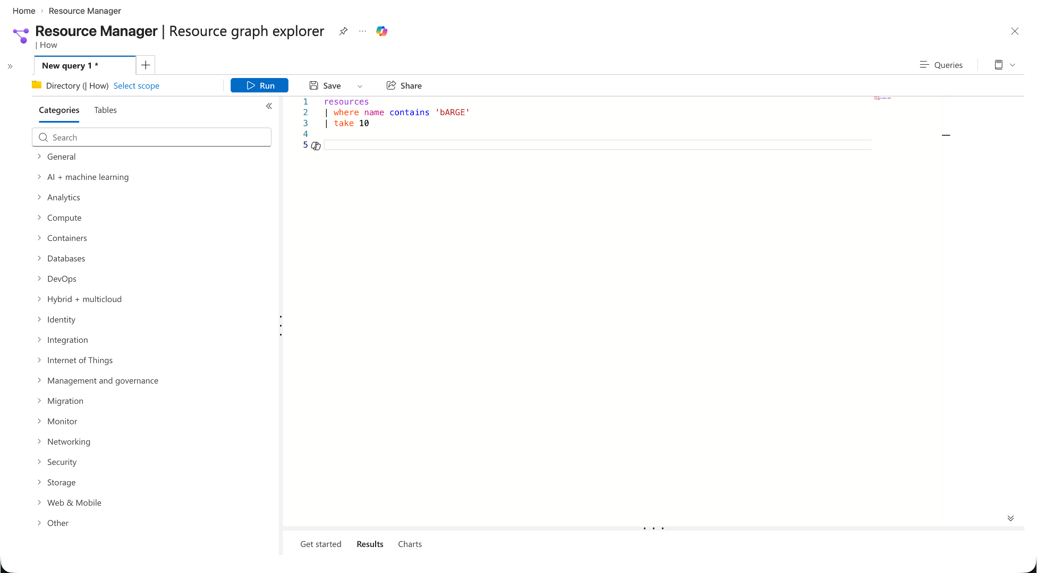
Azure Resource Graph
Explorer

Slide 11
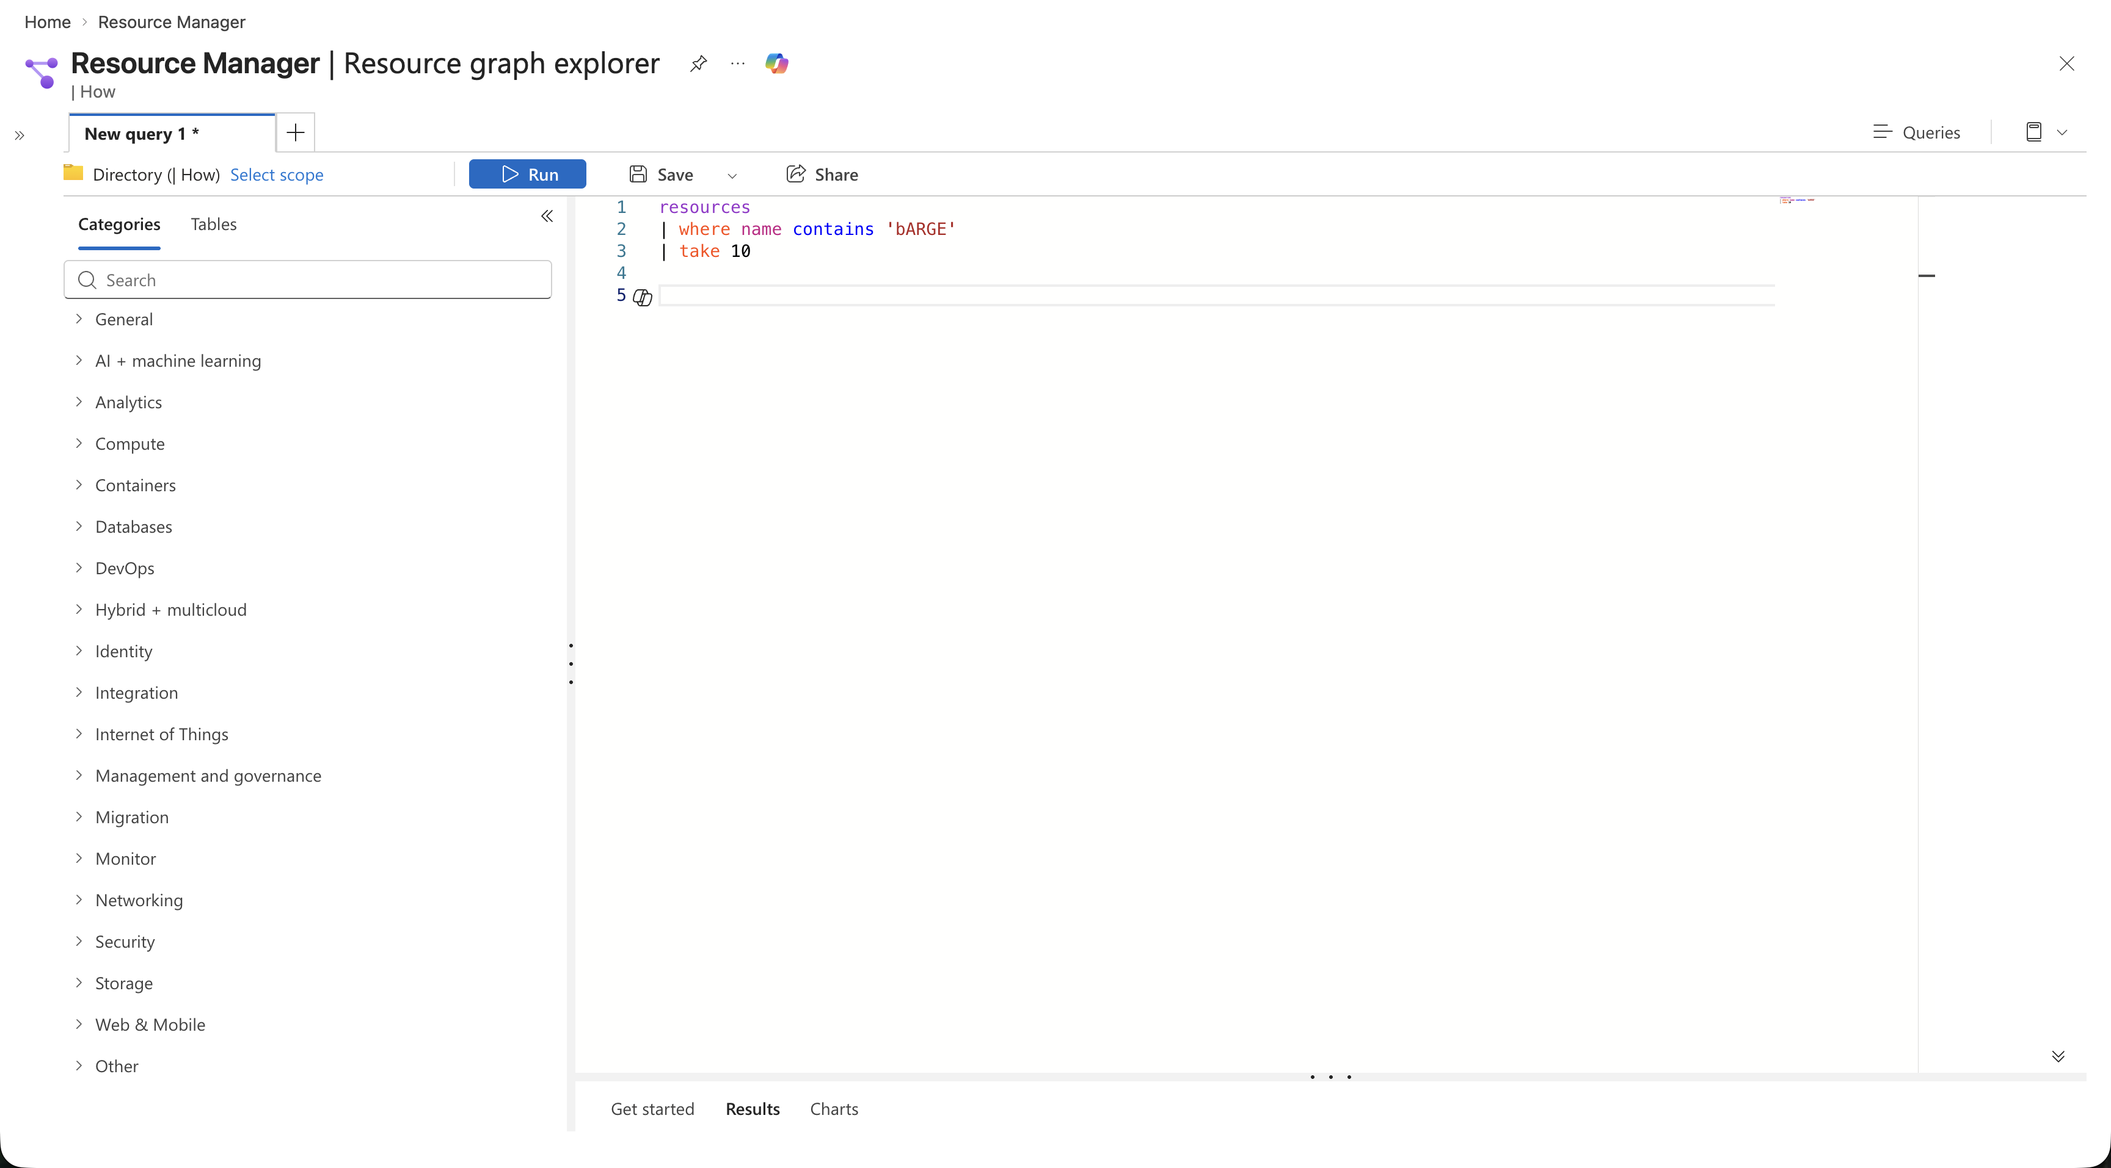
Azure Resource Graph
Explorer

Slide 12
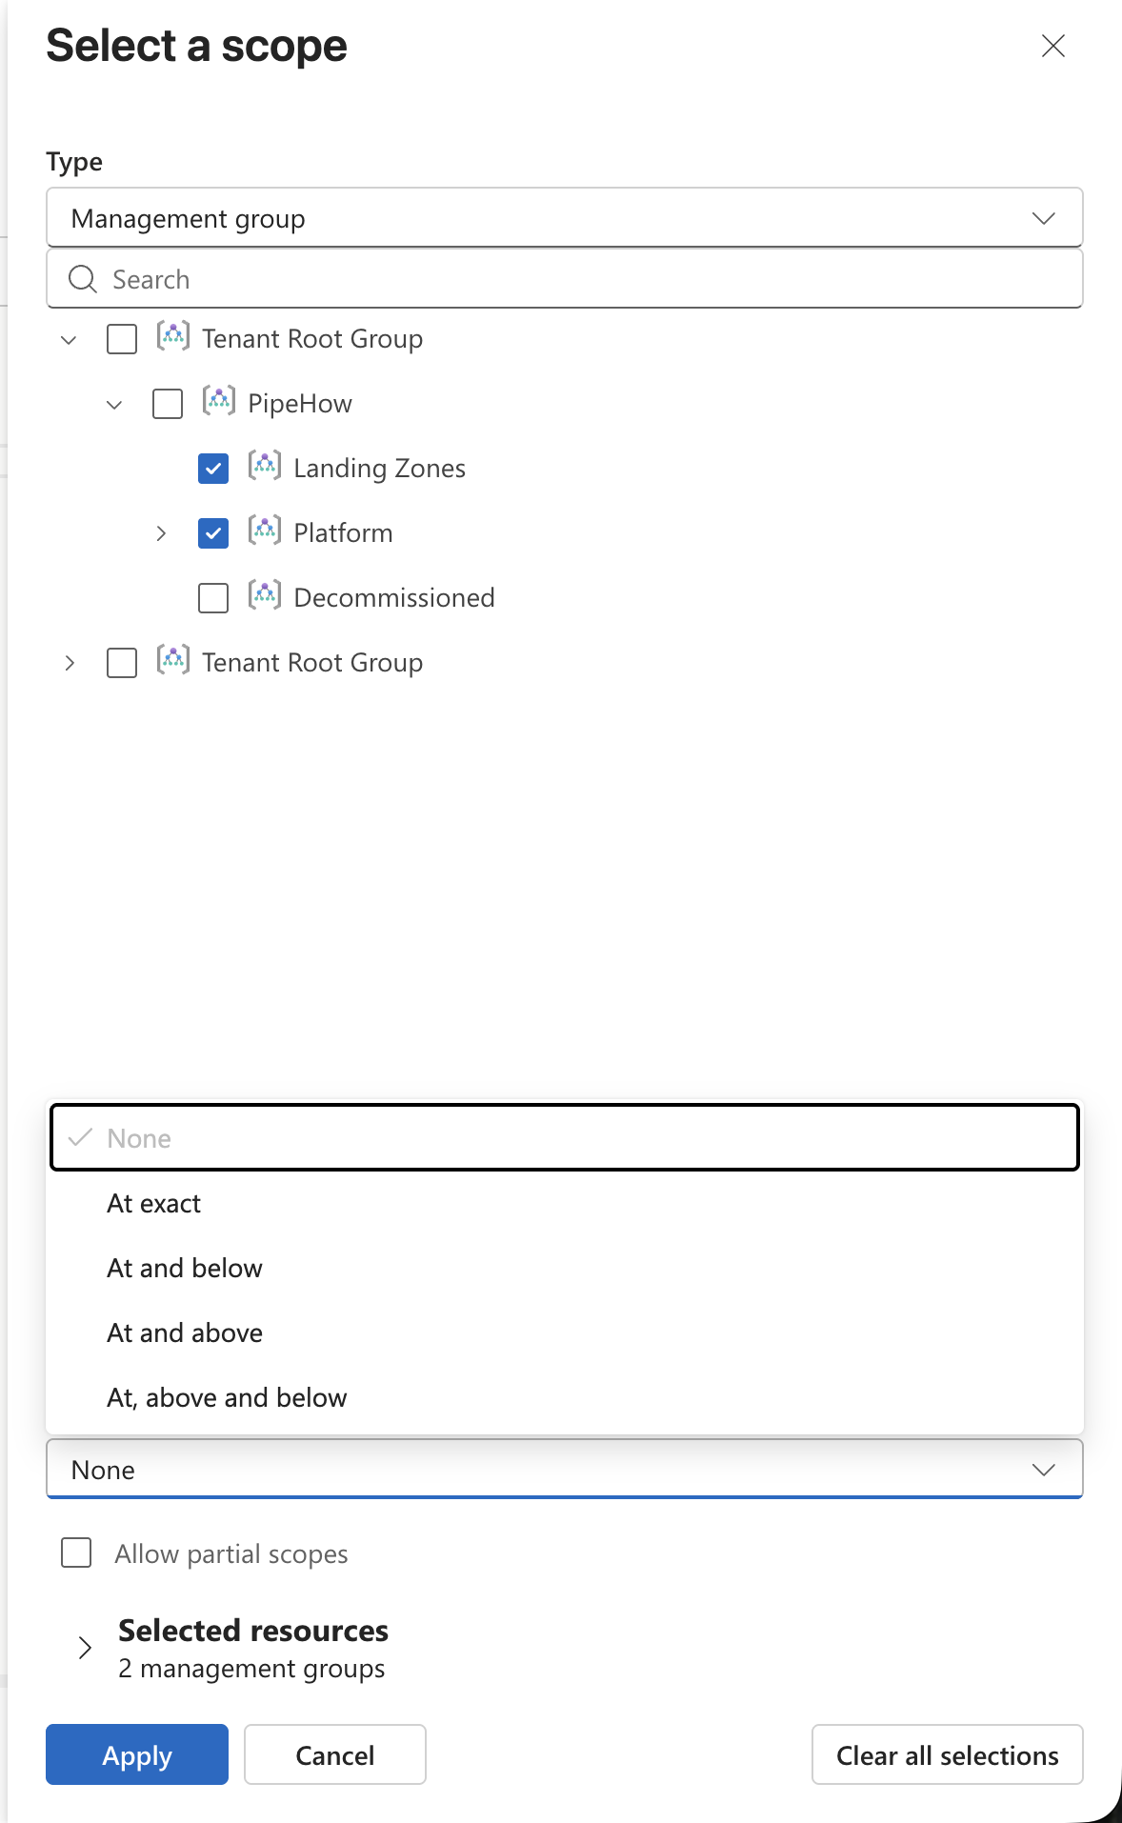
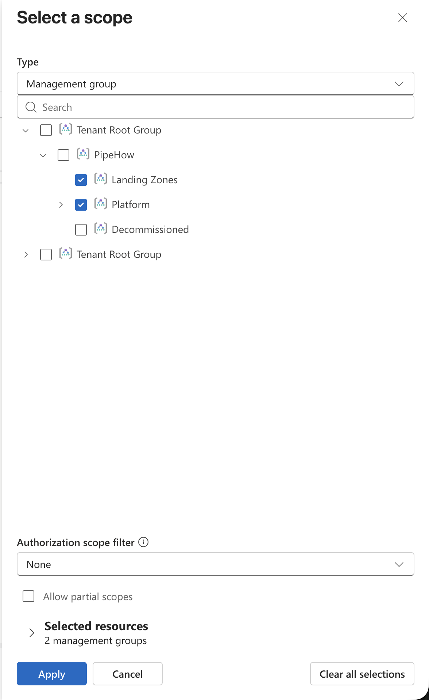
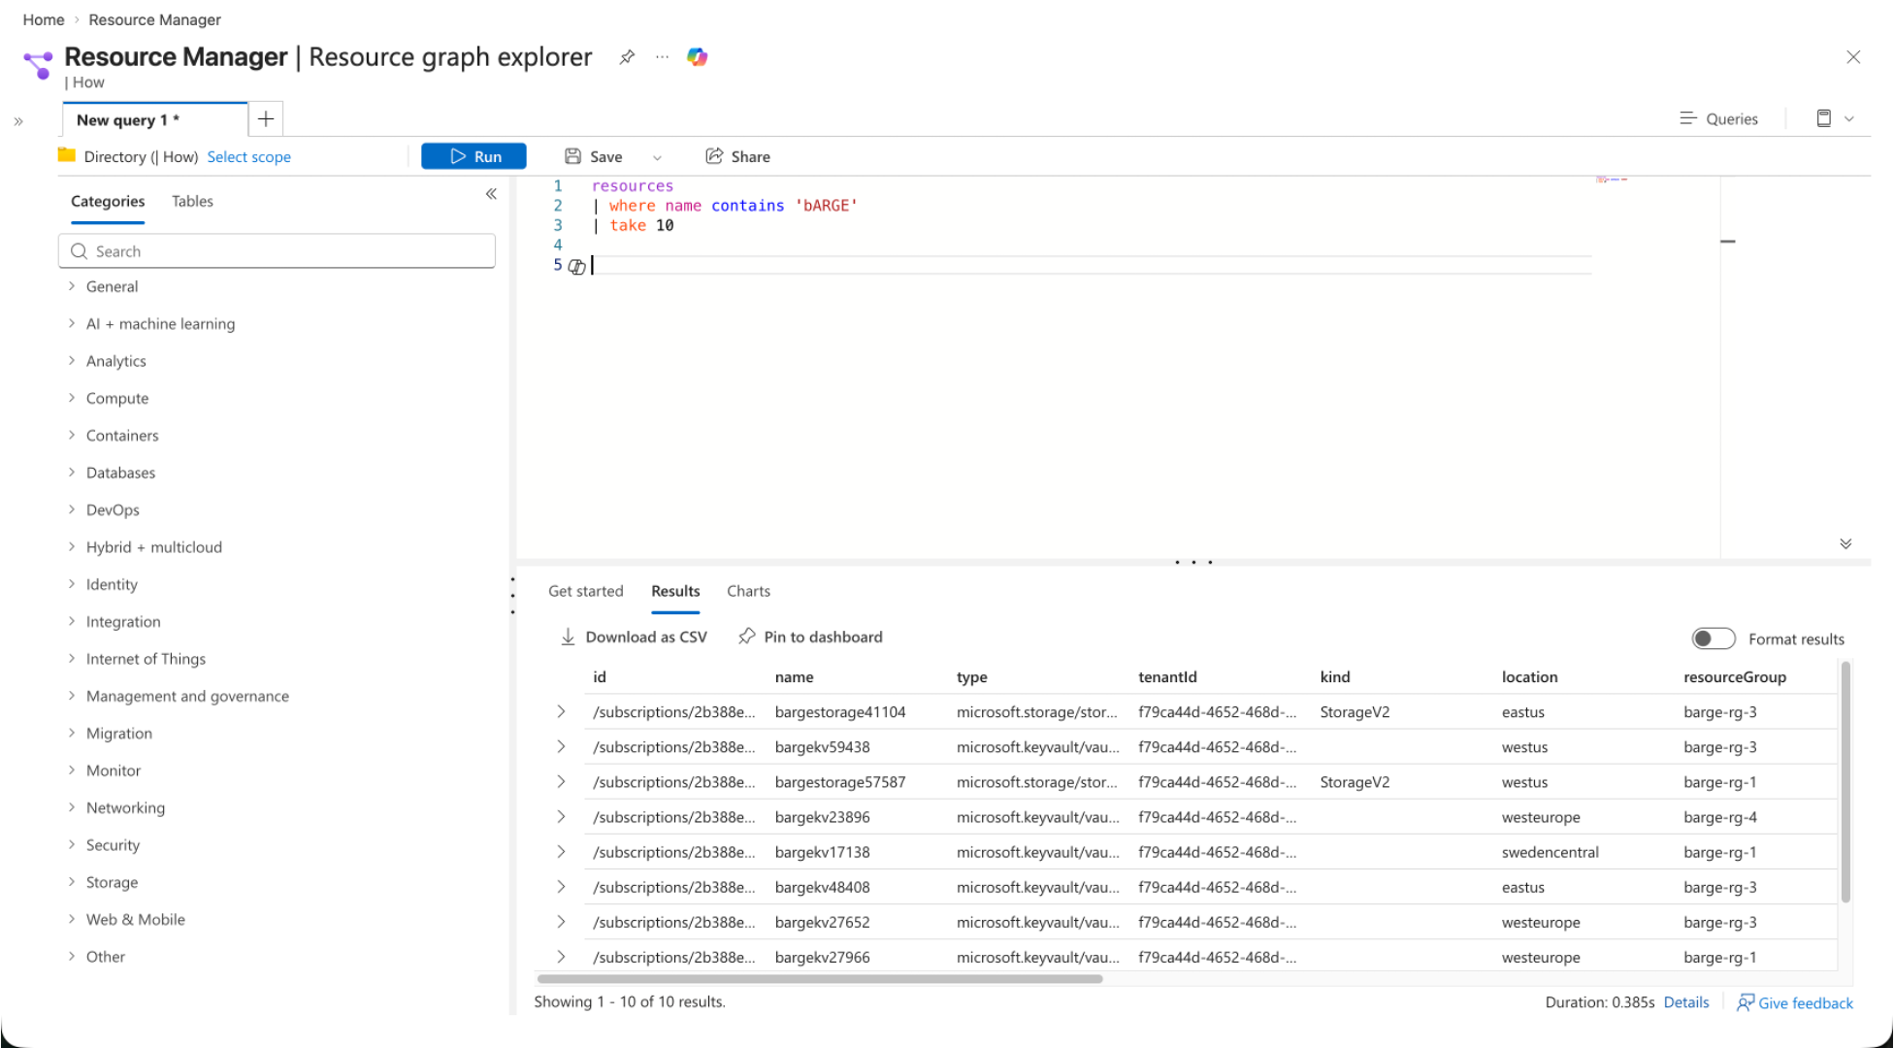
Azure Resource Graph
Explorer

Slide 13



boosted
Azure Resource Graph Explorer

Slide 14
boosted
Azure Resource Graph Explorer

Slide 15
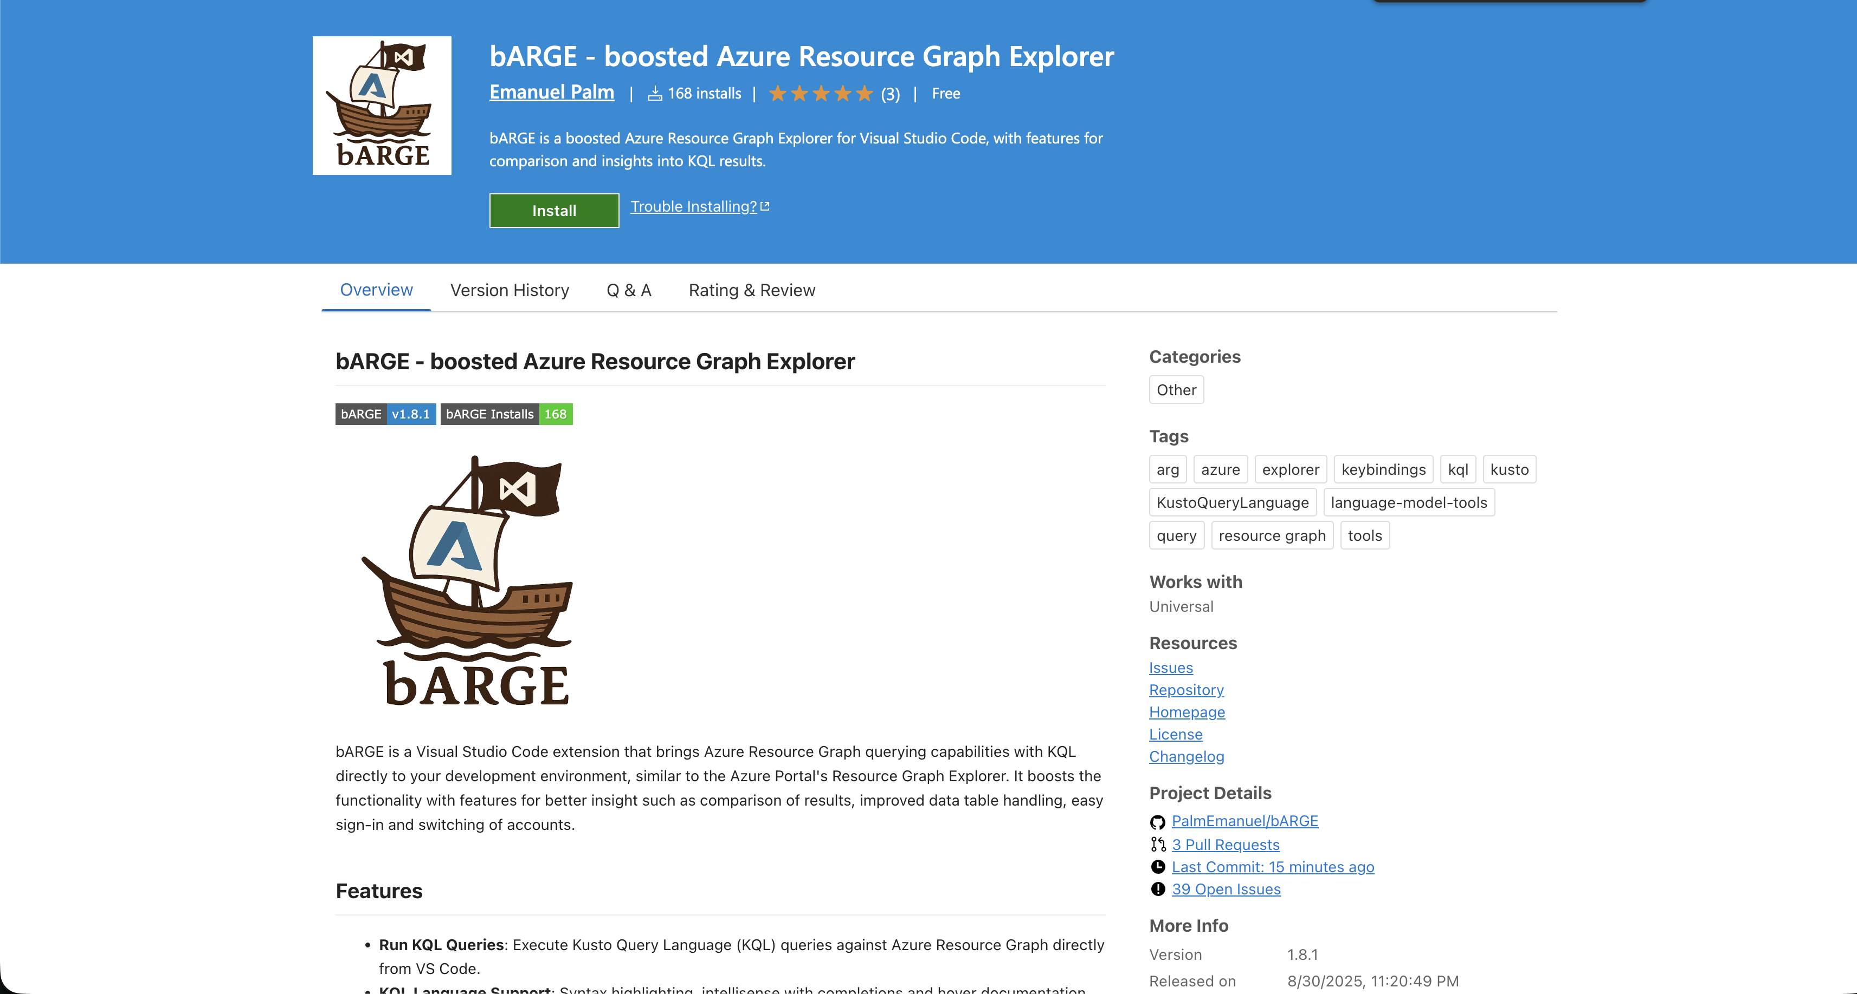

Slide 16
Many thanks to our sponsors:

Slide 17





Emanuel Palm
Cloud Specialist @ Unwonted
💙 Everything-as-Code
📦 Makes modules & tools
📃 Fan of Open Source
🏃🧗🥏🍰🧙
https://www.powershellgallery.com/packages/Bicep https://www.powershellgallery.com/packages/AzAuth https://www.powershellgallery.com/packages/AzBobbyTables

Slide 18

Ways to use Azure Resource Graph
Azure Portal
PowerShell & CLI
REST API
VS Code

Slide 19
ARG KQL Syntax
Tables
ResourceContainers
AuthorizationResources
PolicyResources
Functions
tostring()
isnotempty()
rand()
Resources
not(
)
Operators
project
join
Keywords
or
by
on
where
and
and
contains

Slide 20
Example Query
| type == ‘microsoft.keyvault/vaults’
name ‘kv’
tags[‘env’] == ‘prod’
Resources
where
and
contains
and
not(
)

Slide 21
Example Query
| type == ‘microsoft.keyvault/vaults’
name ‘kv’
tags[‘env’] == ‘prod’
Resources
where
and
contains
and
not(
)

Slide 22
Example Query
| type == ‘microsoft.keyvault/vaults’
name ‘kv’
tags[‘env’] == ‘prod’
Resources
where
and
contains
and
not(
)

Slide 23
Querying ARG – Setting sail!

Slide 24





*ish
Sharing Queries
Resource Graph Queries
Git Repository
Log Analytics Query Packs *
.KQL files
Microsoft.ResourceGraph/queries
Microsoft.OperationalInsights/queryPacks/queries

Slide 25
Tips & Tricks
The Resources table is the default, no need to specify it
Hidden SystemData property for resource metadata
If supported by the resource – Check API version
Shared queries can be used inside queries with {{ }} syntax
You can use ARG from Log Analytics with arg(“”).Resources
But not yet* with bARGE
Notes:
https://learn.microsoft.com/en-us/azure/governance/resource-graph/concepts/query-language#resource-graph-tables
https://learn.microsoft.com/en-us/azure/azure-monitor/logs/azure-monitor-data-explorer-proxy#query-data-in-azure-resource-graph-by-using-arg-preview
https://learn.microsoft.com/en-us/azure/azure-monitor/logs/azure-monitor-data-explorer-proxy#azure-resource-graph-cross-service-query-considerations
https://learn.microsoft.com/en-us/azure/governance/resource-graph/concepts/query-language#resource-graph-custom-language-elements

Slide 26
Alerts with Azure Resource Graph
Don’t forget Azure Policy
Alerts are reactive
Examples of potentially interesting ARG alerts
FinOps – Someone creates allowed, but high-cost resources
Operational – ResourceChanges in sensitive scopes
Security – Resource-related events, permissions and roles
Alerts need access permissions for ARG
Limitations
Cannot join multiple ARG tables, union works
Only 1000 records
Notes:
https://learn.microsoft.com/en-gb/azure/governance/resource-graph/alerts-query-quickstart?tabs=azure-resource-graph
https://learn.microsoft.com/en-us/azure/azure-monitor/logs/azure-monitor-data-explorer-proxy#query-data-in-azure-resource-graph-by-using-arg-preview
https://learn.microsoft.com/en-us/azure/azure-monitor/logs/azure-monitor-data-explorer-proxy#azure-resource-graph-cross-service-query-considerations

Slide 27
Alerts with ARG

Slide 28
Limitations
1000 records per query response
Implement pagination
15 queries / 5 seconds / User
x-ms-user-quota-remaining
10 000 subscriptions limit for wide queries

Slide 29
ARG GET/LIST API
4000 queries / Minute / User / Subscription
Redirect ARM API requests to ARG
&useResourceGraph=true
&useResourceGraph=true
https://management.azure.com/subscriptions/{subscriptionId}/resourceGroups/{resourceGroup}/providers/{providerNamespace}/{resourceType}/{resourceName}?api-version={apiVersion}
Notes:
https://learn.microsoft.com/en-us/azure/governance/resource-graph/concepts/azure-resource-graph-get-list-api

Slide 30
Azure Resource Graph in Dashboards

Slide 31
Dashboards with ARG

Slide 32



Key Takeaways
Navigate the cloudy sea
ARG lets you query at scale
Find hidden treasures
Identify differences, misconfigurations, details
Hoist your sails anywhere
Use from Portal, VS Code (bARGE), CLI, dashboards, alerts and more
Reach out!

Slide 33
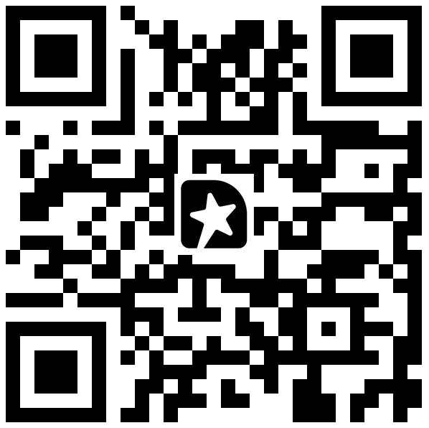

Q & A & Feedback!
Install bARGE here!

