Slide 1
Code Orchestration with Durable Azure Functions
Emanuel Palm
Notes:
The worst thing about automation? The real world.
This meeting could have been an email > I’d like to counter with “This email could have been a workflow”

Slide 2
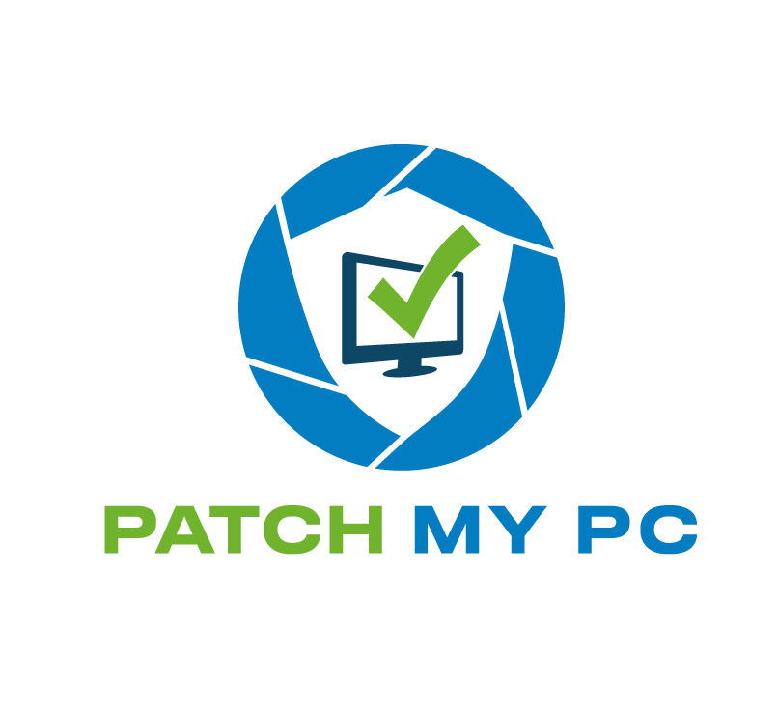

Many thanks to our sponsors!

Slide 3

Emanuel Palm
Consultant at Advania – Knowledge Factory
Loves code - .NET, PowerShell, C# 💙
Blogs at pipe.how
Maker of modules
🧙‍♂️🍰☕🧗‍♂️🥏
Notes:
2

Slide 4
Agenda
1. What are Azure Functions?
What are Durable Azure Functions?
2. Why, when, how?
3. Demo
func, code, pwsh
External Approval using Teams
4. Recap & Questions
Notes:
3

Slide 5



about_AzureFunctions
“Just run my code”
Bindings
Language flexibility
What are they good for?
Mini-APIs
Event-driven processing of data
Got a time machine?
Notes:
2 hours back
108 days and 23 hours forward

Slide 6
less
State
ful
Notes:
6

Slide 7
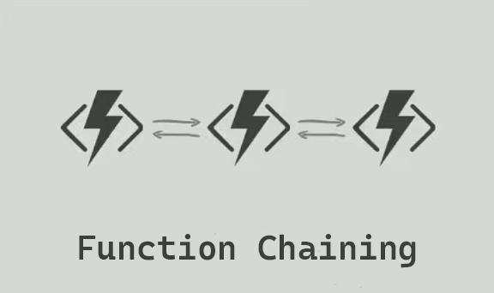
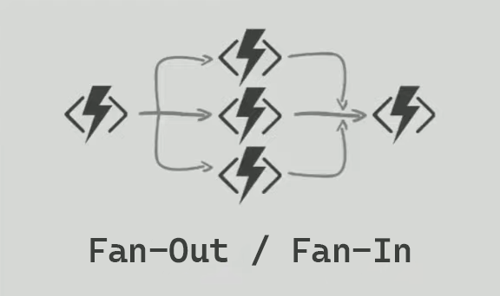
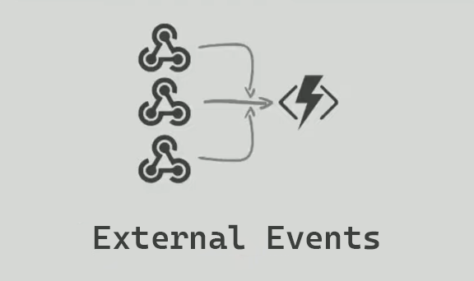
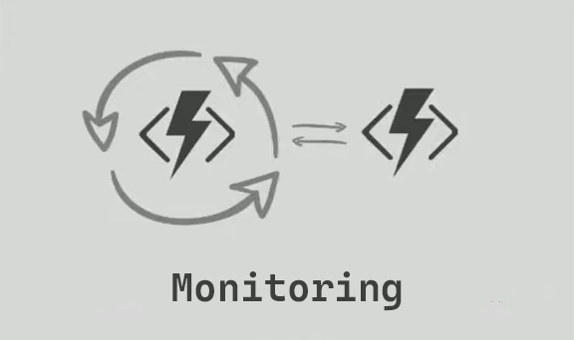
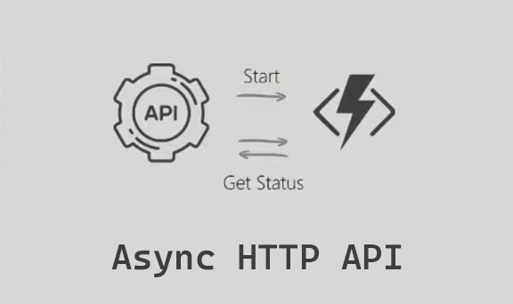
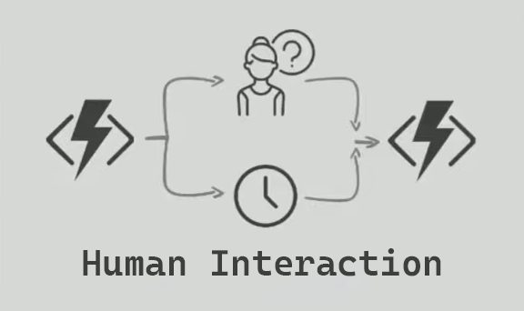
about_AzureFunctions_Durable
Long-running workflows
The code version of Logic Apps
Patterns
TaskHub – The State
ExecutionHistory
PowerShellWorker module
Input, Parameters and Data Types
Image: Durable Functions 2.0 @ .Net Conf 2019
Notes:
7
Image credit: Jeff Hollan’s presentation on Durable Functions 2.0 at DotNetConf 2019
Get-ChildItem "$(Split-Path (Get-Command 'func').Source -Parent)\*\7.2" -Recurse | Get-ChildItem -Recurse -Filter 'Microsoft.Azure.Functions.PowerShellWorker*' -File | Where-Object { $_.Extension -in '.dll','.psd1' } | Import-Module

Slide 8







Function Types
HttpTrigger
Client Function
Starts workflow
“Normal” Azure Function
Orchestrator Function
Only deterministic code
Specific APIs
Activity Function
Only idempotent code
At least once execution
NewUserOrchestrator
CreateUser
SetProfilePicture
Notes:
10

Slide 9
Storage Providers
Azure Storage
Legacy v1 general purpose SKU recommended
MSSQL
Azure or on-premises
Netherite
Research project
Event Hubs and Azure Page Blobs
Notes:
13

Slide 10
Creating Durable Azure Functions
New-Demo –Topic @(
‘Azure Durable Functions’
‘Azure Functions’
‘PowerShell’
‘Azure Storage’
‘VS Code’
‘Durable Functions Monitor‘
‘Microsoft Teams’
‘Netherite’
)
PalmEmanuel/PSDayUK2023
Notes:
15
func extensions install --package Microsoft.Azure.DurableTask.Netherite.AzureFunctions --version 1.3.1
func extensions install --package Microsoft.Azure.WebJobs.Extensions.DurableTask --version 2.9.2
Get-ChildItem "$(Split-Path (Get-Command 'func').Source -Parent)\*\7.2" -Recurse | Get-ChildItem -Recurse -Filter 'Microsoft.Azure.Functions.PowerShellWorker*' -File | Where-Object { $_.Extension -in '.dll','.psd1' } | Import-Module
{ "version": "2.0", "extensions": { "durableTask": { "storageProvider": { "type": "Netherite" } } } }
"EventHubsConnection": "SingleHost“ / “Memory”

Slide 11
Wait-SessionEnd -Task @(‘Recap’, ‘Q&A’)
> Get-DurableFact –Count 5
6% of all Azure Functions are Durable Functions.
Netherite is named after a material in Minecraft.
One of the easiest ways to clear state is to change the TaskHubName.
Durable Functions can live in the same function app as normal functions.
You can use the Durable Functions API for operations not exposed through the PowerShell module.
PalmEmanuel/PSDayUK2023

