Slide 1

Hope & Play
Resource Locator

Slide 2
Requirements
Help the public find resources
At least Twitter,SMS or Email submission
Easy access to information
Allocate resources to project.

Slide 3
The Technology
Twitter API
Oauth
CakePHP
Lamp Stack
Twitter Bootstrap
MySQL

Slide 4
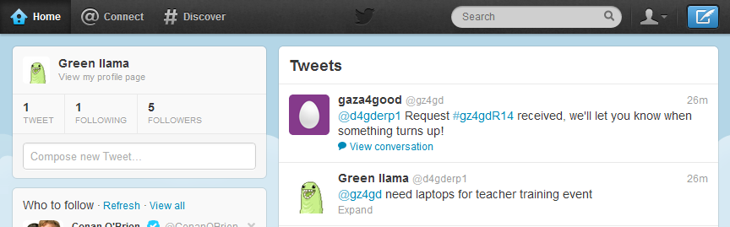

Slide 5
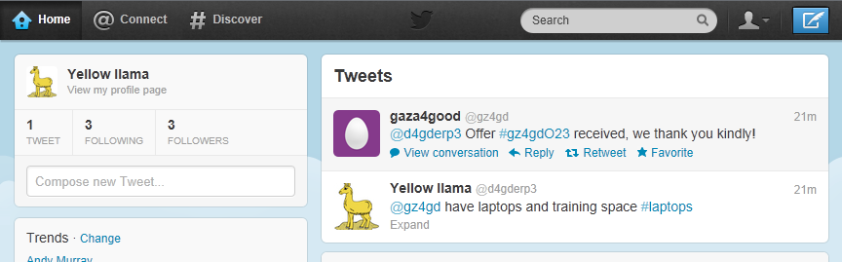

Slide 6
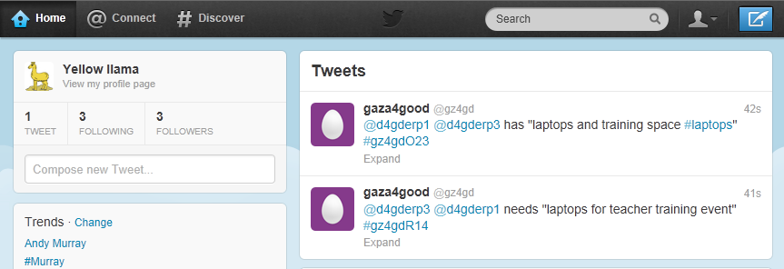

Slide 7
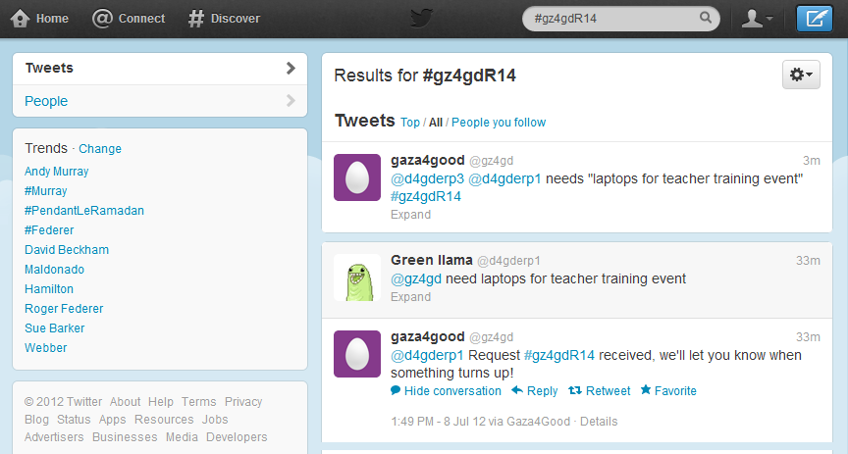

Slide 8
Demo
How the system works

Slide 9
What’s next?
Better Map Integration (heat maps)
Notifications
Auto-Linking
Post grouping (mobile, group of users)

Slide 10
The effect
Bringing the community together
Helping those in need
Keeping the Children safe
Escapism

Slide 11
Thank You!
Thank you for your time
Thank you for your collaboration
Thanks to Dev4Good

