Slide 1
Blazor – neformálny workshopík
November 2019

Slide 2
Agenda
Čo je Blazor
Blazor server-side
Blazor WASM
Demo
Server-side
WASM
Razor class library
Diskusia

Slide 3
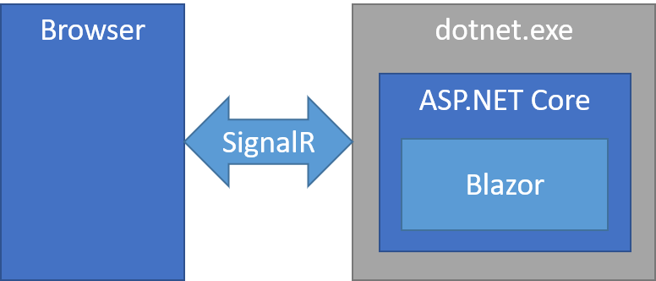
Blazor server-side
ASP.NET Core 3.0 – podporovaný produkčný release
https://docs.microsoft.com/en-us/aspnet/core/blazor/hosting-models?view=aspnetcore-3.0

Slide 4
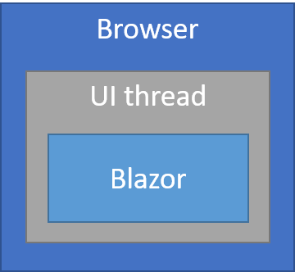
Blazor WebAssembly
ASP.NET Core 3.1 preview

Slide 5
Demo Blazor server-side

Slide 6
Demo Blazor WebAssembly

Slide 7
Demo – Razor class library

Slide 8
Otázky / diskusia...

