Slide 1
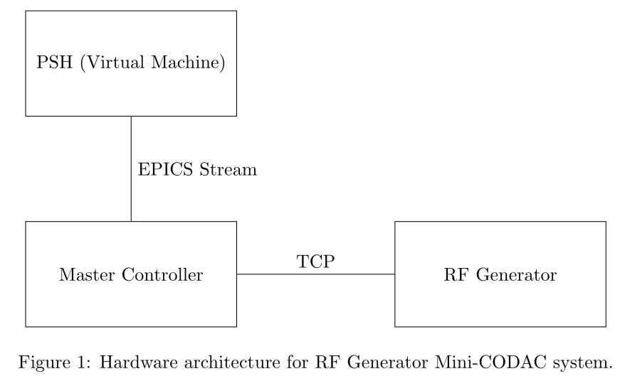
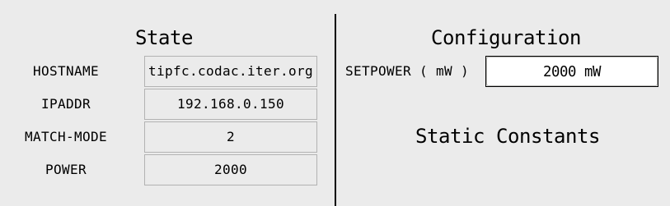
Mini-CODAC System For RF Generator
EPICS application (IOC) running in virtual machine on PSH
Python server on Master Controller acting as stream device interface between EPICS IOC and RF generator
Sample HMI for controlling the RF generator

