Slide 1




NIA ENGINEERING
I&C Common solutions – IA02
Prepared by:
I. Smirnov, N. Babinov, A. Govorov
9 October 2024

Slide 2

NIA ENGINEERING
Agenda
Brief introduction
Idea of common solution
Currently available and planned common solutions
How to integrate a common solution into an existing project
Conclusion
Number of slides - 20
Duration of the presentation ~ 15 min

Slide 3

NIA ENGINEERING
OUR TEAM AND RESPONSIBILITY
Responsible organizations
Arthur Leveque – IO RO
Our responsibility
V&V activities – inspection of SMS, MIP, wiring diagrams, software and on-site manufacturing
Preparation of manufacturing progress reports
Preparation of the common solutions
Ilya Smirnov – RAWE Project Manager
Nikita Babinov – General manager of NIA Engineering
Alexey Govorov – Technical coordinator of NIA team

Slide 4
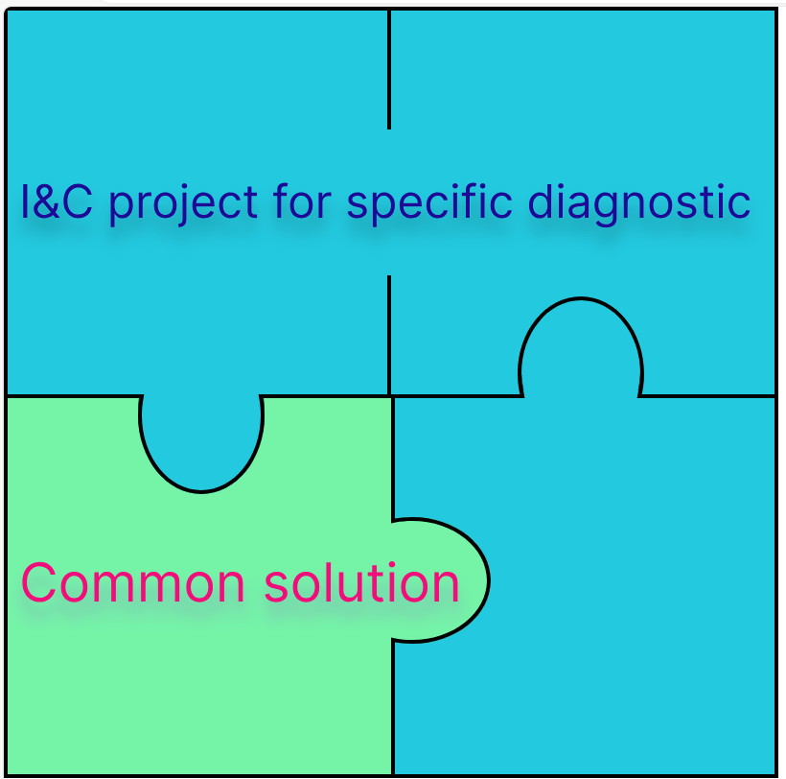
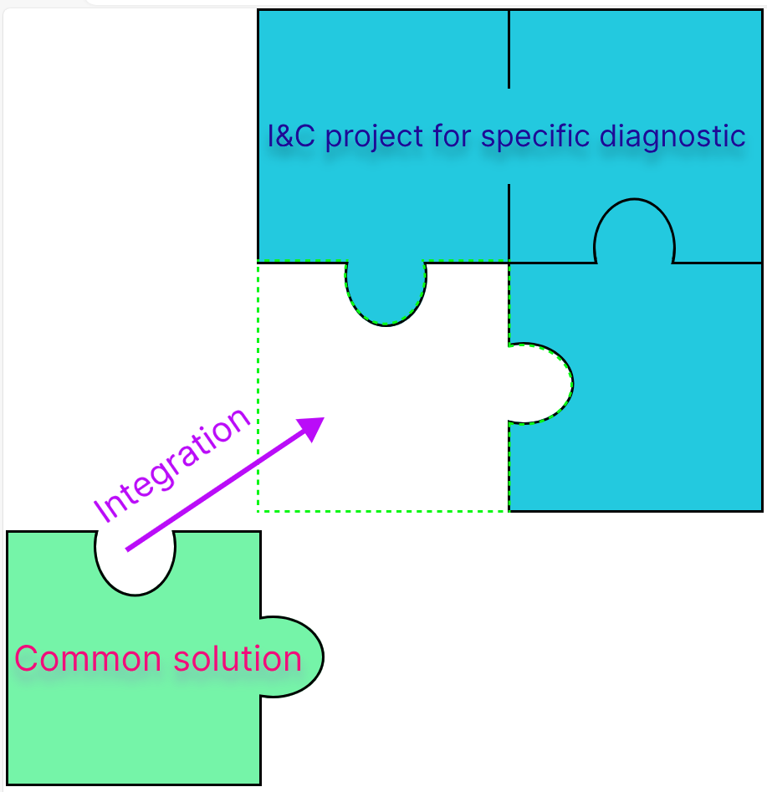
NIA ENGINEERING
IDEA OF COMMON SOLUTION
I&C project where solution (A) can be used
Solution (A) prepared by the I&C team that potentially can be used by other I&C teams
Common solution package
Integration of the solution (A) into I&C project taking into account specific for this I&C project PBS and CBS

Slide 5
NIA ENGINEERING
BENEFITS OF COMMON SOLUTIONS
FOR I&C PRODUCTION TEAMS
Decrease of the production time
More attention can be paid to the complex parts of the I&C project
Ready for use solution
Clear parameters of HW and SW
Automation of a significant part of the integration process

Slide 6
NIA ENGINEERING
EXISTING COMMON SOLUTIONS
Elements of the Common solution package:
  Guideline for implementation
  FBS/NDS generation tool
  FBS/NDS specification
  BOM if applicable
  Set of HMI objects
List of Common solution that are defined today
Thermocouple monitoring [AFPCTH]
Mirror Cleaning Operation Scheme [AFPL4Q]
Temperature control through Baking Jacket [AFPLNZ]
Piezo motor controller [B5VN3U]
Imaging System
ADC with FPGA in μTCA form factor
Being updated according to new prototype prepared by 55.E6 team
These common solutions will be prepared later in the project

Slide 7
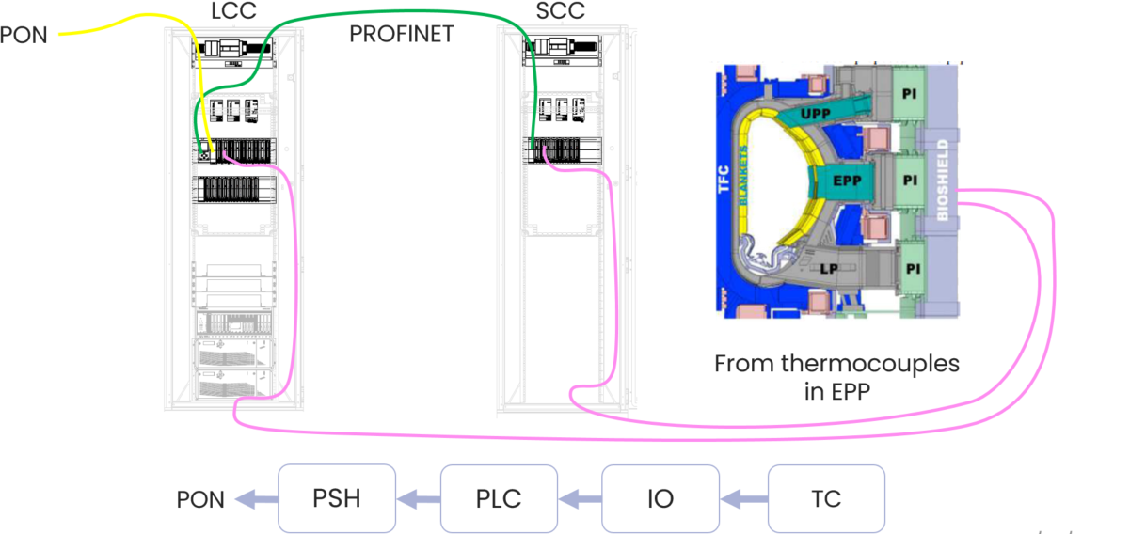
NIA ENGINEERING
THERMOCOUPLE MONITORING SYSTEM
Purpose
Almost all diagnostic systems will need to monitor temperature at various locations. The goal of this package is to provide an existing solution with a slow controller that can be quickly adapted to all systems.
Hardware used
This solution uses the Siemens S7-1500 slow controller.
More information about Hardware used can be found in the FBS specification for thermocouple monitoring system [ADAVQH]
Communication scheme of the 55.Q0 solution for thermocouple monitoring system

Slide 8
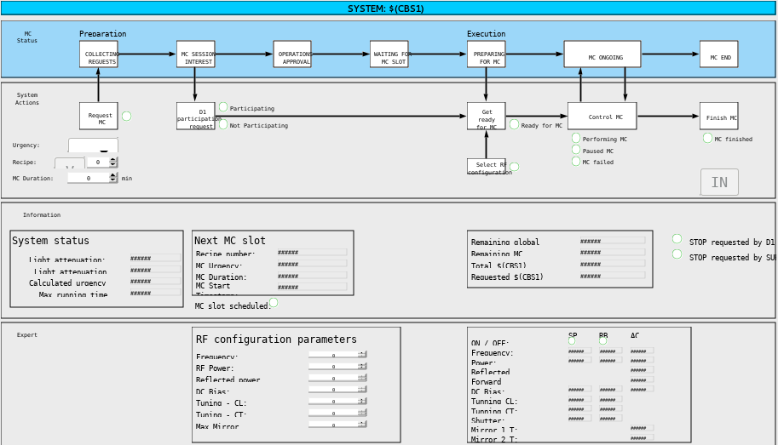
NIA ENGINEERING
MIRROR CLEANING
OPERATION SCHEME
Purpose
Each Diagnostic operator will monitor the status of their System mirrors and decide when a mirror cleaning request shall be issued. The Main Diagnostic Operator will collect all requests from the individual systems and provide a unique consolidated request to get a Tokamak Operation slot.
There is no Hardware used in this common solution
All the variables are deployed on PSH
Main HMI screen for Mirror cleaning prepared by the Cosylab team

Slide 9
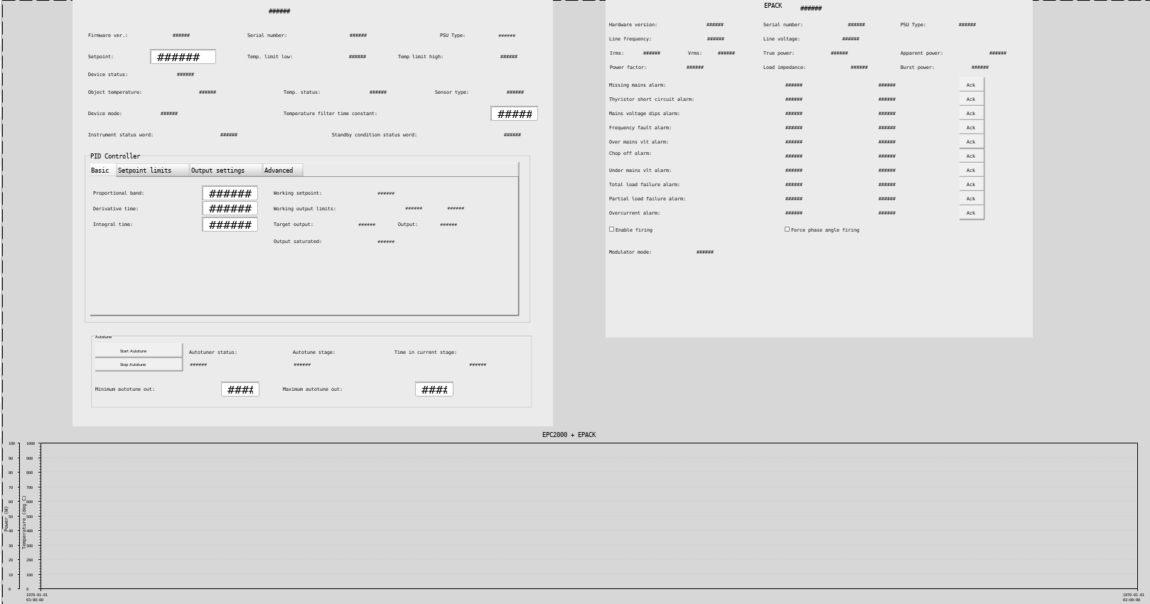
NIA ENGINEERING
TEMPERATURE CONTROL THROUGH BAKING JACKET
EPC2000
EPACK
Purpose
Several Diagnostics systems need to control the temperature of some of their pipes to follow the Temperature of the vacuum.
Hardware used
There are 2 COTS controllers used in the solution:
EPC2000 Temperature controller
EPACK Heating Power controller
Main HMI screen for Temperature control through Backing Jacket prepared by the 55.G3.50 team

Slide 10
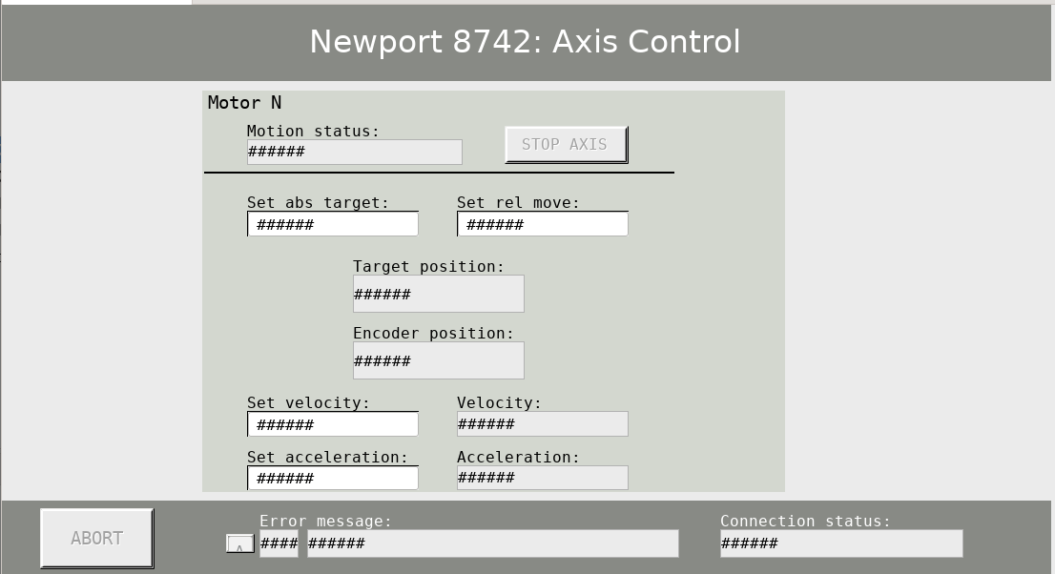
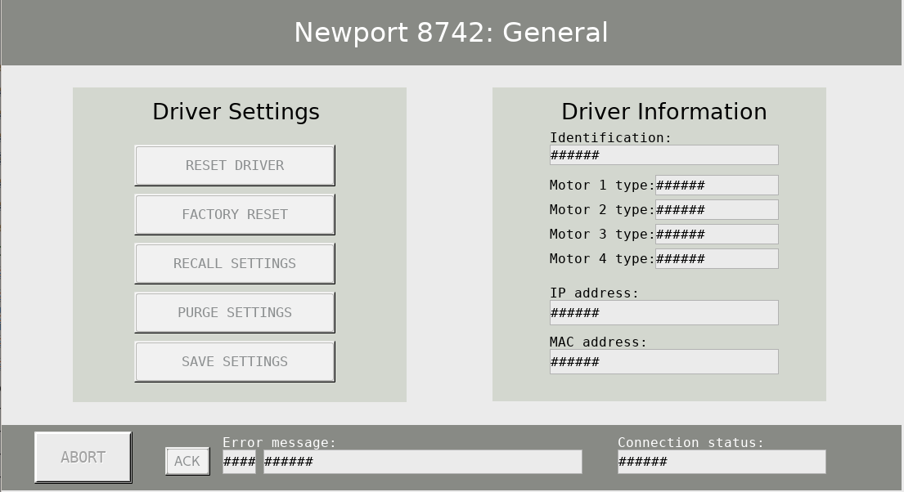
NIA ENGINEERING
PIEZO MOTOR
CONTROLLER
Purpose
To provide a fully CODAC-integrated solution for Piezo motor controller.
Hardware used
Piezo motor controller Newport 8742 is used in this common solution.
HMI screens for setting and controlling piezo motor controller Newport 8742

Slide 11
NIA ENGINEERING
HOW TO INTEGRATE COMMON SOLUTION INTO EXISTING PROJECTS - GENERAL APPROACH
Actions to be performed on Windows environment
Download the Common solution package from IDM
Generate FBS/NDS templates
Import into existing FBS/NDS templates
Import FBS/NDS template into EA project
Convert EA project to .xml using EA2SDD script
Actions to be performed on CODAC environment
Import the .opi files into CS project
Change the common macros to specific data for the I&C project
Run the SDD project and test the HMI with integrated common solution
Import .xml into SDD project
Generate configuration file

Slide 12
NIA ENGINEERING
HOW TO INTEGRATE COMMON SOLUTION INTO AN EXISTING PROJECT STEP 1
For demonstration Temperature control through Backing Jacket is used
FBS/NDS generation using FBS_template_for_Temperature_Control_Com_ARXHPQ_v1_0.xlsm [ARXHPQ]

Slide 13
NIA ENGINEERING
HOW TO INTEGRATE COMMON SOLUTION INTO AN EXISTING PROJECT STEP 1
For demonstration Temperature control through Backing Jacket is used
FBS/NDS generation using FBS_template_for_Temperature_Control_Com_ARXHPQ_v1_0.xlsm [ARXHPQ]

Slide 14
NIA ENGINEERING
HOW TO INTEGRATE COMMON SOLUTION INTO AN EXISTING PROJECT STEP 2
Generated FBS template ready for integration

Slide 15
NIA ENGINEERING
HOW TO INTEGRATE COMMON SOLUTION INTO AN EXISTING PROJECT STEP 3

Slide 16
NIA ENGINEERING
HOW TO INTEGRATE COMMON SOLUTION INTO AN EXISTING PROJECT STEP 4
NDS variables EPACK and EPC2000 for Temperature Control Common Solution [AU3RWH]

Slide 17
NIA ENGINEERING
HOW TO INTEGRATE COMMON SOLUTION INTO AN EXISTING PROJECT STEP 4
NDS variables EPACK and EPC2000 for Temperature Control Common Solution [AU3RWH]

Slide 18
NIA ENGINEERING
HOW TO INTEGRATE COMMON SOLUTION INTO AN EXISTING PROJECT STEP 5
Generated NDS template

Slide 19
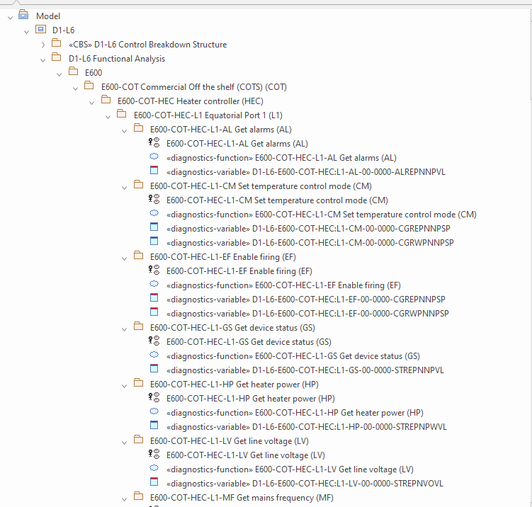
NIA ENGINEERING
HOW TO INTEGRATE COMMON SOLUTION INTO AN EXISTING PROJECT STEP 6
Importing into EA project
Using the standard procedure for importing data into EA project through the “Functional analysis” EA Add-in

Slide 20
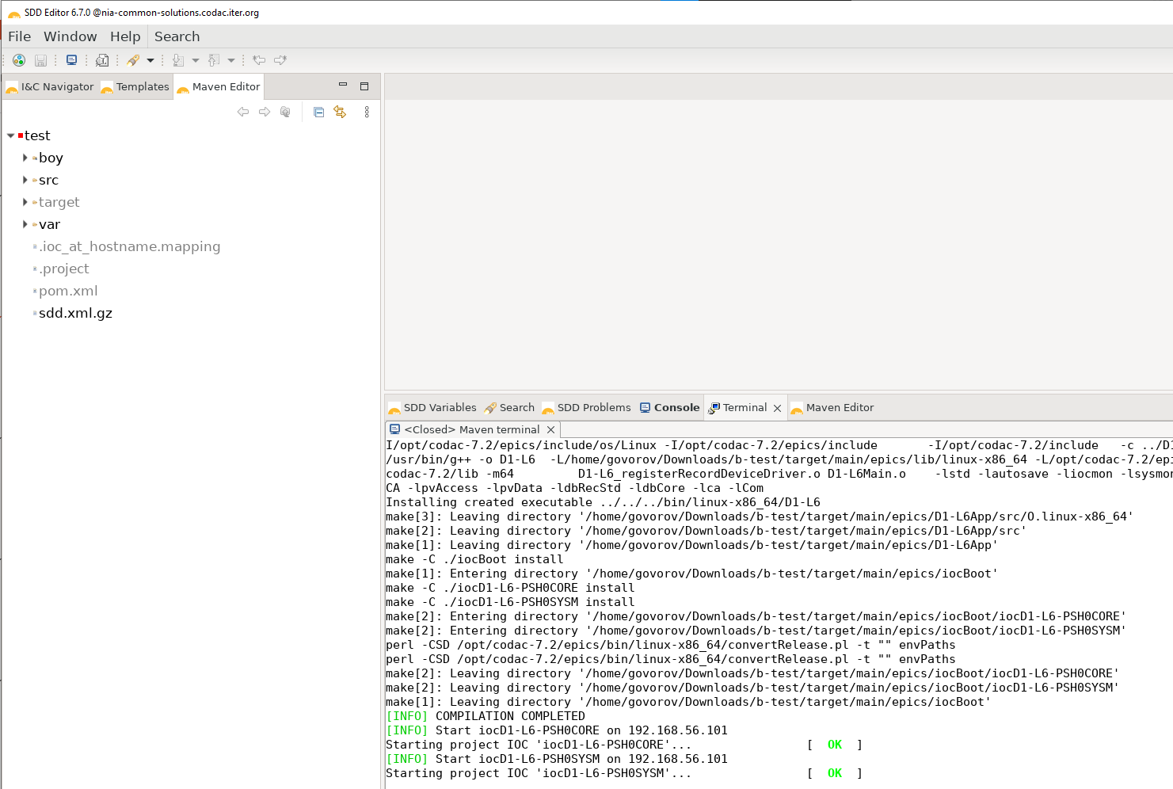
NIA ENGINEERING
HOW TO INTEGRATE COMMON SOLUTION INTO AN EXISTING PROJECT STEP 7
Importing generated .xml file into SDD
Standard procedure to import and run the project:
Prepare the .xml file using the ea2sdd script
Import .xml into SDD
Run the SDD from Maven Editor on target deployment units

Slide 21
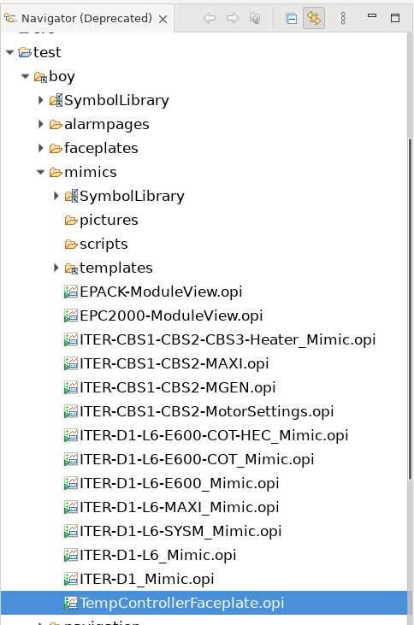
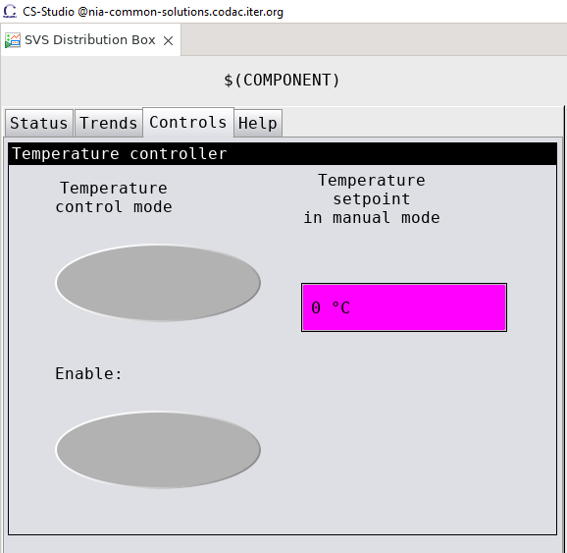
NIA ENGINEERING
HOW TO INTEGRATE COMMON SOLUTION INTO AN EXISTING PROJECT STEP 8
Importing the .opi files into CS project

Slide 22


NIA ENGINEERING
CONCLUSION
Please give us your feedback after using the Common solution on our Confluence page:
https://confluence.iter.org/x/GJ9MJw
Arthur Leveque: arthur.leveque@iter.org
Ilya Smirnov: ilya.smirnov@rosatom.fr
Nikita Babinov: n.babinov@niaengineering.ru
Alexey Govorov: a.govorov@niaengineering.ru
If you have questions or suggestions to improve our Common solution, feel free to contact us

