Slide 1
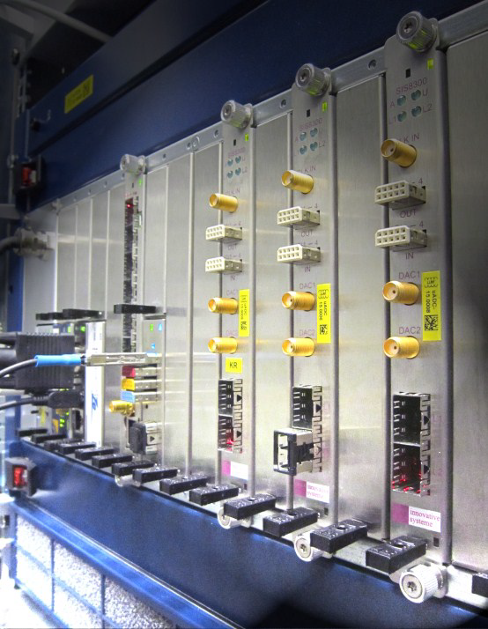
Configuration Objects

Slide 2
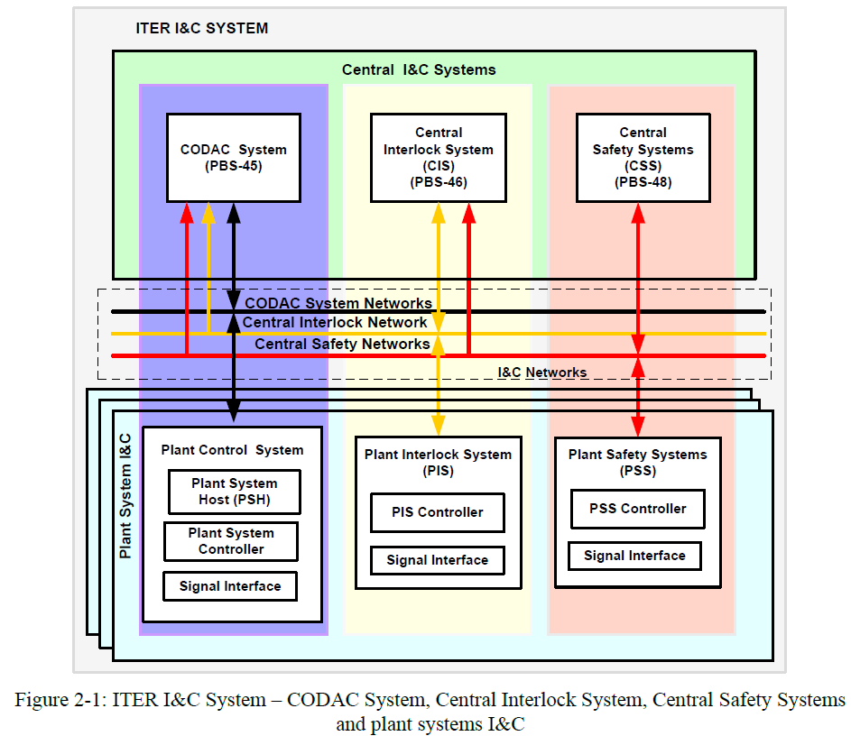
Plant I&C Configuration
Plant Control Design Handbook requires that plant system developers provide configuration for their plant system.
Integration of the plant system into the ITER CODAC I&C system is made smoother if the configuration complies with CODAC.
Configuration of Plant I&C is managed by Central I&C (specifically SUP-CONFIG)
Not in scope of this discussion – Configurations other than PV’s (EPICS process variables) on PON (Plant Operation Network).

Slide 3
Which Configuration will be managed by SUP-CONFIG?
Only those Plant I&C configuration/parameters which need to be changed/applied before the start of a pulse can be managed by SUP-CONFIG.
In other words SUP-CONFIG will not change the configuration of Plant I&C during the pulse.
The Plant I&C designers (through the advice from TROs) need to formulate the configuration strategy i.e. which parameters need to be configured through SUP-CONFIG.
Configuration objects are at the heart of defining Plant I&C Configuration.
Central I&C
(SUP-CONFIG)
Conf parameters managed by SUP-CONFIG
Plant I&C
Conf parameters managed by Plant I&C

Slide 4
What is a Configuration Object?
The Configuration Object is a data object (a XML file) consisting of:
  Plant I&C configuration variables (EPICS PV’s)
  Constraints (that ensure consistency and correctness of the values assigned to configuration variables)
  User functions as needed (for transformation of high level variables to Plant I&C variables)
It is apparent from good design practices that one should avoid relying on a ‘monolithic’ configuration object (consisting of say hundreds of configuration variables).
Instead should define multiple configuration objects for each diagnostic, to support different use cases across all lifecycles phases (development, testing, commissioning, operation and maintenance).
High-level variables
(may not be EPICS PVs)
(Configuration
Domain)
SUP-CONFIG:
Transforms (as needed)
Performs Validation checks
Apply Configuration
Plant I&C Variables
(Hardware domain)

Slide 5
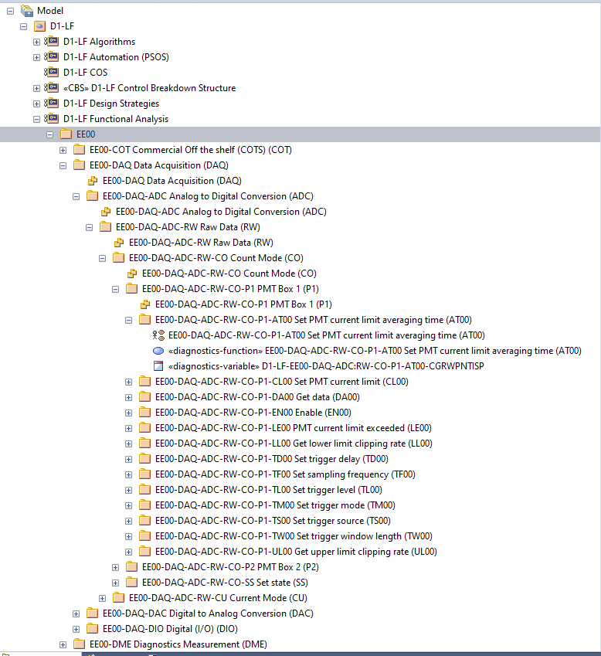
Where is your support needed? (1)
Flat List of Variables in EA project (populated as per functional breakdown)
Help to define
logical grouping of variables
(including high level variables as needed)
which will
eventually form the configuration objects.
Help to define constraints (operating limits,
dependencies, etc.)
for configuration
variables
Help to define transformation functions
(as needed)

Slide 6
Where is your support needed? (2)
For each use case:
  Define the configuration objects to be defined
    List the configuration variables impacted
    Define the constraints to be applied
Configuration objects can be very high-level/abstracted (e.g. Basic-Control vs Physics Studies)
From 1000s of variables, 10s of objects could be defined.
Different level of abstractions can be met.
Think of the needs of the operator/physicist/diagnostician during calibration/commissioning/operation/maintenance…
Configuration objects should allow:
  A non-specialist to run the diagnostic.
  A diagnostic expert to configure precisely the system as intended.

Slide 7
Thank you for your attention!

