Slide 1
55.G2 Divertor thermocouples
Functional breakdown
M.Salmic
Notes:
<number>

Slide 2
Outline
<number>
Signal chain
FPGA functions
Configuration objects
CODAC communication
Compliance matrix

Slide 3
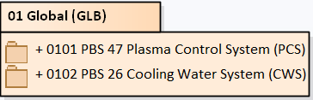

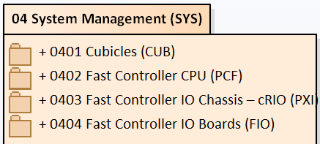
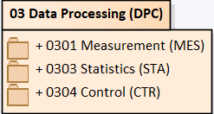
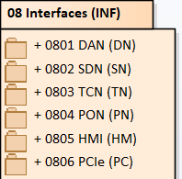
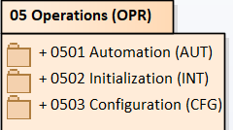

Slide 4
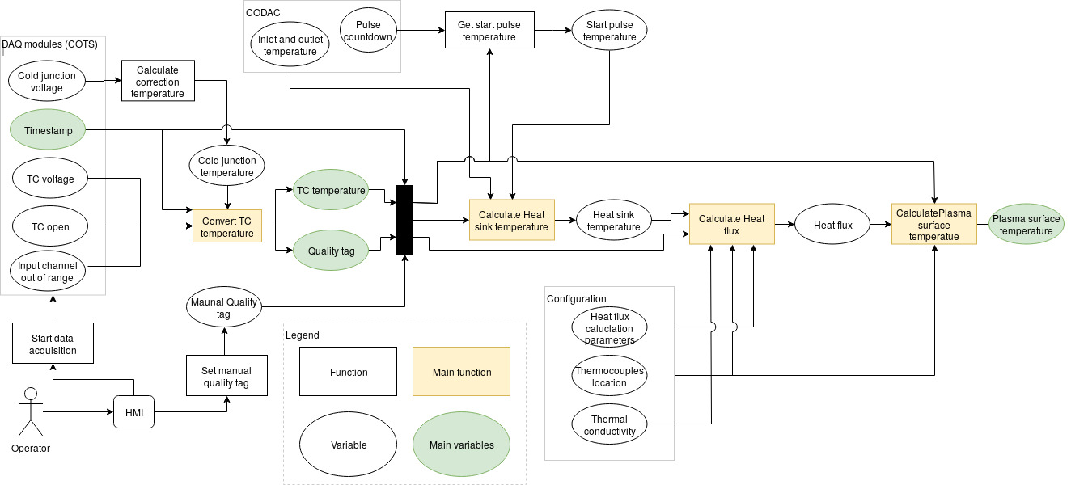
Signal chain
<number>
polarimeter

Slide 5
FPGA functions
<number>
Communication with DAQ modules
  TC voltage
  CJC voltage
  Open TC
  Channel out of range
  Module properties
  Conversion time configuration
Timestamping
  Acquiring value from DAQ modules
  Attaching a timestamp
  Clock

Slide 6
Configuration objects
<number>
Heat flux parameters (set during commisioning)
Thermocouples location (set during commisioning)
Sampling rates
  During pulses
  Between pulses
Start temperature limit
Thermal conductivity
Connectivity configuration
  IP addresses, buffers, ports

Slide 7
CODAC communication
<number>
PCS
  Thermocouple temperature
  Plasma surface temperature
    Temperature
    Timestamp
    Quality tag
  Timing
    ITER time synchronization
    Pulse start countdown
Cooling water system
  Heatsink inlet temperature
  Heatsink outlet temperature

Slide 8
Compliance matrix
<number>
Most system specific requirements are covered by data acquisition and processing functions
Most of the common PCDH requirements are covered by Operations and System management functions
Because some of the requirements are so vague they can be covered by either any function or in other case by none.
For the FDR this will have to be resolved

