Slide 1
I&C Functional Breakdown Structure
55.EC CXRS Edge Preliminary Design Review
Ekaterina Mironova

Slide 2
Functional Analysis (L1 + L2)
Function Name | FBS ID | Function Code | Description
Global | 01 | GI | Global Function - this function provide functional interface across the plant system. .I & C data will be exchange with other plant system. All data will be exchange through CODAC.
Signal Conditioning | 02 | SC | Signal Conditioning Function - This function will describe signal conditioning within plant I&C. those signal condition level 2 function have I&C interface need to mention under Level 1 function.
Data Acquisition | 03 | DQ | Data Acquisition – This function describe data acquisition functions like acquire raw data, configure timing for data acquisition, control etc. of plant I&C.
Data Processing | 04 | DP | Data Processing – Data processing function converts acquired data into measurement (Engineering) data. Data processing function is also used to do analysis on process data, calculate measurement error, Alarm and sometimes control.
System Management | 05 | SM | System Management – This function is used to define system management of plant I&C component (Hardware and Software) like cubicle, PSH, PCF, Slow controller, Health management and monitoring etc.
Operation | 06 | OP | Operation – This function describe the functions required for operation like Plant Automation, Configuration, Plant Function Diagnostics etc.
Machine Protection | 07 | MP | This function will take the measures for protection of the plant system.
Occu Safety | 08 | OS | Occupational Safety - This function is not applicable for this Plant I&C
COTS | 09 | CM | Commercial measurement and control (COTS devices) - his function is not applicable for this Plant I&C
Interface | 10 | IF | Interface – This function will be used to describe plant I&C interface like PON, TCN, SDN
Function Name | FBS ID | Function Code | Description
Measurement | 0401 | ME | The measurement of temperature of the port plug is the essential parameter to be measured for the UPP#18 diagnostics. This function will convert raw data to measurement data (Temperature). This function also measure temperature error.
Control | 0402 | CL | The temperature of the port plug is to be controlled by the electric heater.
Alarm | 0403 | AL | When the temperature of a part of the port plug is more than the set point temperature, then the condition of overheating arises. When overheating occurs alarm will be generated. This function will configure and monitor alarms.
Calibrate | 0404 | CB | Calibration for Upper port plug 18 - This function will be used to calibrate thermocouple signal to get accurate temperature.
Analysis | 0406 | AN | In this function temperature analysis will be done. Following analysis will be done : Calculate RMS temperature value, minimum, maximum temperature etc.
from S.Simrock’s presentation

Slide 3
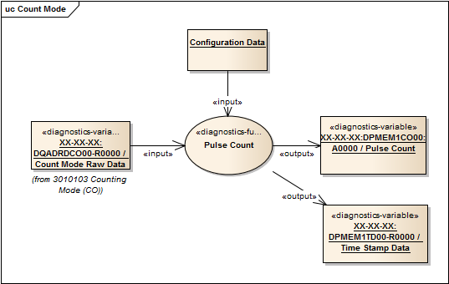
Functional Analysis (variable definition)
Ref ID | Function Name | Description | Interface Type | Protocol
0401-SW-001 | Temperature Measurement | Raw data will be converted in to process / engineering data. Calculate measurement error. | PON | CA
0401-SW-002 | Archive Data | Archive engineering data | DAN | UDP
Variables
Variable Name | Description | Interface | Hardware Allocation
XX-XX-XX:GLVAMEPR00-R0000 | Read Pressure Value | PON | FPGA
XX-XX-XX:GLVAMEPR00-E0000 | Read Pressure Error | PON | FPGA
Ref ID | H/W Interface Type | Description | Direction(I/O)
04-HW-001 | PON | All Processed data will be send to CODAC over PON Network. This function will receive some configuration data from HMI. | Input & Output
04-HW-002 | DAN | All Processed temperature data will be send archiving server over DAN network | Input & Output
Attributes (Code) | Description
Read (R) | Read Pressure value
Error (E) | Read Pressure Error
PON (P) | PON interface
Ref ID | Function Name | Description | Interface Name
0401-HM-001 | Temperature Measurement | Display Port plug structure temperature on HMI | PON
0401-HM-002 | Temperature Error | Display Port plug structure temperature, error on HMI | PON
Constraint | Description
Scan Rate – 1 Sec | Read pressure value at every 1 second
from S.Simrock’s presentation

Slide 4
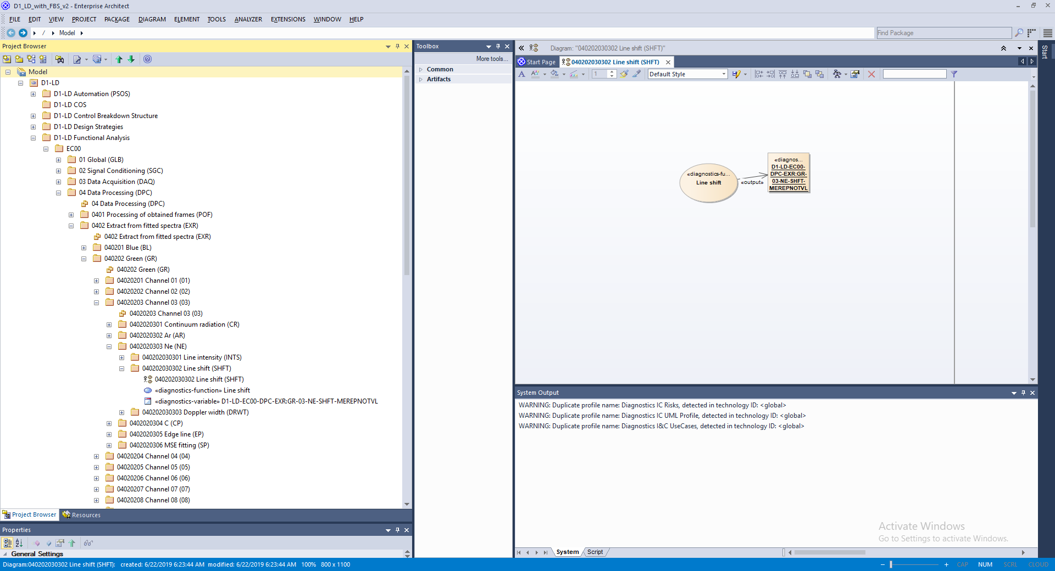
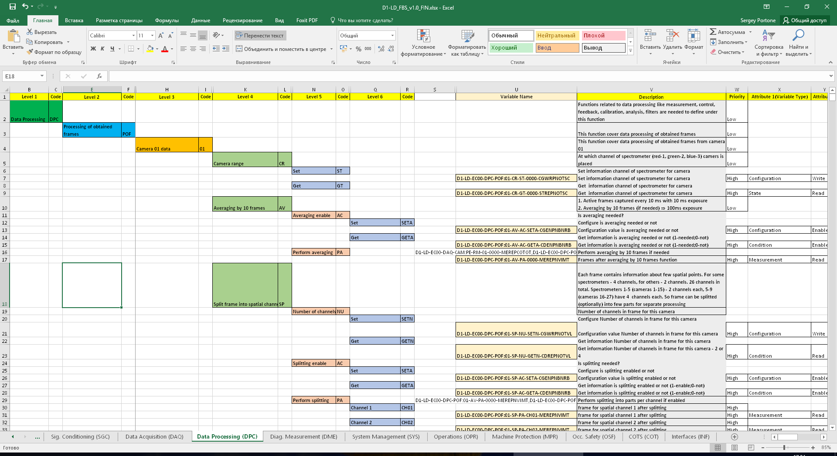
55.EC (D1-LD) FBS Outline
Following information was imported via add-in to EA Project:
Functional Breakdown Structure
  L1 functions – 8/10 (two are not applicable for D1-LD);
  L2 functions – 40;
  L3 functions – 201;
  L4 functions – 1010;
  L5 functions – 3563;
  L6 functions – 3284.

