Slide 1
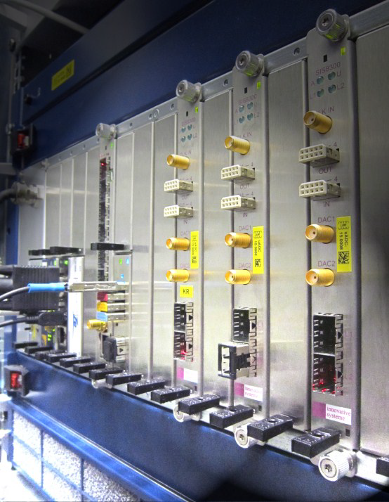
Diagnostic Plant I&C Methodology
A Quick Walkthrough

Slide 2
The three important documents
The methodology: 01_Diagnostics Plant I&C Design Process (SRS and SDS) with link to templates and examples (JQLRRK v2.0)
  From 2019, needs an update
  Therefore, needs to be read in conjunction with the last 7 workshop discussions.
The EA user manual: System Engineering Diagram for Diagnostics Plant I&C -EA User Manual (Q77FFP v3.4)
  From 2019
  In the process to be updated with separate user manuals for individual add-ins.
  Most separate user manuals updated at UL2FMF
The EA project structure document: EA Project Structure for Diagnostics Plant I&C (6UER9M v0.0)
  First version in near future (1-2 weeks)
  Draft version in Sharepoint

Slide 3
Diagnostic Plant I&C Methodology - Overview
Use Cases
Operation Procedures (flowcharts) –
(WHAT the System and the Operator
will do in Operation)
Signals and Components+
Hardware Architecture
(WHERE/WHO) +
Cubicle Configuration +
BOM
Obsolescence Management
with ITER part no.
Derived requirements
Applicable Requirements
from sources in IDM (Standard requirements from
handbooks and Derived Requirements)
Req1… VM1
Req2… VM2
VM = verification method (for each lifecycle phase)
Plant I&C Operation
Maintenance
P1
P5
…
…
P2
Shows
reuse
P6
Req. Cat1
Req.
Cat2
P6
P7
State Machine
Requirement category to supporting functions mapping for Verification
State 1
…
P3
Procedure to Function Mapping
P4
Conditions
Acceptance Criteria for Validation
AC1
AC2
V22
V23
…
Cat1
Cat2
Functional Analysis (HOW)
SYSM
Variables
Procedures
(Entry, Do, Exit)
P5, P7
…
FBS1 - DAQ
DPC
…
F1
V4
V5
F2
V9
V8
V11
V1
V2
V12
Algorithms
Test Cases to Acceptance criteria mapping
NDS
Variables
HMI
Test Scenarios
TS1
TS2
F3
…
Software Arch
F4
Config. Objs.
V3
V6
V7
System Manuf. Spec (+MIP)
In orange are the Plant I&C variables
System Test Plan
Test Case1,…..
01_Diagnostics Plant I&C Design Process (SRS and SDS) with link to templates and examples (JQLRRK v2.0)

Slide 4
Use Cases and Requirements
Most important while writing the use cases are the normal flow steps (which are written from the operator’s perspective)
  An example of normal flow step is – “Diagnostics Operator monitors (on HMI) the error status of devices in the signal chain (to verify that there are no reported errors).
Requirements
  Derive requirements from the use cases
  Add these derived requirements to the IO provided pre-filled template of requirements
  Mark applicability for the requirements (Yes/No), Add justification when not applicable.
  All the requirements must have a source and section.
  Add verification method for all requirements along with the relevant phase
  Import requirements file to the EA project using the requirements add-in
EA Add-in User Manual - Requirement Management ,
ITER_D_X7VG4C, ITER_D_UNL5VW, Slides 2-4 of ITER_D_4ZKAE6

Slide 5
Operation Procedures
Two ways to document them in the EA project -1) excel file import using add-in (recommended) 2) using add-in’s editor
Method 1
  Take the Operation Procedures excel file template.
  Define procedures/activities at different levels along with the interconnections between them, in the excel file. There is also a possibility to define corresponding functions for the procedures.
  Import the excel file using the add-in. The procedures are created, and also the functions are mapped (provided functions are already present in the EA project, and have been defined in the procedures excel file).
  Perform special steps to make the procedures navigable, to rearrange the activity diagrams and to use the concept of reference procedures
EA Add-in User Manual - Operations Procedure , Slides 5-13 of ITER_D_4ZKAE6

Slide 6
Functional Analysis
Two ways to document them in the EA project -1) excel file import using add-in (recommended) 2) using add-in’s editor
Method 1
  Take the Functional Analysis excel file template (2020 version).
  Define functions and variables at different levels. Multiplicity feature is also available.
  Define the name attributes for all the variables.
  Define non-name attributes for all the variables (most import being hardware allocation).
  Define SYSM variables (if needed) and NDS variables using add-in.
  Define input (can be Plant I&C, SYSM, NDS variables) and output variables (can be Plant I&C, NDS variables) for all functions
  Import the excel file using the add-in. Function processing diagrams are created (SYSM and NDS variables are mapped only if they are already present in the EA project)
EA Add-in User Manual - Functional Analysis,
Slides 14-23 of ITER_D_4ZKAE6, ITER_D_LAJF9S

Slide 7
State Machine, Test Scenarios, Acceptance Criteria
State Machine
  Define different states and also the transition between the states (this information to be also presented in System Concept of Operations document)
  Define conditions for every state (design mapping add-in)
  Allocate variables to state (design mapping add-in)
Test Scenarios
  Define test scenarios (high level only) (can be considered as use cases for testing)
Acceptance Criteria
  Use the list provided by IO-CT (ITER_D_6JL6ZQ)
  Make acceptance criteria non-applicable with appropriate justification
  Add additional acceptance criteria as per the individual diagnostic
  Import to the EA project (import functionality under development)
EA Add-in User Manual - Design Mapping,EA Add-in User Manual - Verification and Validation ITER_D_4WDZXW, ITER_D_UKHVM5, slide 7 of ITER_D_4XLBK8

Slide 8
HMI, Algorithms, Hardware Architecture et al
Configuration Objects, HMI
  Propose Plant I&C HMIs (mock ups sufficient)
  Define Configuration Objects
Algorithms
  Descriptions along with equations sufficient for FDR
Hardware Architecture et al
  Define hardware architecture diagram (high level and detailed down to device and board level). Also refer concept of Master Controller.
  Bill of Materials
  Propose (validate) COTS integration strategy (black box checklist)
  Define software architecture
  Define cubicle configuration layout, along with the detailed design aspects
  Signals and Components list
  Obsolescence Management Plan along with ITER Part numbers
EA Add-in User Manual - Signals and Components, ITER_D_3JV3ZX, ITER_D_QARUAC, ITER_D_ Q68UB6, ITER_D_63JB56, ITER_D_4YLDY7

Slide 9
Verification, SMS, STP
Verification
  Map requirement categories to the supporting functions using verification and validation add-in
Design Mapping add-in can also be used for the following
  Procedure to function mapping (in addition to the method explained in slide 4)
  Mapping input and output variables for functions (in addition to the method explained in slide 5)
SRS and SDS can be generated from the EA project using the add-in.
SMS (System manufacturing Specification) to be prepared for MRR. Template provided – ITER_D_6375ZU
System Test Plan – Detailed test plan possible after manufacturing phase. Test cases to be mapped to Acceptance Criteria.
Mapping,EA Add-in User Manual - Verification and Validation, ITER_D_4WDZXW

Slide 10
Acceptance Criteria
Acceptance criteria support the writing of test cases/procedures (documented in System Test Plan) OR in other words the flow down of the existing requirements to the test cases/procedures.
These acceptance criteria do not add any new requirements.
These are written from the perspective of validating the requirements in context of the whole plant system.
Example – 1) Operator can verify the operation of Plant I&C from Central I&C through COS:PSOS mapping. 2) Operator verifies that he/she is able to manage calibration data in all repositories as required for all diagnostic use cases.
In the 5th I&C workshop, this topic was presented. 04 - Concept for Acceptance (2021). The Plant I&C designers from various DA’s requested IO-CT to help them with a minimum basic set of acceptance criteria, which they could later update/add as per the needs of their system. ITER_D_55G3CQ Action #2

Slide 11
Split of Topics between PDR and FDR (Proposal)
 |  | Weightage
Procedures | Operation Procedures | 13
 | Exceptional Detection and Handling Procedures | 2
 | Procedures to Function Mapping | 5
Functions | Functions including NDS functions | 12
 | Acceptance Criteria | 3
 | Function Processing Diagram/ Input variables/Signal Chain | 5
 | Algorithms | 2.5
 | Function to Requirement Category Mapping (Verification) | 2.5
Variables | Variables (including 1. NDS variables and 2. smart conditions 3. Configuration Objects) | 10
 | Variable name and non-name attributes (importantly Hardware Allocation) | 5
Hardware Architecture | Signals and Components | 5
 | Hardware Architecture (includes software architecture) | 5
 | Obsolescence management plan | 2
 | Cubicle Configuration | 7
 | BOM | 4
 | ITER Part Number | 2
State Machine | States | 7
 | Allocation of procedures to states, mapping of conditions to states | 3
HMI | HMI | 3
Test scenarios | Test scenarios | 2
The topics in blue can be considered to be presented at FDR.
Weightage column gives an idea about the estimated effort expected for each topic.
Weightage of 5 ≈ 1 person month of effort.
Total weightage = 100 = For reaching FDR maturity level.

Slide 12
Thank you for your attention!

