Slide 1
JAVA Graphical User Interface
10

Slide 2
License Information
CSCI230 JAVA Graphical User Interface 10 by Gheni Abla is licensed under a Creative Commons Attribution 4.0 International License, except where otherwise noted.
The CC-BY license excludes the images in this slide deck. The creators of the images retain their rights.

Slide 3
Topics
Java Timers
Animation

Slide 4
Timers
Java’s Timer class generates a sequence of action events, spaced at equal intervals
Included in javax.swing package
Timer constructor requires two arguments:
  delay time (in milliseconds)
  action listener to handle the event triggered by the Timer
  Timer myTimer = new Timer(DELAY, listener);

Slide 5
Example: Implement A Simple Clock
A Timer object used to create events
An Action Listener object performs update
A Date object is used to display and update the current time

Slide 6
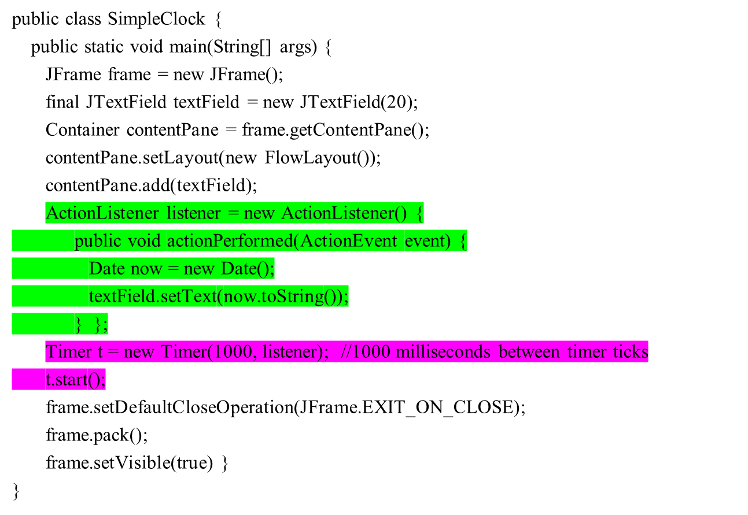
Simple Clock
ActionListener object performs:
Translate the current date & time into a readable String
The ActionListener is associated with the Timer via the Timer’s constructor; once the Timer starts, it spawns an ActionEvent once per second

Slide 7
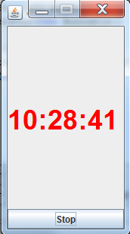
Code: SWING Timer Control
Csci230_timercontrol.java
Demonstrates:
  Swing Timer
  Timer Control

Slide 8

Animation
Animation involves painting, erasing, and repainting the same visible scene or object
  Gives the viewer the illusion of a moving or changing picture

Slide 9


Animation- The Repeated Actions
The repeated actions can accomplish moving animation
  draw a shape
  move the shape
The repeated actions can accomplish changing animation
  Draw a shape
  Erase the shape
  Draw a slightly modified shape

Slide 10
Implementation of Animation
To draw the picture, begin with an object that implements the Icon interface, and define the paintIcon method
Place the resulting Icon object in a JLabel, and place the label in the content pane of a frame for display
We add a timer to automate the process, passing it an ActionListener that redraws the shape

Slide 11
Animation Implementation Example
In this example code, a series of random pictures are drawn, changing once every second
(Horst Transformer)

Slide 12
Transformer Example (1)
import java.awt.*;
import java.awt.event.*;
import javax.swing.*;
import java.util.*;
import javax.swing.Timer;
public class Transformer extends JFrame implements ActionListener, Icon {
public static void main(String [] args) {
JFrame f = new Transformer();
}
private Icon [] imageArray; // collection of random images
private int index = 0; // current array index
private Container win; // content pane of the frame
private JLabel pic; // JLabel used to display current image
private Timer t; // spawns new action event every 2 seconds
private Random rg; // used for choosing images and generating
// background colors

Slide 13
Transformer Example (2)
public Transformer() {
setTitle("It changes!");
setAlwaysOnTop(true); // window always visible, if present
imageArray = new ImageIcon[8];
win = this.getContentPane();
win.setBackground(Color.WHITE);
win.setLayout(new FlowLayout());
imageArray[0] = new ImageIcon("3x2x2connector.jpg");
// some images omitted to fit on this slide …
imageArray[7] = new ImageIcon("motor.jpg");
setDefaultCloseOperation(JFrame.EXIT_ON_CLOSE);
rg = new Random();
pic = new JLabel(imageArray[rg.nextInt(8)]);
win.add(pic);
setVisible(true);
t = new Timer(1000, this);
t.start();
}

Slide 14
Transformer Example (3)
public int getIconWidth() {return imageArray[index].getIconWidth();}
public int getIconHeight() {return imageArray[index].getIconHeight();}
public void paintIcon (Component c, Graphics g, int x, int y) {
index = rg.nextInt(8);
pic = new JLabel(imageArray[index]);
}
public void paint (Graphics g) {
win.setBackground(new Color(rg.nextInt(256), rg.nextInt(256), rg.nextInt(256)));
paintIcon(this, g, 0, 0);
}
public void actionPerformed(ActionEvent event) {
pic = new JLabel(imageArray[index]);
win.removeAll(); // erases current image
win.add(pic); // adds new image to content pane
repaint(); // calls paint (resetting background &
pack(); // painting image)
}
}

Slide 15
Shapes that Move
In the next example, a more typical form of animation is used
A picture is drawn, then redrawn with the “moving” part of the image in a different location
The repaint() method takes care of erasing and redrawing the picture
The next several slides provide an example

Slide 16
Shapes that Move – Example (1)
import java.awt.*;
import java.awt.event.*;
import javax.swing.*;
import java.util.*;
import javax.swing.Timer;
public class Traveller extends JFrame {
public static void main(String [] args) {
JFrame f = new Traveller();
}
private Container win; // frame’s content pane
private Timer t; // changes picture once per second
private Random rg; // provides random image locations
private ImageIcon bouncer; // the “moving” part

Slide 17
Shapes that Move – Example (2)
public Traveller() {
setTitle("It moves!");
setSize(200,200);
setAlwaysOnTop(true);
win = this.getContentPane();
win.setBackground(Color.WHITE);
setDefaultCloseOperation(JFrame.EXIT_ON_CLOSE);
rg = new Random();
bouncer = new ImageIcon("barbiehd.gif");
setVisible(true);
t = new Timer(1000, new ActionListener () {
public void actionPerformed(ActionEvent event) {
repaint();
}
});
t.start();
}

Slide 18
Shapes that Move – Example (3)
public void paint (Graphics g) {
g.setColor(Color.RED);
g.fillRect(0,0,200,200);
bouncer.paintIcon(win, g, rg.nextInt(150), rg.nextInt(150));
}
}

Slide 19
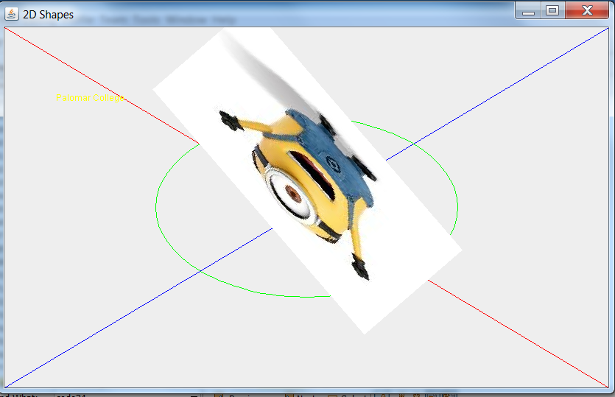
Code – Canvas, 2D & timer
Csci230_canvastimer.java

Slide 20
MoveableShape Interface
We can define an interface for generic shape animation
The interface has two methods:
  draw() draws the shape
  translate() moves the position of the top left corner of the shape
  public interface MoveableShape
  {
  void draw(Graphics2D g2);
  void translate(double dx, double dy);
  }

Slide 21
MoveableShape Interface – Example (1)
import java.awt.*;
import javax.swing.*;
import java.awt.geom.*;
import java.awt.event.*;
public class BouncingBall implements MoveableShape {
private double x, y; // position of ball
int size; // size of ball
public BouncingBall(double x, double y, int size) {
this.x = x;
this.y = y;
this.size = size;
}

Slide 22
MoveableShape Interface – Example (2)
// Ball “moves” according to the arguments passed to this method
public void translate (double dx, double dy) {
x += dx;
y += dy;
}
// Paints ball at its current position (defined by x & y)
public void draw(Graphics2D g2) {
g2.setColor(Color.red);
Ellipse2D.Double ball = new Ellipse2D.Double(x,y,size,size);
g2.fill(ball);
}
}

Slide 23
MoveableShape Interface – Example (3)
import java.awt.*;
import java.util.*;
import javax.swing.*;
// This class contains a MoveableShape; because it implements Icon,
// we can use it to put a BouncingBall object into a JLabel for
// display (as we’ll see in the driver program)
public class ShapeIcon implements Icon {
private int width;
private int height;
private MoveableShape shape;
public ShapeIcon(MoveableShape shape, int width, int height) {
this.shape = shape;
this.width = width;
this.height = height;
}

Slide 24
MoveableShape Interface – Example (4)
public int getIconWidth() {
return width;
}
public int getIconHeight() {
return height;
}
public void paintIcon(Component c, Graphics g, int x, int y) {
Graphics2D g2 = (Graphics2D) g;
shape.draw(g2);
}
}

Slide 25
MoveableShape Interface – Example (5)
import java.awt.*;
import javax.swing.*;
import java.awt.geom.*;
import java.awt.event.*;
public class DropTheBall extends JFrame {
private JLabel space; // space ball occupies
MoveableShape bb; // BouncingBall object
ShapeIcon shape; // Icon container for BouncingBall

Slide 26
MoveableShape Interface – Example (6)
public DropTheBall () {
setSize(300,300);
setTitle("oops");
setAlwaysOnTop(true);
bb = new BouncingBall(135,0,20);
shape = new ShapeIcon(bb, 300,300);
space = new JLabel(shape);
Container contentPane = getContentPane();
contentPane.setLayout(new FlowLayout());
contentPane.add(space);
setVisible(true);
setDefaultCloseOperation(JFrame.EXIT_ON_CLOSE);
Timer t = new Timer(10, new ActionListener () {
public void actionPerformed(ActionEvent event) {
bb.translate(0,1);
space.repaint(); }});
t.start();
}

Slide 27
MoveableShape Interface – Example (7)
public static void main (String [] args) {
DropTheBall b = new DropTheBall();
}
}

