Slide 1
CSCI230
JAVA Graphical User Interface
11

Slide 2
License Information
CSCI230 JAVA Graphical User Interface 11 by Gheni Abla is licensed under a Creative Commons Attribution 4.0 International License, except where otherwise noted.
The CC-BY license excludes the images in this slide deck. The creators of the images retain their rights.

Slide 3
Topics
HTML in SWING Components
Embed Web Browser in Java GUI applications

Slide 4
Text Format in SWING Components
Many SWING components display a text string as part of their GUI
By default, a component's text is displayed in a single font and color, all on one line
Font and color of a text are set by invoking the component's setFont and setForeground methods
Example:
label = new JLabel("A label");
label.setFont(new Font("Serif", Font.PLAIN, 14));
label.setForeground(new Color(0xffffdd));

Slide 5

HTML in SWING Components
Font and color of a text string also can be set by HTML tags
Using HTML tags can be easier for formatting
  To specify that a component's text has HTML formatting, just put the <html> tag at the beginning of the text, then use any valid HTML in the remainder.
  Example:
button = new JButton("<html><b><u>T</u>wo</b><br>lines</html>");

Slide 6
Common HTML Tags
HTML – Hyper Text Markup Language, the language of webpages
  HTML page tag: <HTML> </HTML>
  Fonts: <font size= +2> </font>, <font color=red> </font>
  Font Style: <i> italic <i>, <b>bold</b>
  List: <ul> <li>1</li><li>2</li><li>3</li></ul>
  Image: <img src=“selfy.gif" height=“80" width=“80">
  New Paragraph, line break: <p>, <br>
  Horiontal line: <hr>
For more tags, just google “HTML tags”

Slide 7
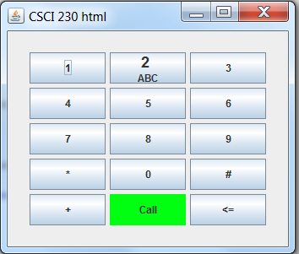
Code: Using HTML in SWING Components
Csci230_html
Demonstrates:
  1) HTML; 2) BorderFactory; 3) Layout Manager

Slide 8
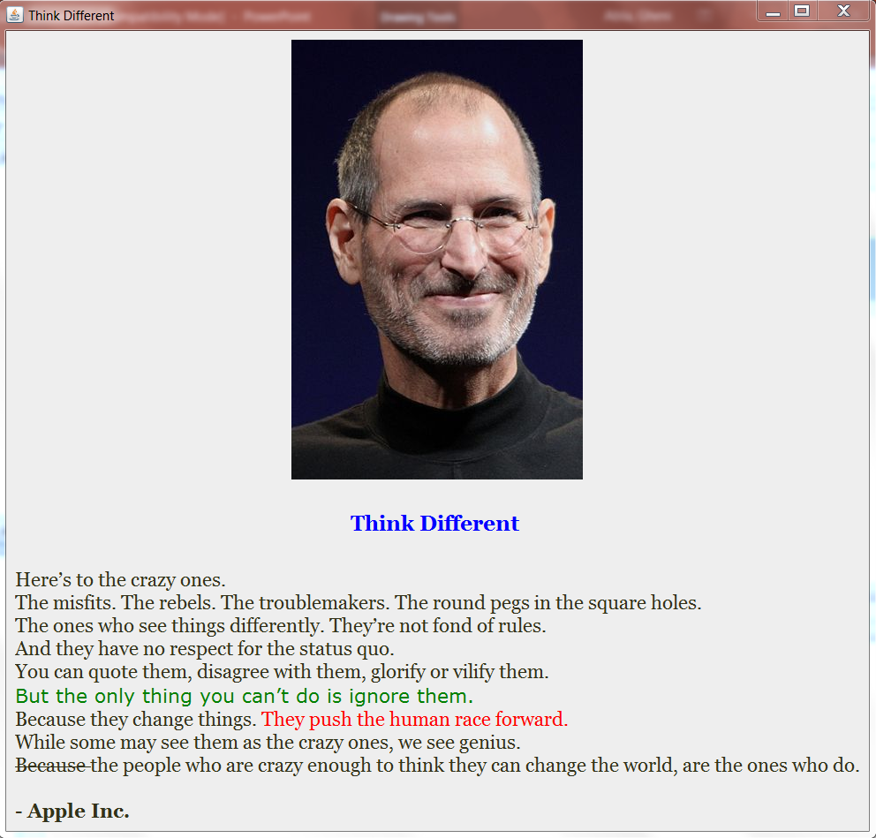
Code: Using HTML in SWING Components
Csci230_html2
Demonstrates:
  1) HTML; 2) Border Layout; 3) Label; 4) BorderFactory

Slide 9
Using Web Browser in SWING Applications
Some times Java GUI applications need integrate web browser control to display HTML content and communicate with web services
Jxbrowser is library to allow embedding web browser in Java GUI
  External library –not a part of Java SWING
  https://www.teamdev.com/jxbrowser

Slide 10
JxBrowser Example
import com.teamdev.jxbrowser.chromium.Browser;
import com.teamdev.jxbrowser.chromium.swing.BrowserView;
import javax.swing.*;
import java.awt.*;
public class JavaSwingSample {
public static void main(String[] args) {
Browser browser = new Browser();
BrowserView view = new BrowserView(browser);
JFrame frame = new JFrame();
frame.add(view, BorderLayout.CENTER);
frame.setSize(700, 500);
frame.setVisible(true);
browser.loadURL("http://www.google.com");
}
}

Slide 11
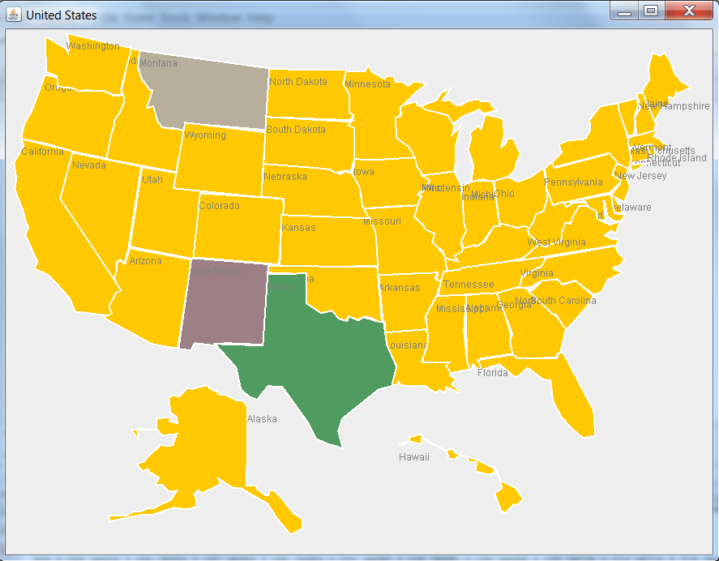
Code: Map and Data Visualization
Csci230_mapanddata
Demonstrates:
  Drawing polygon from data
  Data I/O

