Slide 1
CSCI230
JAVA Graphical User Interface
12

Slide 2
License Information
CSCI230 JAVA Graphical User Interface 12 by Gheni Abla is licensed under a Creative Commons Attribution 4.0 International License, except where otherwise noted.
The CC-BY license excludes the images in this slide deck. The creators of the images retain their rights.

Slide 3
Topics
Advanced SWING Components
  JSpinner
  JFileChooser
  JColorChooser
  JTable
  JTree
  JTabbedPane

Slide 4
JSpinner
Lets users choose from a range of values and allows edit the value directly
Does not display possible values - only the current value is visible
Example:
//month names
String[] monthStrings ={“January”, “February”,...};
SpinnerListModel monthModel = new SpinnerListModel(monthStrings);
JSpinner spinner = new JSpinner(monthModel);

Slide 5
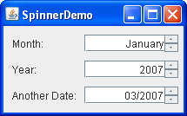
JSpinner

Slide 6
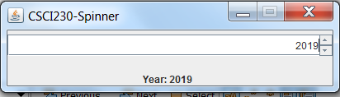
Code – JSpinner
Csci230_spinner.java
Builds a GUI for selecting and entering/choosing a value through a JSpinner

Slide 7
JFileChooser
Provides a GUI for navigating the file system, and then either choosing a file or directory from a list, or entering the name of a file or directory.
JFileChooser displays a modal dialog
  Allows filename filtering
  Allows customization of file view
//Create a file chooser
final JFileChooser fc = new JFileChooser();
...
//In response to a button click:
int returnVal = fc.showOpenDialog(aComponent);

Slide 8
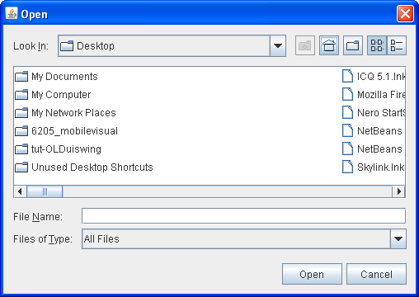
JFileChooser

Slide 9
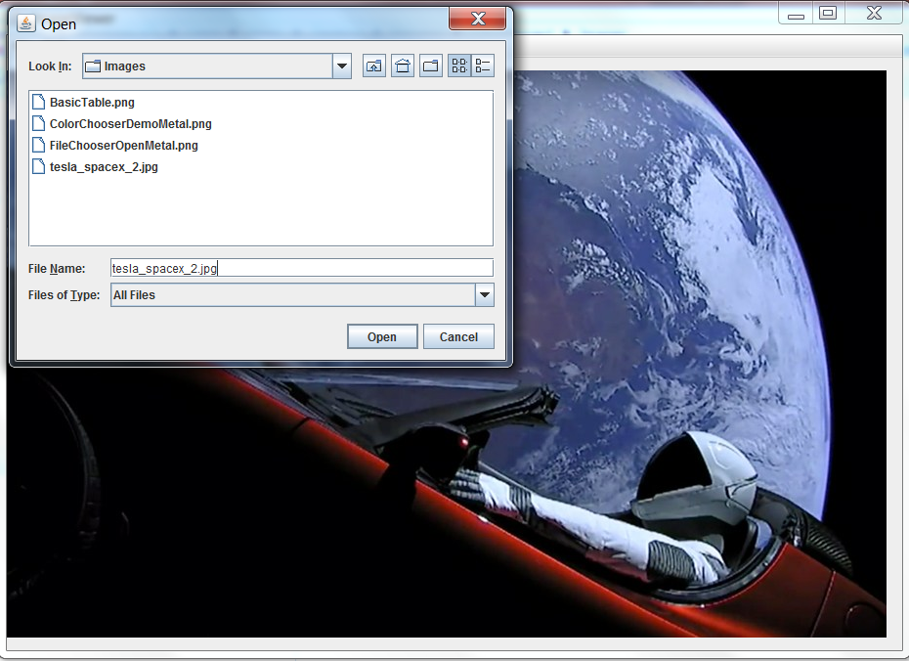
Code – JFileChooser
Csci230_menufilechooser.java
Shows a menu and filechooser for navigating the file system, and then opens the chosen image file.

Slide 10
JColorChooser
Enables users to choose from a palette of colors.
Can be place anywhere within a GUI
By default color chooser provides five chooser panels:
  RGB, HSV, HSL, CMYK, Swatches
  Can be extended with addChooserPanel()
Example:
tcc = new JColorChooser(banner.getForeground());
. . .
add(tcc, BorderLayout.PAGE_END);

Slide 11
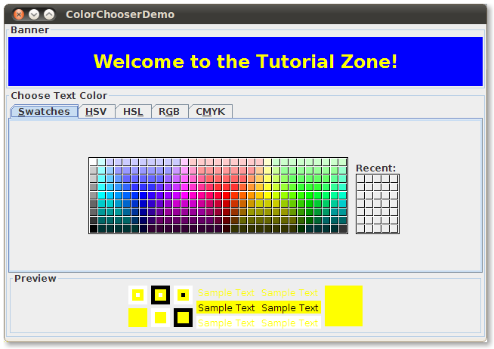
JColorChooser

Slide 12
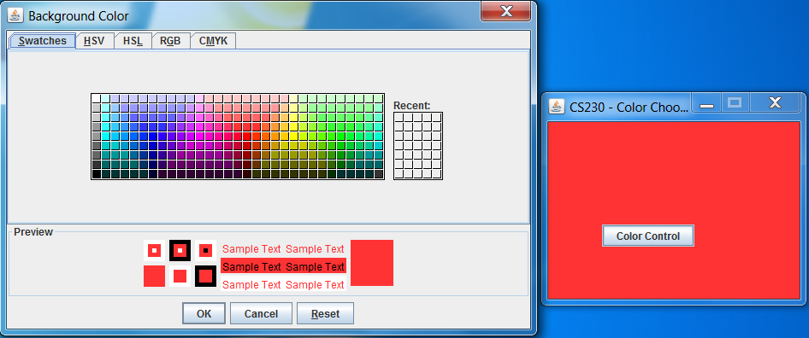
Code – JColorChooser
Csci230_colorchooser.java
Builds a GUI for navigating & choosing a color, and apply the chosen color to components

Slide 13
JTable
Display tables of data, optionally allowing the user to edit the data.
It does not contain or cache data; it is simply a view of your data.
Example:
String[] columnNames = {"First Name","Last Name","Sport”, "# of Years","Vegetarian"};
Object[][] data = {{"Kathy", "Smith", "Snowboarding", new Integer(5), new Boolean(false)} };
JTable table = new JTable(data, columnNames);

Slide 14
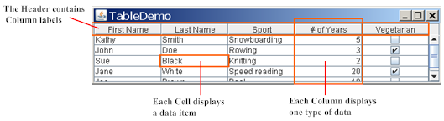
JTable

Slide 15
Code ?? – JTable
Builds a GUI for navigating & choosing a color, and apply the chosen color to components

Slide 16
JTree
Displays hierarchical data in a tree like structure
  Every tree has a root node from which all nodes descend
  A node can either have children or not
  If a node doesn’t have children then it is called branch
  Nodes that can not have children are leaf nodes.
The tree is highly customizeable
Example:
private JTree tree;
DefaultMutableTreeNode root =
new DefaultMutableTreeNode(“The Java Series");
tree = new JTree(root);
…

Slide 17
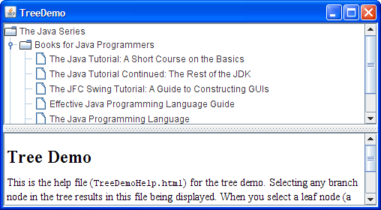
JTree

Slide 18
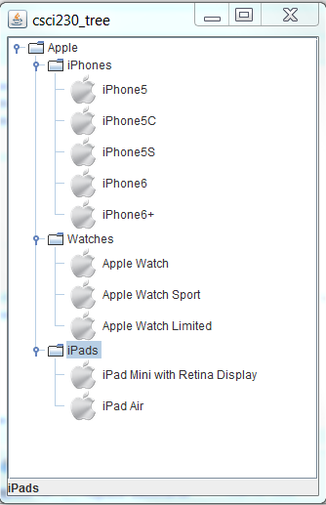
Code – JTree Example
Csci230_tree.java
Builds a hierarchical GUI for navigating the tree & choosing an item
Includes example for JScrollPane

Slide 19
JTabbedPane
Allows multiple components, such as panels, share same space
User choose which component to view by selecting the tab corresponding to the desired component
  Similar functionality to card layout
Example:
JTabbedPane tabbedPane = new JTabbedPane();
ImageIcon icon = createImageIcon("images/middle.gif");
JComponent panel1 = makeTextPanel("Panel #1");
tabbedPane.addTab("Tab 1", icon, panel1,
"Does nothing");
tabbedPane.setMnemonicAt(0, KeyEvent.VK_1);
…

Slide 20
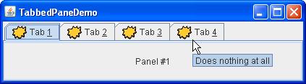
JTabbedPane

Slide 21
Code – JTabbedPane
Csci230_tabbedpane.java
Builds a hierarchical GUI for navigating the tree & choosing an item

Slide 22
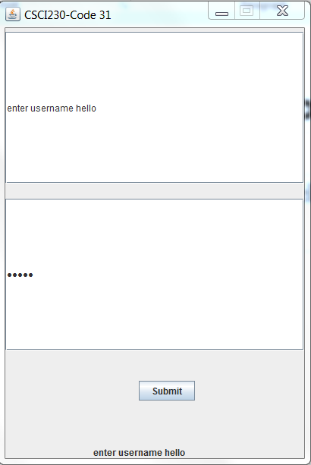
Code – JPasswordField
Csci230_passwordfield.java
Demonstrates password field

Slide 23
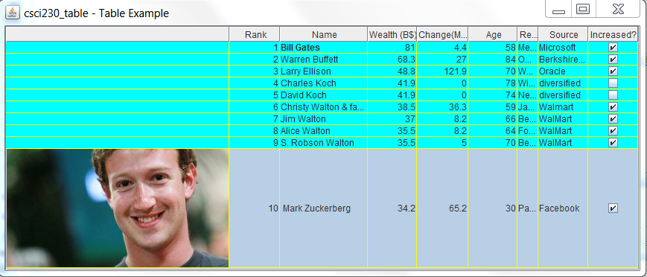
Code – JTable
Csci230_table.java
Demonstrates JTable

