Slide 1
CSCI230
JAVA Graphical User Interface
13

Slide 2
License Information
CSCI230 JAVA Graphical User Interface 13 by Gheni Abla is licensed under a Creative Commons Attribution 4.0 International License, except where otherwise noted.
The CC-BY license excludes the images in this slide deck. The creators of the images retain their rights.

Slide 3
Topics
More Advanced SWING Components

Slide 4
JCheckBox
Provides an item that can be selected or deselected, and which displays its state to the user.
By convention, any number of check boxes in a group can be selected.
  Does not display possible values - only the current value is visible
Selected Constructors:
  JRadioButton() => Creates an initially unselected radio button with no set text.
  JRadioButton(String text, Icon icon, boolean selected) => Creates a radio button that has the specified text, image, and selection state.

Slide 5
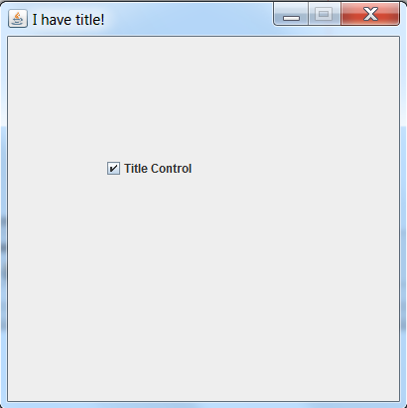
Code – JCheckBox Sample
Csci230_checkbox.java
Demonstrates:
  CheckBox
  BoxLayout
  actionPerformed
  ActionEvent getSource

Slide 6
JRadioButton
Provides an item that can be selected or deselected, and which displays its state to the user
Used with a ButtonGroup object to create a group of buttons in which only one button at a time can be selected
  ButtonGroup is logical grouping (not physical)
Selected Constructors:
  JCheckBox() => Creates an initially unselected check box button with no text, no icon.
  JCheckBox(Action a) =>Creates a check box where properties are taken from the Action supplied.
  JCheckBox(String text, Icon icon, boolean selected) =>Creates a check box with text, icon; specifies if it is initially selected.

Slide 7
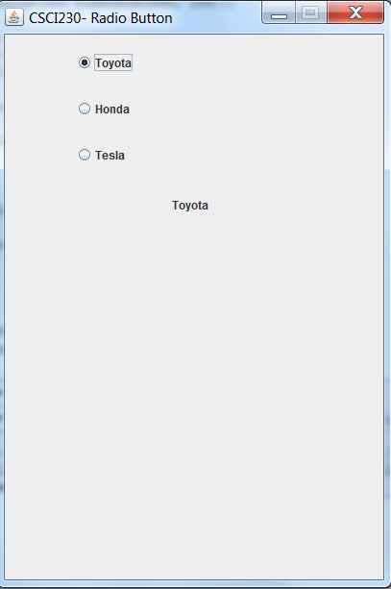
Code – JRadioButton Sample
Csci230_radiobutton.java
Demonstrates:
  JRadioButton

Slide 8
JComboBox
A component that combines a button or editable field and a drop-down list
The user can select a value from the drop-down list, which appears at the user's request
  The list is defined in ComboBoxModel
If editable, then the combo box includes an editable field into which the user can type a value
Selected Constructors:
  JComboBox() => Creates a JComboBox with a default data model
  JComboBox(ComboBoxModel<E> aModel) => Creates a JComboBox that takes its items from an existing ComboBoxModel

Slide 9
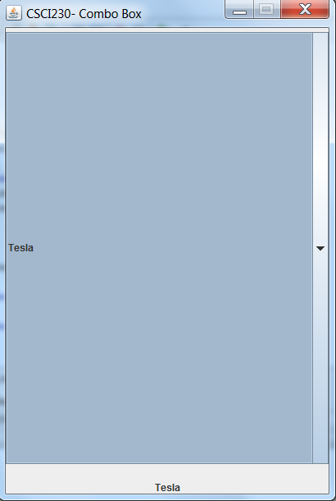
Code – JComboBox Sample
Csci230_combobox.java
Demonstrates:
  JComboBox

Slide 10
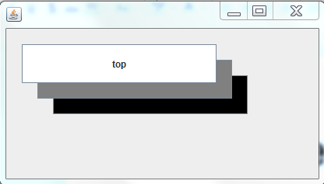
Code – Layered Pane
Csci230_layeredpane.java
Demonstrates:
  Layered panes

Slide 11
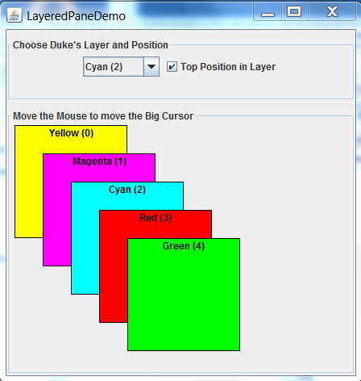
Code – Layered Pane 2
Csci230_layeredpane2.java
Demonstrates:
  Layered panes and related functionalities

