Slide 1
CSCI230
JAVA Graphical User Interface
14

Slide 2
License Information
CSCI230 JAVA Graphical User Interface 14 by Gheni Abla is licensed under a Creative Commons Attribution 4.0 International License, except where otherwise noted.
The CC-BY license excludes the images in this slide deck. The creators of the images retain their rights.

Slide 3
Topics
Introduction to JavaFX
AWT vs. SWING vs. JavaFX
Structure of JavaFX codes
JavaFX layout panes

Slide 4
JavaFX
A library for building rich client applications with Java
It provides an API for designing GUI applications that run on almost every device with Java
Java8, 9, 10 comes with JavaFX.
  It will be eliminated from JDK starting JDK11
  Will become a standalone library module

Slide 5
JavaFX Continued
JavaFX is a framework and (large) set of objects we can use to develop GUI-based applications
The JavaFX API is a good example of how object-oriented principles can be applied in software development
One of the most important parts of JavaFX is controller API, the core focus if next several sessions

Slide 6
Java AWT, SWING and JavaFX
AWT – Abstract Windows Toolkit
  The first GUI library of Java
  Java interface to native system GUI code present in local OS
  Has limitations and platform dependent
  Still exist, but not used very much anymore
Java2 introduced SWING and AWT’s functionalities mostly replaced with SWING functionalities

Slide 7
Java AWT, SWING and JavaFX (2)
Swing was designed primarily for use in desktop applications
  Java Applet, which is a component for web-based applications, not being supported anymore
“Light-weight” and Model/View/Controller software design pattern based
SWING is a mature library and Oracle is not further developing it anymore

Slide 8
Java AWT, SWING and JavaFX (3)
JavaFX is replacing SWING functionalities completely
Cross Platform
  JavaFX lets programmers write RIAs (Rich Internet Applications), which essentially run under a browser (Internet Explorer/FireFox /Chrome / Safari) just like they run on a desktop

Slide 9
Basic Structure of JavaFX Code
public class MyProgram
{
// Body of class
}
import javafx.application.Application;
public class MyProgram extends Application
{
// Body of class
}

Slide 10
import javafx.application.Application;
import javafx.event.ActionEvent;
import javafx.event.EventHandler;
import javafx.scene.Scene;
import javafx.scene.control.Button;
import javafx.scene.layout.StackPane;
import javafx.stage.Stage;
public class Csci230_firstjavafx extends Application {
@Override
public void start(Stage primaryStage) {
Button btn = new Button();
btn.setText("Say 'Hello World'");
btn.setOnAction(new EventHandler<ActionEvent>() {
@Override
public void handle(ActionEvent event) {
System.out.println("Hello World!"); } });
StackPane root = new StackPane();
root.getChildren().add(btn);
Scene scene = new Scene(root, 300, 250);
primaryStage.setTitle("Hello World!");
primaryStage.setScene(scene);
primaryStage.show(); }
public static void main(String[] args) {
launch(args); }}
The main method is only needed for the IDE with limited
JavaFX support. Not needed for running from the command line.

Slide 11
JavaFX Programs are based on the Analogy of a Stage
In JavaFX, we create the components, add them to scenes, and then add scenes to the stage
  On a theater stage, the stage may be divided into portions, where individual scenes take place.
  Each scene’s set will have actors, props, backdrops, lighting, etc.
  On the stage are scenes, and each scene is also made up of other components.

Slide 12
JavaFX Stage, Scene
Stage - the window our code runs in
Since every GUI application, by definition, involves a window with the UI, we get the primaryStage by default when the application launches
JavaFX applications are not limited to a single stage
Stage
Scene
Button

Slide 13
Code - Adding Additional Stage (2)
By default, stages/windows are resizeable
  Can be resized by leftclick and dragging right bottom corner
  Note that there are minimize and maximize buttons for the stage/window
If the stage needs to be of fixed size (i.e., not resizeable), the stage property can be set as following:
stage.setResizeable(false)

Slide 14
Panes, Shapes, UI Controls
Normally, UI elements are placed into panes, then panes are added to the scenes
Panes are containers
  Pane can contain other containers
UI elements – also known nodes (e.g button)
Line, Circle, Rectangle etc. are shapes; They are subclass of Shape
UI elements such as Button, Label, TextField, RadioButton are subclass of Controls

Slide 15
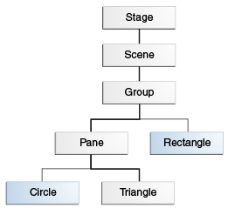
Panes, Shapes, UI Controls Hierarchy

Slide 16
JavaFX Layout Panes
JavaFX GUI development steps summary:
  Add Nodes to a Pane
  Add the Pane to a Scene
  Add the Scene to a Stage (probably the primary stage).
There are different types of panes that can help with arranging (i.e., lay out) the nodes on the pane
  E.g, Flow Pane, Hbox, StackPane
  Similar to SWIM’s layout managers

Slide 17
JavaFX Layout Panes (2)
Name | Description
Pane | Base class for layout panes. Use its getChildren() method to return the list of nodes on the pane (or add to that list) Provides no particular layout capabilities – it’s a “blank canvas” typically used to draw shapes on
StackPane | Places nodes on top of each other in the center of the pane
FlowPane | Places the notes row-by-row horizontally or column-by-column vertically (reading order)
GridPane | Provide a 2-D grid of cells, into which we can place nodes
BorderPane | Divides pane into top, bottom, left, right, and center regions
HBox | Places nodes in a single (horizontal) row
VBox | Places nodes in a single (vertical) column

Slide 18
JavaFX FlowPane
Similar to SWING’s Flow Layout
The FlowPane can be set up to work in “reading order” (sequential rows left-to-right), by using Orientation.HORIZONTAL or in sequential top-to-bottom columns (Orientation.VERTICAL)
The gap between nodes (in pixels) also can be specified

Slide 19
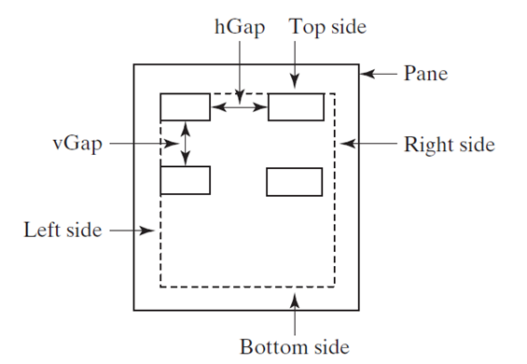
JavaFX FlowPane
Setting the padding with an Insets object gives margin inside the pane.
  Insets are specified in clockwise order from the top, right, buttom, and left
The Hgap and Vgap properties specify the gap between elements on the row, or between rows
Resizing the window “re-flows” the nodes

Slide 20
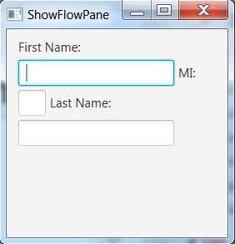
Code – FlowPane Example
Csci230_javafxflowpane.java

Slide 21
JavaFX GridPane
The GridPane divides the pane’s area into a 2-D grid of rows and columns.
Somewhat similar to SWIM’s GridLayout
The next code shows the previous example redone, with the three Labels in the left column, and the three TextFields

Slide 22
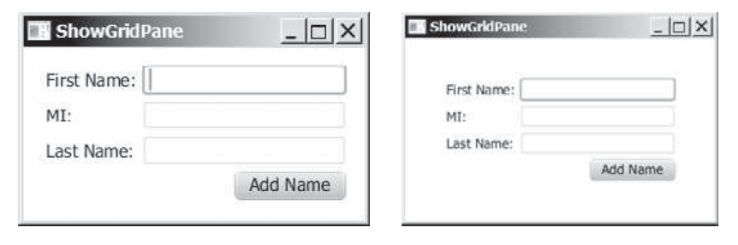
Code Exercise - JavaFX GridPane

Slide 23
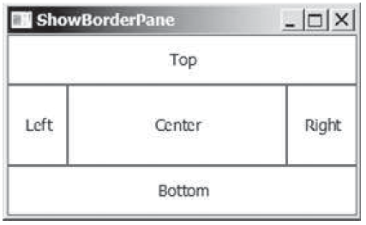
JavaFX BorderPane
Divides the pane into five “regions” – Top, Right, Bottom, Left and Center
  Similar to SWIM’s BorderLayout manager
  Another pane (CostomPane or StackPane) can be placed on each region
  If a region is empty, it’s simply not shown
  A region can be cleared with set<region>(null)

Slide 24
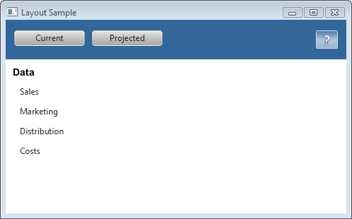
JavaFX HBox and VBox
HBox – gives a single row
VBox – gives a single coloumn

