Slide 1
CSCI230
JAVA Graphical User Interface
15

Slide 2
License Information
CSCI230 JAVA Graphical User Interface 15 by Gheni Abla is licensed under a Creative Commons Attribution 4.0 International License, except where otherwise noted.
The CC-BY license excludes the images in this slide deck. The creators of the images retain their rights.

Slide 3
Topics
JavaFX 2D Shapes

Slide 4
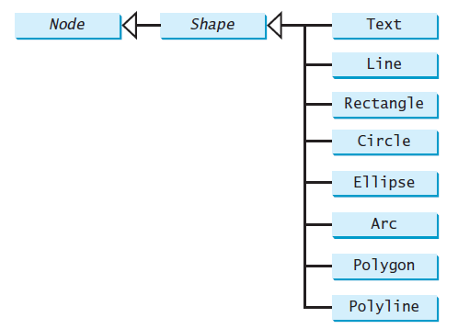
JavaFX Shapes
Shapes allow us to draw on panes
There are 8 the most used shapes: Text, Line, Rectangle, Circle, Ellipse, Arc, Polygon, Polyline

Slide 5
Common Properties of JavaFX Shapes
All of the shapes have some common properties:
  fill (color)
  stroke (line color)
  strokeWidth (how heavy the stroke line is)

Slide 6
JavaFX Text
The Text shape lets us put text on a pane
  It is similar to Label, but Label and Text are two different kinds of text, with two different inheritance paths.
  Text constructor uses (double, double, String) form to specify the x and y locations for the String.
  Text object can have its color, font (typeface, weight, size, and posture), underline, and strikethrough properties set.

Slide 7
JavaFX Line
Each Line object is specified by its two endpoints: startX, startY and endX, endY (all doubles, in pixels)

Slide 8
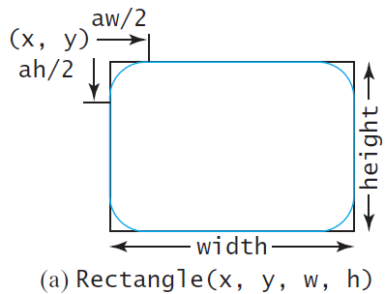
JavaFX Rectangle
The Rectangle shape is specified by its top-left corner (x, y) and its width and height.
Optionally, we can specify the arcWidth and arcHeight (in pixels) of the corners, to create rounded corners (arc measurements of 0 make
squared-off corners)

Slide 9
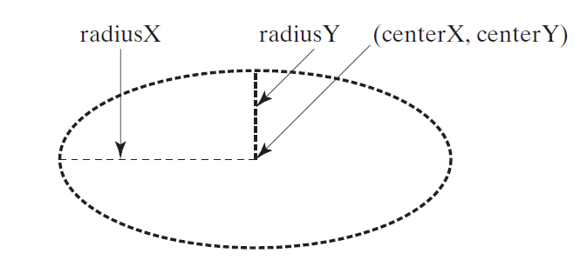
JavaFX Circle & Ellipse
The Circle and Ellipse shapes are very similar
Both are specified by their center point (centerX, centerY)
The Circle has a single radius
The Ellipse has two radii (radiusX & radiusY)

Slide 10
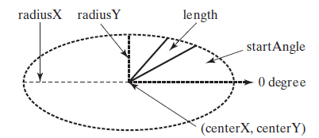
JavaFX Arc
An Arc is just part of an Ellipse
An Arc is specified by its center point, radii, start angle (in degrees), and length (in degrees)
  If the two radii are equal, then it’s a circular arc
  Angles may be negative (clockwise sweep)

Slide 11
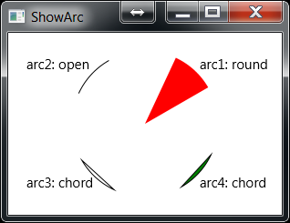
JavaFX Arc (2)
Once specified, an Arc can be drawn in any of three styles: ArcType.OPEN, ArcType.CHORD, or ArcType.ROUND

Slide 12
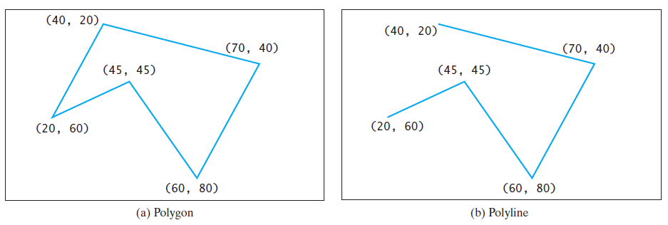
JavaFX Polygon & Polyline
The Polygon and Polyline shapes are identical, except that the Polyline isn’t closed
Both are specified by a list of (x, y) pairs

Slide 13
JavaFX Polygon & Polyline (2)
If we know all of the points up-front, we can specify them as a variable-length parameter list:
Polygon p = new Polygon(x1, y1, x2, y2, …);
If we don’t know all of the points a priori, the Polygon exposes an ObservableList to which we can add points (i.e., generate the points on-the-fly and add them to the list as we go)

Slide 14
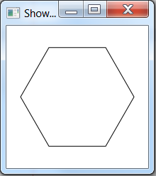
Code - JavaFX Polygon & Polyline
csci230_javafxpolygonpolyline.java

