Slide 1
CSCI230
JAVA Graphical User Interface
2

Slide 2
License Information
CSCI230 JAVA Graphical User Interface 2 by Gheni Abla is licensed under a Creative Commons Attribution 4.0 International License, except where otherwise noted.
The CC-BY license excludes the images in this slide deck. The creators of the images retain their rights.

Slide 3
Topics
Basic elements of GUI - Review
Java & NetBeans IDE: Hands-on coding
Java GUI Discussion: Hands-on coding
Introduction to Java AWT and SWING

Slide 4
Basic Elements of GUI Review
Pointers: single point, area…
Pointing devices: mouse, finger, gesture…
Sensors: Face, fingerprint, voice…
Devices: different size screens (Desktop, phone)
Windows
Menus, tabs, combo boxes
Textbox, buttons, radio button, check box, label

Slide 5
Java
Java is a general-purpose computer-programming language designed by James Gosling
  First announced on May 23, 1995
  Concurrent, class-based, object-oriented
  Includes Swing and JavaFX
  website: http://java.com
  Documents: https://docs.oracle.com/javase/tutorial/
You are required to have Java programming experience
Download and install JDK8:
  https://www.java.com/en/download

Slide 6
NetBeans IDE
IDE – Integrated Development Environment
  Consists of a source code editor, build automation tools, and a debugger
  Multiple IDE’s exist: NetBeans, Eclipse, Intellij…
We will use NetBeans IDE in this class
  Apache project - Free, Open-Source
  Cross Platform- Supports Desktop, mobile, and web with Java, JavaScript, HTML5, PHP, C/C++
Download and install NetBeans
  Website: https://netbeans.org/

Slide 7
Test Java & NetBeans on Your Computer (1)
Write a program displays “Hello World!”
Setting up a project:
  Create a New Project
  Choose General -> Java Application
  Set a Project Name - “csci230_helloworld”

Slide 8
Test Java & NetBeans on Your Computer (2)
Enter the following code in the NetBeans editor:
public class Csci230_helloworld {
public static void main(String[] args) {
System.out.println("Hello World");
}
}

Slide 9
Compile and Build
Try to run the code
Try to build jar file
  by right click the project name and choose “Clean and Build”
  The Java™ Archive (JAR) file format enables you to bundle multiple files into a single archive file.
  Security, Decreased download time, Compression, Packaging for extension, Package sealing, Versioning, Portability
  Details: http://docs.oracle.com/javase/tutorial/deployment/jar/

Slide 10
Find & Explore Project Directory
Find & Explore the project directory of your project
OS File System Commands (Windows and Linux)
  Navigate and find source code directory and source code file
  Navigate and find build directory and jar file
Try to create an zip archive of your project folder
  Result file name: csci230_helloworld.zip

Slide 11
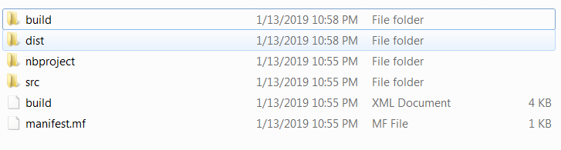
Project Directory Sub Directories

Slide 12
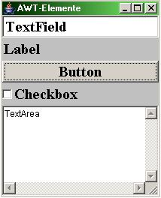
Java Graphics: AWT
Abstract Window Toolkit (AWT) is Java's original windowing, graphics, and GUI widget toolkit
Introduced in JDK1.0
It is part of the Java Foundation Classes (JFC) — the standard API for developing GUI in Java programs
https://en.wikipedia.org/wiki/Abstract_Window_Toolkit
API details:
  https://docs.oracle.com/javase/8/docs/api/java/awt/package-summary.html

Slide 13
Java Graphics: SWING
“SWING” is the codename of lightweight JFC GUI components.
Provide a more sophisticated GUI components than AWT and platform independent
API Documentation: https://docs.oracle.com/javase/7/docs/api/javax/swing/package-summary.html
We will utilize SWING in this class

Slide 14
SWING Features
The Swing Components
    Dialog, Pane, Buttons, Label, File Chooser, Menu...
Pluggable Look and Feel
Accessibility API
    E.g, Screen readers
Java 2DTM API
Drag and Drop
    Between Java applications and native applications.
Extensible

Slide 15
Swing Components
Swing provides many standard GUI components such as buttons, lists, menus, and text areas…
Swing provides containers such as windows and tool bars.
  Top level: frames, dialogs
  Intermediate level: panel, scroll pane, tabbed pane, ...
  Other Swing components: buttons, labels, menus…

Slide 16
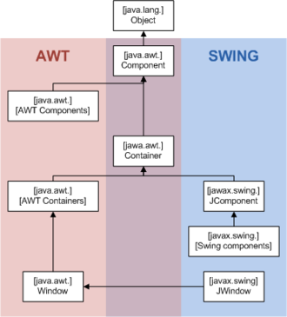
AWT and SWING Class Hierarchy

