Slide 1
CSCI230
JAVA Graphical User Interface
3

Slide 2
License Information
CSCI230 JAVA Graphical User Interface 3 by Gheni Abla is licensed under a Creative Commons Attribution 4.0 International License, except where otherwise noted.
The CC-BY license excludes the images in this slide deck. The creators of the images retain their rights.

Slide 3
Topics
Containers
Top level containers
JFrame - Hands-on coding
JLabel - Hands-on coding
Font drawing – Hands on coding

Slide 4
Containers
Components that can contain other components
Descendants of the java.awt.Container class
Use a layout manager to position and size the components contained in them.
Components are added to a container using one of the various forms of its add method
  Depending on which layout manager is used by the container
panel.add(component);

Slide 5
Three Types of Containers
Frame
  A window with its title and icons.
Panel
  A pure container and is not a window in itself.
  The purpose of a Panel is to organize the components on to a window.
Dialog
  A pop-up window that pops out when a message has to be displayed.

Slide 6
SWING Top Level Containers
Every program that presents a GUI contains at least one top-level container
A Top level container provides the support that SWING components needed in order to perform their painting and event-handling
SWING provides three top-level containers:
  JFrame (Main window)
  JDialog (Secondary window)
  JApplet (An applet display area within a browser window) - being deprecated and removed from Java

Slide 7
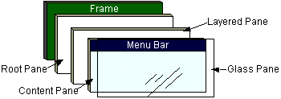
Top Level Containers (cont)
To appear on screen, every GUI component must be part of a containment hierarchy, with a top-level container as its root.
Each top-level container has a content pane that contains visible components in that top-level container’s GUI.
Don’t add a component directly to a top-level container.

Slide 8
Frame
Definition: A window that has decorations such as a border, a title and buttons for closing and iconifying the window
The frame implemented as an instance of the JFrame class,
  The decorations on a frame are platform dependent.
Applications with a GUI typically use at least one frame.

Slide 9
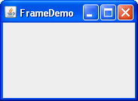
JFrame Decorations Exercise
Let’s identify the frame decorations such as a border, a title and buttons for closing and iconifying the window.

Slide 10
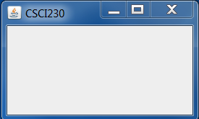
Code – Creating a Frame
import javax.swing.*;
public class Csci230_frame1{
public static void main(String[] args) {
JFrame frame = new JFrame();
frame.setSize(640,480);
frame.setTitle("CSCI230");
frame.setDefaultCloseOperation(JFrame.EXIT_ON_CLOSE);
//frame.pack();
frame.setVisible(true);
}
}

Slide 11
Code - Creating JFrame Using a Separate Method
public class Csci230_code2 extends JFrame{
public Csci230_code2() {
super("CSCI230");
setSize(640, 480);
//final JLabel label = new JLabel("Hello CSCI230");
//getContentPane().add(label);
//add(label);
setDefaultCloseOperation(JFrame.EXIT_ON_CLOSE);
//pack();
}
public static void main(String[] args) {
Csci230_code2 frame = new Csci230_code2();
frame.setVisible(true);
}
}
In this example a custom frame is created

Slide 12
JLabel
Label - A display area for a short text string, an image, or both
A label does not react to input events
Constructor
  public JLabel(String text)
  public JLabel(String text,int horizontalAlignment)
  public JLabel(Icon image, int horizontalAlignment)
  public JLabel(String text, Icon image)
  public JLabel(Icon image)

Slide 13

Code - Creating a Label

Slide 14
Fonts
Character
  A character is a symbol that represents an item such as a letter, a digit, or punctuation in an abstract way. For example, 'g', LATIN SMALL LETTER G, is a character.
Glyphs
  A glyph is a shape used to render a character
Font Family
  E.g, Serif, SansSerif, Monospaced, Dialog, and DialogInput
Font Face
  A Font have many faces, e.g., heavy, medium, oblique, gothic and regular

Slide 15
Font Drawing
Java has “Font” class
  Controls how a text is rendered
Font objects describe font family, font faces, size, directions etc.
Example:
Font font = new Font("Helvetica", Font.PLAIN, 14));

Slide 16

Code – Font Example
Let’s look at the csci230_label code again
Try to change the font family, font face etc…

Slide 17
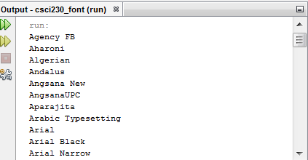
Code – Font Example
Csci230_font
Demonstrates to list font names of the local Graphics environment
The displayed results can be vary if run on different computers and Operating Systems

