Slide 1
CSCI230
JAVA Graphical User Interface
4

Slide 2
Topics
SWING class hierarchy
Frequently used SWING Components
Hands-on coding

Slide 3
License Information
CSCI230 JAVA Graphical User Interface 4 by Gheni Abla is licensed under a Creative Commons Attribution 4.0 International License, except where otherwise noted.
The CC-BY license excludes the images in this slide deck. The creators of the images retain their rights.

Slide 4
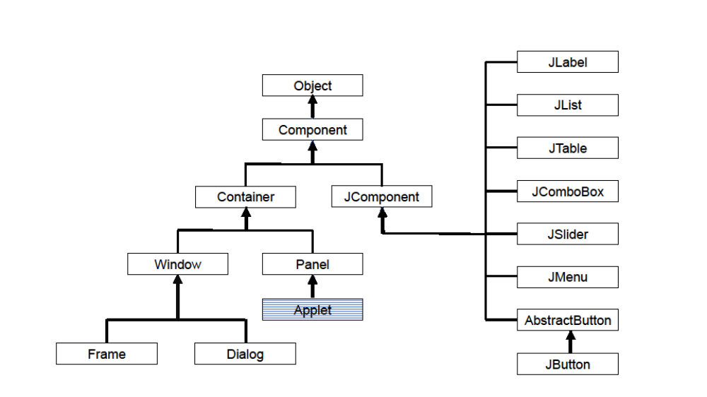
Java SWING Class Hierarchy

Slide 5
JButton
An implementation of a "push" button.
  Can be configured and controlled by action
  Will learn about actions later
Constructor
  JButton() => no text or icon
  JButton(Action a) =>Action supplied
  JButton(Icon icon) => with an icon.
  JButton(String text) =>with text.
  JButton(String text, Icon icon) => with text & icon
See for details at: https://docs.oracle.com/javase/8/docs/api/javax/swing/JList.html

Slide 6
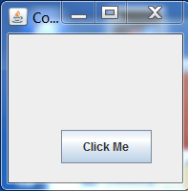
Code - JButton
An implementation of a "push" button.

Slide 7
JTextField
Lightweight component that allows the editing of a single line of text
  Can be configured and controlled by action
  Will learn actions later
Constructor
  JTextField() => creates new text field
  JTextField(int cols) => text field with the number of columns
  JTextField(String t) => text field initialized with t
  JTextField(String t, int c) => text field initialized with t & cols
See for details at: https://docs.oracle.com/javase/8/docs/api/javax/swing/JTextField.html

Slide 8
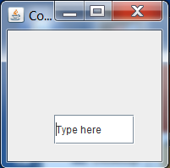
Code - JTextField
An implementation of a text field.

Slide 9
JTextArea
A multi-line area that displays plain text
  Can be configured and controlled by action
  Will learn actions later
Constructor
  JTextArea() => creates new text area
  JTextArea(int rows, int col) => with the rows & columns
  JTextArea(String t) => text area initialized with t
  JTextArea(String t, int rows, int columns) => text field initialized with t and specified rows and cols
See for details at: https://docs.oracle.com/javase/8/docs/api/javax/swing/JTextArea.html

Slide 10
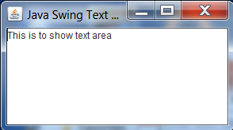
Code - JTextArea
An implementation of a text area.

Slide 11
JList
A component that displays a list of objects & allows the user to select one or more items
  String[] data = {"one", "two", "three", "four"};
  JList<String> myList = new JList<String>(data);
Constructor
  JList() => empty list
  JList(E[] data) => elements in the specified array
See for details at: https://docs.oracle.com/javase/8/docs/api/javax/swing/JList.html

Slide 12
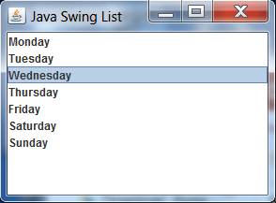
Code - JList
An implementation of a list.

