Slide 1
CSCI230
JAVA Graphical User Interface
5

Slide 2
License Information
CSCI230 JAVA Graphical User Interface 5 by Gheni Abla is licensed under a Creative Commons Attribution 4.0 International License, except where otherwise noted.
The CC-BY license excludes the images in this slide deck. The creators of the images retain their rights.

Slide 3
Topics
Layout
Layout management
Layout managers

Slide 4



Layout
The process of determining the size and position of components in a container
Similar to newspaper layouts

Slide 5
Layout Management
Layout management is often performed using layout mangers
  Components can provide size and position hints to layout managers, but layout managers have the final say on the size and position of those components.

Slide 6
Layout Management (cont)
Layout hints
  Preferred minimum and maximum size
  X axis alignment, Y axis alignment
Customizing layout hints
  Invoking setter methods: setMinimumSize, setAlignmentX, ...
  Subclassing and overriding the getter methods: getMinimumSize, getAlignmentX, ...

Slide 7
Java Provides Multiple Layout Managers
BorderLayout
BoxLayout
CardLayout
FlowLayout
GridBagLayout
GridLayout
GroupLayout
SpringLayout

Slide 8
Using Layout Manager
“add” method puts the components into container
When using the add method to put a component into a container, the container’s layout manager must be taken into account.
  Relative position (BorderLayout)
  panel.add(component, BorderLayout.CENTER);
  Order of addition (BoxLayout, GridLayout, ...)
  panel.add(component);

Slide 9
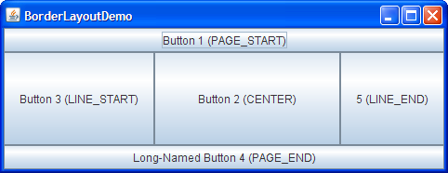
BorderLayout
Has five areas available to hold components
  north, south, east, west and center
All extra space is placed in the center area
  Only the center area is affected when the container is resized.
Default layout manager of content panes.

Slide 10
Code – BorderLayout
csci230_borderlayout.java
Exercise: Please modify the code so that the label2 is displayed on the south border.

Slide 11
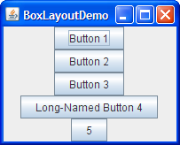
BoxLayout
Places components in a single row (left to right) or column (top to bottom).
Respects component’s maximum size and alignment hints.

Slide 12
Code – BoxLayout Example
Csci230_boxlayout.java
Exercise: Please modify the code so that the labels are displayed horizontally.

Slide 13
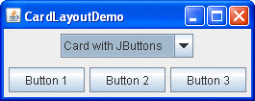
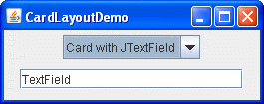
CardLayout
Same area can contain different components at different times

Slide 14

FlowLayout
Places components from left to right
Starts new rows if necessary.

Slide 15
Code – FlowLayout Example
Csci230_flowlayout.java

Slide 16
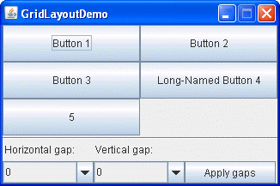
GridLayout
Puts components in a requested # of rows & columns
Components placed left-to-right and top-to-bottom
Forces all components to be the same size
  as wide as the widest component's preferred width
  as high as the highest component’s preferred height

Slide 17
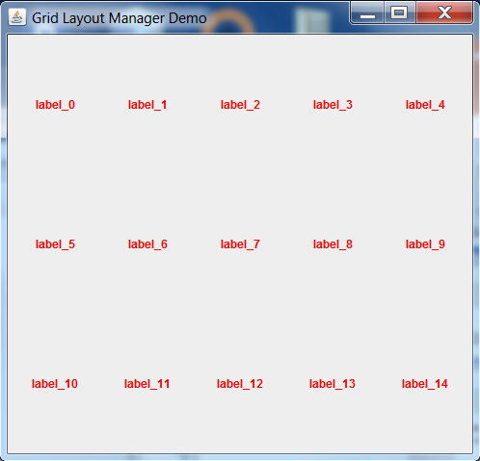
Code – Grid Layout Example
Csci230_gridlayout.java
Exercise: Please modify the code so that labels are displayed in 3 x 5 format.

Slide 18
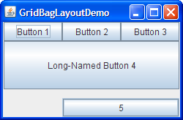
GridBagLayout
Aligns components by placing them within a grid of cells, allowing components to span more than one cell
The rows in the grid can have different heights, and grid columns can have different widths

Slide 19
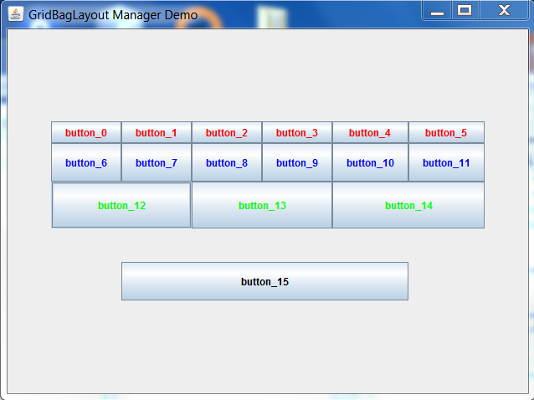
Code – GridBag Layout Example
Csci230_gridbaglayout.java
Exercise: Please modify the code so that only button_12 and button_14 are displayed at row number 3.

Slide 20
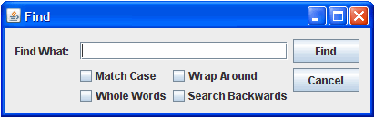
GroupLayout
Works with the horizontal and vertical layouts separately
The layout is defined for each dimension independently
Consequently, however, each component needs to be defined twice in the layout.

Slide 21
GroupLayout
Exercise: Please create a program that demonstrates the GroupLayout manager.

Slide 22

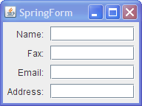
SpringLayout
Lets you specify precise relationships between the edges of components under its control.
  For example, you might define that the left edge of one component is a certain distance (which can be dynamically calculated) from the right edge of a second component.

Slide 23
Code – Spring Layout Example
Exercise: Please create a program that demonstrates the SpringLayout manager.

Slide 24
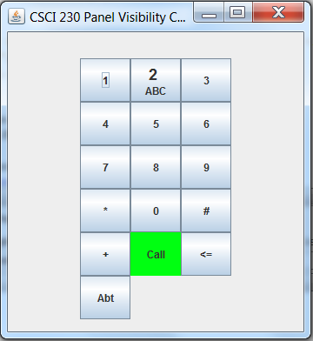
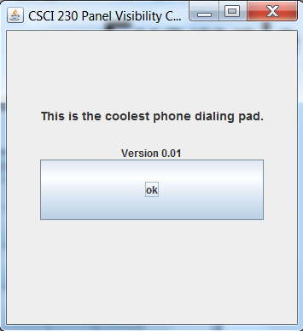
Code – Panel Visibility Example
Csci230_panelvisibility.java
Changes the visibility of panels

