Slide 1
CSCI230
JAVA Graphical User Interface
6

Slide 2
License Information
CSCI230 JAVA Graphical User Interface 6 by Gheni Abla is licensed under a Creative Commons Attribution 4.0 International License, except where otherwise noted.
The CC-BY license excludes the images in this slide deck. The creators of the images retain their rights.

Slide 3
Topics
Events
Event handling
Different types of events

Slide 4
Introduction to Events
Event occurs in many situations
  Every time a user types a character or pushes a mouse button
  Every time an internet connection is established
  A window is resized or moved or closed
  When the timer fires an event
There is an event source and event type
An event must be “listened” to capture or act on it

Slide 5

Event Handling
Any object can be notified of an event by registering as an event listener on the appropriate event source.
Multiple listeners can register to be notified of events of a particular type from a particular source
Example:

Slide 6
Different Types of Event Listeners
Act that results in event | Listener type
User clicks a button, presses Return while typing in a text field, or chooses a menu item | ActionListener
User closes a frame (main window) | WindowListener
User presses a mouse button while the cursor is over a component | MouseListener
User moves the mouse over a component | MouseMotionListener
Component becomes visible | ComponentListener
Component gets the keyboard focus | FocusListener
Table or list selection changes | ListSelectionListener

Slide 7
Implementation Steps of an Event Handler
Step1: Implement a listener interface or extend a class that implements a listener interface
Step2: Register an instance of the event handler class as a listener upon one or more components
Step3: Implement the methods in the listener interface to handle the event

Slide 8
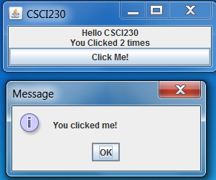
Code – Action Handler Example
Csci230_buttonaction.java

Slide 9
Code – ActionListener Interface Example
Csci230_actionlistenerinterface.java
This code implements ActionListener interface

Slide 10
Pop-up Message Boxes
SWING provides several pop-up message or dialog boxes
  Simple pop-up message:
  JOptionPane.showMessageDialog(frame, “Print completed!");
  Pop-up message with custom title, warning icon:
  JOptionPane.showMessageDialog(frame, “Out of paper!“, “Warning",
  JOptionPane.WARNING_MESSAGE);
  Pop-up message with custom title, error icon:
  JOptionPane.showMessageDialog(frame, “Jammed!“, “Error",
  JOptionPane.ERROR_MESSAGE);

Slide 11
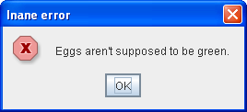
Code - Message Boxes Example
Exercise: Please create a program which displays the error message box shown below.

Slide 12
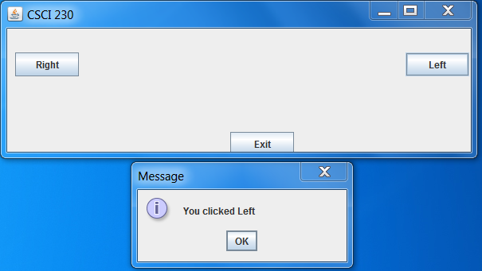
Code – Action Listener and Message Boxes Example
Csci230_actionlistener2.java
  This code is an example to demonstrate more sophisticated action listener, message box and layout manager.
Exercise: Please create a program which displays a “center” button and shows a proper message box when the “center” button is pressed.

Slide 13
Code – Center the Window Automatically
Csci230_actionlistener2.java
This code is an example to demonstrate more sophisticated action listener, message box and layout manager.
Exercise: Please create a program which displays a “center” button and shows a proper message box when the “center” button is pressed

Slide 14
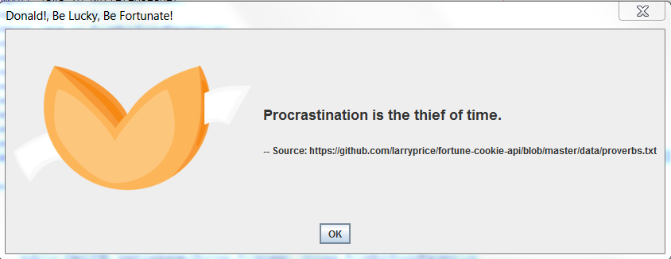
Code – Option Pane
Csci230_joptionpane.java
This code is an example to demonstrate JOptionPane

Slide 15
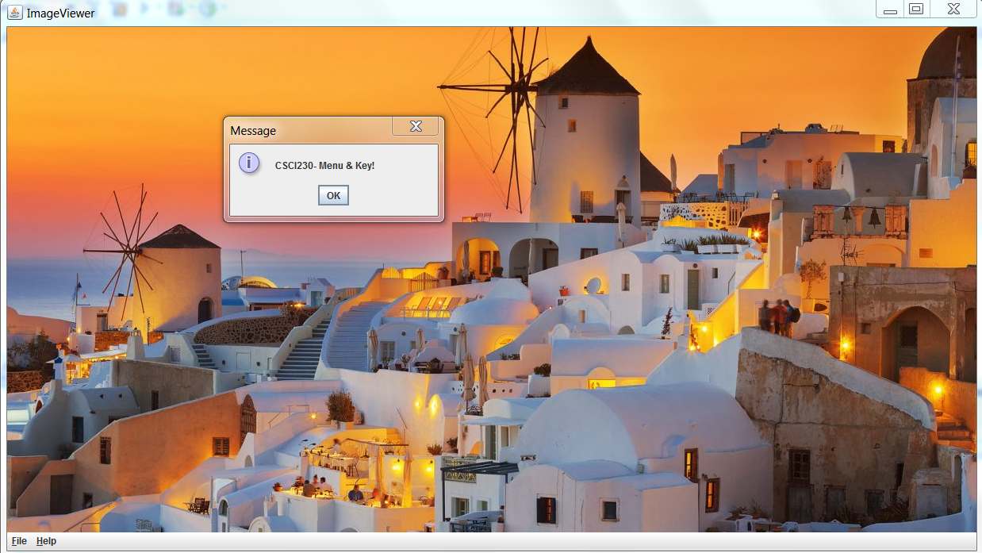
Code – MenuKey
Csci230_menukey.java
Demonstrates:
  Keyboard Mnemonics
  Key Accelarators
  Adding the menu to content pane (instead of jFrame)

Slide 16
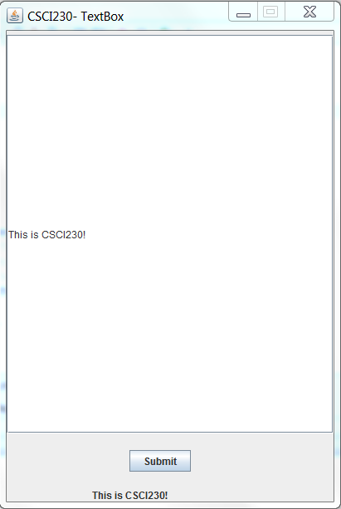
Code – Text Box 2
Csci230_textbox2.java
Demonstrates:
  Textbox with actions

Slide 17
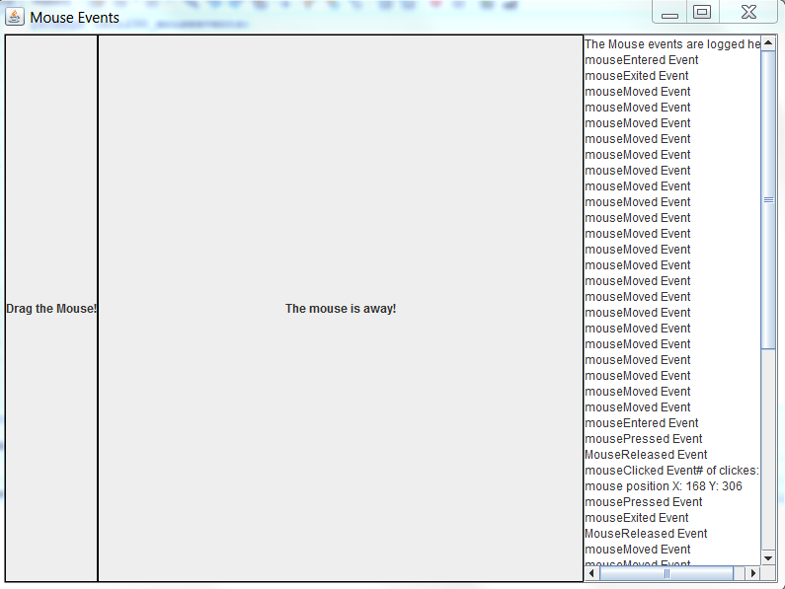
Code – Mouse Events
Csci230_mouseevents.java
Demonstrates:
  Capturing mouse events and
  processing them

