Slide 1
JAVA Graphical User Interface
7

Slide 2
License Information
CSCI230 JAVA Graphical User Interface 7 by Gheni Abla is licensed under a Creative Commons Attribution 4.0 International License, except where otherwise noted.
The CC-BY license excludes the images in this slide deck. The creators of the images retain their rights.

Slide 3
Topics
Graphics Fundamentals
Imaging Fundamentals
Color
Image Transformations

Slide 4
Graphics Fundamentals
Java2D
  AWT has Graphics
  Swing always uses Graphics2D
Rendering
  Steps: Get Graphics2D object, Set attributes, Draw primitives
Graphic State
Graphics Primitives

Slide 5
Graphics vs. Graphics2D
Graphics
  public void paintComponent(Graphics g) {
  super.paintComponent(g);
  message to g
  }
Graphics2D (recommended)
  public void paintComponent(Graphics g) {
  super.paintComponent(g);
  Graphics2D g2d = (Graphics2D)g;
  message to g2}

Slide 6
Rendering Operations
Shape
Text
Image
Default Rendering Attributes:
  Paint
  Font
  Stroke
  Transform
  Composite
  Clip

Slide 7
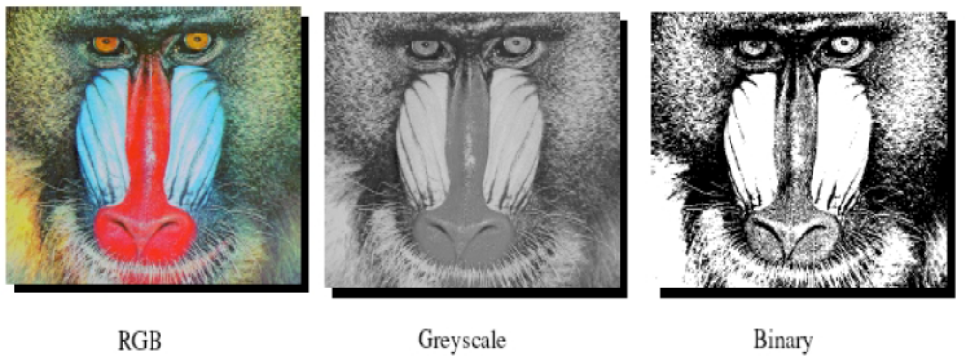
Imaging Fundamentals
Each image pixel is brightness/intensity

Slide 8
Image Digitization
    Sampling
    Quantization

Slide 9
Color Images
Color image
  made up of pixels each of which holds three numbers corresponding to the red, green, and blue levels of the image at a particular location.
  Assuming 256 levels for each primary, each color pixel can be stored in three bytes (24 bits) of memory.

Slide 10
Color Spaces
  RGB
    - RGB uses additive color mixing
    - RGBA is RGB with an additional channel, alpha, to indicate transparency
  CMYK
    - CMYK uses subtractive color mixing used in the printing process

Slide 11
Transformation
Definition: A function that maps an object from one point to another
Types:
  Translation
  Scaling
  Rotation
  Reflection
  Shear

Slide 12
Transformation
Transformations can be concatenated:
  C = Translate * Scale * Rotate * Shear
Java Classes:
  AffineTransform ( java.awt.geom )
  AffineTransformOp ( java.awt.image )

Slide 13
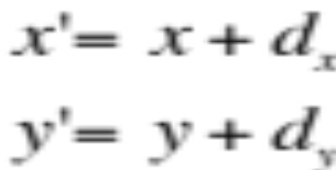
Translation
y
x

Slide 14
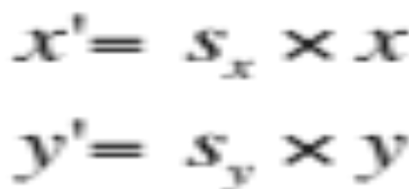
Scaling
y
x

Slide 15
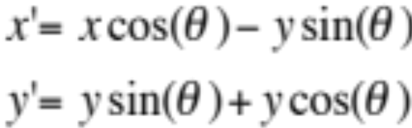
Rotation
y
x

Slide 16
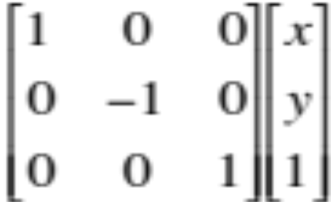
Reflection
y
x

Slide 17
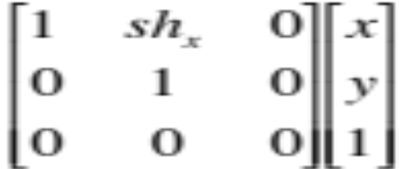
Sheer
y
x

Slide 18
Interpolation
Interpolation is a process of generating a value of a pixel based on its neighbors.
Types of Interpolation:
  Nearest-neighbor
  Linear
  Bilinear
  Trilinear
  Cubic

Slide 19
Bilinear Interpolation
P_{(x,y)}
P_{(x+1,y)}
d_{y}
d_{x}
P_{(x’,y’)}
P_{(x,y+1)}
P_{(x+1,y+1)}

Slide 20
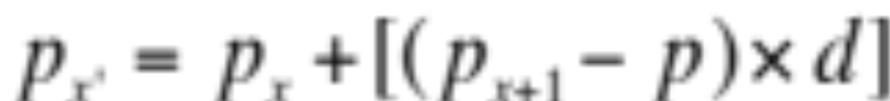
Linear Interpolation
d
Interpolated Pixel
p_{x}
P_{x’}
P_{(x+1)}
P_{(x+1)}
P_{x’}
p_{x}
x
x’
x+1

Slide 21
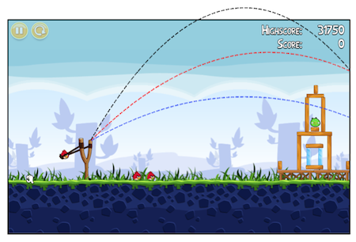

Animation Example
http://sites.davidson.edu/mathmovement/algebra-of-angry-birds/

Slide 22
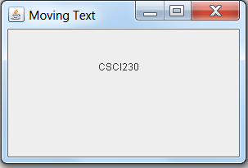
Code – Moving Text
Csci230_movingtext.java
Demonstrates translation & animation

Slide 23
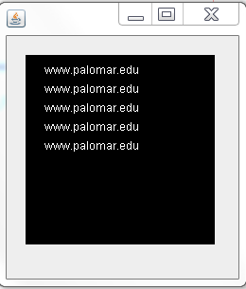
Code – Buffered Image
Csci230_bufferedimage.java
Demonstrates buffered image

Slide 24
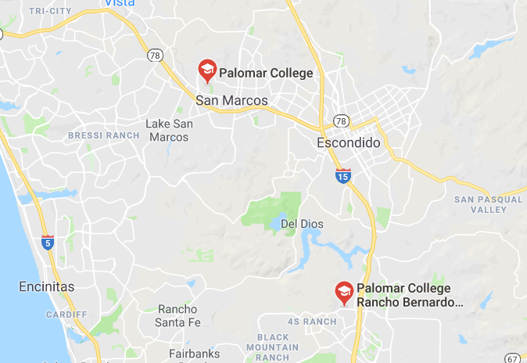
Code – Google Maps Static Map Image
Csci230_googlemapimage.java
Demonstrates map image & 2D drawing

Slide 25
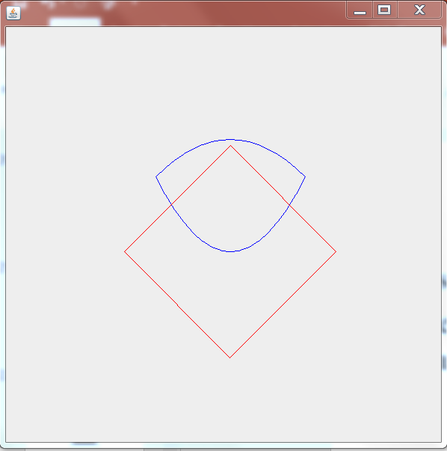
Code – Bezier Curve
Csci230_bezier.java
Demonstrates drawing bezier curve, translation, rotation

Slide 26
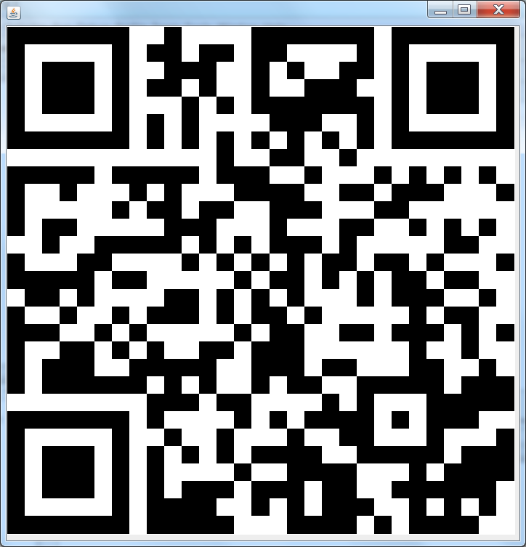
Code – QR Code
Csci230_qrcode.java
Demonstrates display of a QR code generated via API

