Slide 1
JAVA Graphical User Interface
8

Slide 2
License Information
CSCI230 JAVA Graphical User Interface 8 by Gheni Abla is licensed under a Creative Commons Attribution 4.0 International License, except where otherwise noted.
The CC-BY license excludes the images in this slide deck. The creators of the images retain their rights.

Slide 3
Topics
Java Concurrency
Process vs. Thread
SWING Concurrency
SWING Event Threads

Slide 4
Java Concurrency
Of the Programs need to more than one task at a time – Concurrent Software
  E.g streaming audio application simultaneously read the digital audio off the network, decompress it, manage playback, and update its display
  word processor always be ready to respond to keyboard/mouse events, no matter how busy it is reformatting text or updating the display.
Java supports concurrency
  Basic concurrency support in the Java Language and libs
  Starting Version 5.0, provide high level APIs in java.util.concurrent

Slide 5
Process and Thread
A process has a self-contained execution environment. A process generally has a complete, private set of basic run-time resources; in particular, each process has its own memory space.
  To facilitate communication between processes, most operating systems support Inter Process Communication (IPC) resources, such as pipes and sockets.
Threads are sometimes called lightweight processes. Threads share the process's resources, including memory and open files.
  More efficient but problematic

Slide 6
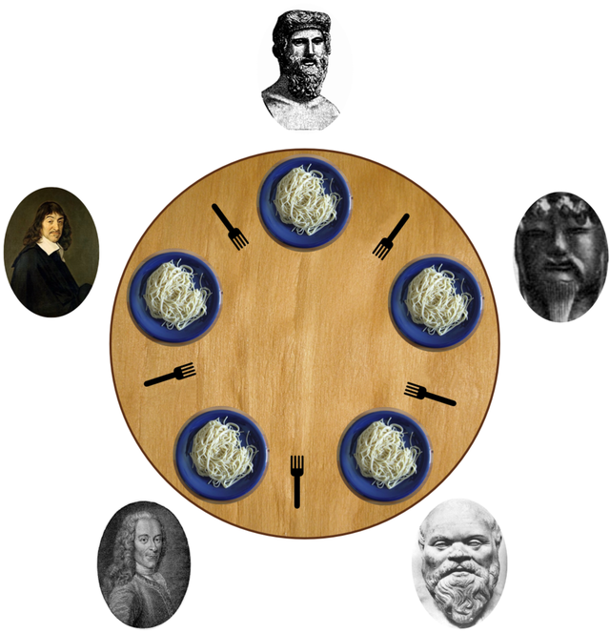
Example of Thread Problems – Dining Philosophers

Slide 7
In Java, there are two ways of defining and starting a thread
Provide a Runnable object
  The Runnable interface defines a single method, run, meant to contain the code executed in the thread. The Runnable object is passed to the Thread constructor
Subclass Thread
  The Thread class itself implements Runnable, though its run method does nothing. An application can subclass Thread, providing its own implementation of run

Slide 8
sleep() and join() methods
  Thread.sleep() causes the current thread to suspend execution for a specified period.
  Example: Thread.sleep(4000) //pauses 4 seconds
The join() method allows one thread to wait for the completion of another
  If t is a Thread object whose thread is currently executing, t.join() causes the current thread to pause execution until t's thread terminates.

Slide 9
Interrupts
  An interrupt is an indication to a thread that it should stop what it is doing and do something else
    Example 1:
    for (int i = 0; i < importantInfo.length; i++) {
    try {
    Thread.sleep(4000)
    } catch (InterruptedException e) {
    return;
    }
    Example 2:
    if (Thread.interrupted()) { throw new InterruptedException(); }

Slide 10
Codes – Runnable & Thread1
  Csci230_runnable.java
    - Demonstrates runnable Interface
  Csci230_thread1.java
    - Demonstrates thread Class

