Slide 1
Molecular Bioactivity Prediction
Prml Project Report – Progress Report
Sayyam Palrecha - EE22BTECH11047

Slide 2
Introduction
What is Molecular Bioactivity Prediction?
Predicts whether a chemical compound will be biologically active against a specific target (e.g., protein, receptor).
Used in early drug discovery to filter out non-promising molecules before expensive laboratory experiments.
Input: molecular structure (SMILES/graph) → Output: Active / Inactive (binary classification)
Drug discovery is slow (10-12 years) and expensive. Only 1 out of ~10,000 compounds reaches the market.
Predicting bioactivity computationally allows:
  Rapid screening of millions of molecules
  Cost reduction in wet-lab experiments
  Shortened discovery cycle
Method | How it works | Drawbacks
QSAR (Quantitative Structure–Activity Relationship) | Hand-crafted descriptors (physicochemical features, fingerprints) used with ML models | Limited ability to generalize across chemical space
Docking / molecular simulation | Physically places molecule in a target binding site | Computationally expensive; sensitive to conformation and scoring bias
Rule-based filters (Lipinski, PAINS) | Hard-coded heuristics to eliminate bad molecules | Not predictive; only filters candidates
The table shows: Traditional Approaches (Classical/QSAR Methods)

Slide 3
MOTIVATION/context
Why These Models?
We require a rapid, data-driven method to predict whether a compound is active or inactive before experimental validation.
Why Machine Learning (ML)?
Benefit | What It Solves in Drug Discovery
Learns relationships between molecular structure and bioactivity | Eliminates manual feature engineering (rules/QSAR)
Fast inference (milliseconds per molecule) | Enables virtual screening of millions of molecules
Works with small or moderate datasets | Ideal when experimental data is limited
Model | Why used in our project? | Strength
SVM | Strong baseline classifier for small datasets | Maximizes margin between Active / Inactive classes
Random Forest (RF) | Handles noisy and imbalanced chemical data | Robust, interpretable (feature importance)
XGBoost | Often state-of-the-art in tabular molecular data | Learns complex/non-linear feature interactions; efficient
Graph Neural Networks (GNN) | Learns directly from molecular graphs instead of fingerprints | Captures chemical structure + topology automatically
ML accelerates drug discovery by predicting molecular bioactivity without costly experiments.
GNNs go one step further — letting the model “see” the molecule as a graph of atoms and bonds, not just numbers.

Slide 4
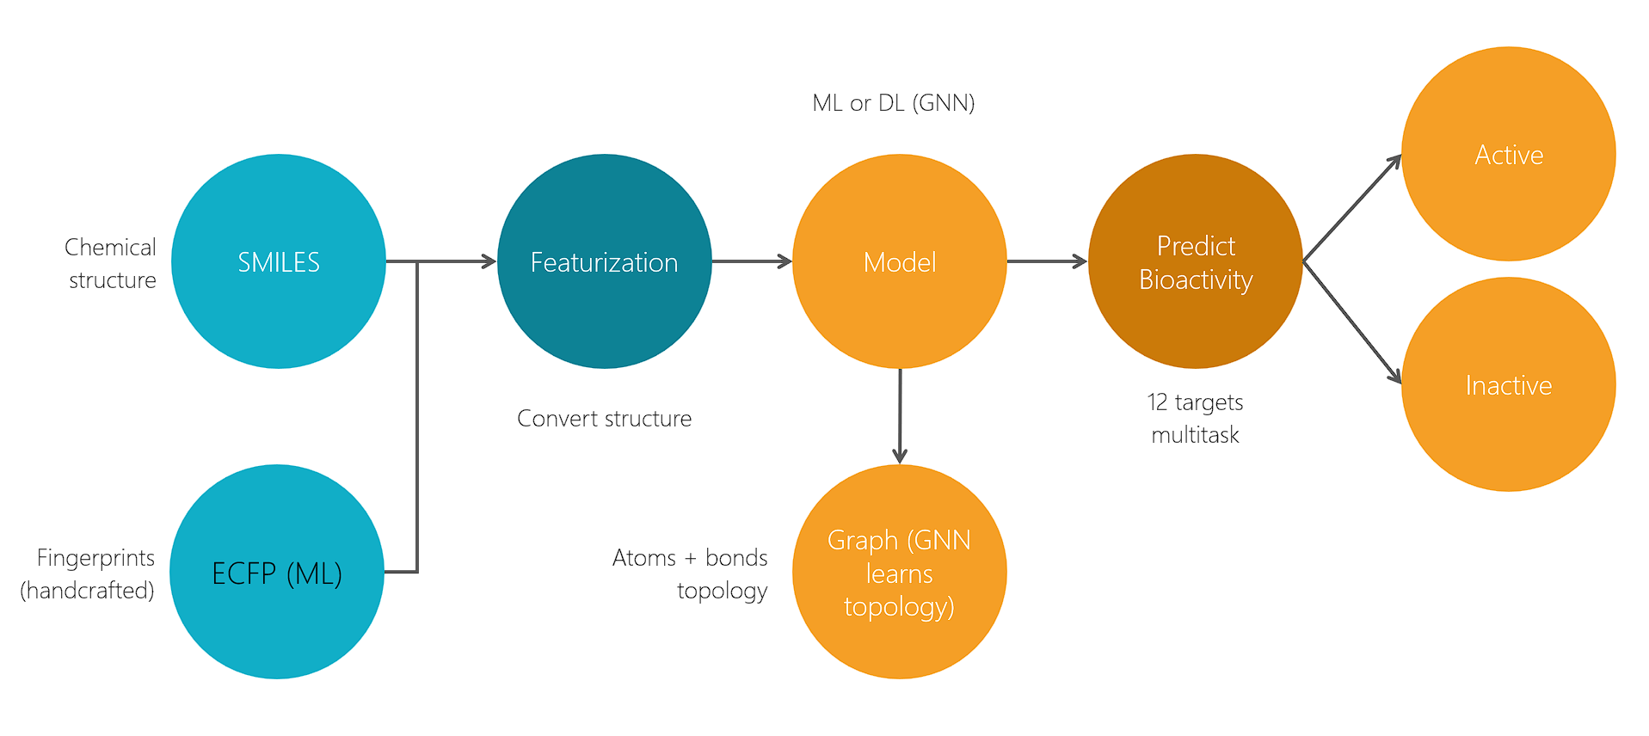
PROBLEM STATEMENT & PROJECT GOALS
Given molecular structures (SMILES), build a model that predicts bioactivity across multiple biological targets (Tox21 - 12 tasks), despite label imbalance and noisy data.
Specific Goals
  Train baseline ML models on fingerprint representations and optimize using imbalance handling + hyperparameter tuning
  Advance to Deep Learning (GNNs) to learn directly from molecular graphs
  Compare ML vs GNN performance and interpret learned molecular features
  Develop an SOTA-inspired hybrid modelling approach to overcome ML/DL limitations
Challenge | Meaning
Multi-task classification | One molecule → 12 outputs (bioactivity across targets)
Severe class imbalance | Very few Active vs many Inactive compounds
Feature representation problem | Fingerprints lose topological structure of molecules

Slide 5
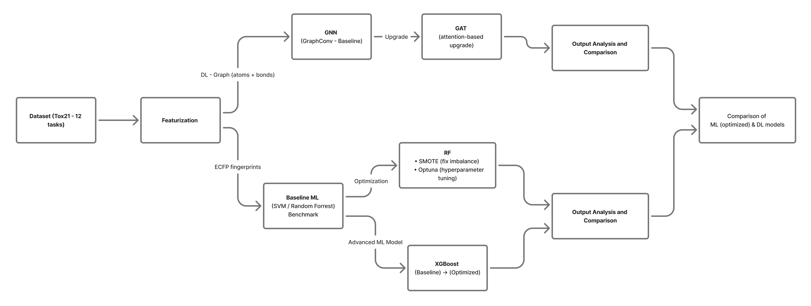
APPROACH (materials & methods)
Dataset Used: Tox21 (Toxicology in the 21st Century) - public benchmark for predictive toxicology.
  12 binary toxicity endpoints (Nuclear Receptors + Stress Response pathways)
  ~8,000 unique compounds (SMILES / SDF) with a multi-task, multi-label setup
  Strong class imbalance (far fewer actives than inactives)
Approach: From Baseline → Optimization → Deep Learning (flowchart)

Slide 6
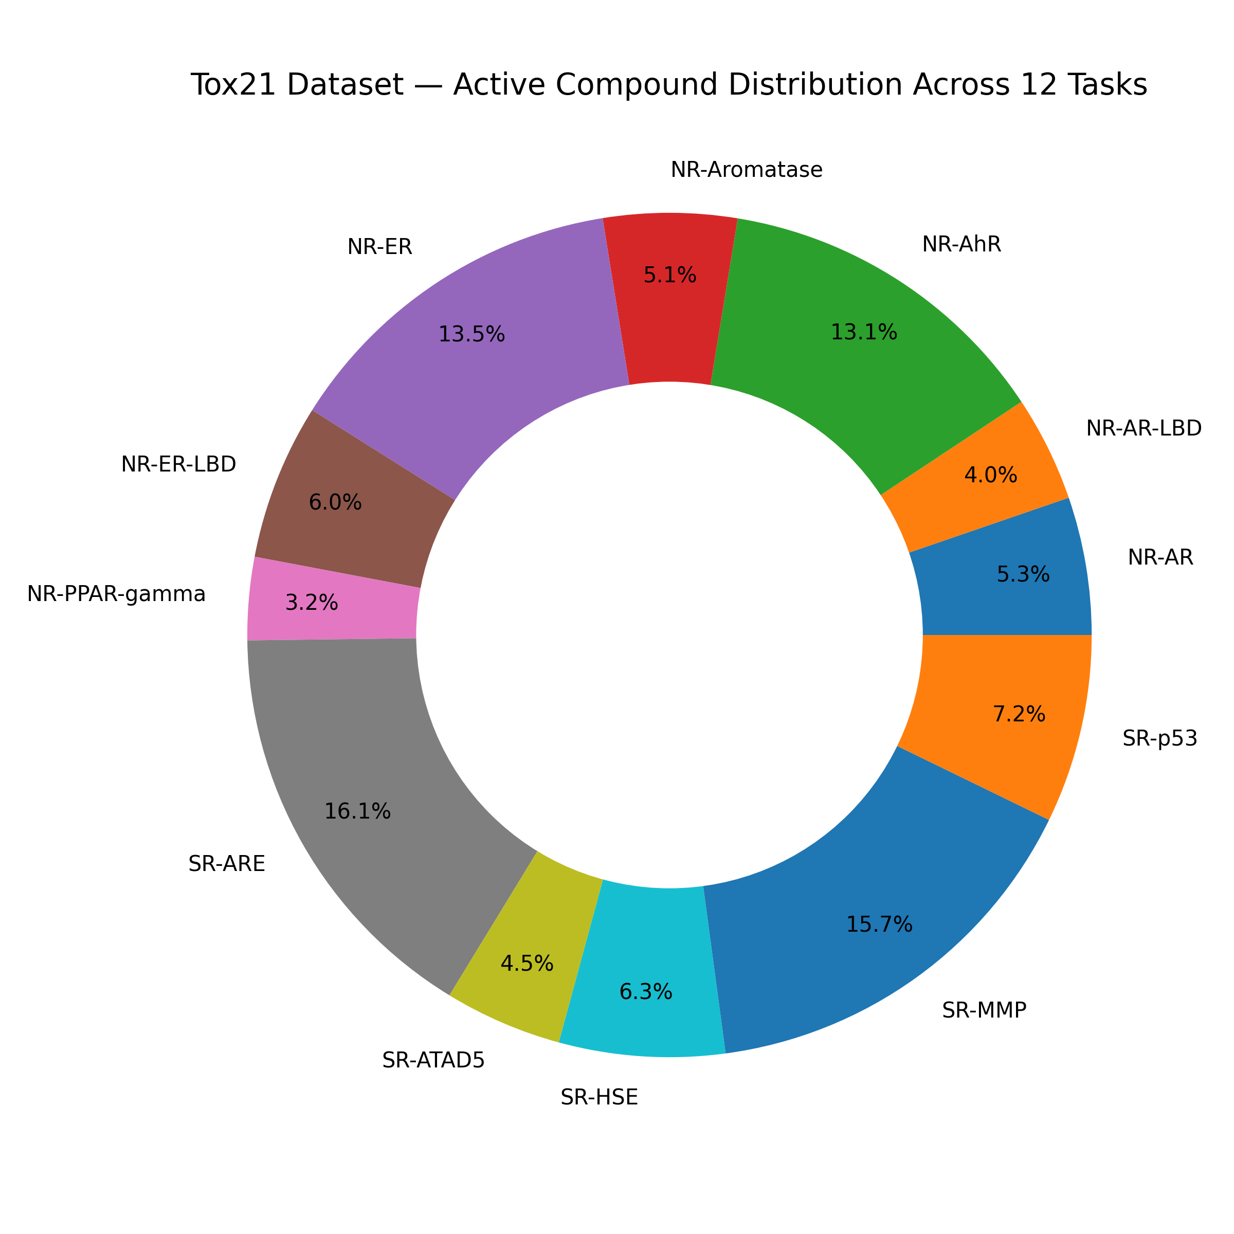
APPROACH (materials & methods)
Metrics Used:
ROC-AUC: How well the model separates Active vs Inactive compounds
PR-AUC: Performance under severe class imbalance
F1 Score: Balance between precision & recall
Precision/Recall: False positives vs false negatives trade-off
How results are analysed:
Compare metrics across models:
  Baseline ML → Optimized ML → GNN
Visual comparisons:
  Bar plots for ROC-AUC/PR-AUC
  Training time comparison

Slide 7
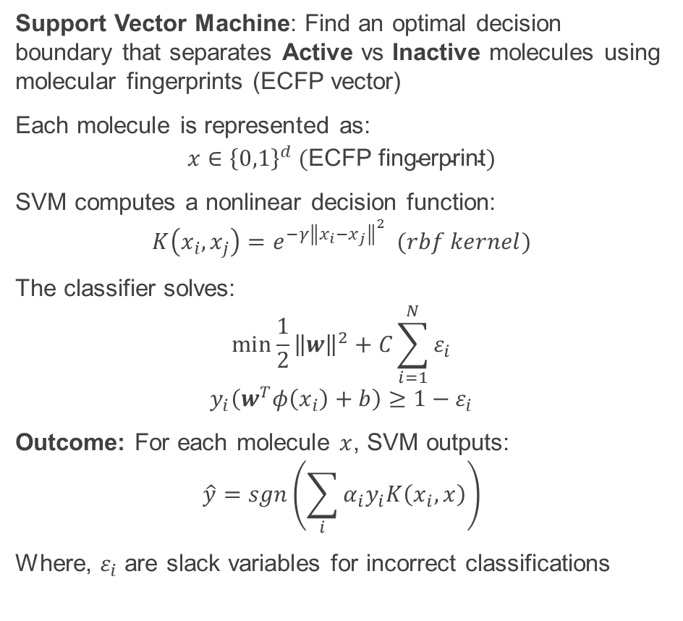
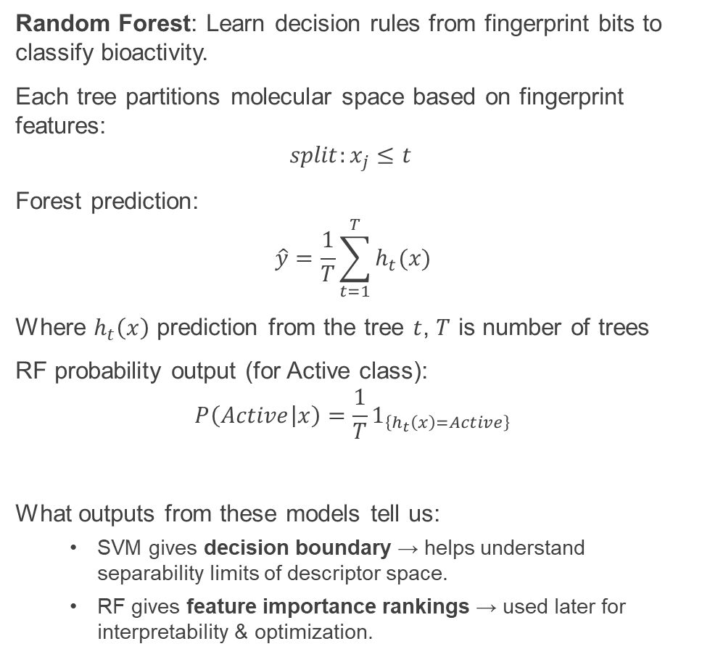
Implementation (Baseline: SVM & Random Forest)
Support Vector Machine: Find an optimal decision boundary that separates Active vs Inactive molecules using molecular fingerprints (ECFP vector)
Each molecule is represented as:
$$x∈{\left\{0,1\right\}}^{d} (\text{ECFP} \text{fingerprint})$$
SVM computes a nonlinear decision function:
$$K\left(x_{i},x_{j}\right)=e^{−γ{\left\|x_{i}−x_{j}\right\|}^{2}} (rbf kernel)$$
The classifier solves:
$$\min{\frac{1}{2}{\left\|w\right\|}^{2}+C\sum_{i=1}^{N}{ε_{i}}}$$
$$y_{i}\left(w^{T}φ\left(x_{i}\right)+b\right)≥1−ε_{i}$$
Outcome: For each molecule $x$, SVM outputs:
$$\hat{y}=sgn\left(\sum_{i}{α_{i}y_{i}K\left(x_{i}, x\right)}\right)$$
Where, $ε_{i}$ are slack variables for incorrect classifications
Random Forest: Learn decision rules from fingerprint bits to classify bioactivity.
Each tree partitions molecular space based on fingerprint features:
$$split:x_{j}≤t$$
Forest prediction:
$$\hat{y}=\frac{1}{T}\sum_{t=1}^{T}{h_{t}(x)}$$
Where $h_{t}\left(x\right)$ prediction from the tree $t$, $T$ is number of trees
RF probability output (for Active class):
$$P\left(Active | x\right)=\frac{1}{T}1_{\left\{h_{t}\left(x\right)=Active\right\}}$$
What outputs from these models tell us:
  SVM gives decision boundary → helps understand separability limits of descriptor space.
  RF gives feature importance rankings → used later for interpretability & optimization.

Slide 8
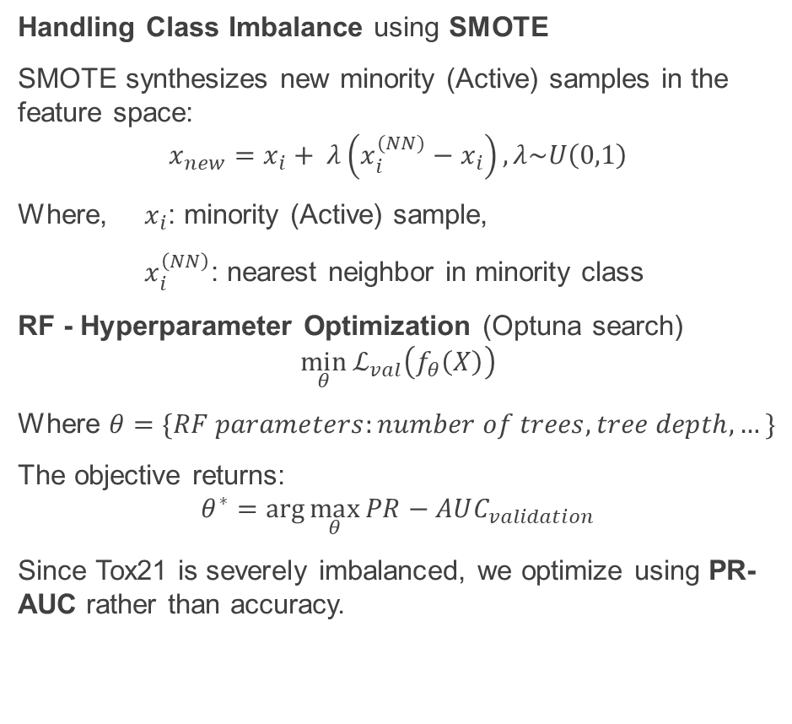
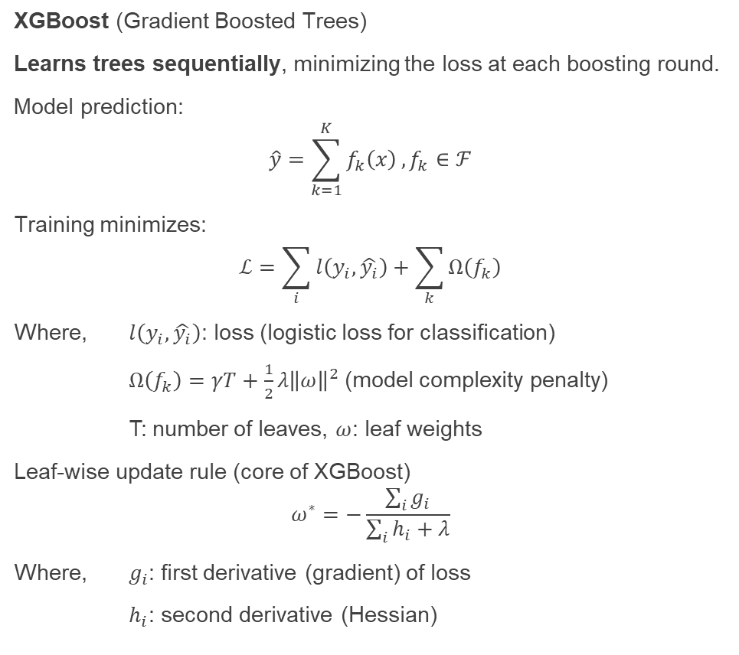
Implementation (Optimized RF & XGBoost)
Handling Class Imbalance using SMOTE
SMOTE synthesizes new minority (Active) samples in the feature space:
$$x_{new}=x_{i}+ λ\left(x_{i}^{(NN)}−x_{i}\right), λ\sim U\left(0,1\right)$$
Where, $x_{i}$: minority (Active) sample,
$x_{i}^{\left(NN\right)}$: nearest neighbor in minority class
RF - Hyperparameter Optimization (Optuna search)
$$\min_{θ}{ℒ_{val}\left(f_{θ}\left(X\right)\right)}$$
Where $θ=\{RF parameters:number of trees, tree depth, …\}$
The objective returns:
$$θ^{∗}=\arg{\max_{θ}{PR−AUC_{validation}}}$$
Since Tox21 is severely imbalanced, we optimize using PR-AUC rather than accuracy.
XGBoost (Gradient Boosted Trees)
Learns trees sequentially, minimizing the loss at each boosting round.
Model prediction:
$$\hat{y}=\sum_{k=1}^{K}{f_{k}\left(x\right)},f_{k}∈ℱ$$
Training minimizes:
$$ℒ=\sum_{i}{l\left(y_{i},\hat{y_{i}}\right)}+\sum_{k}{Ω\left(f_{k}\right)}$$
Where, $l\left(y_{i},\hat{y_{i}}\right)$: loss (logistic loss for classification)
$Ω\left(f_{k}\right)=γT+\frac{1}{2}λ{\left\|ω\right\|}^{2}$(model complexity penalty)
T: number of leaves, $ω$: leaf weights
Leaf-wise update rule (core of XGBoost)
$$ω^{∗}=−\frac{\sum_{i}{g_{i}}}{\sum_{i}{h_{i}}+λ}$$
Where, $g_{i}$: first derivative (gradient) of loss
$h_{i}$: second derivative (Hessian)

Slide 9
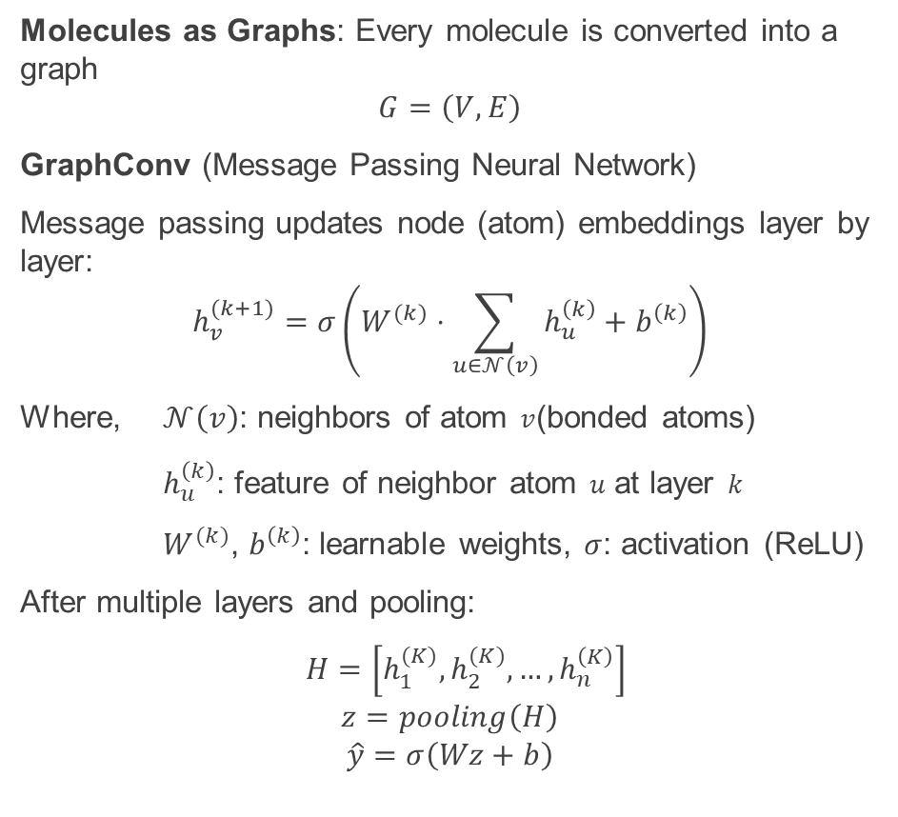
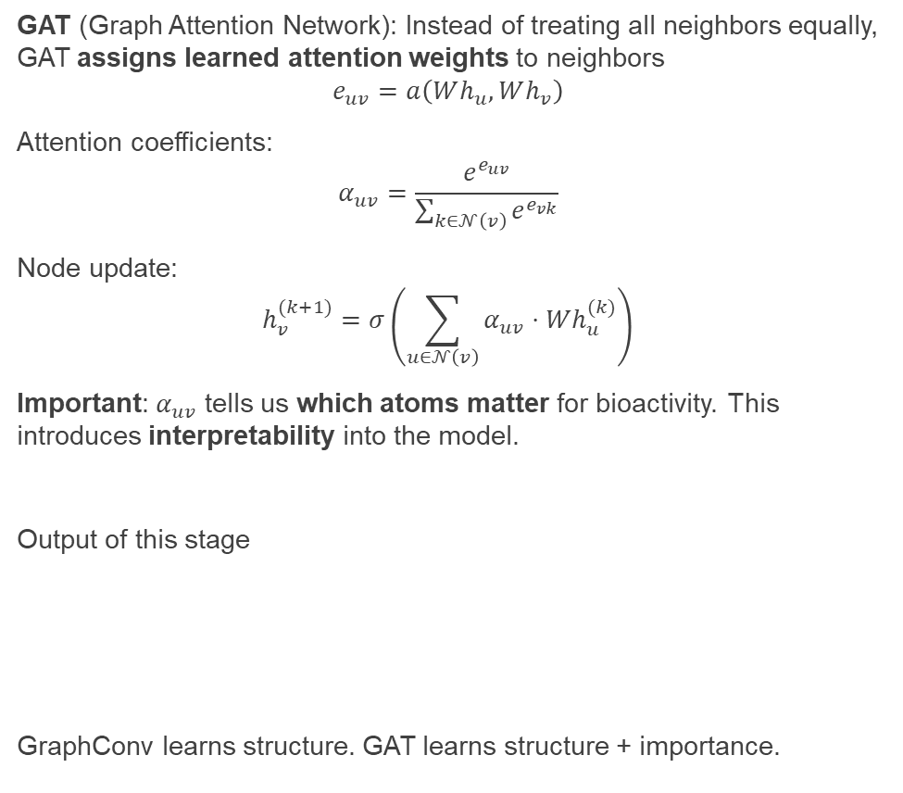
Implementation (DL: GraphConv → GAT)
Molecules as Graphs: Every molecule is converted into a graph
$$G=\left(V,E\right)$$
GraphConv (Message Passing Neural Network)
Message passing updates node (atom) embeddings layer by layer:
$$h_{v}^{(k+1)}=σ\left(W^{(k)}⋅\sum_{u∈𝒩\left(v\right)}{h_{u}^{\left(k\right)}}+b^{\left(k\right)}\right)$$
Where, $𝒩\left(v\right)$: neighbors of atom $v$(bonded atoms)
$h_{u}^{\left(k\right)}$: feature of neighbor atom $u$ at layer $k$
$W^{(k)}$, $b^{\left(k\right)}$: learnable weights, $σ$: activation (ReLU)
After multiple layers and pooling:
$H=\left[h_{1}^{(K)},h_{2}^{(K)},…, h_{n}^{\left(K\right)}\right]$
$$z=pooling\left(H\right)$$
$$\hat{y}=σ\left(Wz+b\right)$$
GAT (Graph Attention Network): Instead of treating all neighbors equally, GAT assigns learned attention weights to neighbors
$$e_{uv}=a\left(Wh_{u},Wh_{v}\right)$$
Attention coefficients:
$$α_{uv}=\frac{e^{e_{uv}}}{\sum_{k∈𝒩\left(v\right)}{e^{e_{vk}}}}$$
Node update:
$$h_{v}^{(k+1)}=σ\left(\sum_{u∈𝒩\left(v\right)}{α_{uv}⋅Wh_{u}^{(k)}}\right)$$
Important: $α_{uv}$​ tells us which atoms matter for bioactivity. This introduces interpretability into the model.
Output of this stage
GraphConv learns structure. GAT learns structure + importance.
Model | Output
GraphConv | Learns structural (topological) patterns
GAT | Learns which atoms contribute most to bioactivity

Slide 10
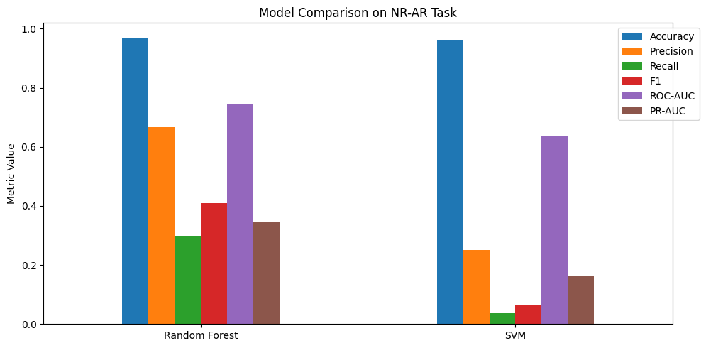
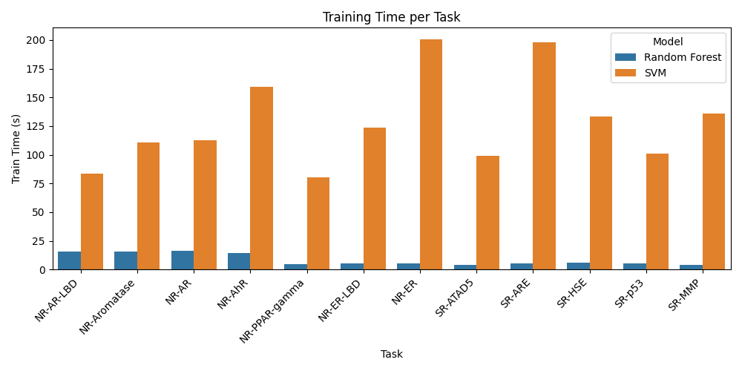
Intermediate results
For baseline ML models, RF and SVM (model comparison done for a single task) Train time comparison per task (RF vs SVM)
Model | Accuracy | Precision | Recall | F1-Score | ROC-AUC | PR-AUC | Train Time (s)
Random Forest | 0.9298 | 0.4333 | 0.0886 | 0.1376 | 0.6895 | 0.2324 | 8.50
SVM | 0.9266 | 0.3361 | 0.0702 | 0.1107 | 0.6769 | 0.2019 | 128.16

Slide 11
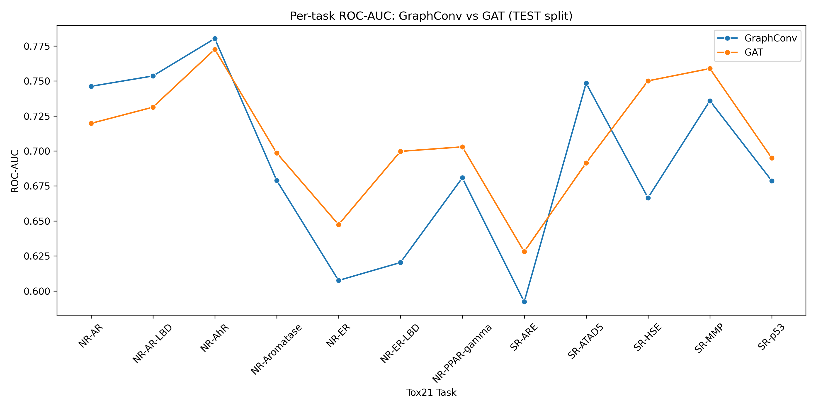
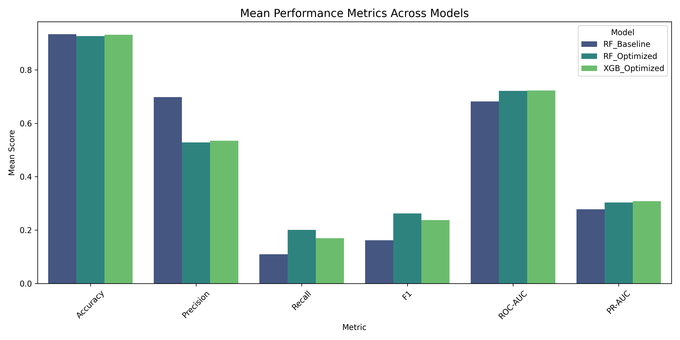
Intermediate results
Optimized RF and XGBoost - mean score comparison
Across Baseline and Optimized Models (for four tasks)
Improvement Over Baseline (Mean Across 4 Tasks)
GNN Results (Across all tasks):
Mean scores (Across all tasks):
Metric | RF Improvement | XGB Improvement
Accuracy | −0.75% | −0.20%
F1 Score | +62.05% | +46.49%
ROC-AUC | +5.87% | +6.03%
PR-AUC | +9.16% | +10.95%
Model | ROC-AUC (mean) | PR-AUC (mean)
GraphConv | 0.7154 | 0.2517
GAT | 0.7302 | 0.2185

Slide 12
KEY LEARNING & CHALLENGES SOLVED
Challenges and learning
Bioactivity dataset was highly imbalanced (very few Active molecules). Solved using SMOTE oversampling + cost-sensitive learning.
Baseline ML (RF/SVM) gave high accuracy but low recall, meaning actives were missed. Hyperparameter search (Optuna) improved Recall, F1, ROC-AUC and PR-AUC.
XGBoost outperformed RF in PR-AUC and ROC-AUC, confirming effectiveness on sparse chemical fingerprints.
GraphConv/GAT performed better in generalization across tasks. GAT gives the highest ROC-AUC value.
Observed that the attention mechanism (GAT) improves the learning of structural molecular features.
Key takeaways
Optimizing ML models required balancing recall vs precision.
GNNs demonstrated better chemical structure awareness than ECFP+ML models.
ML is fast & interpretable; GNN is powerful & scalable.

Slide 13
Future steps and References
Future Steps
Explore a hybrid ML + DL framework: Combine the strengths of classical ML models with GNNs to build a meta-model that utilises fingerprints + learned graph embeddings.
Investigate model-level optimization
  Evaluate techniques like feature selection + dimensionality reduction before SVM/ML models.
  Experiment with GNN hyperparameter tuning (GIN depth, attention heads, dropout, learning rate schedules) to improve performance & reduce training time.
References
“Toxicology in the 21st Century (Tox21)” - Dataset description (NIH/NCATS public documentation)
Chawla, N. V., et al. (2002). SMOTE: Synthetic Minority Over-sampling Technique.
Optuna Documentation — https://optuna.org/
Kipf, T. N., & Welling, M. (2017). Semi-Supervised Classification with Graph Convolutional Networks.
Veličković, P. et al. (2018). Graph Attention Networks.

