Slide 1
Rangeland Meeting
28th Feb

Slide 2
From Last Time
Based on our last discussion, we narrowed down our search space on two parameters:
Selection of counties based on the area of county covered by rangelands or the coverage %
Selection of grids based on the area of grid covered by rangelands

Slide 3
Filtering Based on Area covered by Rangelands
We have a total of 2355 counties that have at-least one pixel of their area covered by Rangelands.
Area = Area of county covered by rangelands(in acres)
Area | # of counties
<5M | 2345
<1M | 2186
<0.5M | 2042
<0.1M | 1581
<0.05M (50K) | 1459
<0.01M (10K) | 1192
<0.005 (5K) | 1077

Slide 4
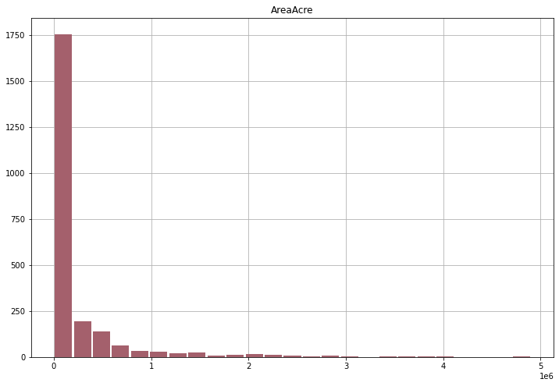
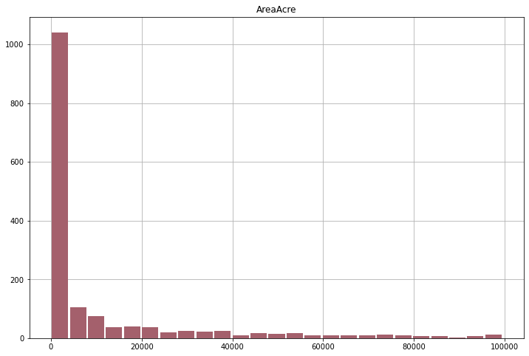
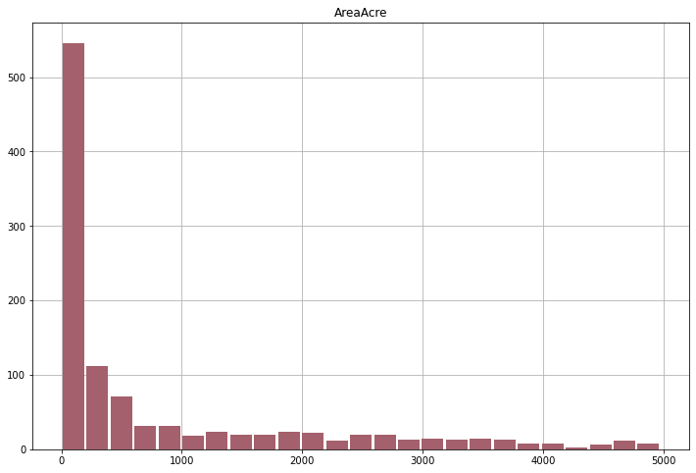
Histograms on Area (in acres)
5K
0.1M
5M

Slide 5
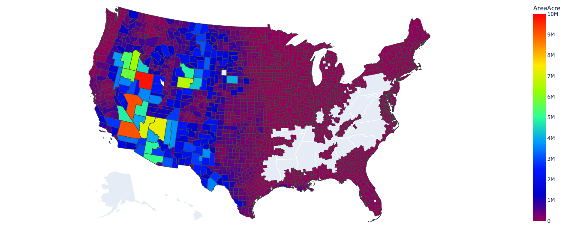
Map showing counties covered with rangelands – Area (in acres)

Slide 6
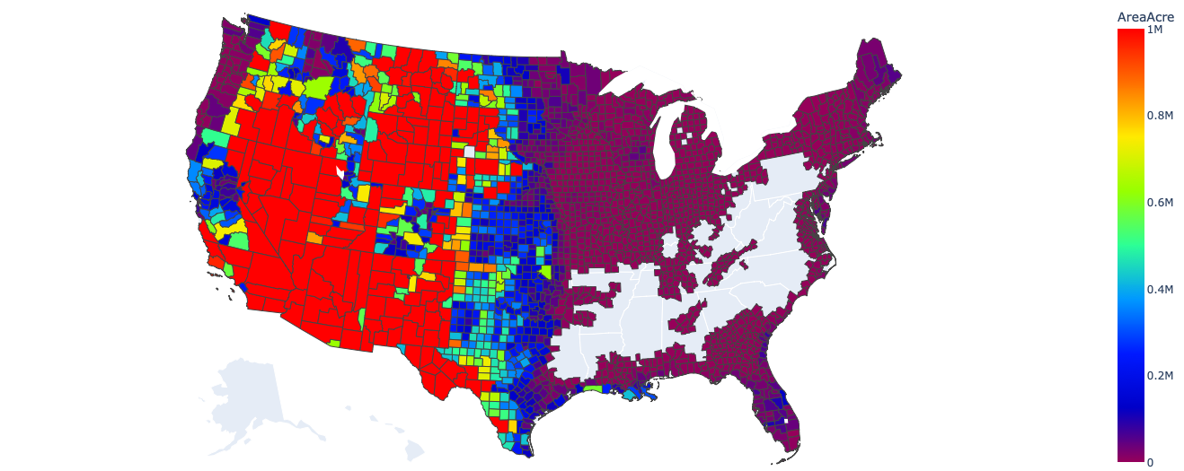
Map showing counties covered with rangelands – Area threshold set as 1 M

Slide 7
Filtering Based on Coverage %
We have a total of 2355 counties that have at-least one pixel of their area covered by Rangelands.
Coverage % = $\frac{\text{Area} \text{of} \text{county} \text{covered} \text{by} \text{Rangelands}}{\text{Total} \text{area} \text{of} \text{the} \text{county} }$ * 100
Coverage % | # of counties
<50 % | 1933
<20 % | 1579
<10 % | 1437
<5 % | 1315
<1 % | 1011

Slide 8
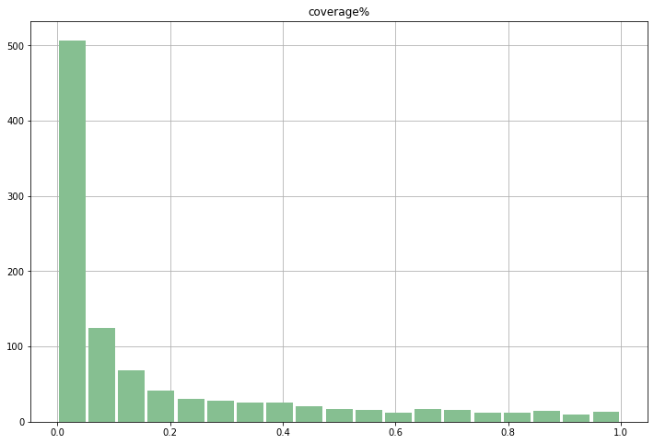
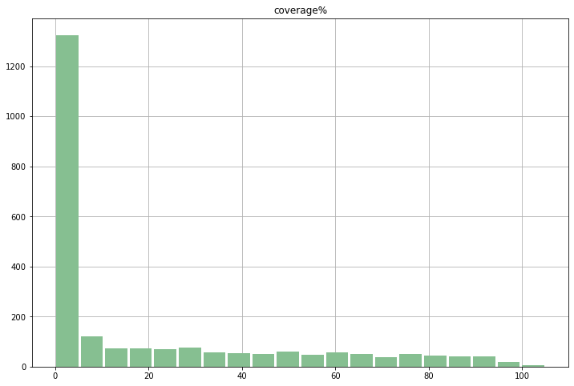
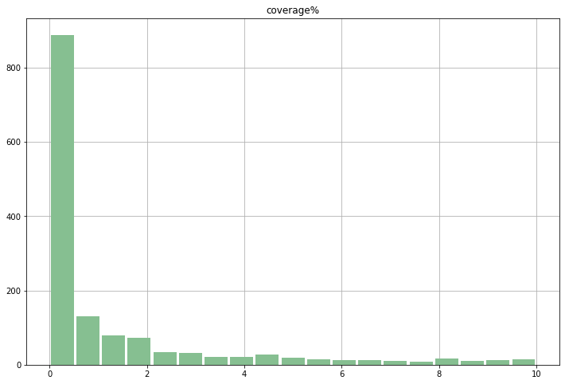
Histograms on Coverage %

Slide 9
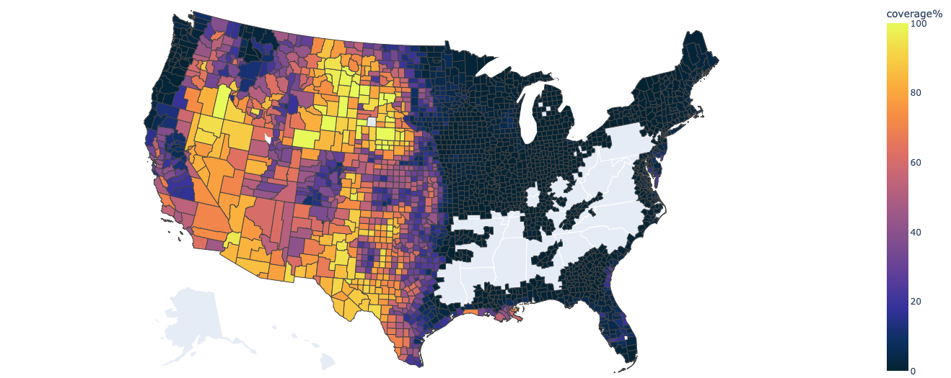
Map showing counties covered with rangelands – Coverage %

Slide 10
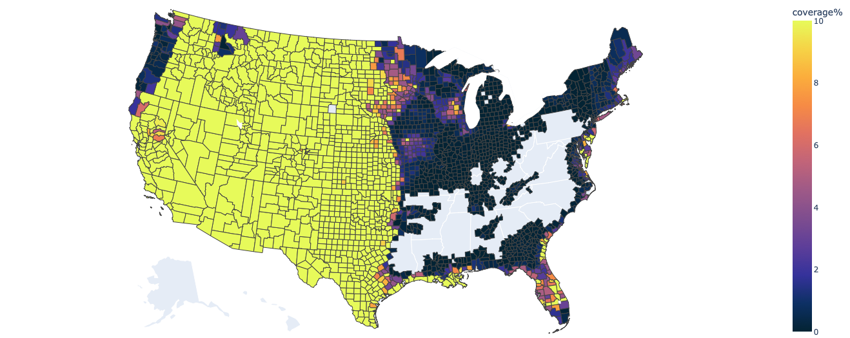
Map showing counties covered with rangelands – Coverage % threshold set as 10%

