Slide 1
Physics
the fundamental natural science that studies matter, energy, space, time, and how they interact with each other

Slide 2
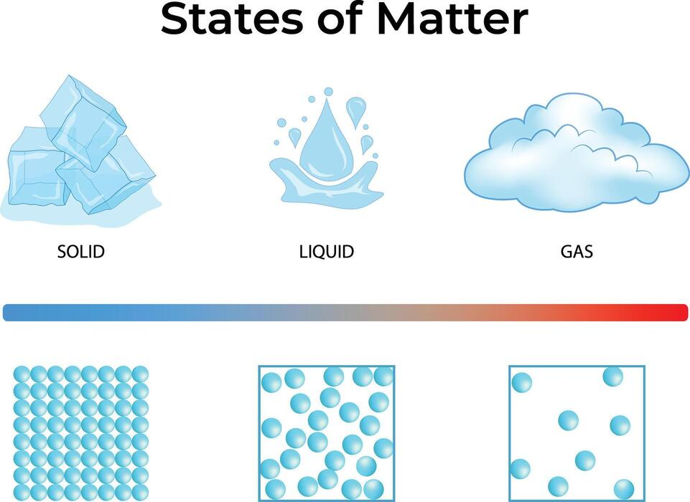
Matter
The Fundamental Substance of the Universe

Slide 3
What is Matter?
Definition: Anything that has mass and takes up volume (occupies space).
Mass: A measure of the amount of substance in an object, remaining constant regardless of location.
Volume: The three-dimensional space that an object or substance occupies.
Composition: Composed of fundamental particles called atoms (protons, neutrons, and electrons).

Slide 4
The Primary States of Matter
Solid: Definite shape and volume; tightly packed particles (e.g., Ice, Iron).
Liquid: Definite volume but takes container shape; sliding particles (e.g., Water, Oil).
Gas: No definite shape or volume; rapidly moving, distant particles (e.g., Air, Helium).
Plasma: Highly energetic, ionized gas consisting of free electrons and ions (e.g., Stars, Lightning).

Slide 5
Physical vs. Chemical Properties
Physical Properties: Observed without changing substance identity (e.g., density, boiling point).
Can be intensive or extensive.
Chemical Properties: Describe the ability to transform into a new substance (e.g., flammability, toxicity, reactivity).
Only observable during a chemical reaction.

Slide 6
The Cosmic Scale: Matter & Energy
Law of Conservation of Mass: Matter cannot be created or destroyed, only transformed.
Mass-Energy Equivalence: Einstein's \(E=mc^2\) demonstrates that mass and energy are interchangeable.
Cosmic Breakdown: Normal visible matter makes up only about 5% of the universe, while Dark Matter (~27%) and Dark Energy (~68%) comprise the rest.

Slide 7
Energy
The Driver of the Universe

Slide 8
What is Energy?
Definition: The capacity or ability to do work, cause movement, or change matter.
Measurement: Measured in Joules (J) in the International System of Units (SI).
Nature: Cannot be touched or seen directly, but its effects on matter are observable.
Work: Defined in physics as a force moving an object over a distance (W = F × d).

Slide 9
Two Main Categories of Energy
Potential Energy: Stored energy based on position or state (e.g., a stretched rubber band, water behind a dam).
Kinetic Energy: The energy of an object in motion, depending on mass and speed (\(KE = \frac{1}{2}mv^2\)).
Mechanical Energy: The sum of potential and kinetic energy in a physical system

Slide 10
Law of Conservation of Energy
The Law: Energy cannot be created or destroyed, only transformed from one form to another.
Total Energy: The total amount of energy in a closed system always remains constant.
Efficiency: In energy transformations, some energy is always "lost" as unusable heat due to friction.

Slide 11
The Spectrum of Energy Forms
Thermal & Radiant: Heat generated by moving atoms, and light energy moving in electromagnetic waves.
Chemical & Nuclear: Energy stored in molecular bonds (food, fuel), and energy locked in atomic nuclei.
Electrical: Energy produced by the movement of electrons through a conductor.

Slide 12
Force
The Agent of Change and Motion

Slide 13
What is Force?
Definition: A push or pull exerted on an object resulting from its interaction with another object.
Measurement: Measured in Newtons (N) in the International System of Units (SI).
Vector Quantity: Forces have both magnitude (strength) and direction, represented by arrows.
Net Force: The combination of all forces acting on an object determines its acceleration.

Slide 14
Types of Force
Contact Forces: Physics interactions requiring physical touch (e.g., Friction, Tension, Normal Force, Air Resistance).
Action-at-a-Distance Forces: Forces that act even when objects are separated (e.g., Gravity, Magnetic Force, Electrical Force).
Balanced vs. Unbalanced: Balanced forces cause no change in motion. Unbalanced forces cause objects to accelerate.

Slide 15
Newton's Laws of Motion
First Law (Inertia): An object at rest stays at rest, and an object in motion stays in motion unless acted upon
by a net force.
Second Law (Acceleration): Force equals mass times acceleration (F = ma).
Third Law (Action-Reaction): For every action, there is an equal and opposite reaction.

Slide 16
The Four Fundamental Forces of Nature
Gravity: Attractive force between masses; weakest force but operates over infinite distances.
Electromagnetism: Force between charged particles; responsible for electricity, magnetism, and chemistry.
Strong Nuclear: Binds protons and neutrons together in atomic nuclei; strongest force but short-range.
Weak Nuclear: Responsible for radioactive decay and initiating the nuclear fusion that powers stars.

Slide 17
Space and Time
The Fabric of the Cosmos

Slide 18
Classical Views of Space and Time
Absolute Space: Isaac Newton's view of space as a fixed, unmovable stage where physics happens.
Absolute Time: The classical idea that time flows at the exact same rate everywhere in the universe.
Independence: In classical mechanics, space and time are separate, unchanging entities.
Limitations: This framework works for everyday speeds but fails at extreme speeds and gravity.

Slide 19
Einstein's Breakthrough: Spacetime
Unification: Albert Einstein merged three dimensions of space and one dimension of time into a 4D fabric.
The Speed of Light: Light travels at a constant speed (c) for all observers, no matter their motion.
Relativity: Because light's speed is constant, space and time must stretch or shrink depending on speed.
Frame of Reference: Measurement of time and distance depends entirely on the observer's relative motion.

Slide 20
Time Dilation and Length Contraction
Time Dilation: Moving clocks run slower relative to a stationary observer.
Twin Paradox: A traveling astronaut ages slower than their twin who remains on Earth.
Length Contraction: Objects moving close to light speed shrink in length along their direction of motion.
Cosmic Muons: Particles created in Earth's atmosphere survive long enough to hit the ground because of
time dilation.

Slide 21
Gravity as Curved Spacetime
General Relativity: Gravity is not a pulling force, but the warping of spacetime by mass.
The Analogy: Heavy objects bend spacetime like a bowling ball resting on a trampoline.
Orbital Motion: Planets orbit the Sun because they are following straight lines through curved space.
Extreme Curvature: Black holes warp spacetime so severely that nothing, not even light, can escape.

