Slide 1
OpenID Connect (OIDC)
An identity layer on top of the OAuth 2.0 protocol

Slide 2
What is OIDC?
It’s not OpenID 1.0 or OpenID 2.0
An open standard and decentralized authentication protocol
Promoted by the non-profit OpenID Foundation (https://openid.net/connect/)
When you log into a website using credentials from another site, that process needs a protocol that keeps your secrets safe. You need federated authentication

Slide 3
OAuth 2.0
Provides authorization flows for web applications, desktop applications, mobile phones, and smart devices
Main framework published October 2012
Used by Google, Facebook Graph API, Microsoft’s Azure Active Directory and many other

Slide 4
Authentication vs. Authorization
Authentication
  Who you are
  Verifies identity
Authorization
  What you can do
  Permissions

Slide 5
In OAuth2...
The sole purpose is to relay authorization info to a resource server (relying party)
Access tokens can be things other than a user (a machine for instance) and access rights might be delegated
Alone, it does not indicate that the user is authenticated
The contents of the access token aren’t standardized—they might give you information about a user but they might not
You have no way to know if you’re the intended audience

Slide 6
OIDC Authentication Flows
Authorization Code Flow: redirect-based (client needs browser access), most secure, and can be used when you don’t trust the client
Implicit Flow: Tokens delivered in front channel (browser); best for SPA apps or native apps
Hybrid Flow: a mix of both; allows instant access to basic data while allowing you to secure sensitive data

Slide 7
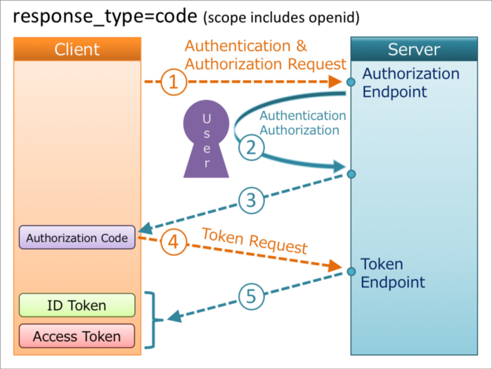
Diagram
Credit: https://darutk.medium.com/diagrams-of-all-the-openid-connect-flows-6968e3990660

Slide 8
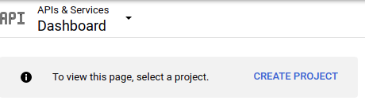

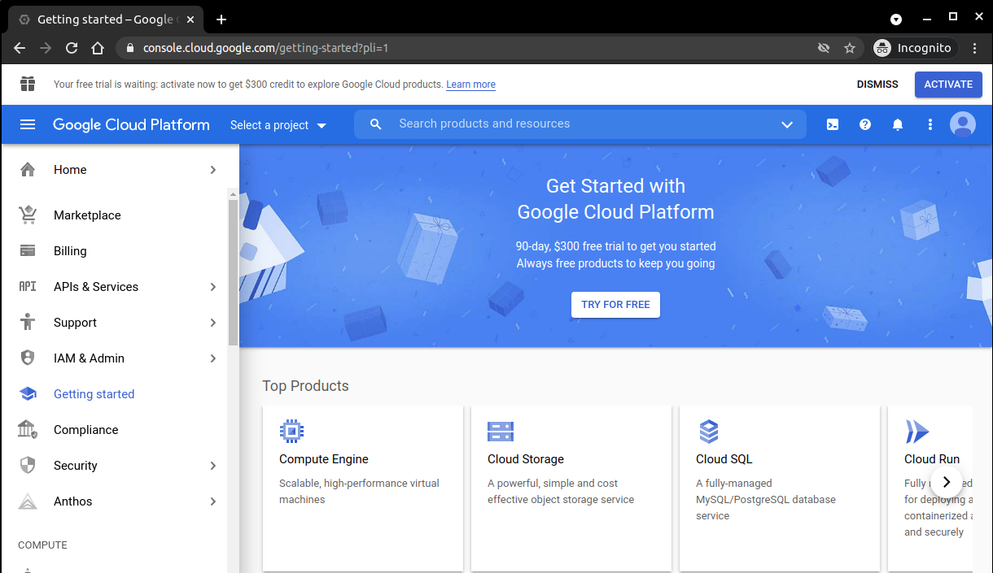
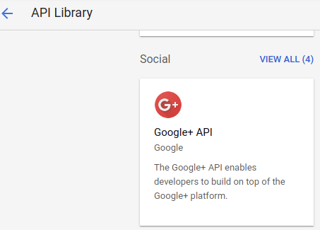
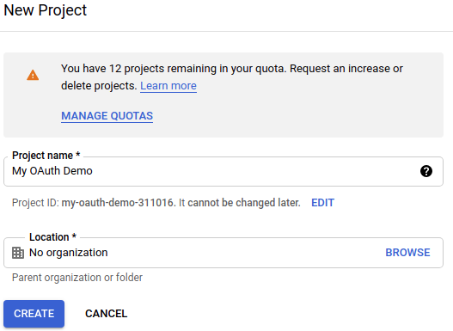
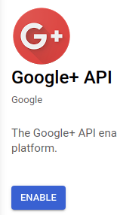
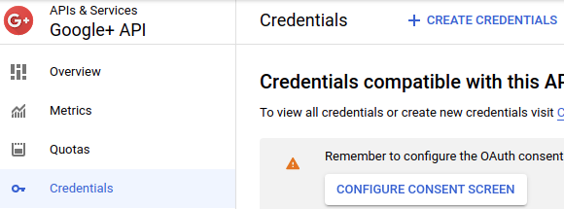
Google: console.cloud.google.com
5
2
6
1
3
8
7
4

Slide 9
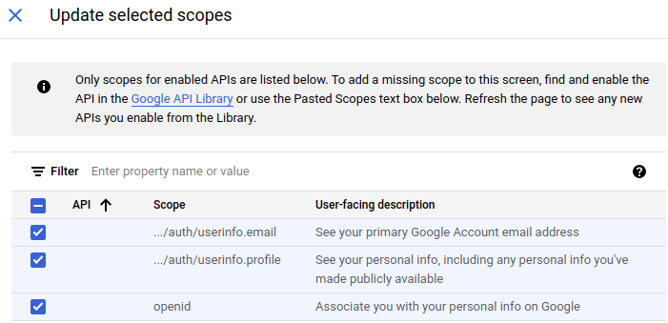
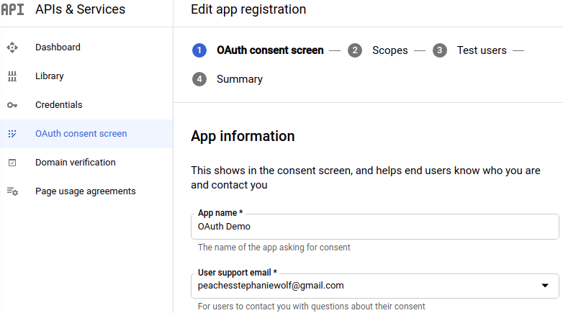
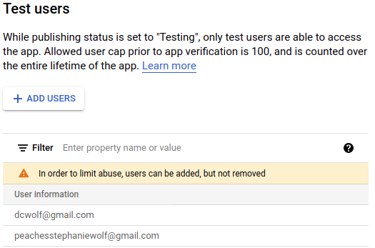
Google: OAuth Consent Screen
11
9
12
10

Slide 10
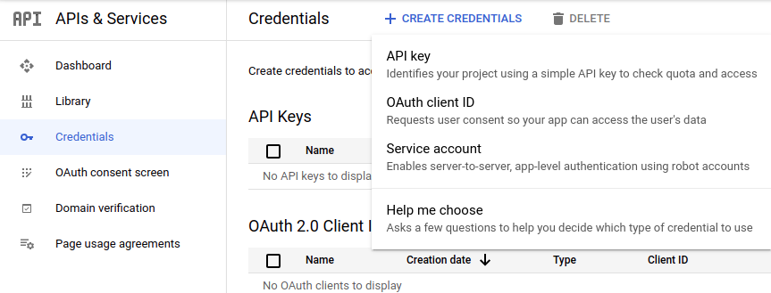
Add OAuth Client ID Credentials
14
13

Slide 11
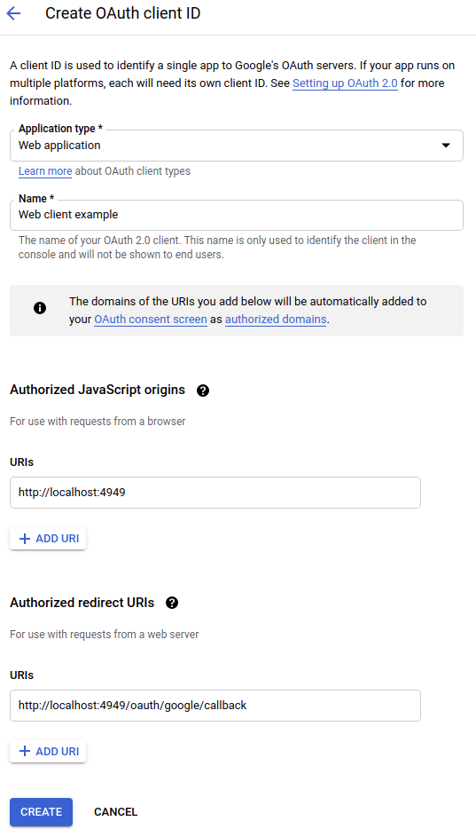
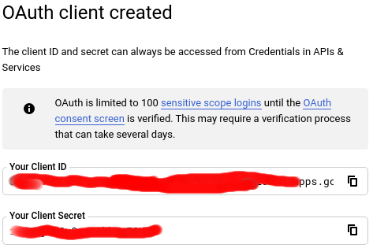
Create Client
15
16
This step will be similar for any OIDC provider because the redirect URI is used to ensure only you get a token for your application.
In this context, your application will be referred to as the “Audience”
19
20
17
18

