Slide 1
Lambda Calculus
Anson Tao
Anand Singh
Hamza Qadri

Slide 2
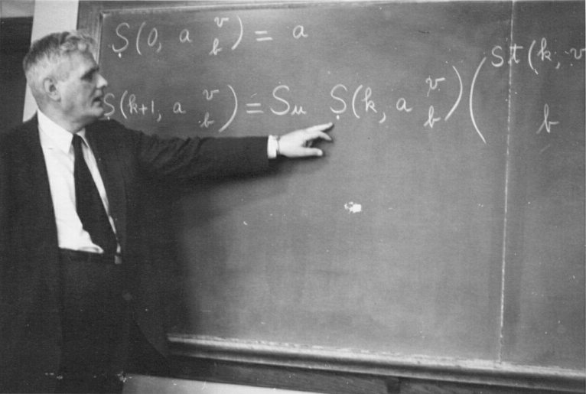
Background
Created by mathematician Alonzo Church in the 1930s
Simple set of rules for expressing functions as first-class values
Many applications and important results
We are able to express any computable function by combining and applying single-argument anonymous functions

Slide 3
Introduction
Application: Done through β-reduction (substituting bound variable with expression).
((λx. (λy.x + y)) 3 4) ((λy.3 + y) 4) Reduction on x arg. (3 + 4) Reduction on y arg. 7 Final result.
Expression: Overarching syntactical concept that is defined in terms of variables, abstractions, and applications
Variables (e.g. x) are themselves expressions
Abstractions (e.g. λx.x) are expressions
The application of an expression to another (e.g. MN) is an expression
Abstraction: Anonymous function that takes a single argument, ie.
λx.(x + 1)
Free and Bound variables: Bound variables attached as parameters to expression, free variables are unbound.
x is bound, but y is free in: λx.(x + y)

Slide 4
Main Result: The Power of Lambda Calculus
Turing Completeness:
Refers to the ability of a set of rules to simulate a Turing machine
A Turing machine, and thus a Turing-complete language, can implement any algorithm
Lambda calculus is Turing complete - we present an informal proof for this
Conditional Branching:
T = λx.λy.x (select first argument)
F = λx.λy.y (select second argument)
ifthenelse = λi.λt.λe.ite
Example: If True then M else N
(ifthenelse)TMN
= (λi.λt.λe.ite)(λx.λy.x)MN
= (λt.λe.(λx.λy.x)te)MN
= (λe.(λx.λy.x)Me)N
= (λx.λy.x)MN
= (λy.M)N = M

Slide 5
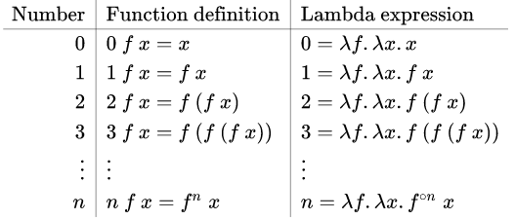
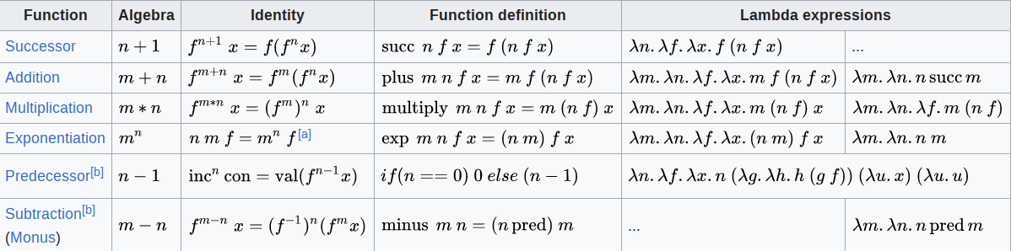
Main Result
Logic:
Defined in terms of booleans and conditional branching
not(x): if x then F else T
(ifthenelse)xFT
and(x) and or(x) are left as an exercise to the viewer!
Arithmetic:
Natural numbers are represented as Church numerals
n = λf.λx.f^{n}(x)
S = λn.λf.λx.f(nfx)
A = λm.λn.nSm

Slide 6
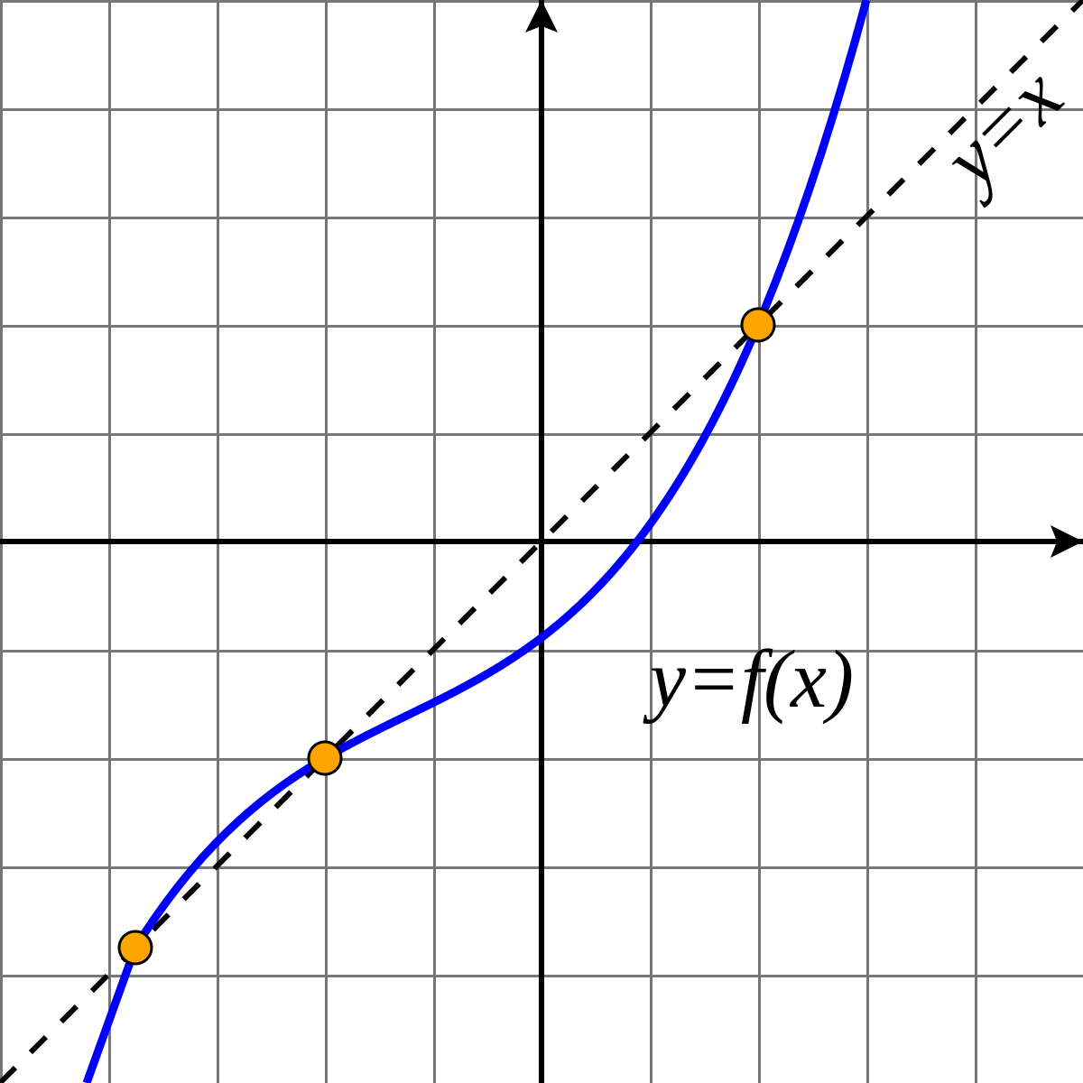
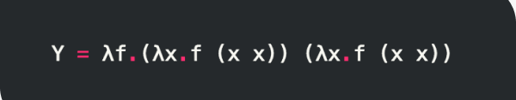
Main Result
Loops via Recursion
We cannot refer to an abstraction within its own body
Solution: fixed-point combinators
Every function in lambda calculus has a fixed point
A fixed-point combinator (example: Y combinator) generates a function’s fixed point: F(YF) = YF
By rewriting a function in terms of its fixed point using inverse β-reduction, and then rewriting it in terms of the Y combinator, we can achieve recursion within the rules of pure lambda calculus

Slide 7
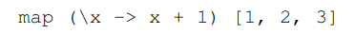
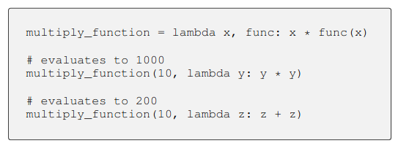
Applications to Functional Programming
We have shown that it is possible to represent common programming constructs in lambda calculus
Could we use lambda calculus as a basis for programming languages?
Yes! Functional programming languages (Haskell, Clojure, etc.)
Even many non-functional languages support the paradigm
Advantages of functional programming paradigm
Maintainability: functions have no external effects, so there is less coupling
Debugging: pure functions have no state or side effects, so finding bugs is easier
Modularity: functions can be composed together without affecting each other
Concurrency: it is easier and more natural to implement concurrency due to the separation of functions

Slide 8
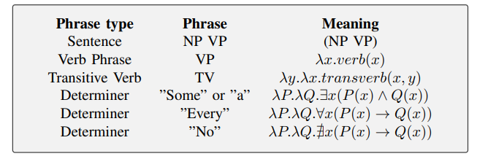
Generalization: Montague Semantics and NLP
Aims to provide a formal treatment of natural language meaning by using lambda calculus to represent the meaning of expressions
Determiners: Specify reference and quantity (“a”, “an”, “some,” “the”)
Noun Phrase: Functions as subject in sentence
Verb Phrase: Verbs and complements, objects, and modifiers

Slide 9
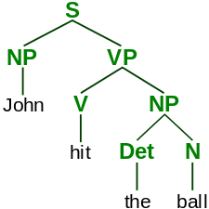
Generalization: Montague Semantics and NLP
Rules of montague grammar can be used in addition to a parse tree to transform a sentence into some proposition.
But mapping a CFG to lambda-calculus from text is still currently being researched. https://www.computer.org/csdl/proceedings-article/ictai/2008/3440b135/12OmNx7ouR0
“Hit” is a transitive verb here, so it is likely transformed into something like this:
λx.λy.hit(x,y)(John, ball)

Slide 10
Lambda Calculus Interpreter
apply
(λa.λb.a)(λc.d)(λe.f)
[(, λa, λb, a, ), (, λc, d, ), (, λe, f, )]
apply
λe
Lexer
Parser
λa
λc
f
λb
d
String
Tokens
a
Abstract Syntax Tree

Slide 11
Lambda Calculus Interpreter
apply
apply
λe
λc.d
λc
λa
λc
f
Interpreter
Recursive to_string
d
λb
d
a
Abstract Syntax Tree (evaluated)
Abstract Syntax Tree
String

Slide 12
References
Brilliant Math and Science Wiki: Lambda Calculus - This website rigorously yet clearly defines the syntax of lambda calculus as well as how to express common constructs in it. It was a very useful reference for our main result.
Stanford Library of Philosophy: The Lambda Calculus - This is another introduction to lambda calculus that explains some aspects of its usage in more detail and also introduced us to our generalization topic.
Jason Eisner: Functional Programming - This document explains the relationship between functional programming and lambda calculus. It allowed us to understand how lambda calculus serves as the basis for the functional programming paradigm, and programming languages in general.
Stanford Library of Philosophy: Montague Semantics - This website, also from the Stanford Library of Philosophy, offered a very detailed introduction to and description of Montague semantics that we referred to extensively.
Richard Montague: The Proper Treatment of Quantification in Ordinary English - This is a relevant research paper from Richard Montague, the mathematician who pubished what became known as Montague semantics. As such, it was very useful for us.
NLTK: Sample usage for logic - This is the official documentation for Python's NLTK library; as such, it was a useful reference when writing the section on NLTK.
Lisperator: Writing a parser - This website served as a good (albeit generic) guide for how to develop interpreters, and gave us sufficient direction to begin writing our lexer and parser.
University of Wisconsin: Lambda Calculus - This document introduced us to abstract syntax trees for lambda calculus. Though our ASTs are slightly different from the examples given here, this page still served as a good introduction.

