Slide 1


SMART INDIA HACKATHON 2024
Problem Statement ID – 1596
Problem Statement Title- Student Innovation
Theme- Agriculture
PS Category- Software
Team ID- 80
Team Name (Registered on portal)- SIHKRISH

Slide 2
FARMEXPERT
SIHKRISH
Proposed Solution (Describe your Idea/Solution/Prototype)
The proposed solution is an integrated Market Linkage Platform designed to bridge the gap between farmers and buyers. The platform facilitates direct access between farmers, retailers and consumers, thereby eliminating intermediaries who often drive up costs and reduce farmers' profits. Also the application will have a feature of crop analysis to find out the disease and suggest some fertilizers for it.
The platform eliminates intermediaries by enabling direct transactions, expanding market access, and providing real-time crop analysis. It enhances efficiency through integrated logistics, and builds trust through a customer care system.
The platform offers a unique integration of direct selling, real-time tracking, logistics, and providing a cohesive and user-friendly experience. Its data-driven insights, enhanced connectivity, and scalability set it apart, making it adaptable to future advancements and market needs.

Slide 3
FEASIBILITY AND VIABILITY
SIHKRISH
The FarmExpert Platform is feasible due to its effective integration of modern technologies for direct selling, real-time data, logistics, supported by strong market demand. While it requires significant initial investment and user adoption, its economic viability is bolstered by potential revenue and operational success with strategic logistics partnerships.
Key challenges includes limited digital literacy among farmers, ensuring data security, maintaining real-time data accuracy, and coordinating complex logistics. Addressing these issues is crucial to avoid low adoption rates, data breaches, operational disruptions, and regulatory non-compliance.
To overcome challenges, implement user-friendly designs and educational resources to boost digital literacy, ensure robust cybersecurity, and establish reliable data partnerships for accuracy. Streamline logistics through strong provider partnerships and maintain regulatory compliance with legal consultations and feature integration.

Slide 4
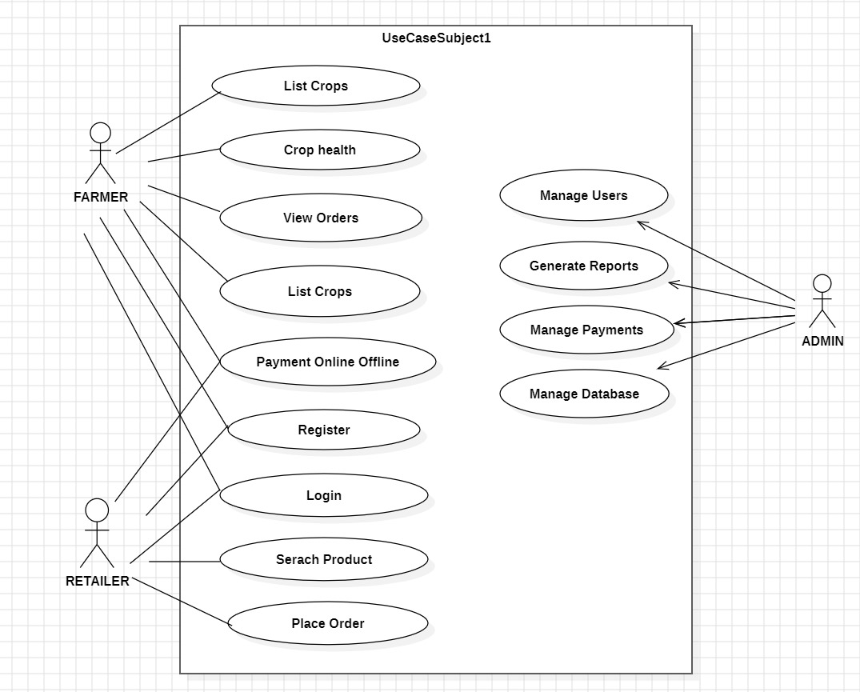
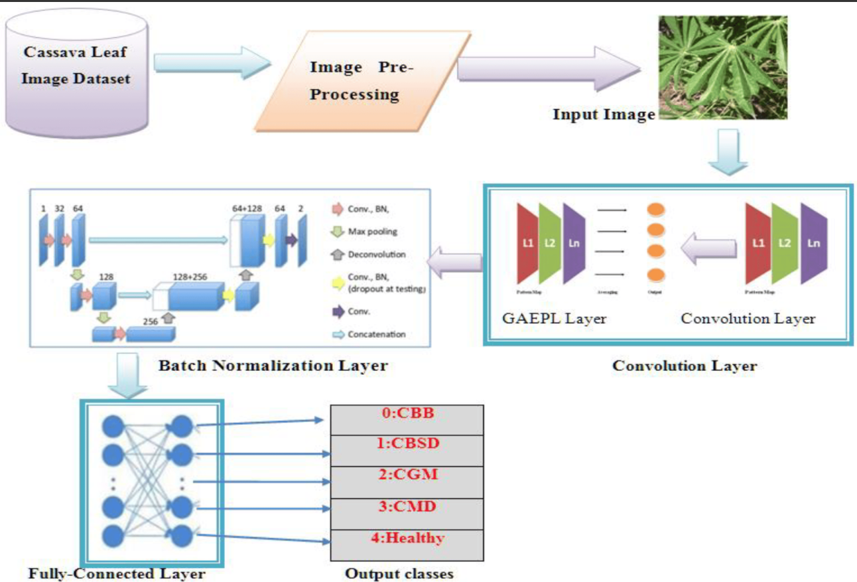
TECHNICAL APPROACH
SIHKRISH
Technologies to be used: HTML, CSS, JavaScript, Python
Methodology and process for implementation
WEBSITE STRUCTURE ALGORITHM

Slide 5
IMPACT AND BENEFITS
SIHKRISH
The platform empowers farmers by facilitating direct sales, enhancing market transparency, and increasing connectivity with diverse buyers. It boosts farmer revenue by eliminating intermediaries, offers cost savings for buyers, and expands market reach. Technologically, it advances agricultural practices through real-time data and secure payments, while its scalable design supports future innovations like AI and blockchain.
The platform provides significant social benefits by empowering farmers, enhancing market transparency, and fostering community engagement. Economically, it boosts farmer revenue by cutting out intermediaries, reduces costs for buyers, and expands market reach. Environmentally, it reduces food waste through efficient logistics and promotes sustainable practices. Technologically, it advances agricultural practices with modern tools and is designed for future innovations, ensuring ongoing progress and adaptability.

Slide 6
RESEARCH AND REFERENCES
SIHKRISH
https://www.scirp.org/journal/paperinformation?paperid=100958
https://dl.acm.org/doi/abs/10.1145/3371158.3371196
https://www.mdpi.com/2227-7390/10/4/580

