Slide 1

WOMEN'S EMERGENCY MEDICAL AI
WEMA
A voice-first maternal emergency assistant grounded in verifiable
clinical guidance and guiding callers through life-saving home actions
until help arrives.
ML TRACK
STACK
Initial Software Product Demonstration
RAG · ChromaDB · LangChain · Groq Llama 3.3 70B
Presented by Victoria Fakunle

Slide 2
The Problem & The Solution
Why WEMA exists, and how it works
The Problem
The Solution: WEMA
Many maternal deaths in low-resource settings occur during obstetric emergencies at home, before a caller can reach a clinician.
Callers and birth attendants often don't know the correct first physical action, and minutes matter for haemorrhage, eclampsia, and cord prolapse.
Generic chatbots risk inventing unsafe advice or recommending drugs that aren't appropriate over a hotline.
A voice maternal-health assistant for Nigeria, grounded in 19 curated WHO / ACOG clinical documents via Retrieval-Augmented Generation (RAG).
Retrieves the most relevant clinical passages for the caller's situation, then responds with short, calm, physical-only home actions.
Uses a dual-path design: give a home action when one exists; otherwise route immediately to transport "go now, not wait".
Evaluated end-to-end against 68 labelled emergency scenarios across 17 emergency types.

Slide 3
The WEMA Pipeline
From caller speech to a safe, grounded home action
1
2
3
4
Caller Query
Embed & Retrieve
Dual-Path Prompt
Llama 3.3 70B (Groq)
→
→
→
Voice input describing the emergency situation at home
MiniLM (all-MiniLM-L6-v2) embeds the query; ChromaDB retrieves top k=4 passages from 7,906 passages
System prompt enforces physical-only, home actions where safe or 'go now'.
Production answer model generates a short, calm, grounded response in real time
Configuration: COLLECTION_NAME="wema_maternal_health" ·
EMBEDDING_MODEL="sentence-transformers/all-MiniLM-L6-v2" ·
K=4 retrieval depth · TEMP=0.2

Slide 4
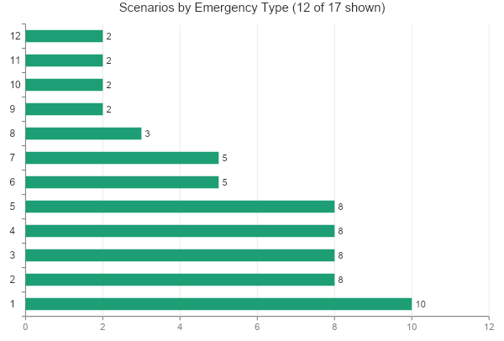
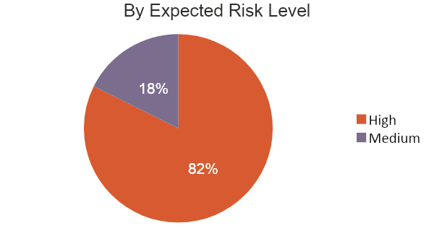
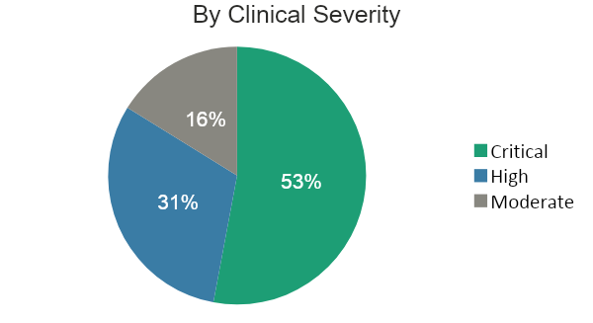
Data Engineering: Preprocessing
How source documents were cleaned, segmented into passages, and validated before indexing
844
~110
Preprocessing Pipeline & EDA Findings
Text extraction & cleaning: PDFs parsed and split into passages; 844 non-content passages (referral forms, citations, headers) removed after indexing
Segmentation strategy: fixed-size sliding window with overlap to preserve sentence context across boundaries
EDA — passage length distribution: most passages fall in the 80–140 token range; long-tail outliers trimmed
EDA — topic coverage: PPH and eclampsia are the most represented conditions; cord prolapse and sepsis have thinner coverage
Retrieval validation: K=4 chosen after manual inspection showed diminishing relevance beyond 4th retrieved passage
noise passages removed in cleaning (forms, citations, headers)
average tokens per passage (sliding-window segmentation)
384-d
K=4
embedding dimensions (MiniLM all-MiniLM-L6-v2)
passages retrieved per query (retrieval depth)

Slide 5
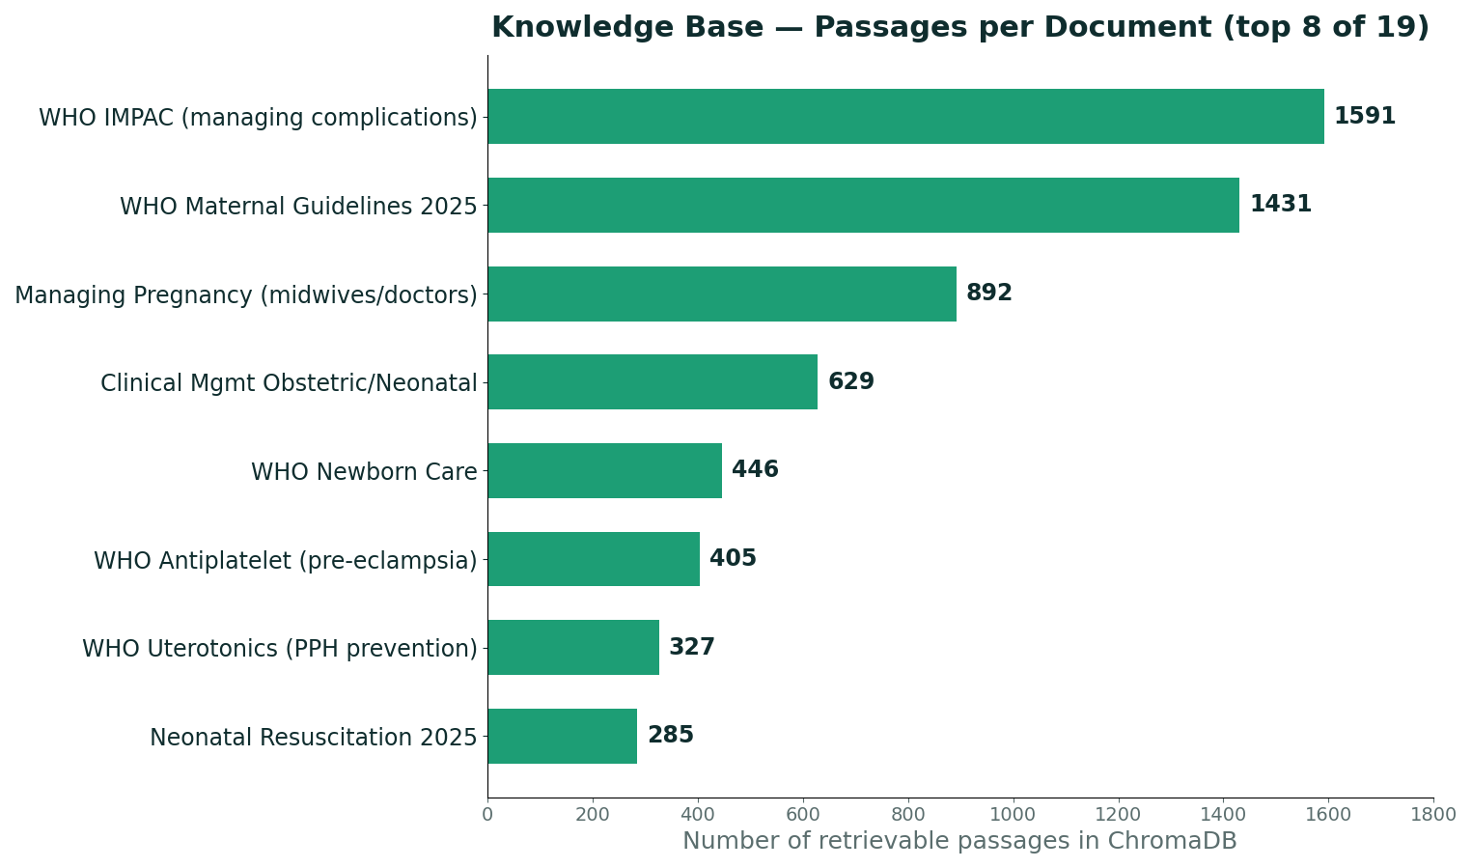
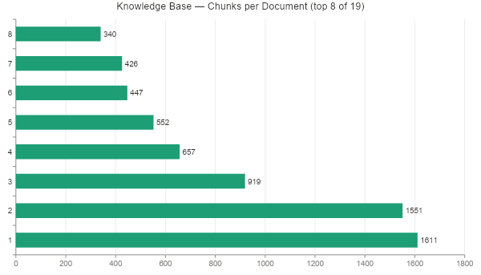
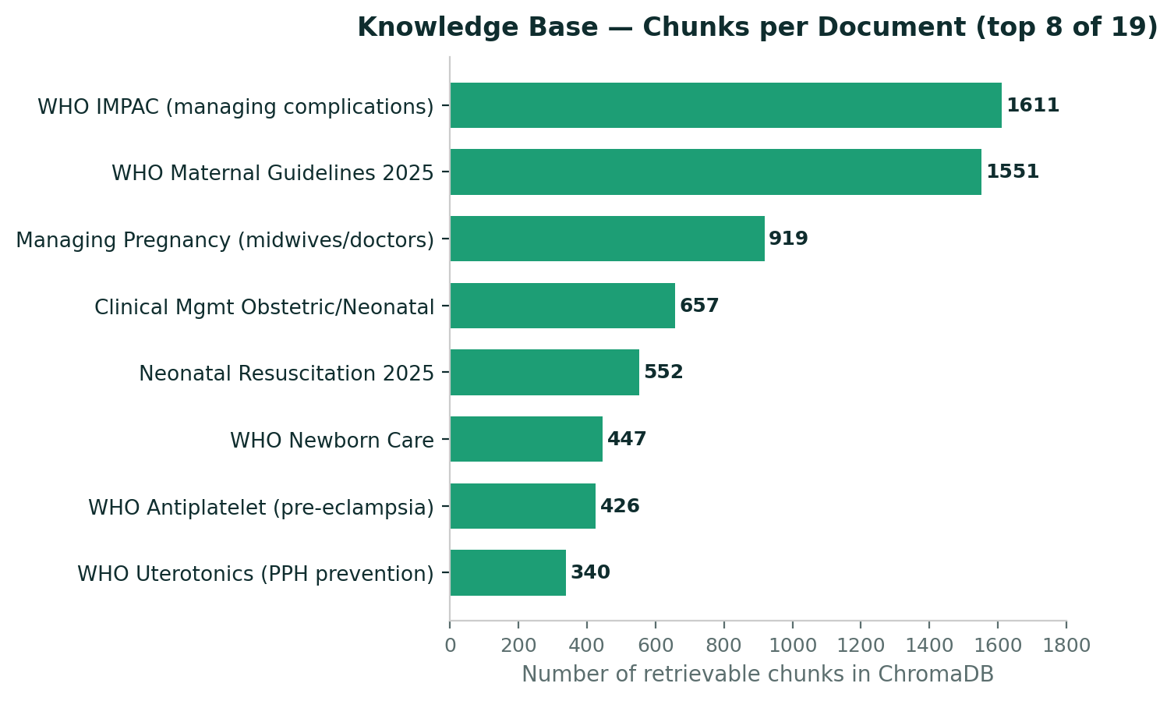
Data Engineering: Knowledge Base
Every WEMA response is grounded in retrieved passages, not memory
19
curated source documents
7,906
retrievable passages indexed in ChromaDB
Source: WHO & ACOG guidelines, national protocols & obstetric/neonatal care manuals.

Slide 6
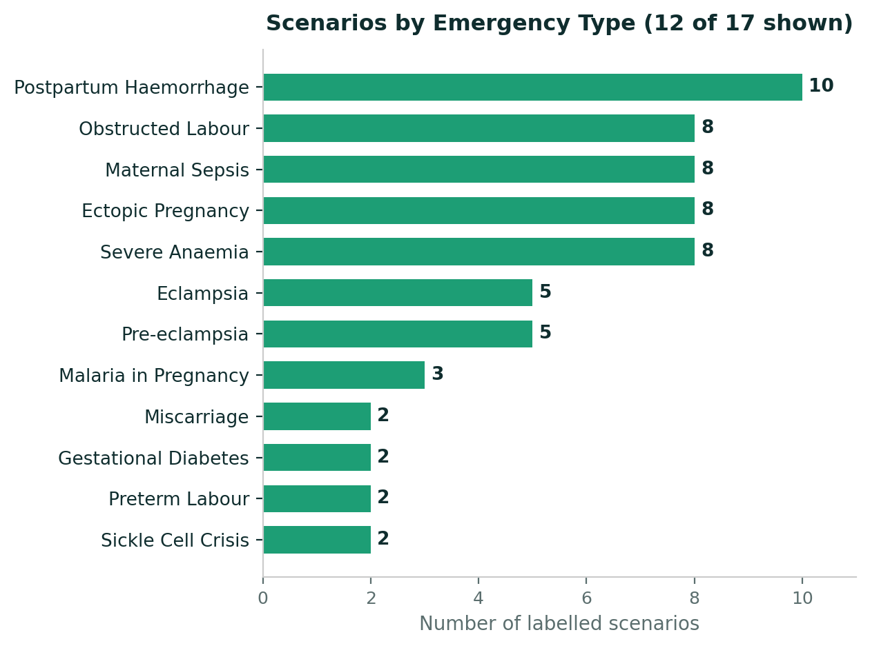
Data Engineering : Evaluation Scenarios
68 labelled test cases across 17 emergency types form the evaluation ground truth

Slide 7
Model Design : The Dual-Path Prompt
The key safety fix: never invent a home action where none exists
Path A : Safe Home Action Exists
Path B : No Safe Home Action
Postpartum Haemorrhage → massage the lower belly firmly, put baby to breast now, empty bladder, lie flat & keep warm
Eclampsia / convulsions → lie on left side, protect from injury, do not restrain
Newborn not breathing → dry the baby, rub the back to stimulate, keep warm
Cord prolapse → hands-and-knees position, chest down, hips up
Surgical emergencies (suspected ectopic pregnancy, placenta praevia) have no safe physical intervention at home.
WEMA does not invent one. It routes to immediate transport by the fastest means, while help is alerted.
Only "what to avoid" is added (e.g. do not press the abdomen, do not get up), to prevent harm while travelling.
Tone conveys urgency: “go now, not wait.”
Then: alert is arranged, transport urged — home action is the first step, not the only step.
Guardrails: always short, calm sentences; never mentions drug names, prescriptions, or medical procedures.

Slide 8
Evaluation Methodology
Generator vs. judge call : two separate calls to the production model: one to answer, one to score
Generator - Llama 3.3 70B (Groq)
Judge- Llama 3.3 70B (Groq, T=0)
The real production model that answers callers.
Receives the dual-path system prompt plus 4 retrieved passages of context per query.
Temperature = 0.2 for consistent, low-variance responses.
Separate call compares WEMA's response against the expected home action for each scenario.
Scores clinical equivalence: EQUIVALENT, PARTIAL, or DIVERGENT, judging intent, not wording.
Runs at temperature = 0 for deterministic, reproducible scoring, separate from the production response.
Why a separate judge call? Running the judge as a dedicated temperature = 0 call — separate from the temperature = 0.2 production response — keeps the evaluation score deterministic and reproducible, and avoids the production response's own randomness leaking into the score.

Slide 9
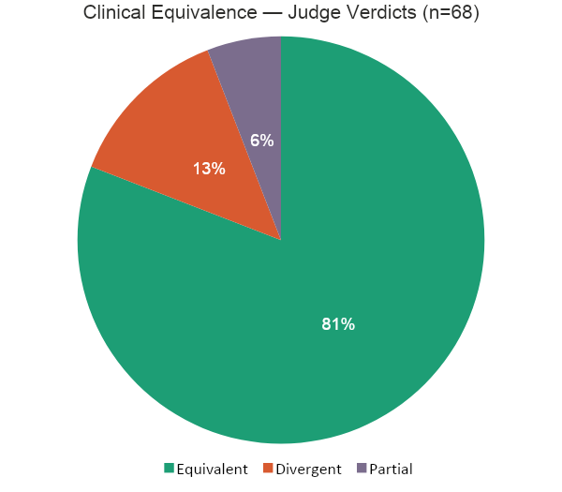
Initial Performance Metrics
Full 68-scenario evaluation run - baseline (K=4, temperature=0.2)
55 / 68
Responses judged EQUIVALENT to the expected clinical action (80.9%)
98.5%
Physical-only safety — 67 of 68 responses contained no drug names or prescriptions (one flagged: S053, Malaria)
9
Divergent cases flagged for clinical review (see next slide)

Slide 10
Results by Emergency Type & Safety Review
Reading results per emergency type, not as one headline number
Verdict by Emergency Type (selected)
Emergency Type | Equivalent | Partial | Divergent
Ectopic Pregnancy | 8 | 0 | 0
Obstructed Labour | 8 | 0 | 0
Maternal Sepsis | 6 | 2 | 0
Severe Anaemia | 7 | 0 | 1
Eclampsia | 5 | 0 | 0
Pre-eclampsia | 4 | 1 | 0
Postpartum Haemorrhage | 4 | 1 | 5
Other (10 types) | 13 | 0 | 3
9 Divergent Cases: Flagged for Review
Judge errors (3) — S002/S006/S007 (PPH): correct massage + breastfeeding guidance wrongly flagged; confirmed correct on manual review
True gaps (3) — S009 (PPH): firm pressure missing · S060 (Praevia): said "get up", should lie flat · S062 (Miscarriage): over-escalated
Borderline (3) — S004, S049, S053: clinically defensible but misaligned with the expected action
Adjusted true divergence: ~4–6% vs raw 13.2% — a judge-prompt limitation, not system failure
Known limitation: the automated safety check only screens for drug-name mentions, not unsafe physical advice — manual review of high-risk divergent cases is a current future-work item.

Slide 11
Deployment Plan & MVP
Current MVP (Notebook / API)
Path to a Live Hotline / App
Retrieval stack: sentence-transformers (MiniLM) + ChromaDB persisted vector store, mounted via Google Drive
Orchestration: LangChain prompt templates + chains (langchain-community, langchain-groq)
Generation: Groq-hosted Llama 3.3 70B (production answer model)
Evaluation: separate Llama 3.3 70B judge call (T=0), automated CSV scoring of all 68 scenarios
Secrets handled via getpass — never committed to the repo
Wrap ask_wema() as an API endpoint (Swagger/Postman UI) for partner integration
Connect to a voice gateway (Twilio) so callers reach WEMA by phone
Add a manual-review queue for DIVERGENT / high-risk verdicts before wider rollout
Move ChromaDB store to a managed host; pin embedding model version with rag.py

Slide 12
Summary & Next Steps
Initial software demonstration - ML Track
What's working
What needs work
Next steps
End-to-end RAG pipeline retrieving from 7,906 grounded passages
Dual-path prompt safely separates home actions from transport-only cases
80.9% of responses judged clinically EQUIVALENT; 98.5% physical-only safety
3 true divergent cases (S009, S060, S062) need prompt refinement, incl. firm-pressure guidance for PPH
Safety check currently screens drug names only and not unsafe physical advice
Manual clinical review of all DIVERGENT cases with the obstetrician advisor
Wrap pipeline as an API (Swagger UI) and connect to a voice/USSD gateway
Expand the safety-phrase watchlist for automated physical-advice review
DATA & NOTEBOOKS
WEMA_Data_Exploration.ipynb · WEMA_Full_Evaluation_Colab.ipynb
WEMA — Women's Emergency Medical AI | Capstone Project, ML Track

Slide 13
THANK YOU!
ANY QUESTIONS?

