Slide 1


COOKING PArtner
Presented by,
TEAM PANDAS:
Lan Chen B00XXXXXX
Song Zhao B00XXXXXX
Sunit Shah B00792267
Eugene Shishlannikov B00XXXXXX

Slide 2
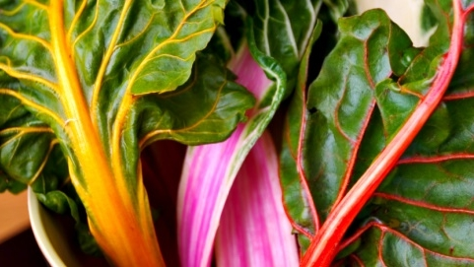

Our Functionalities:
Word Cloud
Fresh
delicious

Slide 3
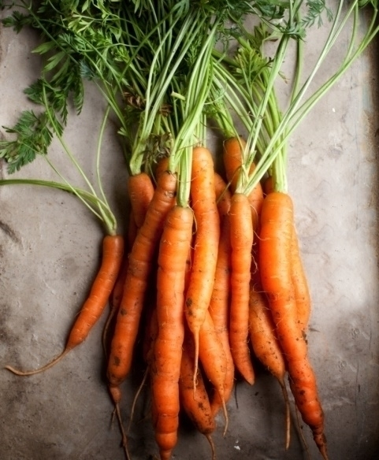
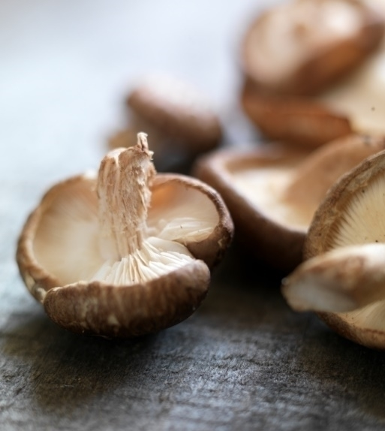

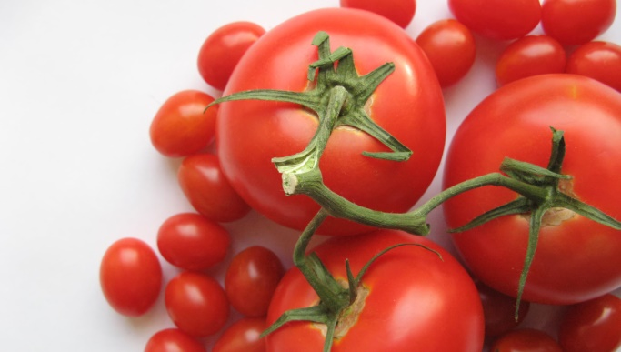
Our process
Plant
Grow
Pick

Slide 4
Research Topic
Various Cuisines country wise
Similarities between the cuisines and their ingredients
Finding the similar recipes by similar ingredients
Finding flavor compounds

Slide 5
Aim of the study
History proves the difficulty in finding the perfect food
Factors affecting the diet of people:
Level of Sugar
Nutrition Value
Culture
Ease of production
Environment

Slide 6
Hypothesis
Earlier:
Ingredients sharing flavor compounds are more likely to taste well together than ingredients that do not.
Worked on:
given the large number of recipes we use in our analysis(56,498), such confounding factors can be systematically filtered out, allowing for the discovery of patterns that may transcend specific dishes or ingredients.

Slide 7
Methodology
Aim was to explore the impact of flavor compounds (51 flavors)
Network-based approach
Two nodes
381 unique ingredients
1021 flavor compounds
Food classes
Meat
Fruits

Slide 8
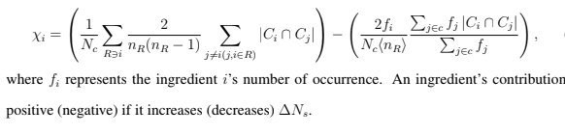
Methods
Shared Compounds:
Ns(R) = 2nR(nR − 1)Σi,j∈R,i6=j|Ci ∩ Cj|
Zero if ingredients do not match the flavor compounds
Contribution:
[1]

Slide 9
Results
Recipes shows likelihood of having ingredients with the same flavor compound (North American and Western Europe)
Recipes uses the ingredients which are in similar flavor compound cluster
Major ingredient classes used in North American food are Dairy Products, Eggs and Wheat!
Where as East Asian uses Soy Sauce, sesame oil, and rice and ginger.

Slide 10

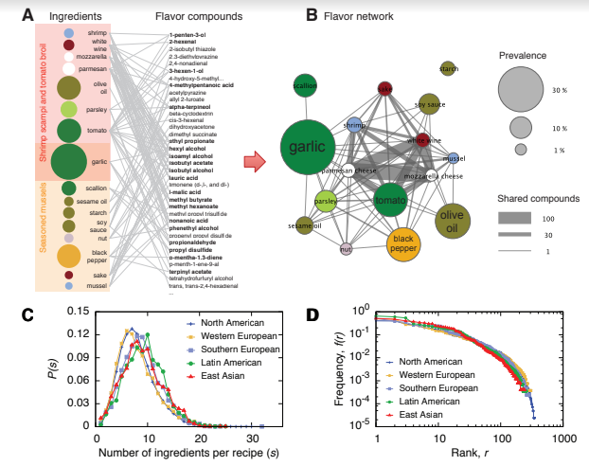

Results(continued...)
[1]

Slide 11
Limitations
Incomplete dataset

Slide 12
Thank you
someone@example.com

