Slide 1

DSC - Phase 3 Project
Pamela Godia, Moringa School
10.05.2025

Slide 2
1. Business understanding
Project Goal
To predict whether there is a pattern of customers who will ("soon“) stop (“churn”) doing business with SyriaTel, a telecommunications company.
Objectives
To determine if there is a predictive pattern of customers who will ("soon") stop doing bussiness with SyriaTel.
Target Audience: Telecom business staff

Slide 3
2. Data understanding
Churn in Telecom's dataset
3333 entries
20 columns
Target (y)
Churn [Yes = 1], [No = 0]
Predictors
['account_length’,
'area_code’
'total_day_charge’
'total_eve_charge’
'total_night_charge’
'total_intl_charge']

Slide 4
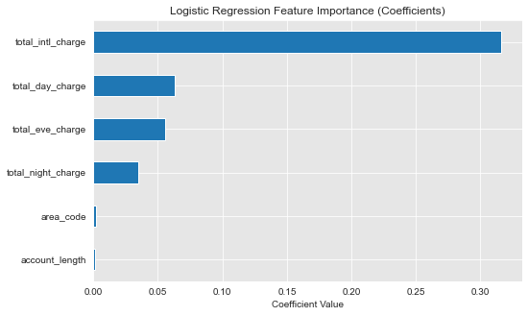
Logistic regression features (coefficients)
The most important feature is the total_intl_charge
A unit increase in international charge increases the chance of churn by 31%

Slide 5
3. Modelling using scikit-learn
Churn | Precision | Recall | F1 score | Support
0 | 0.86 | 1.00 | 0.92 | 2284
1 | 1.00 | 0.01 | 0.03 | 382
Accuracy |  |  | 0.86 | 2666
The f1 score for class 0 is 0.92.
The f1 score for class 1 is very low 0.02.
Problem - data imbalances: 2284 instances for class 0: compared to 382 instances for class 1

Slide 6
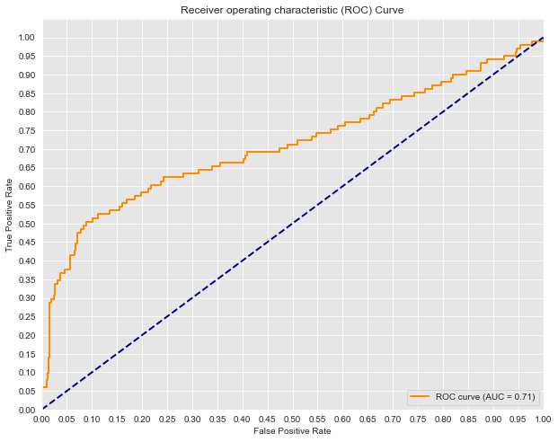
Model has 71.16% chance of predicting correctly the negative and positive classes

Slide 7
Model Improvement
SMOTE (Synthetic Minority Over-sampling Technique)
Regularization - Apply L1 (Lasso) or L2 (Ridge)

Slide 8


