Slide 1

DSC - Phase 3 Project
Pamela Godia, Moringa School
10.05.2025

Slide 2
1. Business understanding
Project Goal
To predict whether there is a pattern of customers who will ("soon“) stop (“churn”) doing business with SyriaTel, a telecommunications company.
Objectives
To determine if there is a predictive pattern of customers who will ("soon") stop doing bussiness with SyriaTel.
Target Audience: Telecom business staff

Slide 3
2. Data understanding
Churn in Telecom's dataset
3333 entries
20 columns
Target (y)
Churn [Yes = 1], [No = 0]
Predictors
['account_length’,
'area_code’
'total_day_charge’
'total_eve_charge’
'total_night_charge’
'total_intl_charge']

Slide 4
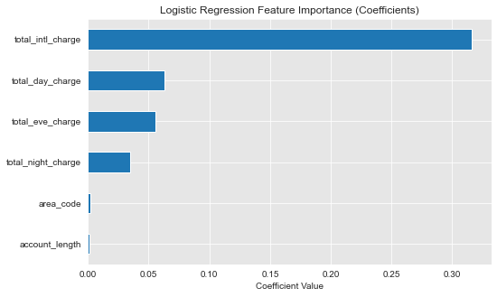
Logistic regression features (coefficients)
The most important feature is the total_intl_charge
A unit increase in international charge increases the chance of churn by 31%

Slide 5
3. Modelling using scikit-learn
Churn | Precision | Recall | F1 score | Support
0 | 0.86 | 1.00 | 0.92 | 2284
1 | 1.00 | 0.01 | 0.03 | 382
Accuracy |  |  | 0.86 | 2666
The f1 score for class 0 is 0.92.
The f1 score for class 1 is very low 0.02.
Problem - data imbalances: 2284 instances for class 0: compared to 382 instances for class 1

Slide 6
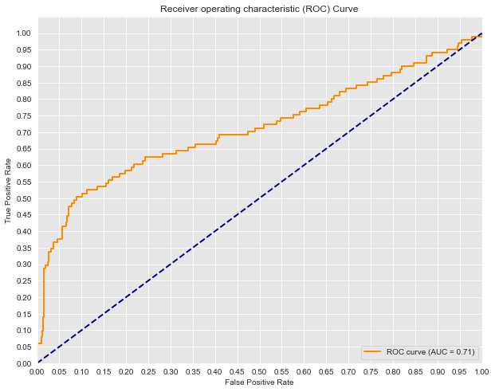
Model has 71.16% chance of predicting correctly the negative and positive classes

Slide 7
Recommendations
International Calls seems to be the main reason why customers may want to churn SyriaTel company
It may be good to explore other variables such compare the international tariffs by other companies in the same sector
One can also explore the local costs for the competitors in the market

Slide 8
Next steps
SMOTE (Synthetic Minority Over-sampling Technique)
Regularization - Apply L1 (Lasso) or L2 (Ridge)

Slide 9


