Slide 1
Algorithms: Instance-Based Learning
K-Nearest Neighbour
Statement for Audio and Video Learning Resources
Video and audio content at the University uses closed captions generated by automatic speech recognition (ASR). The ASR process is based on machine learning algorithms which automatically transcribe voice to text. According to our technology providers, this process is approximately 70-90% accurate depending on the quality of the audio, and consequently video and audio closed captions may include some transcription errors. It is therefore important to recognise that the original recording is the most accurate reflection of the content, and not the captions.
If you require accurate captions as part of your reasonable adjustments, please contact the Inclusion Centre to discuss your requirements.

Slide 2


Slide 3
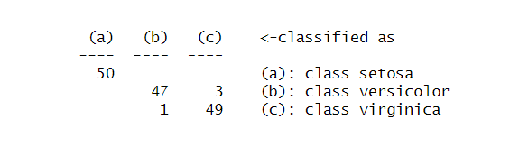
Lab Postmortem
What does this confusion matrix mean?

Slide 4
Lab Postmortem
There are no zeros here.

Slide 5
Lab Postmortem
There were 50 of each class in the dataset (summary(iris)). Rows sum to 50. So, rows indicate actual class. Columns are predictions.

Slide 6
Lab Postmortem
Setosa: 50 correct predictions. 0 incorrect predictions.
If the model predicts setosa, it will be setosa!

Slide 7
Lab Postmortem
3 versicolors were wrongly predicted as virginica
1 virginica was wrongly predicted as versicolor

Slide 8
A note on coding practice
.Rmd files
Interleave markdown and code blocks
Code blocks should contain short exercises (e.g. one train() call plus its trainControl() object)

Slide 9
Lab takeaways
Confusion matrices are useful
trainControl objects control how the dataset is split and how the experiment is repeated
You should know how “train” works by now and you should know which options are available for each of the parameters.
You should be using .rmd files for coding

Slide 10
One last thing…
Your exam will be on lab computers.
Please make sure you can load a .rmd file on the lab computers and run some R before the exam (maybe this afternoon!)

Slide 11
Contents
Nearest-neighbour(s) retrieval
Distance (similarity)
Attribute importance
Problems
missing values
noisy data
Summary

Slide 12
Solving based on past experience
Need to solve new problem. Remember past problems and solutions. Reuse solution to most similar problem
?
?
Notes:
Stacking shapes!
Similar to “case-based-reasoning”: similar problems have similar solutions.

Slide 13
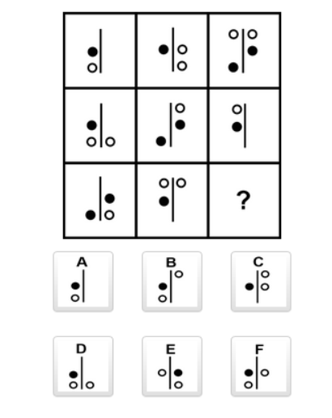
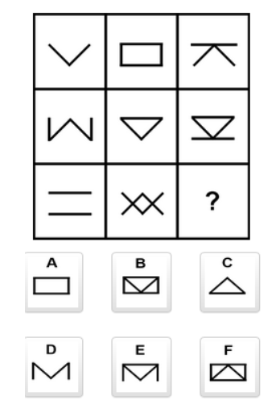
Like the MENSA puzzles
logical deduction - Mensa Norway last 3 questions - Puzzling Stack Exchange
What comes next in the sequence?
Notes:
A and D are the solutions.
Finding commonalities and patterns: this is similar to that leads to…

Slide 14
Instance-Based Learning
Nearest Neighbour algorithms
1-NN – one nearest neighbour
k-NN – k nearest neighbours
1-NN
Find instance which is closest / most similar to current problem
Solution to current problem is solution to closest instance
How do we define similarity (or distance)?
Similarity = closeness ➔ want to maximise
Distance ➔ want to minimise
Opposite concepts
Similarity = 1/distance
Notes:
By “Solution” here I mean “Label”.

Slide 15
Nearest Neighbour (1-NN)
= instance - class Yes
= instance - class No
New Problem – class?
So New problem is
Predicted to be of
class Yes
Lazy algorithm
“All” work is carried out when classifying test example / new problem.
i.e. no model is created
Calculates distance between test example and each training instance.
Notes:
There is no training.

Slide 16
Lazy algorithm
No model created.
BUT some work can be undertaken in advance
Best similarity/distance measure.
Best number of neighbours – usually an odd number
Attributes to be considered.
… and more!
No model – so lots of comparisons of new problem to instances in the dataset.
Important to ensure dataset does not have more instances than required.
Strategies can be used to compare only some instances, e.g. the ones with a suitable value for one or more attributes.
Notes:
You compare the new data point to every other data point in the dataset and calculate distance.

Slide 17
Contents (2)
Nearest-neighbour(s) retrieval
Distance (similarity)
Attribute importance
Problems
missing values
noisy data
Summary

Slide 18

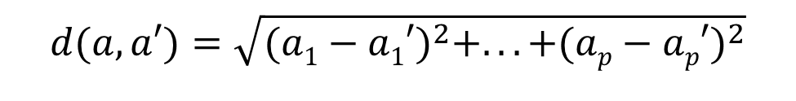
Distance
Need a way of defining proximity/distance.
Suppose a and a' are 2 instances with p attributes
a_{i} is the value of attribute i for instance a
Euclidean distance
Manhattan distance
(a₁',a₂')
$$d(a,a′)=\sqrt{(a1−a1′)^{2}+...+(ap−ap′)^{2}}$$
d
(a₁,a₂)
(a₁',a₂')
$$d(a,a′)=\left|a1−a1′\right|+...+\left|ap−ap′\right|$$
d
(a₁,a₂)
Notes:
Euclidean distance is Pythagoras. It’s also used to calculate the L2 norm distance
Manhattan’s city center is based on a grid (like Glasgow).

Slide 19
WeatherPlay data
 | Outlook | Temperature | Humidity | Windy | Play
1 | Sunny | Hot | High | False | No
2 | Sunny | Hot | High | True | No
3 | Cloudy | Hot | High | False | Yes
4 | Rainy | Mild | High | False | Yes
5 | Rainy | Cool | Normal | False | Yes
6 | Rainy | Cool | Normal | True | No
7 | Cloudy | Cool | Normal | True | Yes
8 | Sunny | Mild | High | False | No
9 | Sunny | Cool | Normal | False | Yes
10 | Rainy | Mild | Normal | False | Yes
11 | Sunny | Mild | Normal | True | Yes
12 | Cloudy | Mild | High | True | Yes
13 | Cloudy | Hot | Normal | Fase | Yes
14 | Rainy | Mild | High | True | No

Slide 20
Nominal Attributes – using Euclidean distance
For each attribute, distance is
0 if attribute values are identical
1 if attribute values are different
Example a & b are instances and p is problem
Outlook Temp Humid Wind Play
a sunny high high false yes
b rainy high high false no
p rainy high low false ?
Instance b is closest to problem p so solution is no
Notes:
Wooo, warm rain is not in our dataset…!

Slide 21
Numeric Attributes
Attributes are measured on different scales
Attributes measured on larger scales have higher impact.
If scales are very different, the attribute with the largest scale may completely dominate!
Solution you may see in CMM535
Normalise to scale [0,1].
Standardise - centre and scale. Convert to scale with
Mean of zero.
Standard deviation of 1.
Range may not be symmetrical: minimum value may have different distance to zero than maximum value.
Normalisation provides a common scale for all attributes when calculating distances.
Notes:
Imagine we measured Temperature in Fahrenheit and Humidity in %. Should our model change if we change Temperature to Centigrade?

Slide 22
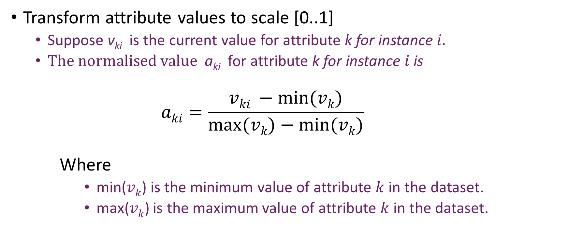
Normalisation to [0..1] scale
Transform attribute values to scale [0..1]
Suppose v_{ki} is the current value for attribute k for instance $i.$
The normalised value a_{ki} for attribute k for instance $i$ is
$$aki=\frac{vki −min⁡(vk)}{max⁡(vk)−min⁡(vk)}$$
Where
min($vk$) is the minimum value of attribute $k$ in the dataset.
max($vk$) is the maximum value of attribute $k$ in the dataset.
Notes:
So minimum value sits at 0 and maximum value sits at 1.

Slide 23
Example – numeric values
Outlook | Temperature | Humidity | Windy | Play
Sunny | 85 | 85 | False | No
Sunny | 80 | 90 | True | No
Cloudy | 83 | 86 | False | Yes
Rainy | 70 | 96 | False | Yes
Rainy | 68 | 80 | False | Yes
Rainy | 65 | 70 | True | No
Cloudy | 64 | 65 | True | Yes
Sunny | 72 | 95 | False | No
Sunny | 69 | 70 | False | Yes
Rainy | 75 | 80 | False | Yes
Sunny | 75 | 70 | True | Yes
Cloudy | 72 | 90 | True | Yes
Cloudy | 81 | 75 | False | Yes
Rainy | 71 | 91 | True | no
Maximum value
Minimum value
Notes:
Worked example of normalisation

Slide 24
Normalisation Example
Attribute data
temperature: minimum 64, maximum 85
Humidity: minimum 65, maximum 96
Normalised humidity values
norm(96)=(96-65)/(96-65)=1
norm(80)=(80-65)/(96-65)= 0.48
norm(70)=(70-65)/(96-65)=0.16
norm(65)=(65-65)/(96-65)=0
…
Normalised attribute data 1, 0.48, 0.16, 0, …
Notes:
Worked example of normalisation

Slide 25
Attribute distance – numeric values
For each (normalised) numeric attribute i distance is:
Absolute value of difference in value
|a_{i} – a_{i}’| where a_{i} and a_{i}’ are the attribute values for the 2 instances.
E.g. for and attribute with values of 0.26 and 0.75 for the 2 instances for which distance is calculated.
|0.26 – 0.75| = 0.49
Notes:
Attribute i in sample a and a’ Absolute so it doesn’t matter which way round they go.

Slide 26
Numeric Distance (normalised)
Distance calculation after normalisation
E.g. a & b are instances and p is problem
Normalised numeric values in red in brackets
Outlook Temp Humid Wind Play
a sunny 85 (1) 85 (0.65) false yes
b sunny 80 (0.76) 90 (0.81) true no
p sunny 72 (0.38) 76 (0.35) true ?
Instance b is closest to problem p so solution is no
Notes:
….Which is the same as before, yay?

Slide 27
Contents (3)
Nearest-neighbour(s) retrieval
Distance (similarity)
Attribute importance
Problems
missing values
noisy data
Summary

Slide 28
Weighting Attributes
Euclidean distance
Works well when all attributes are equally important.
BUT in many domains some attributes are more important than others.
Some attributes are irrelevant!
Not all relevant attributes are equally important.
The importance of some attributes may be class-specific.

Slide 29
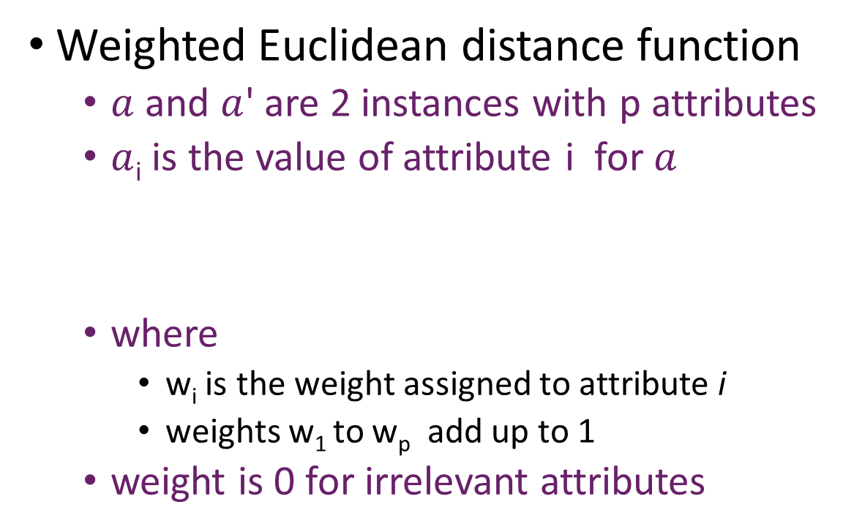
Weighting Attributes (cont.)
Weighted Euclidean distance function
$a$ and $a$' are 2 instances with p attributes
$a$_{i} is the value of attribute i for $a$
where
w_{i} is the weight assigned to attribute i
weights w₁ to w_{p} add up to 1
weight is 0 for irrelevant attributes

Slide 30
Contents (4)
Nearest-neighbour(s) retrieval
Distance (similarity)
Problems
missing values
noisy data
Summary

Slide 31
Missing values (normalised)
Nominal values
If one or both values are missing, assume maximal difference
distance is 1 (same as different values)
Numeric (normalised attributes)
If both values are missing, assume maximal difference
distance is 1
If one value is missing
assume maximal difference using the normalised version of the known value x
larger of x and (1-x)
0 X 1
Notes:
Treating missing values like this might have an exaggeratedly large effect. Replacing them with “mean” might change things.

Slide 32
Missing values
E.g. a & b are instances and p is problem
Outlook Temperature Humid Wind Play
a sunny 0.4 high no yes
b NA 1 high no no
p rainy NA low no ?
Instance a is closest to problem p so solution is yes
Notes:
Normalised temperatures…and the prediction changes.

Slide 33
Noisy Data
Noise is not detected with 1-NN
Nearest neighbour used even if different solutions in neighbourhood
k-NN (k > 1) copes better with noisy data
get k closest instances
take majority vote on their solutions
Notes:
“Closest” means minimal distance/difference.

Slide 34
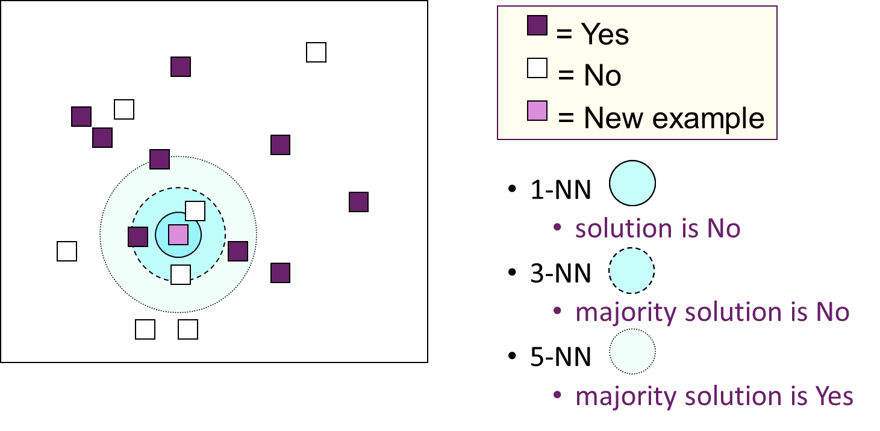
k-Nearest Neighbour (k-NN)
Notes:
Inner solid circle.

Slide 35
How to decide k?
Small k -> higher noise
Larger k -> higher bias – what if the dataset is imbalanced?
Large k -> many more distances to calculate?
Rule of thumb: k depends on the number of instances in your dataset (n). k = 0.5*sqrt(n)
Or: you could try different values of k (in a for loop) and select the best one for your dataset.
Or select a nice, odd value so voting is never tied.
classification - Value of k in k nearest neighbor algorithm - Stack Overflow
Notes:
Seems to be contentious online. Next week we will discuss clustering methods and cluster size might play a part in determining k.
Large k – more instances in your average calculation?

Slide 36
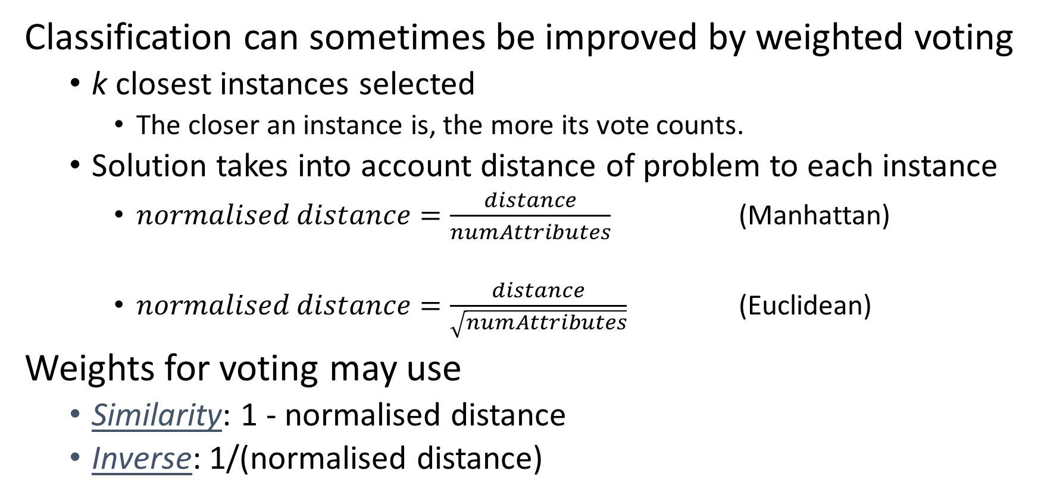
Weighted voting
Classification can sometimes be improved by weighted voting
k closest instances selected
The closer an instance is, the more its vote counts.
Solution takes into account distance of problem to each instance
$normalised distance=\frac{distance}{numAttributes}$ (Manhattan)
$normalised distance=\frac{distance}{\sqrt{\begin{aligned}\#\#\#\#numAttributes \\ \end{aligned}}}$ (Euclidean)
Weights for voting may use
Similarity: 1 - normalised distance
Inverse: 1/(normalised distance)

Slide 37
Inverse Distance Weighting
If the distance is zero, inverse weight is infinity
Solutions
take the class of the instance with zero distance as the solution
if more than one take a majority vote on these
Other solution
Add a small amount, e.g. 0.001 to denominator
no longer dividing by zero
Notes:
If there’s zero distance, then the samples are identical, no?

Slide 38
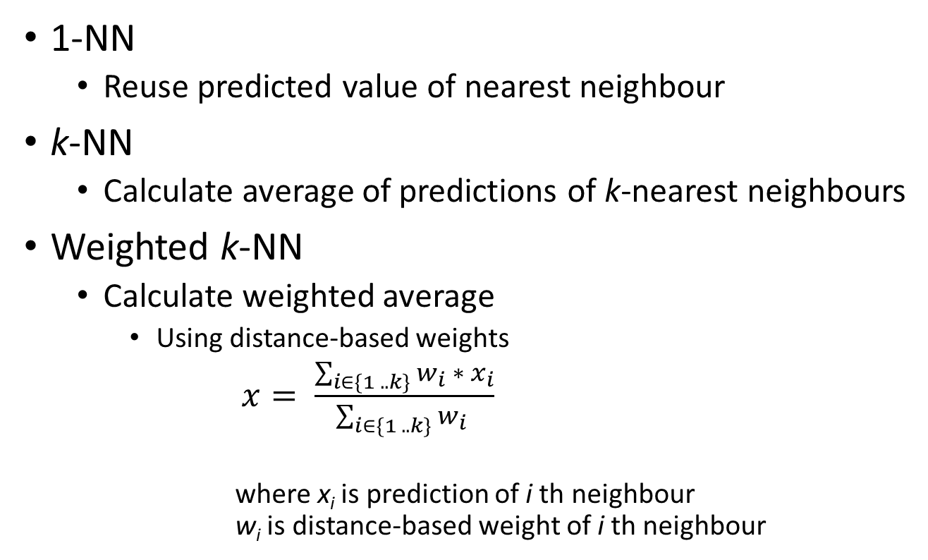
Numeric Prediction
1-NN
Reuse predicted value of nearest neighbour
k-NN
Calculate average of predictions of k-nearest neighbours
Weighted k-NN
Calculate weighted average
Using distance-based weights
$x= \frac{\sum_{i∈\{1 .. k\}}{w_{i} ∗ x_{i}}}{\sum_{i∈\{1 .. k\}}{w_{i} }}$
where x_{i} is prediction of i th neighbour
w_{i} is distance-based weight of i th neighbour

Slide 39
Summary
Lazy Learning
No explicit model is learned.
A lot of work carried out when trying to solve new problem.
Compares new problem with all training instances.
Uses solution to the closest instance(s) as the solution to a new problem.
Use k-NN with k >1 for noisy data.
k-NN is simple but effective method for classification
Performs well compared to other classifiers with attribute weighting.
BUT can be computationally expensive.
Especially with large data sets or lots of attributes.

