Slide 1
R code for train and train control

Slide 2
General template for setting experiment
Clear the environment
rm(list=ls())
library(caret)
…
mydata <- read.csv("mydata.csv", header = T, StringsAsFactors=T)
ctrl <- trainControl(method = "cv", number = 5)
set.seed(123)
c5treemod <- train(myclass ~ ., data = mydata,
method = "C5.0Tree",
trControl = ctrl)
Load libraries (depends on algorithms and data to be used)
Load dataset
Define experiment design
Ensure reproducibility of results – same seed number, same results
Apply algorithm to dataset mydata. myclass is the class
Algorithm is C5.0Tree
Experiment design as defined earlier in ctrl

Slide 3
The train control
0.8441558 0
4-fold cross validation
ctrl <- trainControl(method = "cv",
number = 4)
Repeated 10-fold cross validation
ctrl <- trainControl(method = "repeatedcv",
number = 10,
repeats = 3,
verboseIter = FALSE)
Cross validation
4 folds
Repeated cross validation
10 folds
3 repetitions
Do not show execution trace

Slide 4
The train
4-fold cross validation
ctrl <- trainControl(method = "cv",
number = 4)
Repeated 4-fold cross validation
c5treemod <- train(myclass ~ ., data = mydata,
method = "C5.0Tree",
metric = "Accuracy",
trControl = ctrl)
Cross validation
4 folds
Change according to data
Change according to data
Algorithm
Evaluation metric. Default is Accuracy
Experiment design

Slide 5
Results
We have seen how to check results individually (e.g. check confusion matrices, decision trees, etc)
For statistical significance – check whether there is overlap in intervals
results <- resamples(list(CART=mod.cart,
c5Rules = mod.c5rules,
C5Tree = mod.c5t,
ctree = mod.ctree))
results
summary(results)
Results contains all the data required from the experiments to calculate the confidence intervals, i.e. accuracy/kappa ± margin of error.
How we want to name our models in the plot
Mod.c5rules, mod.c5t and mod.ctree are models we have built . We want to compare their performance.

Slide 6
… Results
Call:
summary.resamples(object = results)
Models: CART, c5Rules, C5Tree, ctree
Number of resamples: 30
Accuracy
Min. 1st Qu. Median Mean 3rd Qu. Max. NA's
CART 0.6842105 0.7114662 0.7385509 0.7408521 0.7662338 0.8181818 0
c5Rules 0.6753247 0.7272727 0.7451299 0.7426179 0.7654648 0.7922078 0
C5Tree 0.6447368 0.7272727 0.7402597 0.7447368 0.7662338 0.8051948 0
ctree 0.6315789 0.7105263 0.7402597 0.7390920 0.7662338 0.8441558 0
Kappa
…
3 repeats of 10-fold cross validation = 30
Kappa figures are also shown

Slide 7
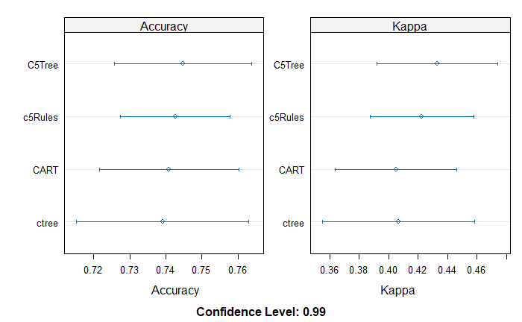
Statistical significance of difference in results
All intervals overlap at this confidence level so the difference in performance is not statistically significant.
C5Tree’s accuracy is a little higher but the difference is not enough to be able to state that it offers better performance.
scales <- list(x=list(relation="free"),
y=list(relation= "free"))
dotplot(results, scales = scales, conf.level = 0.99)

Slide 8
Confusion matrices (examples on 3 reps 4-fold cv)
confusionMatrix.train(c5treemod, norm="none")
Reference
Prediction setosa versicolor virginica
setosa 146 0 0
versicolor 4 136 11
virginica 0 14 139
Accuracy (average) : 0.9356
confusionMatrix.train(c5treemod, norm ="overall")
Reference
Prediction setosa versicolor virginica
setosa 32.4 0.0 0.0
versicolor 0.9 30.2 2.4
virginica 0.0 3.1 30.9
Accuracy (average) : 0.9356
confusionMatrix.train(c5treemod, norm="average")
Reference
Prediction setosa versicolor virginica
setosa 12.2 0.0 0.0
versicolor 0.3 11.3 0.9
virginica 0.0 1.2 11.6
Accuracy (average) : 0.9356
Numbers are counts over the 3 repetitions add up to 150 *3 = 450, i.e. 3 times the number of instances
Numbers add up to 100 as these are percentages.

