Slide 1
CMM500: Data Mining Week 10 – Imbalanced Datasets
Pamela Johnston

Slide 2
What is class imbalance?
Majority class
Minority class
There are way more instances in the majority class than in the minority class.
But the important class is the minority class.
Notes:
Examples: disease presenting in a minority of people, “black swan” events, system failure – a mechanical system might run for lengthy periods of time before failure (i.e. only one day of failure in over a year of running).

Slide 3
Why is class imbalance a problem?
Classifiers prioritise correct majority class.
Poor performance on minority class.
Insufficient data samples on minority class to compensate.
“Accuracy” on the whole dataset becomes a useless metric.

Slide 4
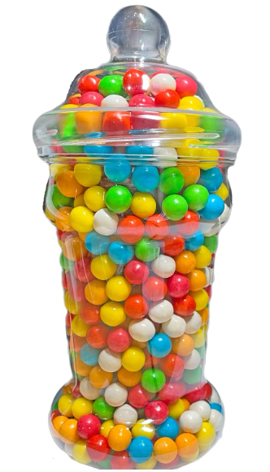

Why is class imbalance a problem?
Pam’s sweetie classifier
Jar has 100 sweeties
1 is “poisoned”
99 are sweet
Model is 99% accurate
NOT
Poison
The classifier
Notes:
Very large class imbalance with 99% of one class, 1% of another.

Slide 5
Is my dataset imbalanced?
50:50 split -> not imbalanced at all (two classes)
33:33:33 -> not imbalanced at all (three classes)
60:40 -> not much imbalance (don’t worry about it)
20:30:50 -> not much imbalance (don’t worry about it)
90:10 -> consider balancing techniques
45:45:10 -> consider balancing techniques
Notes:
Coursework hints…
Don’t worry about it *unless* the confusion matrix implies that you should.

Slide 6
Ambiguity in dataset imbalance
If your dataset is more than ~60:40 imbalanced, then you might get a model improvement by balancing the data.

Slide 7
Is imbalance a problem? (the real check)
Predicted
Once you’ve trained a classifier:
Is the minority (important) class (almost) totally ignored?
What does your confusion matrix look like?
What percentage of your minority class is predicted correctly (i.e. what is the True Positive Rate)?
1
0
1
9
1
Actual
0
90
0
An alarming confusion matrix
Notes:
After you’ve trained a classifier.

Slide 8
Class imbalance and classification
Check confusion matrix
Which is the “important” class?
Is the classifier accurate on the minority class or classes?
Is overall accuracy a good measure?
Which is the “better” classifier?
Notes:
You might be willing to take a drop in overall accuracy if it improves the minority class accuracy (or f1 score).

Slide 9
Class imbalance and cross validation
Sometimes a dataset is so imbalanced that splitting it into parts for stratified cross fold validation means that some folds do not have any instances of a minority class.
This will cause a warning in R. You will see this in today’s lab.

Slide 10
“Class” imbalance and association rules
100% of shopping baskets contain milk!
What is the effect on “Support”?
What might be the effect on “Lift”?
What is the effect on “Confidence”?
Interesting rules might have much less support than something that is very common.
5% of shopping baskets contain eggs!
100% of shopping baskets with eggs also contain bacon!
Notes:
If an itemset is very common, support will be very high.
Confidence ignores baskets without items in the itemset (i.e. ratio, so ignores support)
Lift takes support into account with the “expected” calculation.

Slide 11


Support
Support is the proportion of the dataset that contains the itemset.
If EVERY basket contains milk, then support for {milk} = 1
If half of the baskets contain milk, then support for {milk} = 0.5
Notes:
Support for the itemset

Slide 12
Confidence
Full dataset (n instances)
ID | Milk? | Cheese
0 | Y | N
1 | N | Y
… | … | …
n | Y | Y
The proportion of the instances in the dataset which have the antecedent which also contain the consequent.
Think of filtering the dataset so that we only have the instances where the antecedent is true. Now it’s the proportion of those instances that also contain the consequent.
If the antecedent is {milk} and it’s in half of the dataset (i.e. millk_support=0.5), and in the half of the dataset that contains milk, one quarter of those baskets also contain cheese, then confidence is one quarter.
Milk dataset (n * milk_support)
ID | Milk? | Cheese
0 | Y | N
2 | Y | Y
… | … | …
<n | Y | Y
Notes:
Confidence in the RULE

Slide 13
Lift
Dataset of quantum dice
Roll | Dice 1 | Dice 2
0 | 1 | 6
1 | 2 | 2
… | … | …
n | 3 | 5
What is the ratio of this rule to “chance”?
Two dice. If I roll a 2 on one of them, what are the chances of me rolling a 2 on the second?
Normally they are independent. So, 1 in 6.
But if I have magic quantum-tangled dice, I might get a lift of 36.

Slide 14
Attribute imbalance and clustering
Minority class might form one very small cluster.
Clusters of the majority class might be bigger than the minority class cluster.
Analysis of the clusters might reveal this (but only if the minority class cluster is of sufficient size to appear in the analysis).

Slide 15
What can be done about class imbalance
Tackle it in the dataset:
Undersample
Oversample
Generate synthetic samples
Tackle it in the model:
Some models allow for class weights so that a particular class can be seen as more important.
Notes:
Note best practice regarding training/testing class imbalance

Slide 16

Undersampling (easy)
Randomly ordered majority class
Simply remove some of the majority class to reduce the class imbalance of the minority class.
If you have multi-class classification but are not interested in the minority classes, you can remove whole classes.
Uninteresting classes
Notes:
Can be done using only pandas drop/keep functions.
For coursework, it would be acceptable to do this as a pre-processing step (i.e. subsample the dataset provided before you do anything else to account for the imbalance).

Slide 17
Undersampling choices
In the majority class, you can:
Decide to keep specific samples
Decide to throw away specific samples
Do a combination of both

Slide 18
Undersampling (more complex)
NearMiss Undersampling and CondensedNearestNeighbours : sample (add) the instances of the majority classes that are closest to the instances of the minority class.
TomekLinks: decides which majority class instances to remove based on their distance from instances of the opposite class.
See the lab for examples.
Undersampling Algorithms for Imbalanced Classification - MachineLearningMastery.com

Slide 19
Oversampling (easy)
Just double up on a selection of minority class samples.
This effectively re-weights the sample so that the model sees minority class instances as more important than the appear in the distribution.

Slide 20
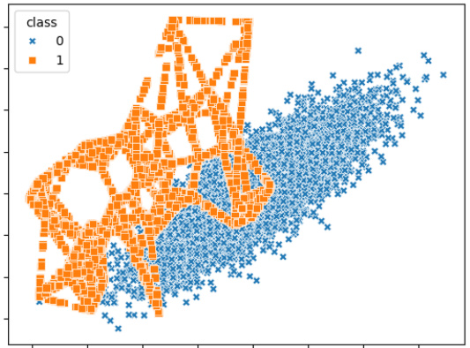
Oversampling (SMOTE)
SMOTE combines both undersampling the majority class and oversampling the minority class.
“The minority class is over-sampled by taking each minority class sample and introducing synthetic examples along the line segments joining any/all of the k minority class nearest neighbors.”
Chawla, Nitesh V., et al. "SMOTE: synthetic minority over-sampling technique." Journal of artificial intelligence research 16 (2002)
Notes:
In the picture, the orange class is oversampled. See the straight lines? That’s the line segments joining nearest neighbours. This is from the lab.
The SMOTE paper is totally readable.

Slide 21
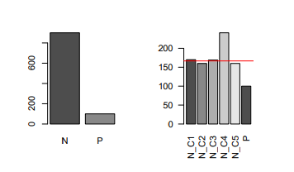
Increasing the number of classes available in the majority class.
Find within-class similarity in the dominant class
Oversample minority-class instances
Classify and compare
Elyan, Eyad, Carlos Francisco Moreno-Garcia, and Chrisina Jayne. "CDSMOTE: class decomposition and synthetic minority class oversampling technique for imbalanced-data classification." Neural computing and applications 33 (2021)

Slide 22
CDSMOTE motivation
Binary classification is dominant in many medical datasets, with the positive class denoting the existence of a particular disease in medical diagnosis applications
Such labelling does not depict the reality of having different categories of the same disease
What if datasests were decomposed using clustering of each class to reveal hidden categories?
Such class decomposition has three (potential) advantages:
Diversification of the input that enhances the ensemble classification;
Improving class separability, easing the follow-up classification process;
Finer-grained training.

Slide 23
Class decomposition – example Iris dataset
Sepal len | Sepal wid | Petal len | Petal wid | class
5.1 | 3.5 | 1.4 | 0.2 | Setosa
4.9 | 3.0 | 1.4 | 0.2 | Setosa
4.7 | 3.2 | 1.3 | 0.2 | Setosa
4.6 | 3.1 | 1.5 | 0.2 | Setosa
5.0 | 3.6 | 1.4 | 0.4 | Setosa
5.4 | 3.9 | 1.7 | 0.3 | Setosa
4.4 | 3.4 | 1.4 | 0.2 | Setosa
Three classes:
Setosa
Virginica
Versicolor

Slide 24
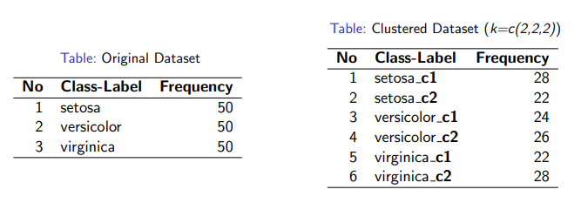
Class decomposition: Iris
Cluster instances within each class into 2 groups

Slide 25
Oversampling (synthetic samples)
Synthetic data samples are a growing research trend.
Useful for classification
Data samples can be used to supplement the minority class.
Should also be present in the majority class or classifier could learn that synthetic == minority class
Generative AI is aiding the generation of synthetic samples.

Slide 26
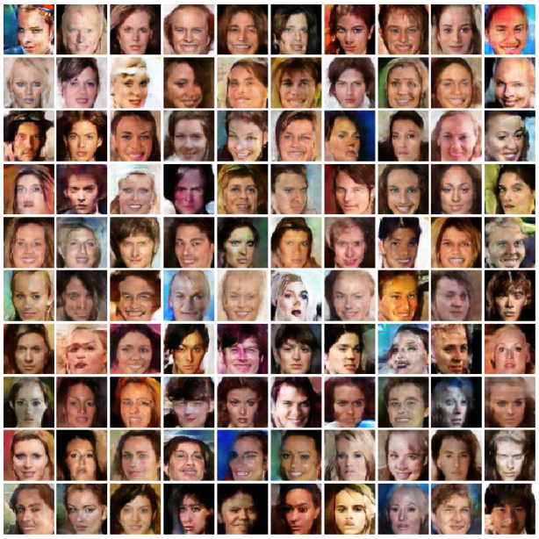
Synthetic image examples from GANs
Images do not have to look perfect to supplement the dataset.
Useful for imbalanced image datasets.
Ali-Gombe, Adamu, and Eyad Elyan. "MFC-GAN: Class-imbalanced dataset classification using multiple fake class generative adversarial network." Neurocomputing 361 (2019)

Slide 27
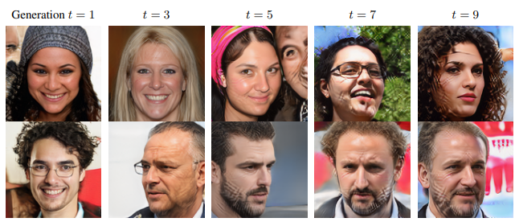
Synthetic data: use caution if training generative AI.
Alemohammad, Sina, et al. "Self-consuming generative models go mad." arXiv preprint arXiv:2307.01850 (2023).
Notes:
They’re frequency features. It’s high frequencies becoming higher and more visible with each re-use. Similar patterns exist in large language models.
If the internet fills up with synthetic data, then we may effectively salt our data harvesting ground. We might be at peak data harvesting for generative AI.

Slide 28
Attention project pickers!
Project involving dataset synthesis
Flow Cytometry (with SPASPHS)
Graphs, clustering, oversampling, data cleaning, interactive data visualisation

