Slide 1
Ensembles: Combining Multiple Models
Statement for Audio and Video Learning Resources
Video and audio content at the University uses closed captions generated by automatic speech recognition (ASR). The ASR process is based on machine learning algorithms which automatically transcribe voice to text. According to our technology providers, this process is approximately 70-90% accurate depending on the quality of the audio, and consequently video and audio closed captions may include some transcription errors. It is therefore important to recognise that the original recording is the most accurate reflection of the content, and not the captions.
If you require accurate captions as part of your reasonable adjustments, please contact the Inclusion Centre to discuss your requirements.

Slide 2
Lab Postmortem
What is Lift?
How is lift calculated?
Why is lift different from confidence?
What is support?
What on earth is this graph with all the arrows? How is that useful?

Slide 3


Support
Support is the proportion of the dataset that contains the itemset.
If EVERY basket contains milk, then support for {milk} = 1
If half of the baskets contain milk, then support for {milk} = 0.5
Notes:
Support for the itemset

Slide 4
Confidence
Full dataset (n instances)
ID | Milk? | Cheese
0 | Y | N
1 | N | Y
… | … | …
n | Y | Y
The proportion of the instances in the dataset which have the antecedent which also contain the consequent.
Think of filtering the dataset so that we only have the instances where the antecedent is true. Now it’s the proportion of those instances that also contain the consequent.
If the antecedent is {milk} and it’s in half of the dataset (i.e. millk_support=0.5), and in the half of the dataset that contains milk, one quarter of those baskets also contain cheese, then confidence is one quarter.
Milk dataset (n * milk_support)
ID | Milk? | Cheese
0 | Y | N
2 | Y | Y
… | … | …
<n | Y | Y
Notes:
Confidence in the RULE

Slide 5
Lift
Dataset of quantum dice
Roll | Dice 1 | Dice 2
0 | 1 | 6
1 | 2 | 2
… | … | …
n | 3 | 5
What is the ratio of this rule to “chance”?
Two dice. If I roll a 2 on one of them, what are the chances of me rolling a 2 on the second?
Normally they are independent. So, 1 in 6.
But if I have magic quantum-tangled dice, I might get a lift of 36.

Slide 6
Lift (example)
(“Probability” is same as “Support”.)
100 baskets in the dataset, 50 of them contain milk. Probability of milk being in basket is 50 in 100 (which is 1 in 2).
100 baskets in the dataset, 16 of them contain cheese. Probability of cheese being in basket is 16 out of 100 (which is 4 in 25)
Chances of milk and cheese being in the same basket? 1 in 2 times 4 in 25 (which is 2 in 25).

Slide 7
Lift (example part 2)
Chances of milk and cheese being in the same basket? 1 in 2 times 4 in 25 (which is 2 in 25….which is 4 in 50).
But actual observed milk and cheese in the same basket? Say our dataset has 13 baskets that contain cheese and milk (13 out of 50).
We expected 4 milk+cheese. We got 13 milk+cheese.
Lift is 13/4 = 3.25.

Slide 8
Lift (alternative toy example)
Dataset 100 baskets.
50 {milk} baskets (1 in 2)
50 {lemon} baskets (1 in 2)
3 {lemon+milk} baskets (3 in 100)
Chances of {lemon+milk): 1 in 4 so expect 25 baskets
But get 3 baskets.
Lift is 3/25 = 0.12. Very few people buy lemon and milk.

Slide 9
Contents
A committee of “experts”
Bagging
Randomisation
Boosting
Stacking
Discussion

Slide 10
Modelling algorithms
Business Understanding
Data Understanding
Data Preparation
Modelling
Evaluation
Deployment
Wide range of algorithms for prediction
Classification
Numeric prediction
Data

Slide 11










The bull at the country fayre
Francis Galton (statistician)
Lots of people guess
Actual weight within 1% of the median of all the guesses.
“Wisdom of crowds”
Lots of votes better than single decision
TEDxLiverpool - Tom Scott - A Mobile Future – live demonstration of the “wisdom” of crowds
Notes:
All these little toilet icons are all very different from each other.
Bull is right in front of them and they can see it. Weight is related.
Galton 1822-1911. Bit racist so don’t believe everything he writes.

Slide 12



Ensemble methods
Lots of individual models
All make (different?) predictions (different dataset? Different model?)
Predictions combined (somehow (e.g. voting)
Better than single models (sometimes).
Bull
Truck
Bull
Bull

Slide 13
Algorithms
Hyper parameters
Data
(Train/Test/Validate)
Predictions
Performance Metrics
Model
(architecture)
Notes:
Labelled data
Model architecture? Maybe hyper parameter, but C5.0, rpart, ID3 etc.
Predictions are classes
Performance Metrics are Lecture 4 (Accuracy, ROC curves, AUC, Precision, Recall, Confusion Matrix)
Hyperparameters? Depth of decision tree,

Slide 14
Overfitting
Good on training set, poor on unseen data
Model fits to noise
High variance in the model
Underfitting
Not good on either training data or test data
Model has not converged enough
High bias in the model
Notes:
But individual models can have problems expressed in different ways.
Pruning or stopping training early or limiting the model somehow gets rid of overfitting.
More training helps underfitting.

Slide 15
Ensemble algorithms
Technique which resolves the problem of overfitting by building a committee of experts (models), which vote on the solution to each problem.
The most frequent vote is returned in classification problems.
For regression problems (i.e. numeric prediction), the mean of all predictions is returned.

Slide 16
Ensembles of Multiple Models
Basic idea of meta learning schemes
build different “experts” (predictive model) and let them “vote”
committee or ensemble of experts
Advantage
often improves predictive performance
Disadvantage
produces output that is very hard to interpret
Can be applied to both classification and numeric prediction problems

Slide 17
Basic Ideas
Bagging. Building multiple models
(normally) of the same type
different subsamples of the training dataset.
Randomisation. Build multiple models
Use different random options.
Boosting. Building multiple models
(normally) of the same type
subsequent model learns to fix the prediction errors of an earlier model.
Stacking. Building multiple models
Base models (normally) of differing types
Meta model: learns how to best combine the predictions of the base models.

Slide 18
Contents (2)
A committee of “experts”
Bagging
Randomisation
Boosting
Stacking
Discussion

Slide 19
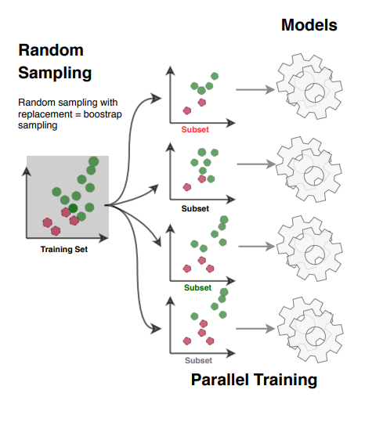
How to split the dataset - Bagging
Bootstrap aggregating (Bagging) is sampling data from the training set with replacement
With Bagging an instance can be sampled more than one time for the same model/ predictor
Once all models are trained, the ensemble can make a prediction for a new instance by aggregating the predictions from all models

Slide 20
Bagging Approach
Simplest way of combining predictions
Classification: vote
Numeric prediction: average
Each model (expert) receives equal weight
Idealised version of bagging:
Use several training sets of size n
instead of just having one training set of size n
Build a model for each training set
Combine the classifiers’ predictions using voting

Slide 21
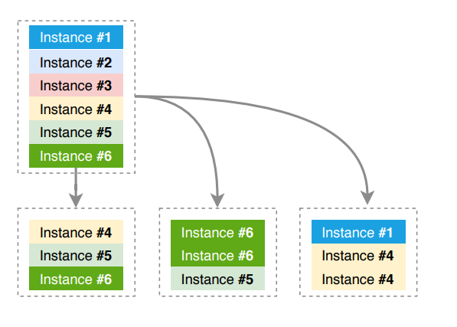
Bagging
For each data sub-set, take k samples from the dataset, one at a time, repeat instances are allowed.
Each model in the ensemble will be trained on almost 63% of the training set. ~37% left for testing (out of bag evaluation)
Dataset
n
n
k
n-k
Training
Testing
Notes:
Bagging is actually a nice dataset division for small datasets. But may amplify dataset imbalance. But you could weight instances so they’re more likely to get picked.

Slide 22
Bagging Performance
Reduces expected error due to variance
Improves performance in almost all cases
unstable learners provide diversity of models from different datasets (e.g. decision trees made even more unstable by removing pruning)
stable learners do not provide diversity (e.g. k-NN)
Usually, the more classifiers the better
more classifiers, greater reduction of variance
voted predictions are more reliable with more votes
Can help a lot if data is noisy

Slide 23
Datasets for Bagging
But the training set is finite!
Generate new datasets of size n by sampling with replacement from original dataset
Bagging = bootstrap aggregating
bootstrap by selecting with replacement
aggregate by combining results

Slide 24
Bootstrap
Dataset D contains n samples
Sample D n times (with replacement) to obtain a training set Tr
Duplicates are allowed
On average each bootstrap sample Tr will contain 63.2% of the instances in D.
Instances not in the training set Tr, become part of the test set Te. This is also called the out of bag sample.

Slide 25
Bootstrap illustration – B samples selected
Original dataset
A
B
C
D
E
F
G
H
I
J
Bootstrap (training) sample 1
Out of bag (test) sample 1
Bootstrap training sample B
Out of bag (test) sample B
A
A
D
A
A
A
D
B
B
G
B
F
C
C
C
H
G
E
…
E
I
F
F
H
I
J
J
J
Notes:
n=10 (10 samples in the original dataset)
10 samples in Sample 1
10 samples in all of the subsampled datasets. But they have repeat samples.

Slide 26
Bagging Model Generation
Let n be the number of instances in the training data
For each of t iterations
Sample n instances with replacement from training set
Apply learning algorithm (e.g. C5.0) to sample
Store the resulting model (e.g. decision tree)
Initial dataset
Bootstrap
Samples
Apply
“C5.0”
Models

Slide 27
Bagging classification
New problem
For each of the t models (e.g. decision trees)
Predict class of instance using model
If task = classification
then
Return class predicted most often
else (task = numeric prediction)
Return average(results)
class

Slide 28
Contents (3)
A committee of “experts”
Bagging
Randomisation
Boosting
Stacking
Discussion

Slide 29
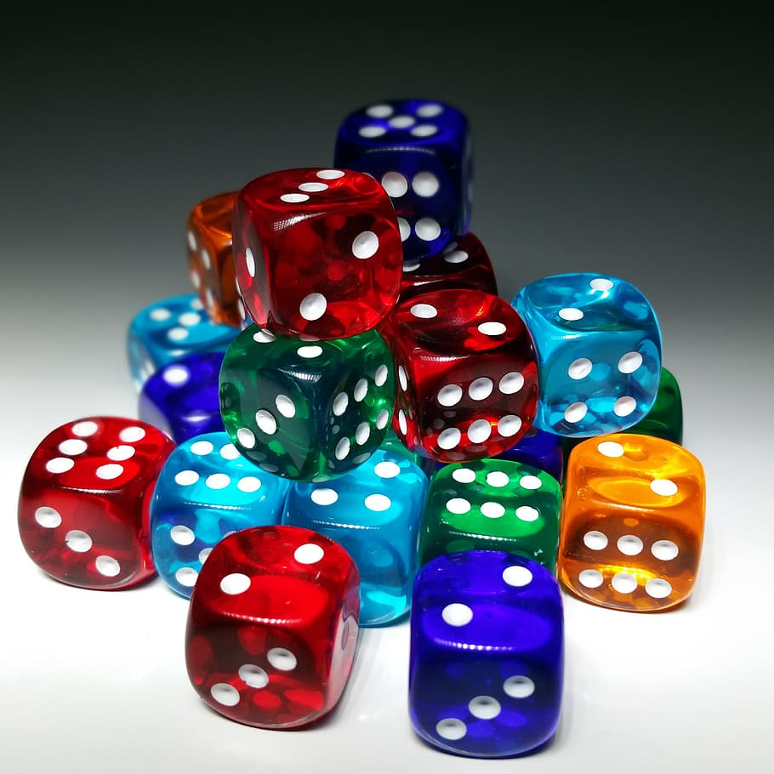
Randomisation
Some algorithms already have a random component
Randomise learning algorithm to construct a committee of classifiers
e.g. change the seed
Most algorithms can be randomised somehow
e.g. attribute selection in decision trees (see below)

Slide 30
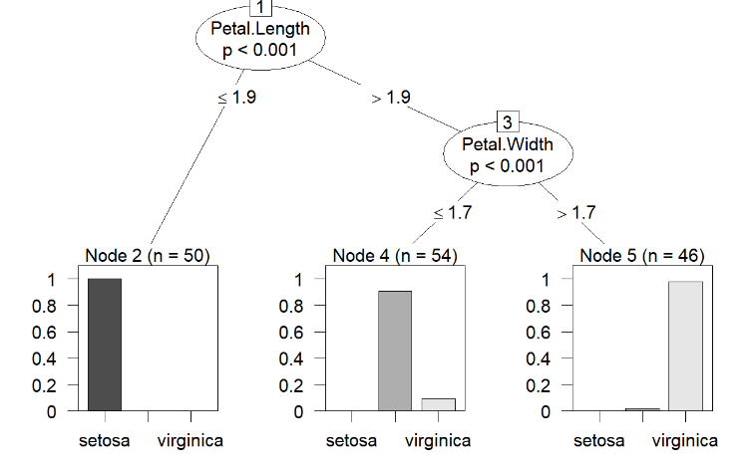
But my decision tree always looks like this...
Same seed, same dataset, same decision tree, right?
What about same dataset, different attributes?
Week 4’s Lab – Ctree on Iris.

Slide 31
Your dataset is a table
Roll | Dice 1 | … | Dice 2
0 | 1 | … | 6
1 | 2 | … | 2
… | … | … | …
n | 3 | … | 5
Bagging randomises rows (allowing repeats).
You can also randomise columns (attributes).
Random Forest does both.
Random tree:
construct a tree. At each level (node) consider only k attributes at random.
k can be selected
Random forest – bagging with random tree

Slide 32
Random forest
Given ONE dataset, how can more than one decision tree be obtained?
Randomisation
Random forests – what is randomised
ROWS: The partitioning of the dataset with Bootstrap to obtain
Training Set
Test set
COLUMNS: Randomisation of the attribute (feature) set for candidate split selection – Feature bagging

Slide 33
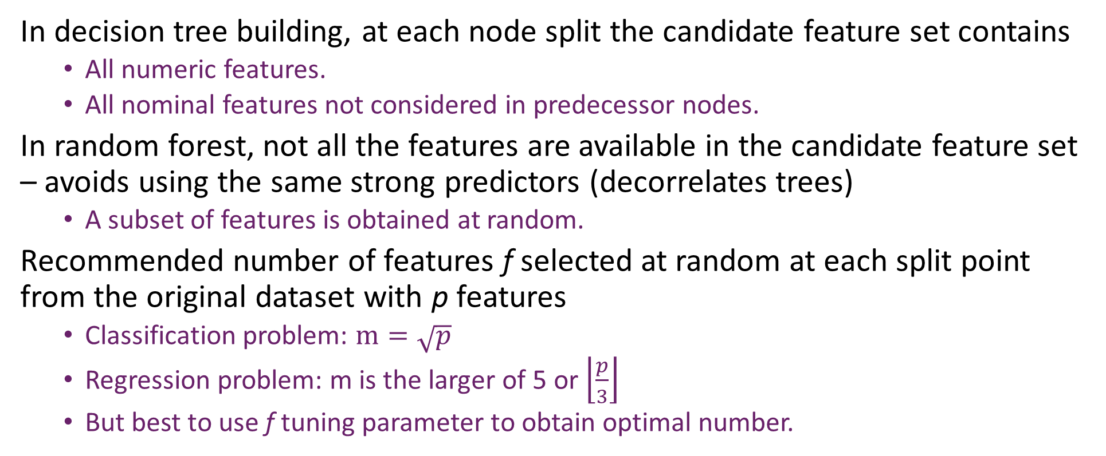
Feature bagging
In decision tree building, at each node split the candidate feature set contains
All numeric features.
All nominal features not considered in predecessor nodes.
In random forest, not all the features are available in the candidate feature set – avoids using the same strong predictors (decorrelates trees)
A subset of features is obtained at random.
Recommended number of features f selected at random at each split point from the original dataset with p features
Classification problem: $m=\sqrt{p}$
Regression problem: m is the larger of 5 or $\left\lfloor \frac{p}{3}\right\rfloor$
But best to use f tuning parameter to obtain optimal number.
Notes:
Features, attributes, columns, whatever.
Subset feature size m

Slide 34
Feature bagging illustration – assume 22 features
One target feature (assumed numeric) so 21 predictive features.
Predictive Features: f₁, f₂, f₃, f₄, f₅, f₆, f₇, f₈, f₉, f₁₀, f₁₁, f₁₂, f₁₃, f₁₄, f₁₅, f₁₆, f₁₇, f₁₈, f₁₉, f₂₀ ,f₂₁
Assume m = 21/3 = 7 features randomly selected to candidate feature sets
Candidate features:
f₄, f₇, f₈, f₉, f₁₂, f₁₃, f₂₁
f9
Candidate features:
f₂, f₄, f₅,f₇, f₁₁, f₁₂f₁₉
<= 0
> 0
Candidate features:
f₁, f₆, f₇,f₁₀, f₁₁, f₁₄, f₁₉
f4
f19
<=20
>20
<=12.5
> 12.5
…
…
…
…
Health plan
Notes:
This is a massive table of data with 21 columns. But each node only sees 7 random columns.

Slide 35
Random forest – number of trees
Random forests generally perform better than classification trees.
Single tree can suffer from overfitting but a team of single trees does not have this disadvantage provided the trees are unrelated.
But bootstrap sampling and feature bagging should lead to trees are not highly correlated as they are built from different training sets and features.
Normally lots of trees generated - a few hundred or more.

Slide 36
Random forest evaluation – out of bag error
B models in the random forest
For each instance in dataset D
Find all models which do not have that instance in the training set.
Solve the instance with each of those models and obtain a combined answered (e.g. majority vote).
Calculate the error.
Return average error over all instances.
The out of bag error stabilises once enough models are considered.
Advantage over cross validation:
Computationally less expensive
Models can be tested as they are trained.

Slide 37
… out of bag error
Out of bag error overestimates in datasets with
Few instances.
Lots of features.
Instances of each class equally represented.

Slide 38
Random Forest
An ensemble classification (and regression) technique introduced by Leo Breiman
Generates a diversified ensemble of decision trees adopting two methods:
A bootstrap sample is used for the construction of each tree (bagging), resulting in approximately 63.2% unique samples, and the rest are repeated
At each node split, only a subset of features are drawn randomly to assess the goodness of each feature/attribute (√F or log₂F is used, where F is the total number of features)
Trees allowed to grow without pruning
Typically, 100 to 500 trees are used to form the ensemble
It is now considered among the best performing classifiers
Breiman, Leo. "Random forests." Machine learning 45 (2001)

Slide 39
Random forest wins!
In one of the largest experiments that have been carried out in 2014, researchers used:
179 classifiers
121 datasets (the whole UCI repository at the time of the experiment)
Random Forest was the first ranked, followed by SVM with Gaussian kernel.
Fernández-Delgado, Manuel, et al. "Do we need hundreds of classifiers to solve real world classification problems?." The journal of machine learning research 15.1 (2014)

Slide 40
Random forest – what can be changed
Criteria for choosing best node
e.g. information gain or gini index
Maximum number of features to be selected for each candidate feature bag.
Maximum depth of each tree, i.e. maximum number of levels.
Number of trees generated.
Number of instances in a node to consider splitting.
Notes:
So everything is the same as decision trees except the last two

Slide 41
Advantages and disadvantages of RF
Advantages:
Performance generally better than trees
Reduced variance compared to decision trees.
No overfitting
Variable importance can be assessed (outside the scope of this module).
Used for classification and regression
Disadvantages
Very difficult to interpret models.
Computationally expensive.

Slide 42
Contents (4)
A committee of “experts”
Bagging
Randomisation
Boosting
Stacking
Discussion

Slide 43
Boosting
~~~~
~~~~
☑ ~~~~
~~~~
☑ ~~~~
~~~~
~~~~
~~~~
☑ ~~~~
~~~~
~~~~
☑ ~~~~
Iterative procedure
New models influenced by performance of previous
Combining predictions
Classification: weighted vote
Numerical prediction: weighted average
Models weighted: according to performance
New model encouraged to be expert for instances classified incorrectly by earlier ones
intuitive justification: models should be experts that complement each other
E.g. AdaBoost.M1 for classification

Slide 44
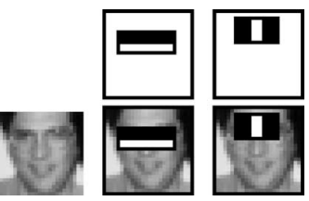
AdaBoost
Build a classifier on some base features
Make predictions
Look at misclassified instances
Reweight dataset to make misclassified instances more important
Train another classifier or reweighted dataset
Models vote but votes weighted by error rate on own dataset.
Features for face detection.
Viola, Paul, and Michael J. Jones. "Robust real-time face detection." International journal of computer vision 57 (2004)

Slide 45
AdaBoost.M1 Model Generation
Assign equal weight (1/n) to each training instance
for each of t iterations:
Apply algorithm to weighted dataset and store model
Compute error e on weighted dataset and store error
if e = 0 or e >= 0.5
Terminate model generation
for each instance in dataset
if instance classified correctly by model
Multiply instance weight by e / (1 - e)
Normalize weight of all instances (sums to 1)
Re-weight
Apply
“C5,0”
e
e
e
i.e. reduce weight if correct
Notes:
Training instance = dataset row.
e/ (1-e) will be smaller than 1 if e is smaller than 1
Error rate is total weight of incorrect samples divided by total weight of all samples… or could just be the proportion of samples that are incorrectly classified.
Error too big or too small! Too big is more than half the samples are still incorrect after a specific model.

Slide 46
AdaBoost.M1 Classification
Assign weight of zero to all classes
For each of the t models
Add -log(e / (1 - e)) to weight
of class predicted by model
Return class with highest weight.
e
e
e
class
Notes:
Each model gets weighted vote on the output class.
Models votes are then combined.

Slide 47
Boosting (2)
Correctly classified instances
weight is reduced
easy instances have low weight
learning does not focus on these
Incorrectly classified instances
Relative weight is increased (normalisation)
difficult instances have high weight
learning concentrates on these
C5.0 can use weighted training examples

Slide 48
Characteristics of Boosting
Boosting is often significantly more accurate than bagging
but tends to overfit noise
Boosting works unless
base predictive models are too complex
error becomes too large too quickly
Trade-off: complexity vs accuracy of predictive models
Cannot be trained in parallel (like Bagging)
Notes:
Can’t train all of the models simultaneously like in bagging.

Slide 49
Characteristics of Boosting (2)
Simple learning methods are called weak learners
e.g. decision “stumps”
Boosting works well with weak learners
provided error does not exceed 0.5
easy for binary class problems
often not OK for multi-class problems
Converts them into a strong learner
If boosting is successful, it is often spectacular

Slide 50
Contents (5)
A committee of “experts”
Bagging
Randomisation
Boosting
Stacking
Discussion

Slide 51
Stacking (Stacked Generalisation)
Base learners are usually different
unlike bagging and boosting
Combining predictions
not simple weighted vote/average
stacking learns which models are reliable in different circumstances
Hard to analyse theoretically
used less than bagging or boosting
Notes:
Base learners are your models.
Learning to combine predictions.

Slide 52
Stacking (Stacked Generalisation) (2)
Predictions of base learners (level-0 models) used as input for meta learner (level-1 model)
Predictions on training data can’t be used to generate data for level-1 model!
Results in over-fitting
Cross-validation-like scheme
Training folds are level-0 training data
Testing fold generates level-1 training data
Training
Testing
0-training
0
0
0
1
1-Training
Notes:
Split your dataset in to training and Testing, but then split the training set further into Training for the level-0 models and training for the level 1 models.

Slide 53
Stacking
Base learners do most of the work
meta-learner is simply arbiter
Algorithm for meta-learner
any learning scheme can be applied
sensible to be simple
should reduce risk of over-fitting
Notes:
Models can be trained in parallel. Models evolve new features. Deep learning ensembles sometimes re-use these features and train a new model on features discovered by other models.

Slide 54
… summary
Boosting, randomisation & bagging use same base learners
Unlike stacking
Boosting and bagging generate training data in different ways
Bagging uses simple combination of vote or average
Boosting uses weighted combination of vote or average

