Slide 1
Algorithms: Apriori (association rules)
Statement for Audio and Video Learning Resources
Video and audio content at the University uses closed captions generated by automatic speech recognition (ASR). The ASR process is based on machine learning algorithms which automatically transcribe voice to text. According to our technology providers, this process is approximately 70-90% accurate depending on the quality of the audio, and consequently video and audio closed captions may include some transcription errors. It is therefore important to recognise that the original recording is the most accurate reflection of the content, and not the captions.
If you require accurate captions as part of your reasonable adjustments, please contact the Inclusion Centre to discuss your requirements.

Slide 2
Contents
What are Association Rules?
Itemsets and Rules
Apriori Algorithm
Summary

Slide 3
Classification Rule (Revision)
Predicts value of pre-specified attribute (class or label)
If Outlook=overcast then play=yes
Label (class)
Outlook | Temp | … | Play
Overcast | Cool | … | Yes
… | … | … | …
Rainy | Warm | … | Yes
Attributes (Features)

Slide 4
Association Rules
Predicts value of arbitrary attribute or combination
If temperature=cool then play=yes
If outlook=sunny and play=no then humidity=high
If windy=false and play=no then outlook=sunny and humid=high
Typical example: market basket associations
milk orange_juice ⇒ bread
baby_food nappies ⇒ beer crisps
Notes:
Complete guide to Association Rules (1/2) | by Anisha Garg | Towards Data Science

Slide 5
Association Rules – what are they good for?
The find groups and patterns within the dataset. This could tell you:
What items are bought together in a supermarket (so you can position them appropriately)
What terms typically occur together in spam emails (and whether the same terms co-occur in regular emails, too)
What shortcuts your machine learning algorithm might take
They are associative NOT causative

Slide 6
Association Rules & Itemsets (Jargon)
Item: attribute-value pair
(e.g. temperature = cool)
Itemset: set of items occurring in data
e.g. temperature = cool & humidity = high
An Itemset with k items is a k-itemset
Association rule
relationship between two disjoint itemsets X and Y
X ⇒ Y
if X occurs then Y also occurs

Slide 7
Association Rules (more jargon)
Itemset
Item
Item
If windy=false and play=no then outlook=sunny and humid=high
Antecedent (condition, premise)
Consequent (conclusion)
Support: Of all the instances in the dataset, what percentage does this rule apply to?
Confidence: Out of all the instances in the dataset where the antecedent applies, what percentage also have the consequent?

Slide 8


Support and confidence pictorially
P(A)
P(B)
Rest of dataset (neither A nor B)
Rule that A ⇒ B
Support: % of instances where rules apply out of all data
Confidence: % of antecedent instances where consequent applies
Notes:
Brown bit is the rule that A is associated with B
Support for an itemset
Confidence for a rule

Slide 9
Association Rule Generation
Given a set of transactions
STEP1
Generate itemsets with specified minimum support (coverage)
STEP2
Determine rules that have specified minimum confidence (accuracy)

Slide 10
Market Basket Analysis
Supermarkets, collect and store massive amounts of sales data, called market basket data. A record consist of transaction date and items bought.
“90% of transactions that purchase bread and butter also purchase milk”
Antecedent (condition, premise): bread and butter
Consequent (conclusion): milk
Confidence factor: 90%
Support?
bread butter ⇒ milk (90%)

Slide 11

Example : Market Basket
I: itemset
{tomato, cucumber}
{parsley, onion}
Data: set of transactions
{cucumber, parsley, onion, tomato, salt, bread}
{tomato, cucumber, parsley}
{tomato, cucumber, olives, onion, parsley}
{tomato, cucumber, onion, bread}
{tomato, salt, onion}
{bread, cheese}
{tomato, cheese, cucumber}
{bread, butter}
{tomato, cucumber} ⇒ {parsley, onion}
Notes:
A transaction T = {tomato, cucumber, parsley}
T contains X = {tomato, cucumber}
An association Rule: X ⇒ Y
{tomato, cucumber} ⇒ {parsley, onion}
X = {tomato, cucumber}
Y = {parsley, onion}
Transactions that contain X are {1,2,3,4,7}
Transactions in X that also contain Y are {1,3}
Confidence of the rule: 2/5=0.4, c = 40.
Transactions in D that contain
X∪Y = {tomato, cucumber, parsley, onion} = {1, 3}
Support of the rule= 2/8 = 0.25, s = 25

Slide 12
Example : Market Basket
I: itemset
{tomato, cucumber}
{parsley, onion}
Data: set of transactions
{cucumber, parsley, onion, tomato, salt, bread}
{tomato, cucumber, parsley}
{tomato, cucumber, olives, onion, parsley}
{tomato, cucumber, onion, bread}
{tomato, salt, onion}
{bread, cheese}
{tomato, cheese, cucumber}
{bread, butter}
{tomato, cucumber} ⇒ {parsley, onion}
5 instances that contain our precedent {tomato, cucumber}
Notes:
A transaction T = {tomato, cucumber, parsley}
T contains X = {tomato, cucumber}
An association Rule: X ⇒ Y
{tomato, cucumber} ⇒ {parsley, onion}
X = {tomato, cucumber}
Y = {parsley, onion}
Transactions that contain X are {1,2,3,4,7}
Transactions in X that also contain Y are {1,3}
Confidence of the rule: 2/5=0.4, c = 40.
Transactions in D that contain
X∪Y = {tomato, cucumber, parsley, onion} = {1, 3}
Support of the rule= 2/8 = 0.25, s = 25

Slide 13
Example : Market Basket
I: itemset
{tomato, cucumber}
{parsley, onion}
Data: set of transactions
{cucumber, parsley, onion, tomato, salt, bread}
{tomato, cucumber, parsley}
{tomato, cucumber, olives, onion, parsley}
{tomato, cucumber, onion, bread}
{tomato, salt, onion}
{bread, cheese}
{tomato, cheese, cucumber}
{bread, butter}
{tomato, cucumber} ⇒ {parsley, onion}
Confidence:
2 out of 5 instances (40%) that contain our precedent also contain our consequent {parsley, onion}
Support
2 out of 8 instances (25%) contain both precedent and consequent
Notes:
A transaction T = {tomato, cucumber, parsley}
T contains X = {tomato, cucumber}
An association Rule: X ⇒ Y
{tomato, cucumber} ⇒ {parsley, onion}
X = {tomato, cucumber}
Y = {parsley, onion}
Transactions that contain X are {1,2,3,4,7}
Transactions in X that also contain Y are {1,3}
Confidence of the rule: 2/5=0.4, c = 40.
Transactions in D that contain
X∪Y = {tomato, cucumber, parsley, onion} = {1, 3}
Support of the rule= 2/8 = 0.25, s = 25

Slide 14
Example : Spam Filtering
I: itemset (set of keywords)
{porn, viagra, mail}
{mortgage, apply, mail, ham}
Data: set of emails
{language, maths, mail, ham}
{maths, language, apply, ham}
{language, apply, free, spm}
{apply, mortgage, free, mail, spm}
{porn, free, spm}
{maths, language, apply, ham}
Notes:
Here, our itemsets are mutually exclusive. There is no data instance that contains both of them.

Slide 15
Example: Weather Data
Outlook | Temperature | Humidity | Windy | Play
Sunny | Hot | High | False | No
Sunny | Hot | High | True | No
Cloudy | Hot | High | False | Yes
Rainy | Mild | High | False | Yes
Rainy | Cool | Normal | False | Yes
Rainy | Cool | Normal | True | No
Cloudy | Cool | Normal | True | Yes
Sunny | Mild | High | False | No
Sunny | Cool | Normal | False | Yes
Rainy | Mild | Normal | False | Yes
Sunny | Mild | Normal | True | Yes
Cloudy | Mild | High | True | Yes
Cloudy | Hot | Normal | False | Yes
Rainy | Mild | High | True | No

Slide 16

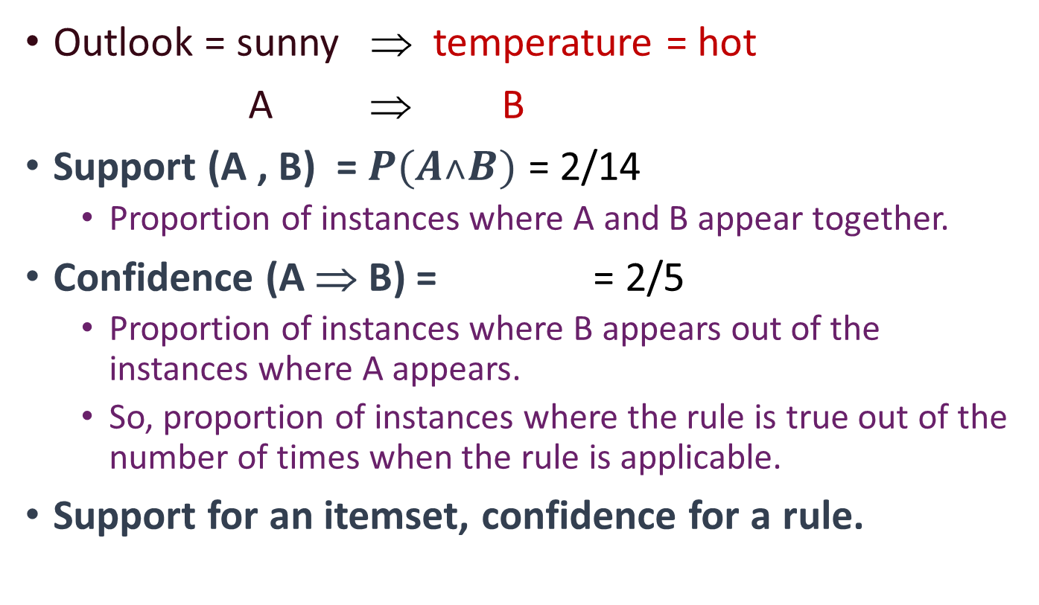

Support and Confidence
Probability of A and B appearing together in the data
Outlook = sunny ⇒ temperature = hot
A ⇒ B
Support (A , B) = $P(A˄B)$ = 2/14
Proportion of instances where A and B appear together.
Confidence (A ⇒ B) = = 2/5
Proportion of instances where B appears out of the instances where A appears.
So, proportion of instances where the rule is true out of the number of times when the rule is applicable.
Support for an itemset, confidence for a rule.
Confidence of A ⇒ B may be very different to confidence of B ⇒ A
$P(A˄B)$
$P(A)$

Slide 17
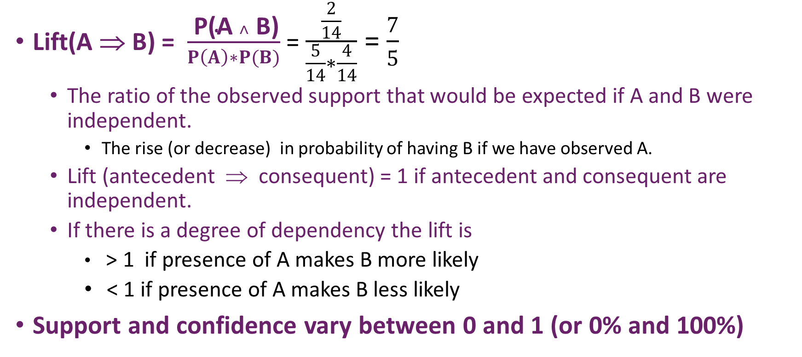
Lift
Lift(A ⇒ B) = $\frac{ \text{P}\text{(}\text{A} ˄ \text{B}\text{)}}{P\left(A\right)∗P(B)}$ = $\frac{\frac{2}{14}}{\frac{5}{14}∗\frac{4}{14}}$ = $\frac{7}{5}$
The ratio of the observed support that would be expected if A and B were independent.
The rise (or decrease) in probability of having B if we have observed A.
Lift (antecedent ⇒ consequent) = 1 if antecedent and consequent are independent.
If there is a degree of dependency the lift is
> 1 if presence of A makes B more likely
< 1 if presence of A makes B less likely
Support and confidence vary between 0 and 1 (or 0% and 100%)

Slide 18
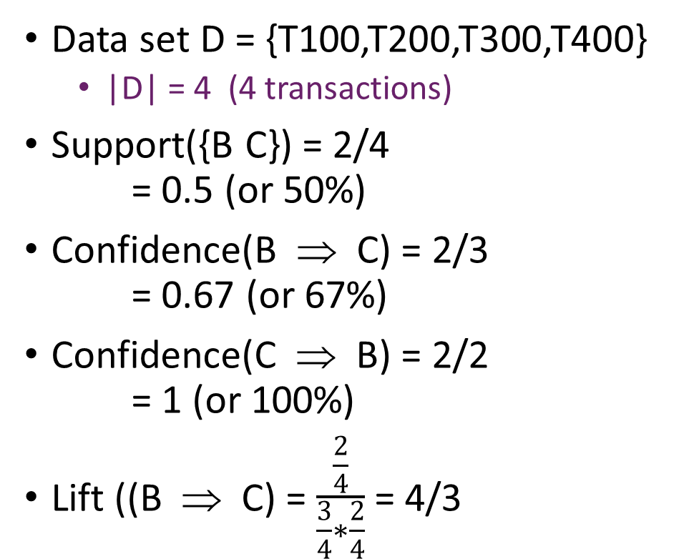
Example: Support, Confidence & Lift
TID | Itemsets
T100 | A D
T200 | B C E
T300 | A B C E
T400 | B E
Data set D = {T100,T200,T300,T400}
|D| = 4 (4 transactions)
Support({B C}) = 2/4 = 0.5 (or 50%)
Confidence(B ⇒ C) = 2/3 = 0.67 (or 67%)
Confidence(C ⇒ B) = 2/2 = 1 (or 100%)
Lift ((B ⇒ C) = $\frac{\frac{2}{4}}{\frac{3}{4}∗\frac{2}{4}}$ = 4/3
B and C appear together in 2 out of the 4 transactions
When B appears, C also appears in 2 out of 3 transactions
Notes:
Transaction ID

Slide 19
Confidence, Support, Lift…?
You want all three to be high for a “solid” rule
high support: should apply to a large amount of cases
high confidence: should be correct often
high lift: indicates it is not just a coincidence

Slide 20
Example Weather Data
I: itemset (set of weather attribute-value pairs)
{Outlook=Sunny, Windy=true, Play=no}
{Outlook=Rainy, Windy=False}
D: set of weather instances
{Outlook=Sunny, Temp=Hot, Humidity=High, Windy = False, Play=No}
{Outlook=Sunny, Temp=Hot, Humidity=High, Windy = True, Play=No}
{Outlook=Cloudy, Temp=Hot, Humidity=High, Windy = False, Play=Yes}
…

Slide 21
Example: Weather Data
Outlook | Temperature | Humidity | Windy | Play
Sunny | Hot | High | False | No
Sunny | Hot | High | True | No
Cloudy | Hot | High | False | Yes
Rainy | Mild | High | False | Yes
Rainy | Cool | Normal | False | Yes
Rainy | Cool | Normal | True | No
Cloudy | Cool | Normal | True | Yes
Sunny | Mild | High | False | No
Sunny | Cool | Normal | False | Yes
Rainy | Mild | Normal | False | Yes
Sunny | Mild | Normal | True | Yes
Cloudy | Mild | High | True | Yes
Cloudy | Hot | Normal | False | Yes
Rainy | Mild | High | True | No

Slide 22
Itemsets for Weather Data with minimum support 2
one-itemsets outlook=sunny (5) | two-itemsets outlook=sunny temp=mild (2) | three-itemsets outlook=sunny temp=hot humid=high (2) | four-itemsets outlook=sunny temp=hot humid=high play=no (2)
temp=cool (4) | outlook=sunny humid=high (3) | outlook=sunny humid=high windy = false (2) | outlook=rainy temp=mild windy = false play=yes (2)
… | … | … | …
12 one-itemsets | 47 two-itemsets | 39 three-itemsets | 6 four-itemsets
0 five-itemsets

Slide 23
Rules from Itemsets
Now turn itemsets with sufficient support into rules
3-itemset: Humidity=Normal, Windy=F, Play=Y
Support = 4/14
Seven potential rules (7=2³-1) Confidence
If Humidity = Normal & Windy = F then Play = Y 4/4
If Humidity = Normal & Play = Y then Windy = F 4/6
If Windy = F & Play = Y then Humidity = Normal 4/6
If Humidity = Normal then Windy = F & Play = Y 4/7
If Windy = F then Humidity = Normal & Play = Y 4/8
If Play = Yes then Humidity = Normal & Windy = F 4/9
If True then Humidity = Normal & Windy = F & Play = Y 4/14

Slide 24
Rules for the Weather Data
Rules with
support ≥ 2/14
confidence = 1
 | Association Rule |  | Support | Confidence
1 | Humidity=Normal & Windy=F | ⇒ Play=Y | 4/14 | 100%
2 | Temperature=Cool | ⇒ Humidity=Normal | 4/14 | 100%
3 | Outlook=Overcast | ⇒ Play=Y | 4/14 | 100%
4 | Temperature=Cold & Play=Y | ⇒ Humidity=Normal | 3/14 | 100%
… | … | … | … | …
58 | Outlook=Sunny Temperature=Hot | ⇒ Humidity=High | 2/14 | 100%
3 rules
5 rules
50 rules

Slide 25
Contents (3)
What are Association Rules?
Itemsets and Rules
Apriori Algorithm
Summary

Slide 26
Generating Rules Efficiently
Step1: Generate itemsets efficiently
with specified minimum support (coverage)
Step 2: Determine rules efficiently
that have specified minimum confidence (accuracy)

Slide 27
Itemset Generation
Brute-force approach
each itemset in the lattice is a candidate itemset
count support of each candidate by scanning dataset
Match each transaction against every candidate
Complexity ~ O(|D|Mw) — Expensive since M = 2^{N}
TID | Items
1 | Bread, Milk
2 | Bread, Nappies, Beer, Eggs
3 | Milk, Nappies, Beer, Coke
4 | Bread, Milk, Nappies, Beer
5 | Bread, Milk, Diapers, Coke
List of Candidates
M
|D|
w
Notes:
D instances in the dataset
Each instance has a maximum width of w items in it
Each instance could generate M itemsets.
An item is either in or out of the dataset hence 2^N complexity.

Slide 28
Itemset Generation (2)
null
Lattice of itemsets
A
B
C
D
E
AB
AC
AD
AE
BC
BD
BE
CD
CE
DE
ABC
ABD
ABE
ACD
ACE
ADE
BCD
BCE
BDE
CDE
ABCD
ABCE
ABDE
ACDE
BCDE
ABCDE
Given N items, there are 2^{N} candidate itemsets
Notes:
32 of them = 2^5 because ABCDE is 5 items.

Slide 29
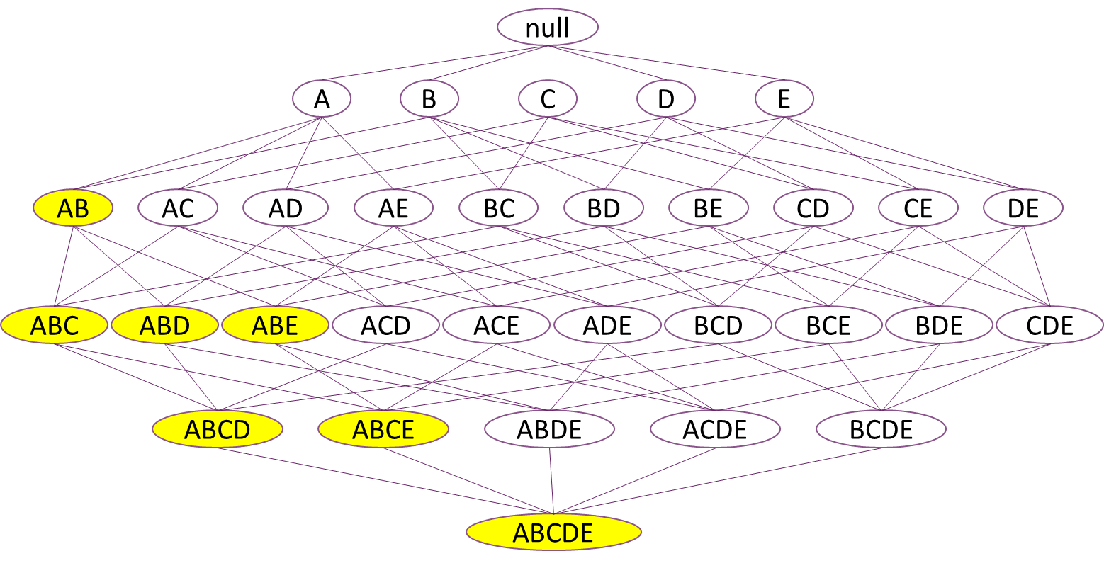
Reduce Number of Candidates
Ensures itemset support ≥ minimum support
Downward closure property
any subsets of a frequent itemset are also frequent itemsets
any supersets of an infrequent itemset are also infrequent itemsets
If insufficient support for {AB}
then insufficient support for any itemset containing AB
Notes:
Each letter is an item. 1-itemsets contain 1 item, 2-itemsets contain 2 items and so on until you get the ultimate itemset that contains all items. This is exhaustive – these are all possible itemsets.

Slide 30
Itemsets Efficiently Generated
Generate one-itemsets (easy)
remove those without minimum support (coverage)
Generate two-itemsets from pairs of one-itemsets
cannot miss a frequent two-itemset
if (A B) is frequent itemset, then (A) and (B) are too!
remove those without minimum support (coverage)
Compute k-itemset by merging (k-1)-itemsets
cannot miss a frequent k-itemset
if X is frequent k-itemset, then all (k-1)-itemsubsets of X are also frequent
remove those without minimum support (coverage)

Slide 31
Candidate Itemsets
Assume C is infrequent (not enough support)
Then using C to generate larger itemsets is pointless
null
A
B
C
D
E
AB
AC
AD
AE

Slide 32
Candidate Itemsets (2)
null
A
B
C
D
E
AB
AC
AD
AE
BC
BD
BE
CD
CE
DE
Greyed nodes containing pairs of items are NOT generated as they will be too infrequent (not enough support).

Slide 33
Candidate Itemsets (3)
null
A
B
C
D
E
AB
AC
AD
AE
BC
BD
BE
CD
CE
DE
ABC
{ABC} will not be generated, as {AC} was not generated.

Slide 34
Itemsets Efficiently Generated (2)
null
A
B
C
D
E
AB
AC
AD
AE
BC
BD
BE
CD
CE
DE
ABC
ABD
ABE
ACD
ACE
ADE
BCD
BCE
BDE
CDE
Greyed nodes containing pairs or triplets of items are NOT generated as they will be too infrequent (not enough support).
Notes:
If C didn’t have enough support, then anything containing C won’t have enough support. Remember, support is the number of instances that contain the itemset.

Slide 35
Itemsets Efficiently Generated (3)
The same itemset can be generated from more than one combination of smaller itemsets. If one of those does not have enough support, the later itemset does not have enough support either
null
A
B
C
D
E
AB
AC
AD
AE
BC
BD
BE
CD
CE
DE
ABC
ABD
ABE
ACD
ACE
ADE
BCD
BCE
BDE
CDE
ABCD

Slide 36
Itemsets Efficiently Generated (4)
Greyed nodes containing pairs, triplets or quadruplets of items are NOT generated as they will be too infrequent (not enough support).
null
A
B
C
D
E
AB
AC
AD
AE
BC
BD
BE
CD
CE
DE
ABC
ABD
ABE
ACD
ACE
ADE
BCD
BCE
BDE
CDE
ABCD
ABCE
ABDE
ACDE
BCDE
ABCDE

Slide 37
Itemsets Efficiently Generated (5)
null
A
B
D
E
AB
AD
AE
BD
BE
DE
ABD
ABE
ADE
BDE
ABDE
The (much reduced!) resulting candidate itemsets if C is infrequent.
Notes:
16 instead of 32 (because we removed one single item that didn’t have sufficient support on its own).
Lower down removal will have a bigger effect. Literally halved the number generated.

Slide 38
Example: Itemsets Efficiently Generated
Given: three-itemsets (lexicographically ordered!)
(A B C), (A B D), (A C D), (A C E), (B C D)
Merge those with same items except last
candidate four-itemsets
(A B C D) from (A B C) and (A B D)
(A C D E) from (A C D) and (A C E)
Prune
remove those without minimum support
remove (A C D E)
(A D E) and (C D E) insufficient support
Single four-itemset
(A B C D)
x
x
ABC
ABD
ACD
ACE
BCD
ADE
CDE
x
ABCD
ACDE
Notes:
You don’t have to brute-force, you can just generate itemsets from all the ones you encounter.

Slide 39
Generating Rules Efficiently …
Step1: Generate itemsets efficiently
with specified minimum support (coverage)
Step 2: Determine rules efficiently
that have specified minimum confidence (accuracy)

Slide 40
Rule Generation
Given a frequent itemset F find subsets f ⊂ F such that
f ⇒ F \ f satisfies minimum confidence requirement
Frequent itemset {A,B,C,D}
Candidate rules
ABCD ⇒ ∅,
ABC ⇒ D, ABD ⇒ C, ACD ⇒ B, BCD ⇒ A,
AB ⇒ CD, AC ⇒ BD, AD ⇒ BC, BC ⇒ AD, BD ⇒ AC, CD ⇒ AB,
A ⇒ BCD, B ⇒ ACD, C ⇒ ABD, D ⇒ ABC,
∅ ⇒ ABCD
If |F| = N, then 2^{N} – 1 candidate association rules
ignoring {F} ⇒ ∅
The set of all item in F excluding f
Notes:
No rule available if all the items in the itemset are in the antecedent, nor if all items are in the consequent.
Again, this is exhaustively generating all rules – brute force.

Slide 41
Rule Generation Efficiently
In general, confidence does not obey the downward closure property
conf(ABC ⇒ D) can be larger or smaller than conf(AB ⇒ D)
But confidence of rules generated from the same itemset does have this property
Itemset {A,B,C,D}
conf(ABC ⇒ D) ≥ conf(AB ⇒ CD) ≥ conf(A ⇒ BCD)
conf(ABC ⇒ D) ≥ conf(AC ⇒ BD) ≥ conf(C ⇒ ABD)
conf(ABC ⇒ D) ≥ conf(BC ⇒ AD) ≥ conf(B ⇒ ACD)
Notes:
Because CD will contain fewer instances than D (see next slide)

Slide 42
Conjunction fallacy conf(ABC ⇒ D) ≥ conf(AB ⇒ CD) ≥ conf(A ⇒ BCD)
Linda is 31 years old, single, outspoken, and very bright. She majored in philosophy. As a student, she was deeply concerned with issues of discrimination and social justice, and also participated in anti-nuclear demonstrations.
Which is more probable?
(a) Linda is a bank teller.
(b) Linda is a bank teller and is active in the feminist movement.
Tversky and Kahnemann: Conjunction fallacy - Wikipedia

Slide 43
Apriori Rule Generation
Lattice of rules
Low Confidence Rule
BCD ⇒ {A}
ACD ⇒ {B}
ABD ⇒ {C}
ABC ⇒ {D}
CD ⇒ {AB}
BD ⇒ {AC}
BC ⇒ {AD}
AD ⇒ {BC}
AC ⇒ {BD}
AB ⇒ {CD}
D ⇒ {ABC}
C ⇒ {ABD}
B ⇒ {ACD}
A ⇒ {BCD}
Pruned rules

Slide 44
Apriori – generating rules
ABCD ⇒ {}
BCD ⇒ {A}
ACD ⇒ {B}
ABD ⇒ {C}
ABC ⇒ {D}
CD ⇒ {AB}
BD ⇒ {AC}
BC ⇒ {AD}
AD ⇒ {BC}
AC ⇒ {BD}
AB ⇒ {CD}
D ⇒ {ABC}
C ⇒ {ABD}
B ⇒ {ACD}
A ⇒ {BCD}

Slide 45
Rule Generation Efficiently
Build rules with (c+1)-consequents from rules with c-consequents
(c+1)-consequent rule meets confidence requirement only if all corresponding c-consequent rules do
Resulting algorithm similar to procedure for large itemsets

Slide 46
Apriori Rule Generation
Candidate rule is generated by joining two rules which:
are from the same itemset
share the same prefix in the rule consequent
Joining (CD ⇒ AB, BD ⇒ AC)
produces the candidate rule D ==> ABC
Prune rule D ⇒ ABC
if it does not have minimum confidence
CD ⇒ AB
BD ⇒ AC
D ⇒ ABC

Slide 47
Example: Apriori
ABCD ⇒ {}
BCD ⇒ {A}
ACD ⇒ {B}
ABD ⇒ {C}
ABC ⇒ {D}
CD ⇒ {AB}
BD ⇒ {AC}
BC ⇒ {AD}
AD ⇒ {BC}
AC ⇒ {BD}
AB ⇒ {CD}
D ⇒ {ABC}
C ⇒ {ABD}
B ⇒ {ACD}
A ⇒ {BCD}
To find 100% confidence rules from Itemset (A B C D)
Suppose support for itemsets is
6 (50%): (A B C D) (A B C) (A B D) (A C D) (A B) (A C) (A D)
8 (75%): (B C D)
Candidate 1-consequent rules from (A B C D)
ABC ⇒ D (6/6) ABD ⇒ C (6/6) ACD ⇒ B (6/6)
BCD ⇒ A (6/8 <100%)
Prune 1-consequent rules ABC ⇒ D (6/6) ABD ⇒ C (6/6) ACD ⇒ B (6/6)

Slide 48
Example: Apriori (cont)
Pruned 1-consequent rules:
ABC ⇒ D ABD ⇒ C ACD ⇒ B
Support 6 (50%): (A B C D) (A B) (A C) (A D)
Build candidate 2-consequent rules
AB ⇒ CD (6/6) AC ⇒ BD (6/6) AD ⇒ BC (6/6)
Prune 2-consequent rules
AB ⇒ CD (6/6) AC ⇒ BD (6/6) AD ⇒ BC (6/6)
Build 3-consequent rules from 2-consequent rules
join (AC ⇒ BD, AD ⇒ BC) to give A ⇒ BCD
check other subset OK for confidence: AB ⇒ CD
other candidates fail subset test
B ⇒ ACD C ⇒ ABD D ⇒ ABC (so cannot have minimum confidence)
Prune 3-consequent rules
check A ⇒ BCD for confidence

Slide 49
Problems
Standard format very inefficient for market basket data
attributes represent items in a basket
most items are usually missing
sparse datafiles
Confidence is not necessarily best measure
milk occurs in almost every supermarket transaction
other measures have been devised
lift measures gain in accuracy over default rule (e.g. default is everyone buys milk)

Slide 50
Apriori
Given number of high support rules desirable?
maintain required minimum confidence (accuracy)
Choose high desired support and generate rules
If not enough rules repeatedly
Reduce minimum support (coverage)
Generate additional rules
To ensure that you generate all rules of sufficient support and minimum confidence
Choose a large number of rules (more than those generated)

Slide 51
Applications
Market basket analysis
Identification of associations between products in shopping trolleys, i.e., which products are frequently bought together
Supermarkets gain understanding of customer shopping habits
Can plan product location within supermarket
Can do targeted marketing
Churn analysis and selective marketing - Telecoms
Identification of behaviours and demographics of customers who are likely/unlikely to switch to other companies
Selection of customer groups who are likely to buy an offering

Slide 52
Applications (2)
Stock market analysis
Identifying link between individual stocks, or between stocks and economic factors
Can help stock traders select interesting stocks and improve trading strategies
Medical diagnosis
Discovering relationships between symptoms, test results and illness
Can be used for diagnosis or treatment support

Slide 53
Applications (3)
Credit risk
Identification of attributes of customers likely to default on payments.
Used to assess loan or credit card applications
Health informatics – knowledge discovery
E.g. Relationship between family medical history, medical issues and lifestyle
Census data correlations
Network traffic analysis
Detection of malware
Notes:
Job data?

Slide 54
Summary
Itemsets capture frequently occurring combinations
Rules rearrange items around ⇒
Apriori efficiency from downward closure
Generate frequent supersets from frequent subsets
Generate high confidence rules from supersets of consequents of high confidence rules from same itemset
Apriori iterates
through high support itemsets first

