Slide 1
Clustering
Statement for Audio and Video Learning Resources
Video and audio content at the University uses closed captions generated by automatic speech recognition (ASR). The ASR process is based on machine learning algorithms which automatically transcribe voice to text. According to our technology providers, this process is approximately 70-90% accurate depending on the quality of the audio, and consequently video and audio closed captions may include some transcription errors. It is therefore important to recognise that the original recording is the most accurate reflection of the content, and not the captions.
If you require accurate captions as part of your reasonable adjustments, please contact the Inclusion Centre to discuss your requirements.

Slide 2
Lab Postmortem
Something to remember/practice:
Practice “knitting” your .Rmd files occasionally (Publish or ctrl+shift+k will knit and output an html file).
Notice where the .Rmd files are saved and how you can find both that and your knitted html file.
Notice how long code takes to run.
When you create code, add notes about the results.

Slide 3
Content
Introduction
Distance metrics
K-Means Clustering algorithm
Centroid creation
Hierarchical (agglomerative) clustering
Discussion.

Slide 4
Cluster learning
Unsupervised
No target value to be predicted – no class or number to be predicted.
Instances divided into natural groups - clusters
Different types of algorithm
Incremental learning
Instances are dealt with one at a time
Batch learning
Instances are dealt with all at once
Different types of output
…..examples follow
Notes:
Different from classifiers.
No labels.

Slide 5
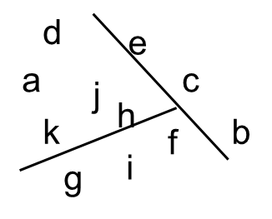
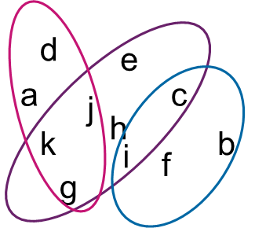
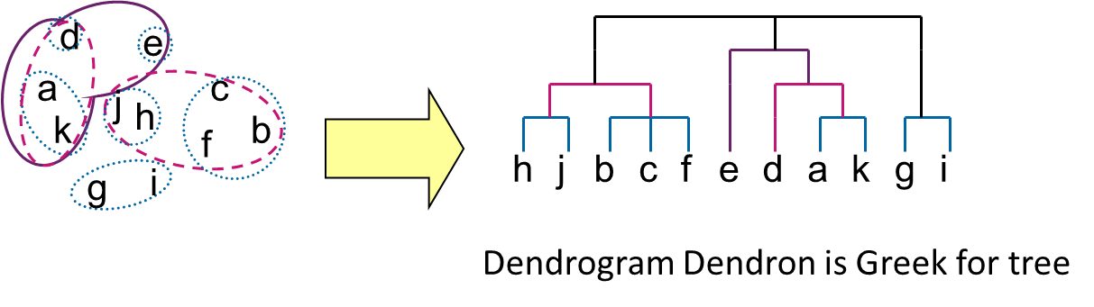
Different types of cluster
Exclusive clusters
Hierarchical clusters
Overlapping clusters
Notes:
Hierarchical clusters: where sub clusters form larger clusters. Genealogy, but I’ve read a recent PhD thesis on different methods of clustering – there are sometimes many paths to get to the same structure and nature has apparently evolved crabs 6 different times.

Slide 6
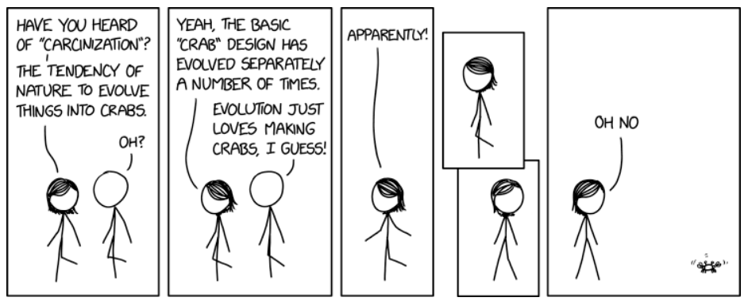
Hierarchical clusters are still a research area
How to design hierarchies such that similar “species” are on the same branch is difficult.

Slide 7
Terminology
Cluster: a group of instances (objects or observations).
Cluster members: the objects (instances) in a cluster
Centroid: the centre of a cluster
Target
For each cluster, its members are similar to each other
High intra-cluster similarity
Instances not belonging to the same cluster are different.
Low inter-cluster similarity
c
f
d
a
e
g
b
i
h
Notes:
Cluster is list of instances. Cluster members form list. Centroid may or may not be a cluster member (average of all cluster members). Members should be close together. Clusters should be distinct.

Slide 8
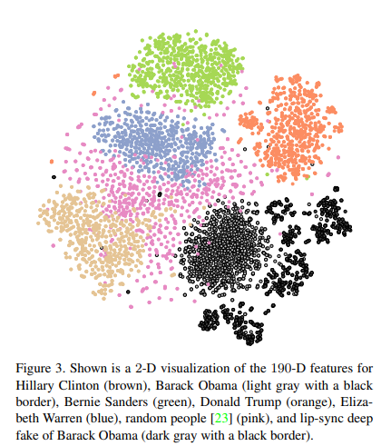
Clustering in action
“Soft biometrics” of world leaders taken from videos.
Clusters form naturally and can easily be seen.
Deep fake data does not cluster with authentic data.
From “Protecting World Leaders Against Deep Fakes” Agarwal and Farid, CVPR, 2018
Notes:
Clusters overlap. But can still see they’re distinct.

Slide 9
Similarity / Distance metric
To cluster similar instances we need a measure of similarity
Often, we have an idea of distance
Low distance = high similarity
Can construct similarity/distance measures in similar way to kNN lecture
Manhattan distance
Euclidean distance
c
f
d
a
e
g
b
i
h
y
x
y
x

Slide 10
k-means Clustering
c
f
d
a
e
g
b
h
Batch clustering
Iterates over all instances until convergence
Typically forms clusters in numeric domains
Uses a distance metric
Partitions instances into disjoint clusters
i
Notes:
Disjoint means no instance can be in 2 clusters. The clusters do not overlap.

Slide 11
k-means Algorithm
c
f
d
a
e
g
Groups the instances into k clusters
Step 1: choose cluster centres (centroids). Options:
k instances at random
Randomly assign instances to clusters.
Step 2: assign instances to clusters based on distance to cluster centroids
Step 3: compute centroids of clusters
Average attribute values of cluster members
What if attributes are nominal? Use most frequent value?
Repeat steps 2-3 with centroids as new centres until clusters do not change
b
i
h
Notes:
Notice: only calculate the distance between the centroids and the instances. NOT the distance between all points in the dataset. So complexity scales linearly with number of clusters and number of instances, not exponentially with number of instances.

Slide 12
k-means Process Example
Assume k = 3
Watch the StatQuest for 1-dimensional clustering.
Notes:
K is assigned through trial and improvement, but cover that in a minute.

Slide 13
k-means Process Example (2)
Randomly select instances to be centroids (or randomly select centroids)
Notes:
We’ve just selected random instances. For each instance, calculate the distance to each centroid. The instance is assigned to the closest cluster (centroid).

Slide 14
k-means Process Example (3)
Assign instances to the nearest cluster (centroid).
Notes:
The circles contain the members, but they don’t define the clusters in this case.

Slide 15
k-means Process Example (4)
Re-calculate new centroids (mean of all instances in the cluster).

Slide 16
k-means Process Example (5)
New centroids (they’re probably not actual instances now).
Notes:
They’re at the centre of the points, not the center of the circles.

Slide 17
k-means Process Example (6)
Assign instances to clusters according to distance to centroids.
One instance changes cluster
Notes:
Look, this one point moves.

Slide 18
k-means Process Example (7)
New clusters formed

Slide 19
k-means Process Example (8)
Calculate new centroids

Slide 20
k-means Process Example (9)
Assign instances to clusters (nearest centroid). No change in cluster members so stop.
Notes:
If you calculate new centroids and they’re the same as the old ones, then the process has converged and clusters have been found.

Slide 21
Forming a cluster centroid
Centre of the cluster
An instance with average values
Instances | age | salary | insurance
A | 25 | 40K | Yes
B | 22 | 35K | No
C | 26 | 38K | Yes
centroid | AVG(25,22,26) | AVG(40, 35, 38) | MajorityVote(Yes, Yes, No)
Note that in reality numeric attributes should have been normalised or standardised
b
c
Age=24.3
Salary= 37.7
Insurance = Yes
Cluster
a
Notes:
Discrete values vote.

Slide 22
Distance - Numeric Attributes
E.g. C1 & C2 are centroids and x is an instance
 | age | salary
C1 | 55 | 55k
C2 | 50 | 60k
X | 35 | 35k
Note that in reality numeric attributes Age and Salary should have been normalised or standardised
X is closest to C1 so assign it to cluster 1
Notes:
Standardisation vs normalisation – depends on the dataset!

Slide 23
Normalisation or standardisation
Attributes are measured on different scales.
Attributes measured on larger scales have higher impact.
Need to
Normalise: transform to scale [0..1]
or
Standardise (centre and scale): transform to mean of zero and standard dev. of 1.
(covered in CMM535?)
Notes:
Realistically, it’s an option in your code! But you might normalize-with-thresholds to get rid of outliers and not let them have too much impact.

Slide 24
Aside: k-means as a mini-max algorithm
Minimise intra-cluster distance
Maximise inter-cluster distance
Some algorithms (e.g. matching networks) actually create a latent space or mapping of attributes that specifically does this for (supervised) classification.

Slide 25
k-means Discussion
Results vary based on initial choice of centroids
But we can run it several times with different initial centroids, evaluate the results and choose the best clusters.
Algorithm can get trapped in a local minimum
Example: 4 instances at rectangle vertices
Local minimum: cluster centres at long edge midpoints
Simple way to increase chance of global optimum
restart with different random centroids

Slide 26

k-means - local minimum
Bad
Clusters!!!
Seeds
Ideal Clusters
Notes:
Dark circles are our data points. Little suns are our randomly chosen initial centroids. Centroids stop changing but the long horizontal clusters are wrong. Could also happen if we selected two points on the left as our seeds.

Slide 27
How many clusters?
If desired number is known, use that number
Otherwise try several values for k and select the k which gives best results.
How is k for “best results” selected?
Elbow method – within clusters sum of squares
Uses sum of squared error for each cluster
Silhouette method – high cohesion and separation
Cohesion – the degree to which an instance is similar to others in its cluster
Separation – the degree to which an instance is not similar to instances in other clusters.
Jump method – choose the value of k which causes the biggest jump in distortion.
Distortion is a measure of within cluster dispersion

Slide 28
How many clusters? Elbow method
Measure of variability of instances within each cluster
Based on the square of the distance of each instance to its cluster centroid.
Number of clusters
Within cluster sum of squares
Notes:
More cluster centroids, the closer any given point will be to a cluster centroid. Think about it like more Ikeas in your area, the closer you are to an Ikea. Within cluster sum of squares can also measure clustering overall.

Slide 29
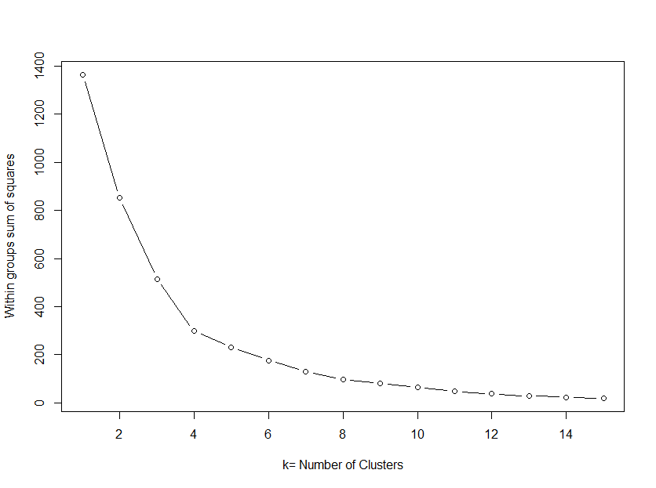
How many clusters? Elbow method (cont)
For each k value
Cluster the data
Calculate the within cluster sum of squares
Plot WCSS for each k value
Pick the k value at the ‘elbow’ in the plot where
X axis – number of clusters
Y axis – within cluster sum of squares
Notes:
Elbow is point closest to corner. Ideal k is that we minimise k and minimise within cluster sum of squares.

Slide 30
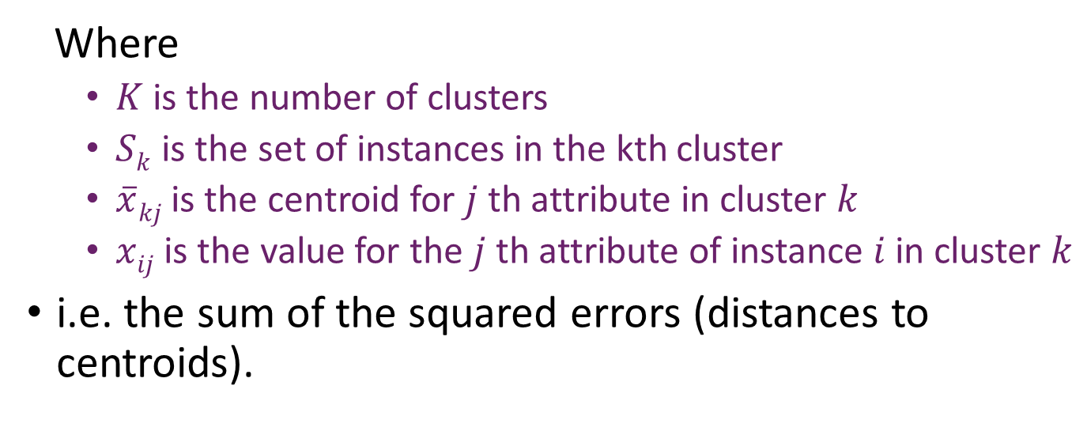
Within cluster sum of squares
For each attribute in instance
$$WC= \sum_{k=1}^{K}{\sum_{i ∈Sk}{\sum_{j=1}^{P}{\left(xij −\overline{x}kj\right)2}}}$$
Calculate square error (“distance”) to centroid
For each cluster
Where
$K$ is the number of clusters
$Sk$ is the set of instances in the kth cluster
$\overline{x}kj$ is the centroid for $j$th attribute in cluster $k$
$xij$ is the value for the $j$th attribute of instance $i$in cluster $k$
i.e. the sum of the squared errors (distances to centroids).
For each instance within cluster
Notes:
This is 3 nested for loops.

Slide 31
How many clusters? Silhouette
For each k value
Cluster the data.
Calculate the silhouette value for each instance.
Silhouette value for instance: number between -1 and 1
Low or negative value: instance is not similar to other instances in the cluster.
High value: instance is similar to other instances in its cluster and dis-similar from instances in neighbouring clusters.
If most instances in most clusters have a high silhouette value, the clustering is appropriate.
Otherwise – a different k value may be appropriate
Calculate the average silhouette value.
Choose the k value which gives the highest average silhouette.

Slide 32
How many clusters? Jump method
Create distortion curve by running k-means with all values of k and calculating distortion.
Run k-means for each k value
For each k, calculate distortion – a measure associated with the dispersion of instances in a cluster.
Select transformation power y so negative power of y is applied to each distortion.
Typically y=p/2 where p is the number of attributes
Calculate the jumps. Look at the change in transformed distortion (the “jump”) between consecutive distortion values for k.
Choose k which maximises the jump.
We will not see the jump method in the labs.

Slide 33
Advantages
K-Means is easy to implement
Reasonably efficient
Easy to explain
Non-deterministic (also a disadvantage)
Different start centroids may produce different clusters
Can be repeated with different seeds and “best” results can be used.
Notes:
Scale linearly with number of points in the dataset.

Slide 34
Disadvantages
The value of k must be specified – tricky. Use elbow, silhouette or jump method
But this equates to running-means with different k values
The choice of initial k centroids is key: results vary according to choice – non deterministic
May not work well with noisy data
Applicable only when averaging is meaningful to the given data set – mean is calculated to calculate centroids

Slide 35
Solutions to weaknesses
Use elbow, silhouette, or jump method for k determination
Run several times with different k values
Repeat k-means with different initial centroids; select result with highest quality
i.e. run several times with same k but different seeds.
Use hierarchical clustering to locate the centres (see below)
Find centres that are not close to each other
K-medoid: use the nearest instance to cluster centre as centroid if mean cannot be defined (i.e. when attributes are nominal or discrete) .

Slide 36
Summary – k-means
Group similar cases on their attributes
K-means is a batch clustering approach
Quality of clusters strongly related to
Selecting the value for k
Initial centroids
Hierarchical k-means
Apply k-means to the dataset
Apply hierarchical k-means to each resulting cluster
K-means can be computationally costly due to pair-wise distance calculations
Binary k means – repeatedly apply 2-means
Results in a binary tree of clusters

Slide 37
Notes
Centroids
Start centroids are often called initial seeds
Instances (or averages of instances) selected to be at the centre of the initial clusters
NOT the “seed” that you set in R for reproducibility
K-means vs kNN
k-means is an unsupervised clustering
kNN is a supervised classification algorithm.
They both use distance between instances (Euclidean, Manhattan).
For k-means, k is the number of clusters
For kNN, k is the number of neighbours

Slide 38
Content
Introduction
Distance metrics
K-Means Clustering algorithm
Centroid creation
Hierarchical (agglomerative) clustering
Discussion

Slide 39
Agglomerative clustering
Each instance is an individual cluster
Build a n x n distance matrix.
distance between any pair of instances (clusters).
While the number of clusters > 1 do:
Find a pair of clusters with the minimum distance
Join the two clusters - merge
Replace the entries in the matrix for the 2 original clusters by the new cluster
Re-calculate distances to other clusters and update the matrix
Notes:
Ewwww, this looks like a lot more distance calculations than k-means!

Slide 40
Example:
Assume the following matrix with distances
 | A | B | C | D
A |  | - | - | -
B | 2.3 |  | - | -
C | 3.6 | 4 |  | -
D | 2.7 | 0.8 | 1.2
Cluster instances with shortest distance, B and D
Merge B and D as they have the shortest distances. Create cluster {B,D}
Compute the distance between {B,D} and A and C
 | A | {B,D} | C
A |  | - | -
{B, D} | 2.55 |  | -
C | 3.6 | 2.6
Repeat with smaller matrix
Notes:
Look, the matrix calculates the distances between all the points.

Slide 41
Agglomerative clustering schemes
What distance is used as inter-cluster distance?
There are different schemes
Single link: the distance between two closest points
Complete link: the distance between two farthest points
Group average: the average of all pair-wise distances
Centroids: the distance between the centroids

Slide 42
Clustering types/schemes
Single link
Complete link
Group average
Centroids

Slide 43
Advantages of agglomerative clustering
Advantages
Deterministic results – not dependent on initial centroids
K not specified
Clusters of arbitrary shapes can be created (single-link)
Disadvantages
Very slow for large data sets
Cannot undo membership like the K-means

Slide 44
Evaluating cluster quality
Good clustering if
High-level similarity within each cluster – high cohesion
Low within cluster sum of squares (WC)
Large distance between clusters – high separation
Sum of distances between clusters (BC) is high
Combination of cohesion and separation
BC/WC - good indicator of overall quality.
Notes:
BC/WC higher is better.

Slide 45
Agglomerative clustering – how many clusters?
Start at the root –
Repeat
Move one level down at a time
At a level, evaluate the overall quality of clusters (e.g. within clusters sum of squares
If the quality is not acceptable , move to the next level down - repeat
Until quality is acceptable
Take the clusters at the last level as the final result.
Notes:
The number of clusters emerges automagically.

Slide 46
Discussion
Evaluation of clustering
Often by inspection - do the clusters “make sense”?
Clusters can be visualised if low dimensionality
“Classes to clusters” – known class values vs clusters.
Need a class attribute (used only for evaluation) to check if cluster members share the class value
Interpretation of clusters
Supervised learning in a post-processing step
Training data is clustered data labelled by cluster id
Decision tree or rule-set inferred to predict cluster
Notes:
Clustering shows patterns within the dataset. Decision trees to predict the clusters can tell if those patterns are significant. They can also help put words and conditions to the clusters.

Slide 47
… discussion
Clusters can be used to fill in missing data values
E.g. average value within cluster
Clustering can improve classification
Cluster and add new attribute with cluster label to dataset
Assumed that attributes are independent
pre-processing step to make more independent
i.e. using principal component analysis

Slide 48
Applications
Recommendation systems
Similar products in same cluster
Recommend products in cluster of current product
Social network analysis
Search result grouping
Medical imaging
Image segmentation
Anomaly detection

Slide 49
Summary
Clustering: dividing instances into groups
Methods:
K-means – needs k set in advance
Agglomerative clustering
4 ways of assigning instances to clusters
Produces a dendogram which can be `cut’ at a level which gives the required quality
E.g BC/WC [ between cluster sum of squares over within cluster sum of squares]

