Slide 1
Naïve Bayes Classification and Regression
Statement for Audio and Video Learning Resources
Video and audio content at the University uses closed captions generated by automatic speech recognition (ASR). The ASR process is based on machine learning algorithms which automatically transcribe voice to text. According to our technology providers, this process is approximately 70-90% accurate depending on the quality of the audio, and consequently video and audio closed captions may include some transcription errors. It is therefore important to recognise that the original recording is the most accurate reflection of the content, and not the captions.
If you require accurate captions as part of your reasonable adjustments, please contact the Inclusion Centre to discuss your requirements.

Slide 2
Contents
Why use statistics
Calculating probabilities
Bayesian theorem –Naïve Bayes
Missing values
Numeric values
Summary

Slide 3
Why use statistics
Simple algorithms often work well in practice.
Based on using ALL the attributes for prediction.
Assumptions
All attributes are equally important
Attributes are independent
I.e. the values of attributes are NOT related
Gives good result even though assumptions are often incorrect.
While here we focus on classification, it can be used for regression too.

Slide 4
Observed probability from datasets
Count the number in the dataset.
If there are 100 instances in the dataset and 2 of them satisfy your condition, then the probability of that condition is 2 out of 100 (which is 1 in 50).
Probabilities are like fractions.

Slide 5
Example
Outlook | Temperature | Humidity | Windy | Play
Sunny | Hot | High | False | No
Sunny | Hot | High | True | No
Cloudy | Hot | High | False | Yes
Rainy | Mild | High | False | Yes
Rainy | Cool | Normal | False | Yes
Rainy | Cool | Normal | True | No
Cloudy | Cool | Normal | True | Yes
Sunny | Mild | High | False | No
Sunny | Cool | Normal | False | Yes
Rainy | Mild | Normal | False | Yes
Sunny | Mild | Normal | True | Yes
Cloudy | Mild | High | True | Yes
Cloudy | Hot | Normal | False | Yes
Rainy | Mild | High | True | No
14 instances in total
9 for Play=Yes
5 for Play=No

Slide 6
Example: frequency table
Outlook |  |  | Temperature |  |  | Humidity |  |  | Windy |  |  | Play
 | yes | no |  | yes | no |  | yes | no |  | yes | no | yes | no
sunny | 2 | 3 | hot | 2 | 2 | high | 3 | 4 | true | 3 | 3 | 9 | 5
cloudy | 4 | 0 | mild | 4 | 2 | normal | 6 | 1 | false | 6 | 2
rainy | 3 | 2 | cool | 3 | 1
sunny | 2/9 | 3/5 | hot | 2/9 | 2/5 | high | 3/9 | 4/5 | true | 3/9 | 3/5 | 9/14 | 5/14
cloudy | 4/9 | 0/5 | mild | 4/9 | 2/5 | normal | 6/9 | 1/5 | false | 6/9 | 2/5
rainy | 3/9 | 2/5 | cool | 3/9 | 1/5
3 outlook = rainy with play=yes out of 9 instances of play=yes
Notes:
Sunny+yes. Out of 9 instances of yes, 2 of them are also Sunny.
Hot+No: Out of 5 instances of No, 2 of them also have Sunny.
Remember “Lift” from association rules?

Slide 7
Example: outlook = rainy
Outlook | Temperature | Humidity | Windy | Play
Sunny | Hot | High | False | No
Sunny | Hot | High | True | No
Cloudy | Hot | High | False | Yes
Rainy | Mild | High | False | Yes
Rainy | Cool | Normal | False | Yes
Rainy | Cool | Normal | True | No
Cloudy | Cool | Normal | True | Yes
Sunny | Mild | High | False | No
Sunny | Cool | Normal | False | Yes
Rainy | Mild | Normal | False | Yes
Sunny | Mild | Normal | True | Yes
Cloudy | Mild | High | True | Yes
Cloudy | Hot | Normal | False | Yes
Rainy | Mild | High | True | No
5 outlook = rainy
3 outlook = rainy with
play = Yes
2 outlook = rainy with
play = No

Slide 8
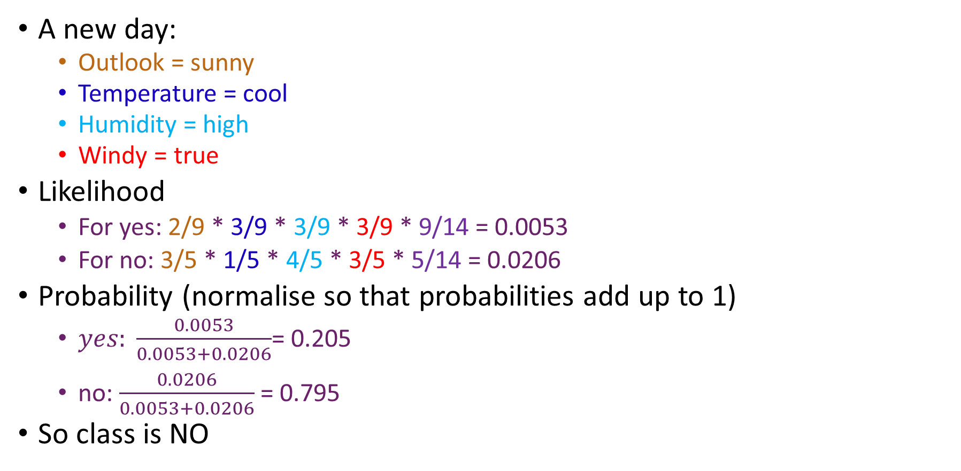
Calculating class for new example
A new day:
Outlook = sunny
Temperature = cool
Humidity = high
Windy = true
Likelihood
For yes: 2/9 * 3/9 * 3/9 * 3/9 * 9/14 = 0.0053
For no: 3/5 * 1/5 * 4/5 * 3/5 * 5/14 = 0.0206
Probability (normalise so that probabilities add up to 1)
$yes: \frac{0.0053}{0.0053+0.0206}$= 0.205
no: $\frac{0.0206}{0.0053+0.0206}$ = 0.795
So class is NO
Notes:
To combine likelihoods, we multiply them (and they get smaller and smaller…!)

Slide 9
Example: frequency table (sunny, cool, high, true)
Outlook |  |  | Temperature |  |  | Humidity |  |  | Windy |  |  | Play
 | yes | no |  | yes | no |  | yes | no |  | yes | no | yes | no
sunny | 2 | 3 | hot | 2 | 2 | high | 3 | 4 | true | 3 | 3 | 9 | 5
cloudy | 4 | 0 | mild | 4 | 2 | normal | 6 | 1 | false | 6 | 2
rainy | 3 | 2 | cool | 3 | 1
sunny | 2/9 | 3/5 | hot | 2/9 | 2/5 | high | 3/9 | 4/5 | true | 3/9 | 3/5 | 9/14 | 5/14
cloudy | 4/9 | 0/5 | mild | 4/9 | 2/5 | normal | 6/9 | 1/5 | false | 6/9 | 2/5
rainy | 3/9 | 2/5 | cool | 3/9 | 1/5

Slide 10
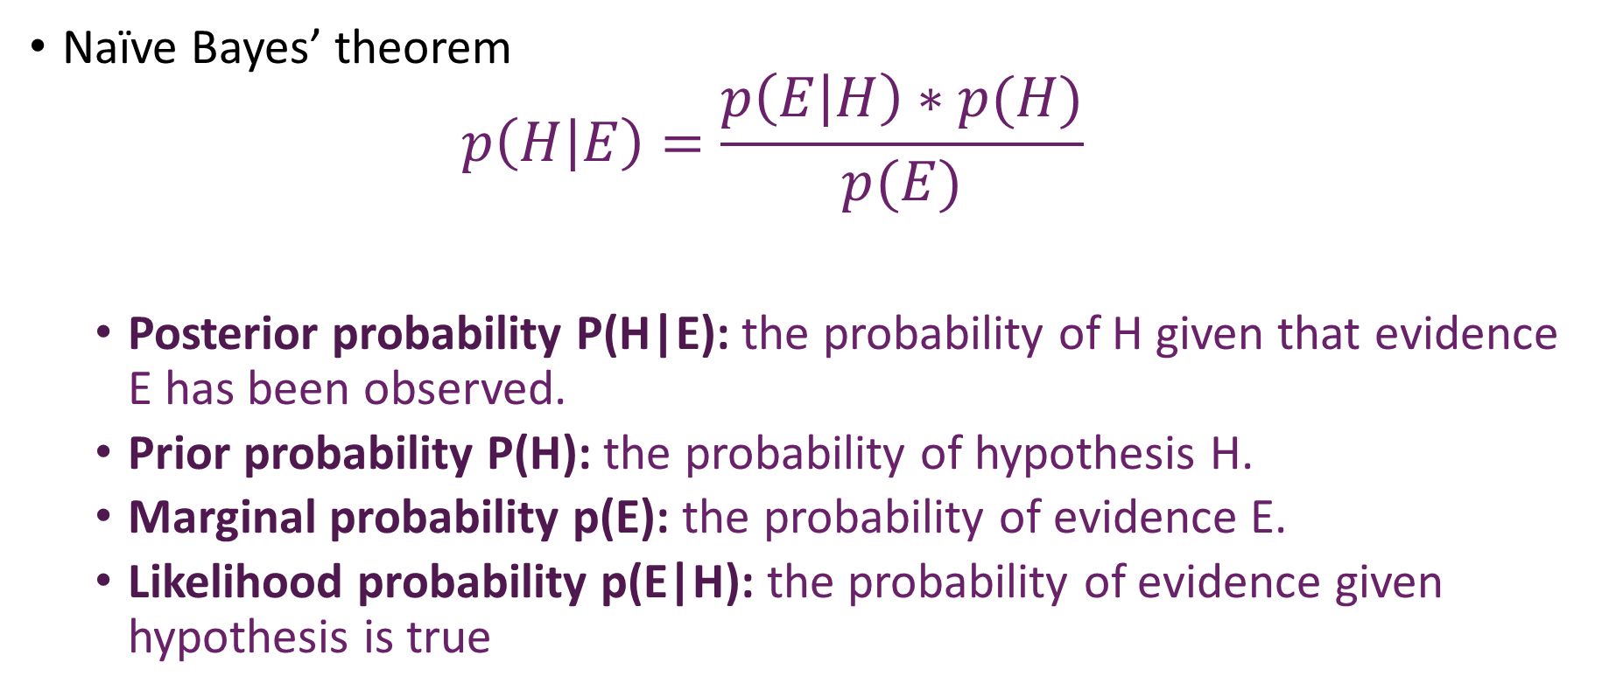
Naïve Bayes’ Theorem
Naïve Bayes’ theorem
$$p\left(H | E\right)=\frac{p\left(E | H\right)∗p(H)}{p(E)}$$
Posterior probability P(H|E): the probability of H given that evidence E has been observed.
Prior probability P(H): the probability of hypothesis H.
Marginal probability p(E): the probability of evidence E.
Likelihood probability p(E|H): the probability of evidence given hypothesis is true
Notes:
Similar to association rules. What is the probability of H give E? It is
the probability of E given H ….multiplied by
the probability of observing H independently of E
divided by the probability of observing E independently of H

Slide 11
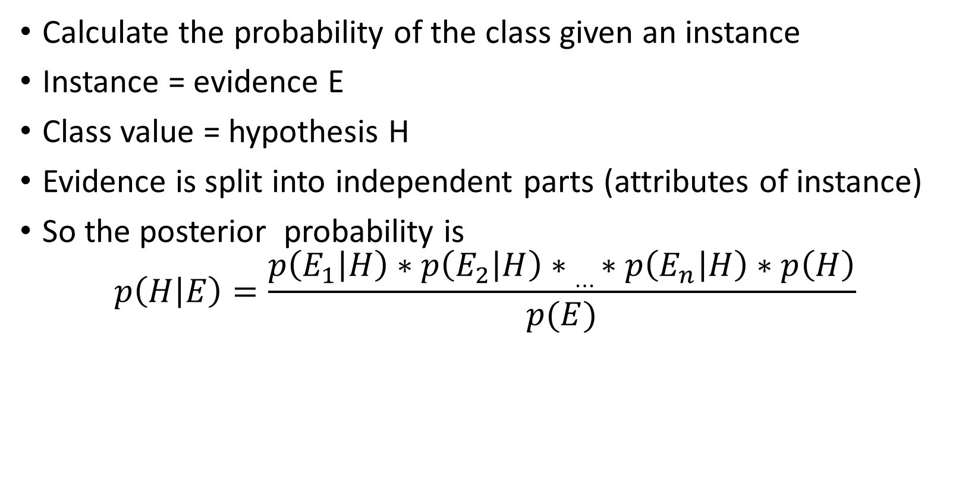
Naïve Bayes’ Theorem for classification
Calculate the probability of the class given an instance
Instance = evidence E
Class value = hypothesis H
Evidence is split into independent parts (attributes of instance)
So the posterior probability is
$$p\left(H | E\right)=\frac{p\left(E_{1} | H\right)∗p\left(E_{2} | H\right)∗…∗p\left(E_{n} | H\right)∗p\left(H\right)}{p(E)}$$
What about this? Ignore it for now.
Notes:
What is p(E) though?? Let’s use that excellent mathematical technique: ignore it for now, maybe it’ll go away…?

Slide 12
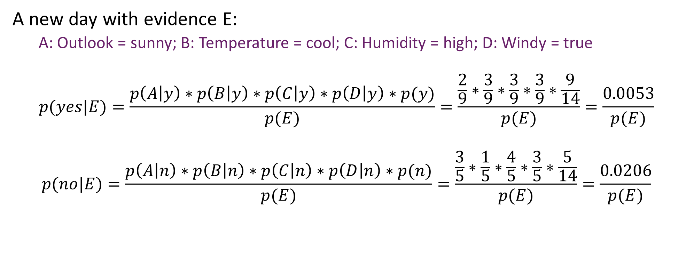
Applying Naïve Bayes’ Theorem
A new day with evidence E:
A: Outlook = sunny; B: Temperature = cool; C: Humidity = high; D: Windy = true
$$p(yes|E)=\frac{p\left(A | y\right)∗p\left(B | y\right)∗p\left(C | y\right)∗p\left(D | y\right)∗p(y)}{p(E)}=\frac{\frac{2}{9}∗\frac{3}{9}∗\frac{3}{9}∗\frac{3}{9}∗\frac{9}{14}}{p(E)}=\frac{0.0053}{p(E)}$$
$$p(no|E)=\frac{p\left(A | n\right)∗p\left(B | n\right)∗p\left(C | n\right)∗p\left(D | n\right)∗p(n)}{p(E)}=\frac{\frac{3}{5}∗\frac{1}{5}∗\frac{4}{5}∗\frac{3}{5}∗\frac{5}{14}}{p(E)}=\frac{0.0206}{p(E)}$$
Notes:
Those probabilities are taken direct from our frequency table (you can check).
Oh look, both of them are over p(E) isn’t that great!

Slide 13
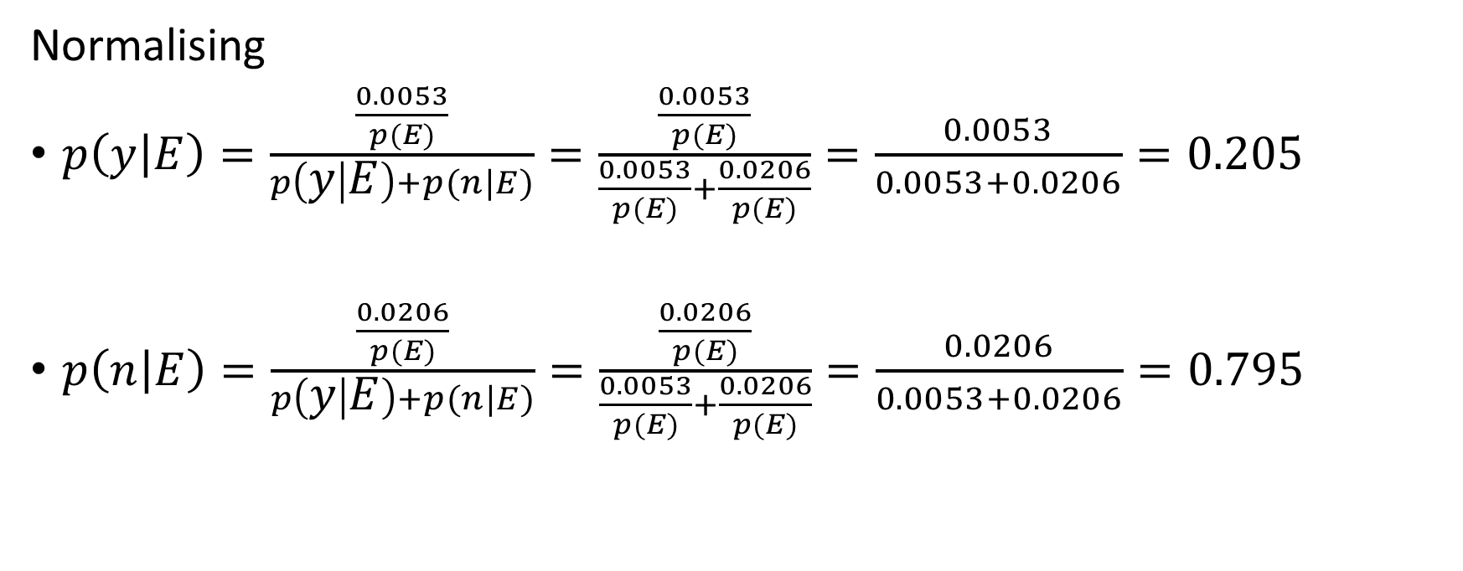
Applying Bayes’ Theorem
Normalising
$p\left(y | E\right)=\frac{\frac{0.0053}{p(E)}}{p\left(y | E\right)+p(n|E)}=\frac{\frac{0.0053}{p(E)}}{\frac{0.0053}{p(E)}+\frac{0.0206}{p(E)}}=\frac{0.0053}{0.0053+0.0206}=0.205$
$p\left(n | E\right)=\frac{\frac{0.0206}{p(E)}}{p\left(y | E\right)+p(n|E)}=\frac{\frac{0.0206}{p(E)}}{\frac{0.0053}{p(E)}+\frac{0.0206}{p(E)}}=\frac{0.0206}{0.0053+0.0206}=0.795$
All p(E) cancel out! Phew!
Notes:
Look at all the p(E) cancelling out! We were so right to ignore it.

Slide 14
Problem: missing combinations
If a certain combination of values does NOT occur in the training set, its probability is 0
Since probabilities are multiplied, the final probability is 0.
E.g. we have no instance of outlook = cloudy with play = no
We cannot predict something we cannot see?

Slide 15
Solution: add 1 to every count (Laplace estimator)
2 + 1 = 2 ‘sunny’ and ‘yes’ plus 1
Outlook |  |  | Temperature |  |  | Humidity |  |  | Windy |  |  | Play
 | yes | no |  | yes | no |  | yes | no |  | yes | no | yes | no
sunny | 3 | 4 | hot | 3 | 3 | high | 4 | 5 | true | 4 | 4 | 9 | 5
cloudy | 5 | 1 | mild | 5 | 3 | normal | 7 | 2 | false | 7 | 3
rainy | 4 | 3 | cool | 4 | 2
sunny | 3/12 | 4/8 | hot | 3/12 | 3/8 | high | 4/11 | 5/7 | true | 4/11 | 4/7 | 9/14 | 5/14
cloudy | 5/12 | 1/8 | mild | 5/12 | 3/8 | normal | 7/11 | 2/7 | false | 7/11 | 3/7
rainy | 4/12 | 3/8 | cool | 4/12 | 2/8
3+5+4 = number of ‘yes’ (9) plus number of values for outlook (3)
Notes:
And look, now we have 1 out of 8 instances where cloudy led to no play (but it’s a fiction!)

Slide 16
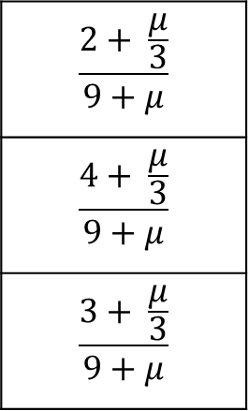
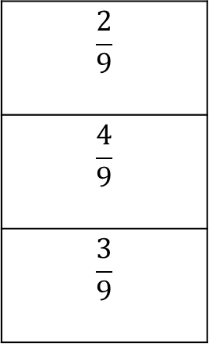
Better solution?
Laplace estimator: adding 1 to each count (why 1? No reason!)
Instead, use a small constant μ.
For example, the probabilities for outlook when play = yes change to
μ indicates how important the a priori value of the attribute is.
$$\frac{2}{9}$$
$$\frac{4}{9}$$
$$\frac{3}{9}$$
$$\frac{2+ \frac{μ}{3}}{9+μ}$$
$$\frac{4+ \frac{μ}{3}}{9+μ}$$
$$\frac{3+ \frac{μ}{3}}{9+μ}$$
3 possible values
Notes:
Miu like the abbreviation for micro.
If miu=3 (the number of possible values), this would simplify to the Laplace estimator.
But this way, it doesn’t disadvantage attributes with different numbers of possibilities.

Slide 17
Better solution – add a “small” amount?
There’s no reason why all μ are multiplied by a 1/3 factor. These factors could be different for as long as they add up to 1.
(2 + μ * P₁) /(9 + μ)
(4 + μ * P₂) /(9 + μ)
(3 + μ * P₃) /(9 + μ)
Advantage: rigorous. All a priori probabilities assigned.
Disadvantage: how these probabilities should be assigned is unclear.
In practice, the Laplace estimator is used.
Notes:
Because it’s simpler and results in less code and fewer user-defined parameters.
Sometimes too much choice is a bad thing.

Slide 18
Problem? Missing Values
If a new instance has an attribute which has a missing value, then it is omitted from the calculation.
E.g. new instance with no outlook value, i.e.
Temperature = cool
Humidity = high
Windy = true
Likelihood(yes) = 3/9 * 3/9 * 3/9 * 9/14 = 0.0238
Likelihood(no) = 1/5 * 4/5 * 3/5 * 5/14 = 0.0343
Normalising
P(yes) = 0.0238/(0.0238 + 0.0343) = 0.41
P(no) = 0.0343/ (0.0238 + 0.0343) = 0.59
If a value is missing in a training instance, it is not included in the frequency count

Slide 19
Numeric values?
2 possibilities
Either: Keep the values numeric, and use statistics about them
Or: Discretise the numeric values
i.e. convert the numeric values to nominal ones
Sort examples according to numeric values for selected attribute, including class outcome.
Partition according to class category
Notes:
Like temperature in degrees.
Continuous distributions rather than discrete probabilities.
Convert using quartiles?

Slide 20
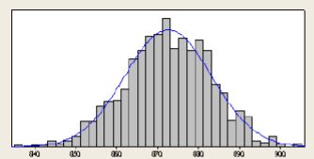
Numeric values: keeping them numeric
Assume a Normal or Gaussian distribution
Nominal values are calculated as before
Counts are normalized into probabilities
Numeric values are listed
Instead of counts, calculate
Mean
Standard deviation

Slide 21
Numeric values:keeping them numeric
Mean μ (average): add all the values together and divide by number of values.
Standard deviation σ :
Subtract the mean from each value
Square the result
Add all results together
Divide by number of values – 1
Calculate square root
Notes:
This is a different mu from the one before. It just means mean.
Standard deviation is a sigma. It’s the average distance from the average.

Slide 22
Example: Numeric values
Outlook | Temperature | Humidity | Windy | Play
Sunny | 85 | 85 | False | No
Sunny | 80 | 90 | True | No
Cloudy | 83 | 86 | False | Yes
Rainy | 70 | 96 | False | Yes
Rainy | 68 | 80 | False | Yes
Rainy | 65 | 70 | True | No
Cloudy | 64 | 65 | True | Yes
Sunny | 72 | 95 | False | No
Sunny | 69 | 70 | False | Yes
Rainy | 75 | 80 | False | Yes
Sunny | 75 | 70 | True | Yes
Cloudy | 72 | 90 | True | Yes
Cloudy | 81 | 75 | False | Yes
Rainy | 71 | 91 | True | no

Slide 23
Numeric values example
Outlook |  |  | Temperature |  |  | Humidity |  |  | Windy |  |  | Play
 | yes | no |  | yes | no |  | yes | no |  | yes | no | yes | no
sunny | 2 | 3 |  | 83 70 68 | 85 80 65 |  | 86 96 80 | 85 90 70 | true | 3 | 3 | 9 | 5
cloudy | 4 | 0 |  | 64 69 75 | 72 71 |  | 65 70 80 | 95 91 | false | 6 | 2
rainy | 3 | 2 |  | 75 72 81 |  |  | 70 90 75
sunny | 2/9 | 3/5 | Mean μ | 73 | 74.3 | Mean μ | 79.1 | 86.2 | true | 3/9 | 3/5 | 9/14 | 5/14
cloudy | 4/9 | 0/5 | Std dev σ | 6.2 | 7.9 | Std dev σ | 10.2 | 9.7 | false | 6/9 | 3/5
rainy | 3/9 | 3/5
Notes:
One value for “Yes”, one for “no” in the temperature and humidity attributes now.

Slide 24
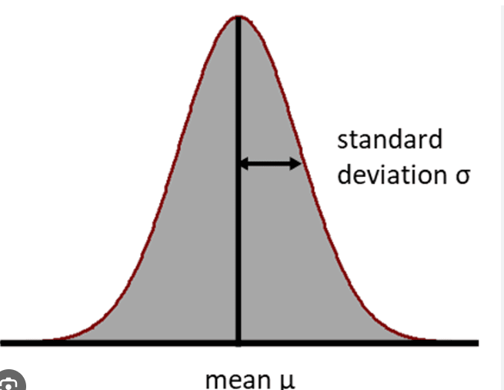
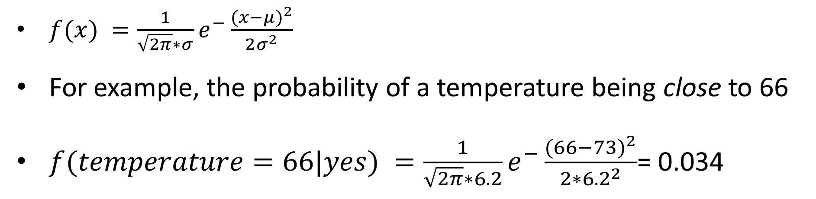
Probability density function (Gaussian distrib.)
Indicates the probability of a quantity being close to a given value
$f(x) =\frac{1}{\sqrt{2π}∗σ}e^{−}\frac{{(x−μ)}^{2}}{2σ^{2}}$
For example, the probability of a temperature being close to 66
$f(temperature=66|yes) =\frac{1}{\sqrt{2π}∗6.2}e^{−}\frac{{(66−73)}^{2}}{2{∗6.2}^{2}}$= 0.034
The Normal Distribution, Clearly Explained!!! - Statquest
Notes:
Yeah, it’s a function, with Euler’s constant “e” in it. x is your value, mu is your mean, sigma is the std deviation. Looks complicated but there are only two things to substitute into it.
Probability is higher closer to the mean.

Slide 25
Numeric values – probability calculations
New day:
outlook = sunny, temperature = 66, humidity = 90, windy = true.
Likelihood (yes) =
2/9 * 0.0340 * 0.0211 * 3/9 * 9/14 = 0.000036
Likelihood(no) =
3/5 * 0.0291 * 0.0380 * 3/5 * 5/14 = 0.000136
Probability(yes) = 0.209
Probability(no) = 0.791
Notes:
I just calculated the number for humidity by substituting int the gaussian distribution function.
And, oooh, it’s the same result with about the same numbers as when we did it with discrete-ised data!

Slide 26
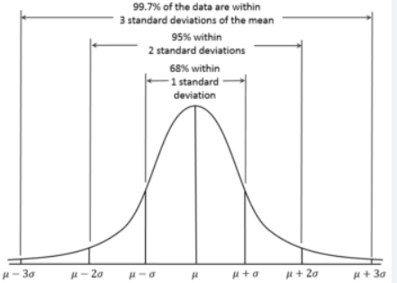
Variants of Naïve Bayes
The following variants are popular.
Gaussian (seen)
Assumes a normal distribution of (continuous) numeric attributes
Multinomial
Assumes multinomial distribution.
Used for text classification.
Bernoulli
Independent binary attributes.
Used for text classification.
The Binomial Distribution and Test, Clearly Explained!!! - Statquest
Notes:
Look up Bernoilli

Slide 27
Advantages and Disadvantages of Naïve Bayes
Advantages
Multi-class classification
Regression
Fast
Often used for text classification
Disadvantages
Attribute independence.
All attributes are equally important.
Notes:
It’s also often the most rubbish classifier, but we’ll see in the lab.

Slide 28
Summary
Probabilities can be used to predict new class or for regression.
Simple method where normally assumptions are not correct, i.e. independent attributes, but it produces good results.
If several attributes are related (redundant attributes), their effect on the conclusion is magnified and Naïve Bayes’ theorem does not work well.
If numeric values do not follow a normal distribution, the use of other formulas, suitable for that distribution, is required.
Discretisation of the numeric values is also a possibility.

