Slide 1
Evaluation of Classification Learning
Statement for Audio and Video Learning Resources
Video and audio content at the University uses closed captions generated by automatic speech recognition (ASR). The ASR process is based on machine learning algorithms which automatically transcribe voice to text. According to our technology providers, this process is approximately 70-90% accurate depending on the quality of the audio, and consequently video and audio closed captions may include some transcription errors. It is therefore important to recognise that the original recording is the most accurate reflection of the content, and not the captions.
If you require accurate captions as part of your reasonable adjustments, please contact the Inclusion Centre to discuss your requirements.

Slide 2
Lab Postmortem (Classifiers and missing data)
Weird errors happen when missing a library:
rm(list=ls()) # Cleans the working environment
library() # Imports a library – you might have more than one.

Slide 3
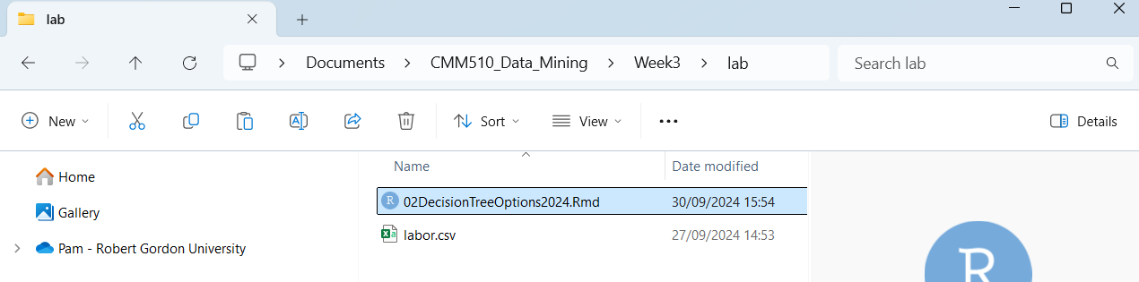
Know where your .rmd file and your dataset
Easiest: keep them both in the same folder and don’t bother with paths.
labor <- read.csv("labor.csv", header = T, stringsAsFactors=T)
Notes:
If you’re not using rmd files yet, please start using them.

Slide 4
Know the “train() function
# Running the algorithm
set.seed(123)
c5model <- train(play ~ .,
data = WeatherPlay,
method = "C5.0Tree",
trControl = control1)
summary(c5model$finalModel)
Notes:
Keep going, Pam.

Slide 5
ChatGPT’s instructions for a C5.0
# 3. Train C5.0 decision tree
model <- C5.0(label ~ number, data = train_data)
# 4. Make predictions
pred <- predict(model, test_data)
# 5. Evaluate accuracy
accuracy <- mean(pred == test_data$label)
cat("Accuracy:", accuracy, "\n")
# 6. View the decision tree summary
summary(model)

Slide 6
Know the “train() function
What is label? What is data?
# Running the algorithm
set.seed(123)
c5model <- train(play ~ .,
data = WeatherPlay,
method = "C5.0Tree",
trControl = control1)
summary(c5model$finalModel)
Your model object
Dataset object
A model architecture
A control object

Slide 7
Know what we added to the train function…
control1 <- trainControl(method = "cv", number = 5)
set.seed(123)
c5Tree <- train( Class ~ .,
data = labor,
method = "C5.0Tree",
na.action= na.pass,
trControl = control1,
control = C5.0Control(CF = 0.35 ))
What to do with missing data
Confidence factor (smaller is more accurate tree but maybe overfitting?)
minCases, winnow – other models had different control options!

Slide 8
What is this hot mess?
Decision tree:
WageIncY1 <= 2.5: bad (15.3/2.3)
WageIncY1 > 2.5:
:...LTDIyes <= 0:
:...Duration > 2: good (2.2)
: Duration <= 2:
: :...Hours <= 39: good (2.5/0.3)
: Hours > 39: bad (5.4/0.7)
LTDIyes > 0:
:...WageIncY1 > 3: good (26.3)
WageIncY1 <= 3:
:...Holidays <= 10: bad (2)
Holidays > 10: good (3.4)
Evaluation on training data (57 cases):
Decision Tree
----------------
Size Errors
7 2( 3.5%) <<
(a) (b) <-classified as
---- ----
20 (a): class bad
2 35 (b): class good

Slide 9
It’s the model summary (but specific to model)
Decision tree:
WageIncY1 <= 2.5: bad (15.3/2.3)
WageIncY1 > 2.5:
:...LTDIyes <= 0:
:...Duration > 2: good (2.2)
: Duration <= 2:
: :...Hours <= 39: good (2.5/0.3)
: Hours > 39: bad (5.4/0.7)
LTDIyes > 0:
:...WageIncY1 > 3: good (26.3)
WageIncY1 <= 3:
:...Holidays <= 10: bad (2)
Holidays > 10: good (3.4)
Evaluation on training data (57 cases):
Decision Tree
----------------
Size Errors
7 2( 3.5%) <<
(a) (b) <-classified as
---- ----
20 (a): class bad
2 35 (b): class good
Your model.
A series of rules that can classify an instance of the dataset.
The confusion matrix. You can do loads with this.
Notes:
And this confusion matrix is what we’re going to talk about today.

Slide 10
Contents
Why Evaluate classification models?
Experimental criteria
Training and test sets
Measures
Bias-variance trade-off
Experimental Design
Holdout
Cross-validation
Leave-one-out
Bootstrap
Other considerations
Statistical significance

Slide 11
Model evaluation
Modelling: use a ML algorithm on a dataset to produce a (predictive) model.
A model needs to be evaluated.
The results of using a predictive model can be:
A class prediction: may be
Class output: can be converted to probabilities (controversial!)
Probability output: logistic regression, random forest , gradient boosting. A class is selected according to the probability outputs.
A numeric prediction.
This lecture concentrates on the evaluation of models for class prediction.

Slide 12
All models are wrong
Some models are useful

Slide 13
Why Evaluate classification models?
Quality of model: how good the classification model is solving unseen problems
Simple solution if lots of labelled (classified) data available
But labelled data is usually limited
Need more sophisticated evaluation techniques
Error on training data is not good indicator of performance on unseen data
Split data into disjoint training and test sets
Learn model from training set; evaluate model on test set

Slide 14
Answer questions
How “right” is the model?
Should we trust it?
We deployed it. Should we still trust it?
But first…
How do we synthesise unseen data?
Should we “hide” some data from the model?
But I don’t have that much data!

Slide 15
Training and Testing
Training set used for testing
Resubstitution error is error rate from training data
Hopelessly optimistic as it is also used for training, i.e. creating the model!
Test set used for testing
Independent instances that play no part in learning of classifier.
Assumptions
Training and testing data sets are representative samples of the underlying problem.
Training and testing sets contain different instances.
Overfitting of data.
Notes:
There’s also a tacit assumption that training and testing sets come from the same distribution. If they don’t, then you get generalisation error.

Slide 16
Data sets (all 3 are different)
Training set
The set of data used to build a model.
Validation set
The set of data used to evaluate a model fit when tuning the model.
Test set
The set of data used in the final evaluation.
Notes:
Sometimes validation and test are swapped. Cross-fold validation means we don’t always see these directly, though!

Slide 17
But if you don’t have enough data…
Training Set
Test Set
Notes:
Cross-fold validation means we don’t always state these.

Slide 18
Data leakage – a novice’s error
Test set
Training
set
Data leakage

Slide 19
Over-fitting
Rarely happens
Overfitting: model biased towards training set.
Accuracy on test set is not as good.
Same accuracy in training and testing set
0 50 100
Accuracy on testing set
Overfitting
0 50 100
Accuracy on training set

Slide 20
Evaluation measures: class prediction
Confusion matrix
Evaluation metric
Accuracy / Error
Precision and Recall
F1 measure
Sensitivity
Specificity
Kappa statistics
ROC curves / AUC

Slide 21
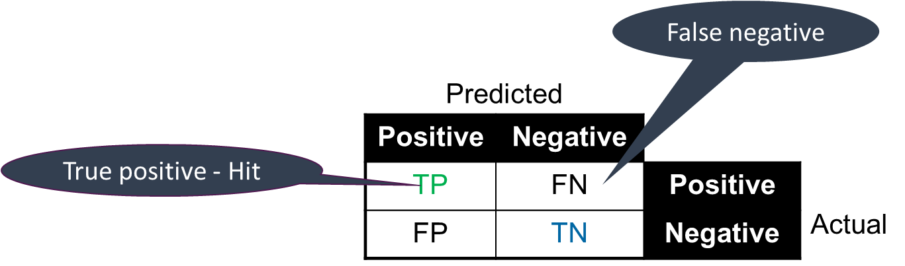

Confusion matrix - binary classification
Confusion Matrix
Predictive Accuracy = 100 * $\frac{TP+TN}{TP+TN+FP+FN}$
TP = Number of positives correctly classified as positive – also called Hit.
FP = Number of negatives falsely classified as positive – also called Type I error.
TN = Number of negatives correctly classified negative.
FN = Number of positives falsely classified as negative – also called miss or Type II error.

Slide 22
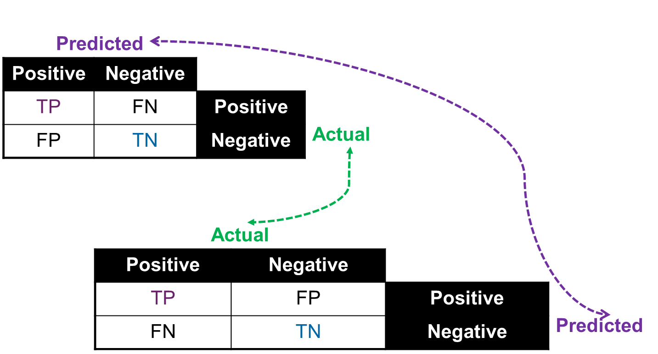
Confusion matrix – 2 options
For any confusion matrix, either columns or rows correspond to predicted. The other option corresponds to actual.

Slide 23
Confusion matrix
Actually Positive | Actually Negative
True Positive (TP) | False Positive (FP) | Predicted Positive
False Negative (FP) | True Negative (TN) | Predicted Negative
Correct predictions fall on the diagonal of the matrix
Off the diagonal are instances that has been misclassified
Performance is based on the counts of the predictions on and off the diagonal of the confusion matrix

Slide 24
Evaluation maths: Accuracy
Number right out of the total number of samples
Percentage the model got right overall
Good metric if the dataset is quite balanced (i.e. same number of all classes). Good for multiclass.
TP + TN
TP + TN + FP +FN

Slide 25

Predictive Accuracy
Predictive Accuracy
proportion of test examples correctly classified
Number between 0 and 1
Often expressed as percentage
Error Rate
Proportion of test examples incorrectly classified
often expressed as percentage
Error rate (%) = 100 – Predictive Accuracy (%)

Slide 26
… predictive accuracy
Accuracy (42/57)
Correctly Classified Instances 42 73.6842 %
Incorrectly Classified Instances 15 26.3158 %
Total Number of Instances 57
Error
15/57

Slide 27
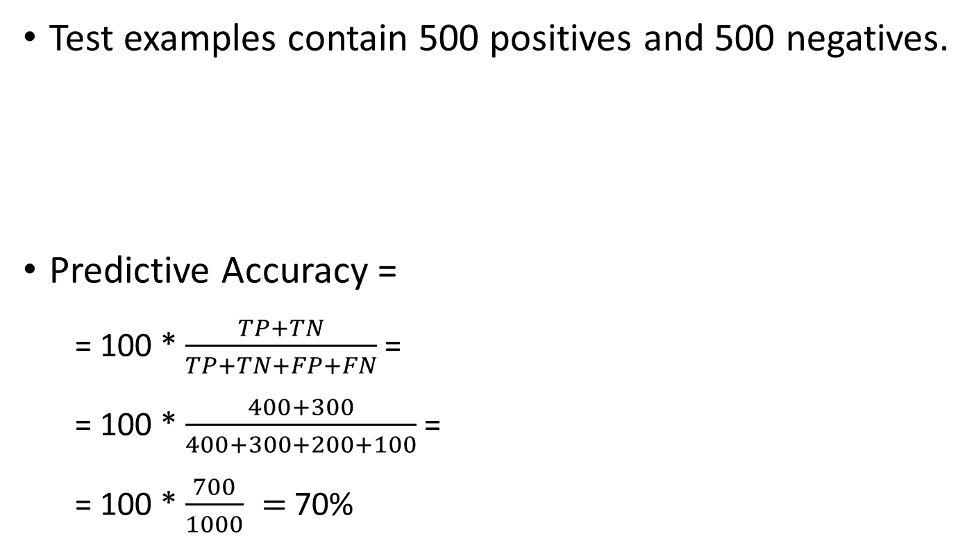
Accuracy example – binary classification
Test examples contain 500 positives and 500 negatives.
Predictive Accuracy =
= 100 * $\frac{TP+TN}{TP+TN+FP+FN}$=
= 100 * $\frac{400+300}{400+300+200+100}$=
= 100 * $\frac{700}{1000} =$70%
Predicted
Positive | Negative
400 | 100 | Positive | Actual
200 | 300 | Negative
Notes:
1000 samples.

Slide 28
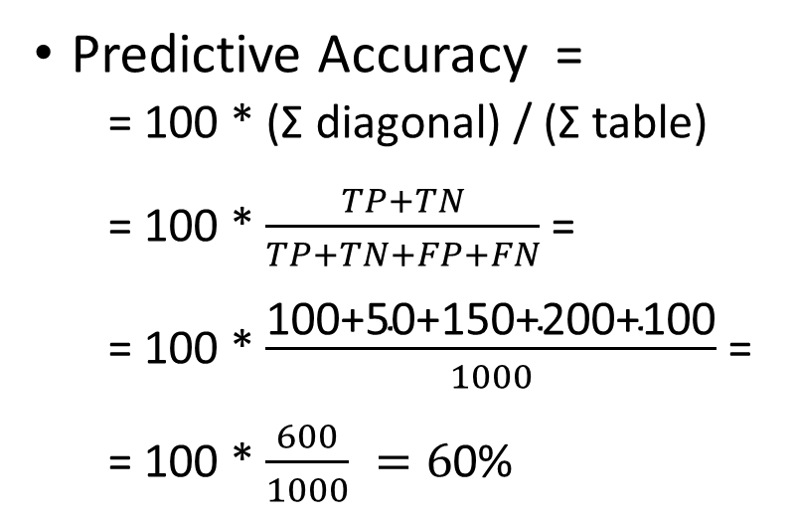
Accuracy – non-binary classification
Predicted
a | b | c | d | e
100 | 60 | 0 | 40 | 0 | a
30 | 50 | 30 | 30 | 60 | b
20 | 0 | 150 | 0 | 30 | c | Actual
0 | 0 | 0 | 200 | 0 | d
0 | 50 | 0 | 50 | 100 | e
Predictive Accuracy =
= 100 * (Σ diagonal) / (Σ table)
= 100 * $\frac{TP+TN}{TP+TN+FP+FN}$=
= 100 * $\frac{\text{100+50+150+200+100}}{1000}$=
= 100 * $\frac{600}{1000} =6$0%
Σ means “sum”

Slide 29
What is “Good” accuracy?
Binary classification >50%
Multiclass classification?
10 classes >10%
3 classes >33%
Any of these suggest the model has learned something. BUT only if the dataset is approximately balanced.

Slide 30
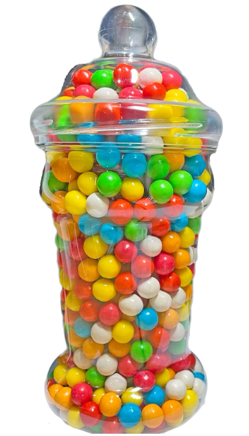

Pam’s sweetie classifier
Jar has 100 sweeties
1 is “poisoned”
99 are sweet
Model is 99% accurate
NOT
Poison
The classifier

Slide 31
Pam’s sweetie classifier confusion matrix
Jar has 100 sweeties
1 is “poisoned”
99 are sweet
Model is 99% accurate
Actually Poisoned | Actually Nice
0 | 0 | Predicted Poisoned
1 | 99 | Predicted Nice

Slide 32
Evaluation maths: Specificity
Proportion of true negatives out of all negatives.
True negative rate.
Goodness of the model at determining a negative sample.
TN
TN + FP
Sweetie Classifier has 100% Specificity
Notes:
Think of diseases. Out of all the people who don’t have the disease, these are the ones our model correctly predicted as clear.

Slide 33
Evaluation maths: Precision
Proportion of true positives out of all predicted positives.
Proportion of the positives predicted by the model that are correct.
TP
TP + FP
Sweetie Classifier has 0% Precision
Notes:
Think of diseases. If you get a positive result from our model, this is the chances of you actually having the disease.
Also sweetie classifier could have infinite precision because it predicts nothing as positive.
Precision, prediction.

Slide 34
Evaluation maths: Sensitivity (or Recall)
Proportion of true positives out of all actual positives.
True positive rate.
Goodness of the model at determining a positive sample.
TP
TP + FN
Sweetie Classifier has 0% Recall
Notes:
Think of diseases. Out of all the people who actually have a disease, this is the proportion that our model will correctly predict.

Slide 35
Precision and Recall
TP Rate FP Rate Precision Recall F-Measure MCC ROC Area PRC Area Class
0.700 0.243 0.609 0.700 0.651 0.444 0.695 0.559 bad
0.757 0.300 0.824 0.757 0.789 0.444 0.695 0.738 good
WA. 0.737 0.280 0.748 0.737 0.740 0.444 0.695 ` 0.675
a b <-- classified as
14 6 | a = bad
9 28 | b = good
Weighted average
Measures are per class value
Precision: Fraction of returned as class X that are really class X
E.g precision(“bad”) =14/23 = 0.609
Recall: fraction of all class X which are returned as class X.
E.g recall(“bad”) = 14/20 = 0.7
Notes:
ROC Curves are coming up.

Slide 36
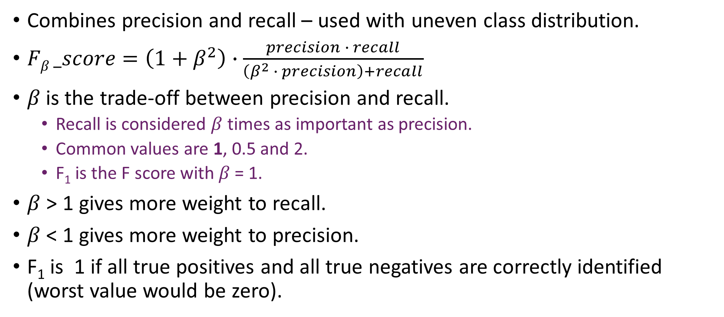
F-score or F-measure
Combines precision and recall – used with uneven class distribution.
$Fβ _score=\left(1+β^{2}\right)∙\frac{precision ∙ recall}{\left(β^{2} ∙ precision\right)+recall}$
$β$is the trade-off between precision and recall.
Recall is considered $β$ times as important as precision.
Common values are 1, 0.5 and 2.
F₁ is the F score with 𝛽 = 1.
$β$ > 1 gives more weight to recall.
$β$ < 1 gives more weight to precision.
F₁ is 1 if all true positives and all true negatives are correctly identified (worst value would be zero).
Notes:
Precision says something about the model (TP out of all predicted P), Recall says something about reality and the real dataset distribution (TP out of all real P) .

Slide 37
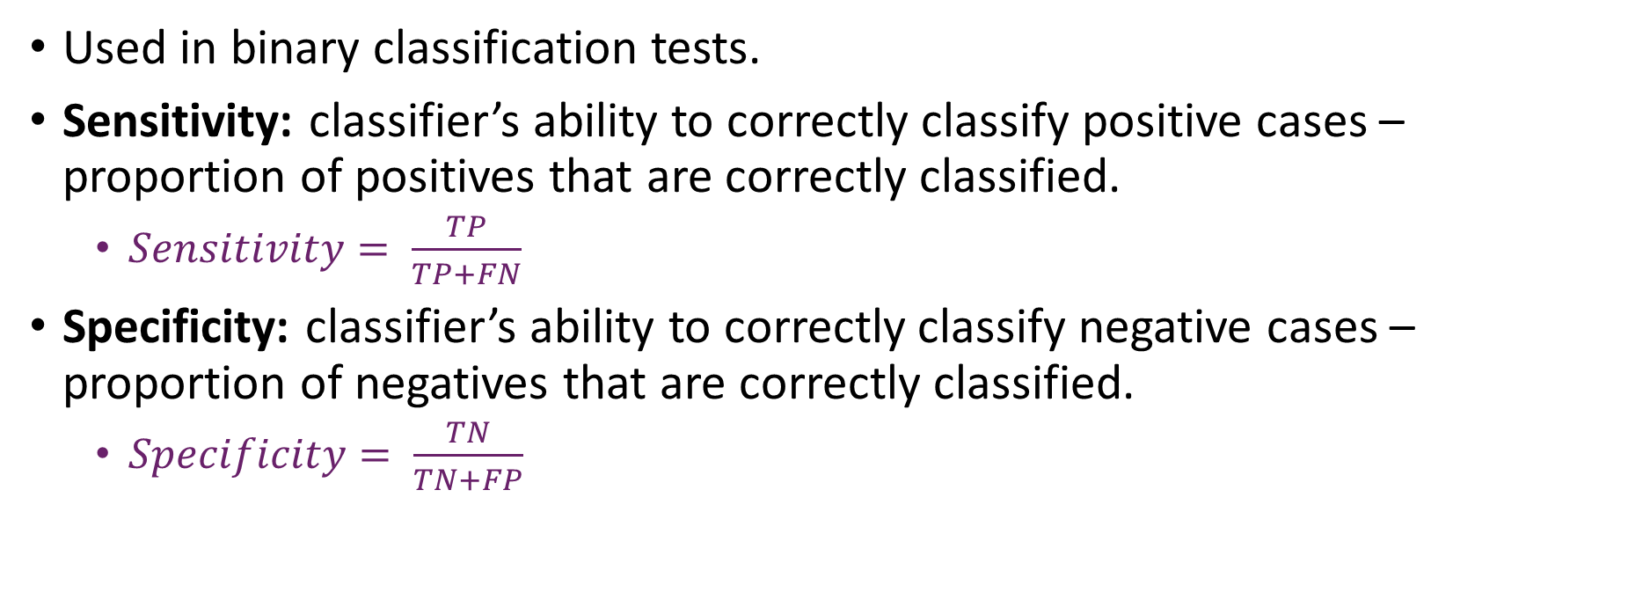
Sensitivity and specificity
Used in binary classification tests.
Sensitivity: classifier’s ability to correctly classify positive cases – proportion of positives that are correctly classified.
$Sensitivity= \frac{TP}{TP+FN}$
Specificity: classifier’s ability to correctly classify negative cases – proportion of negatives that are correctly classified.
$Specificity= \frac{TN}{TN+FP}$

Slide 38
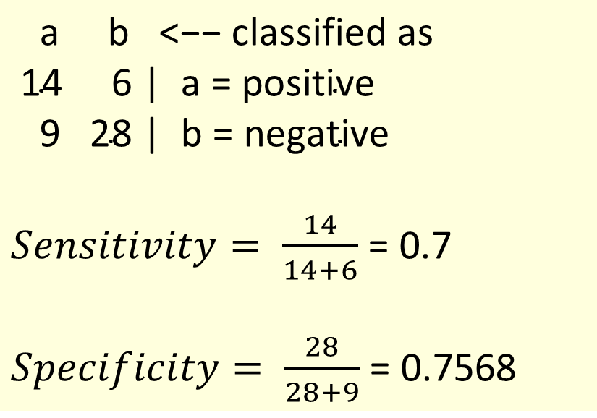
Sensitivity and Specificity (binary classification)
$\text{a} \text{b}\text{ <−− }\text{classified} \text{as}$
$\text{14 6 | }\text{a}\text{ = }\text{positive}$
$\text{9 28 | }\text{b}\text{ = }\text{negative}$
$Sensitivity= \frac{14}{14+6}$ = 0.7
$Specificity= \frac{28}{28+9}$ = 0.7568

Slide 39
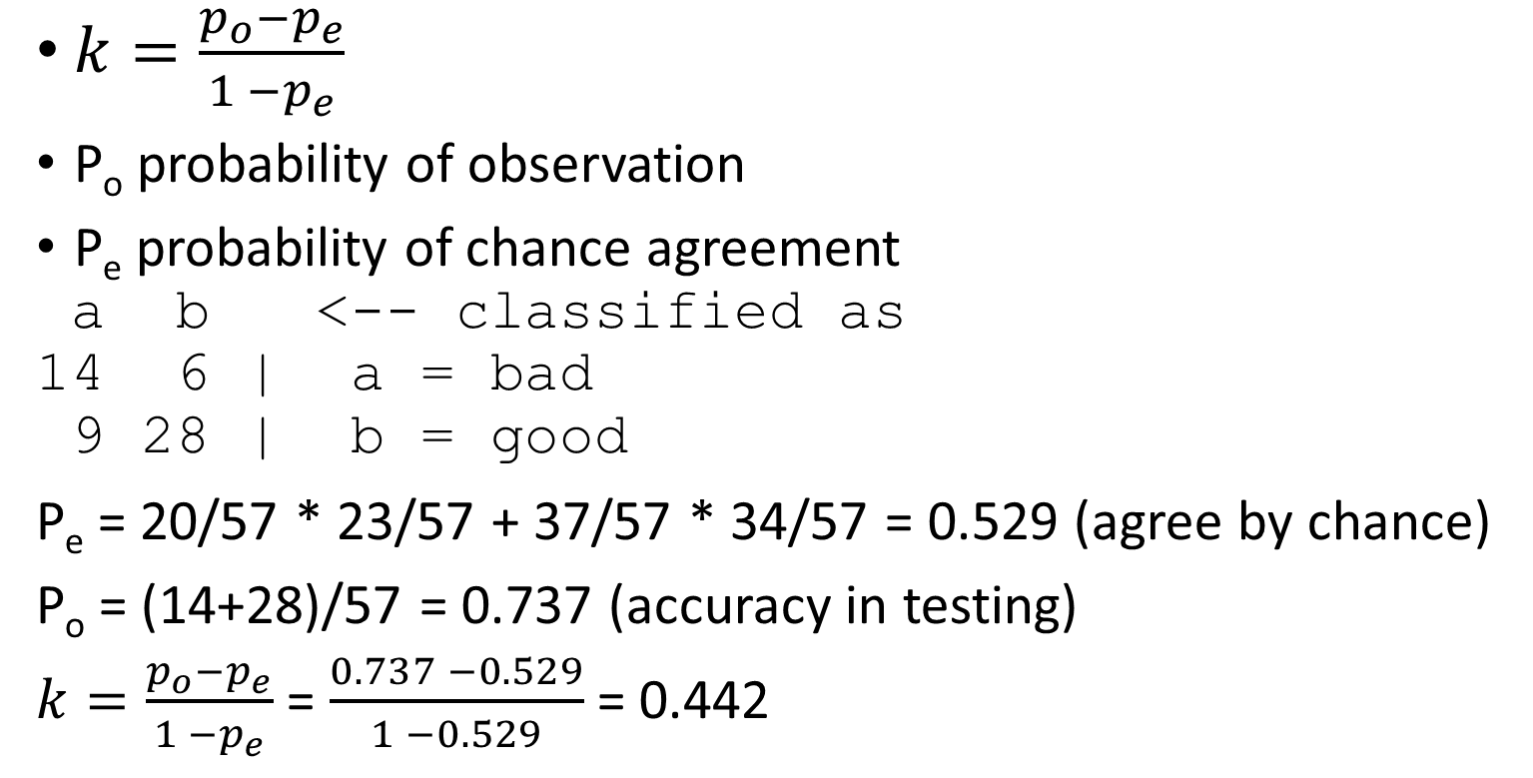
Kappa (inter-related agreement – nominal class)
$k=\frac{p_{o}−p_{e}}{1 −p_{e}}$
P_{o} probability of observation
P_{e} probability of chance agreement
a b <-- classified as
14 6 | a = bad
9 28 | b = good
P_{e} = 20/57 * 23/57 + 37/57 * 34/57 = 0.529 (agree by chance)
P_{o} = (14+28)/57 = 0.737 (accuracy in testing)
$k=\frac{p_{o}−p_{e}}{1 −p_{e}}$ = $\frac{0.737 −0.529}{1 −0.529}$ = 0.442
Actual:
14 + 6 = 20 bad
9+28= 37 good
Classified as:
14+9 = 23 bad
6 + 28 = 34 good
Total = 14+6+9+28 = 57
Notes:
For example, in binary classification with equal classes, models can achieve 50% accuracy just by chance.

Slide 40
Kappa interpretation
Little agreement: k < 0.20
Some agreement: 0.20 ≤ k < 0.40
Moderate agreement: 0.40 ≤ k < 0.60
Good agreement: 0.60 ≤ k < 0.80
Very good agreement: 0.80 ≤ k < 1.00
Notes:
Good observations to make and good to use these terms in markdown.

Slide 41
ROC Curves
ROC curves– used for binary classification
Receiver Operating Characteristic
Hit rate/false alarm trade-off in noisy communication
ROC plot
y axis: % true positives in sample
X axis: % false positives in sample
A classifier that has no skill (e.g. predicts the majority class) will be represented by a diagonal line from the bottom left to the top right.
Plot sensitivity and (1-specificity), i.e. the difference between the true positive rate and the false positive rate.
Measure Area Under Curve (AUC). Whole area is 1, so AUC will be < 1.

Slide 42
Plotting a ROC Curve
P | A
0.99 | T
0.95 | T
0.89 | F
0.88 | T
0.79 | T
0.66 | F
0.65 | T
Perfect classifier: (FPR=0, TPR=100)
TPR
Binary classifier outputs probability
We select the cut off between classes
To get points on the ROC Curve, select different cut offs and measure the True Positive Rate (TPR) and False Positive Rate (FPR)
100%
Cut off
100%
FPR
Curve may not match data.
Notes:
TPR, FPR, Perfect classifier, random chance,

Slide 43
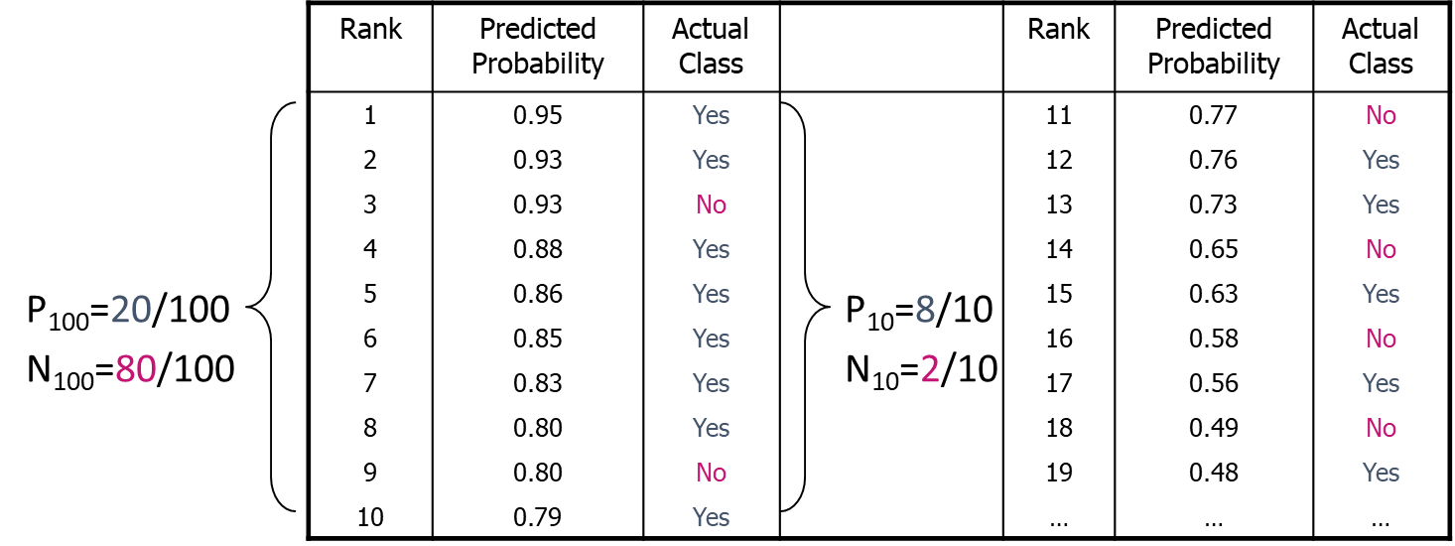
Generating a ROC Curve
TP₁₀rate=8/20, FP₁₀rate=2/80
ROC₁₀₀ = (2/80, 8/20) = (2.5%, 40%)

Slide 44
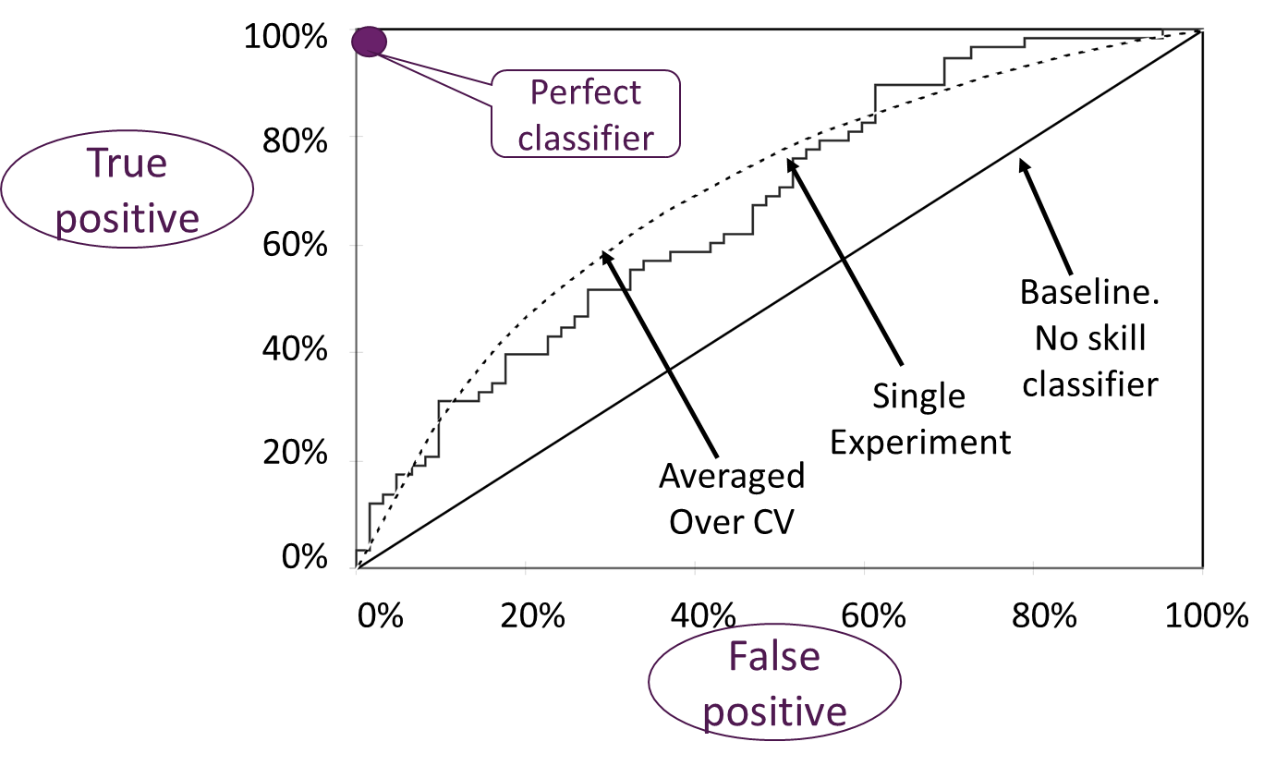
Example ROC Chart
Notes:
CV = crossfold validation.

Slide 45
… ROC curve interpretation
Area under curve is
Excellent 0.9-1
Good: 0.8-0.9
Fair: 0.7-0.8
Poor: 0.6-0.7
Fail: 0.5-0.6
Notes:
AUC is fairly unforgiving metric, though. These sometimes reflect the dataset.

Slide 46
Experimental design
Design experiments to build and evaluate model.
Consider bias vs. variance trade-off.
Consider dataset imbalance – dataset where one type of target scenario is much more represented than another one.
Lots of data required! Need data to
Tune models
Optimise parameter values
Need training and testing sets
Test final model
Need additional testing set.

Slide 47
Model bias vs variance
Bias – incorrect assumptions made
Can introduce systematic prejudice.
Often the result of a cost function (but data may also be biased) which favours some distribution.
While bias may not be intentional, the consequences can be serious (illegal/dangerous).
Common bias problems:
Algorithm .
Sample data – not representative.
Prejudice bias in data – the data collection process made assumptions which contained bias. E.g. all presidents are male.
Measurement bias in data collected: e.g. if a patient knows they are given a test drug, the may feel better because of what they know, not because of what they take.

Slide 48
Examples of bias
Amazon HR recruitment algorithm was biased.
AI algorithm scored candidates from CVs.
BUT was not gender-neutral, discriminating against women.
Had learnt patterns from CVs, most of which had come from men.
Check https://www.reuters.com/article/us-amazon-com-jobs-automation-insight-idUSKCN1MK08G [ accessed 1/10/2024]
COMPAS Software to assess the likelihood of a defendant from recurring was found to be biased according to skin colour.
https://en.wikipedia.org/wiki/COMPAS_(software) [ accessed 1/10/2024]

Slide 49
Variance
Variance: incorrect assumptions learnt from noise in the data.
But the data is correct, not biased.
Algorithm too sensitive to fluctuations in data.
High variance helps reduce bias.
High bias helps reduce variance.

Slide 50
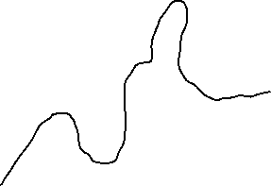
Bias vs variance
High bias  the model does not match the dataset closely (or incorrect dataset).
Low variance. Generalised/simplified model.
Models will be similar for different training sets.
Data trends may not be adequately captured.
Underfitting.
Low bias  the model matches the dataset closely
High variance. More complex model.
Models will be different for different training sets.
Overfitting.
Notes:
All yellow dots on one side of the line – plotting decision boundary.

Slide 51
Bias vs variance trade-off
Select appropriate data
Representative
Large enough
No sample bias or prejudice bias
Test models to ensure there is no algorithm or dataset bias.
Monitor system
Bias may crop up over time as reinforcement learning.
Combat overfitting
Model dependent. E.g. simplify models

Slide 52
Contents
Why Evaluate classification models?
Experimental criteria
Training and test sets
Measures
Bias-variance trade-off
Experimental Design
Holdout
Cross-validation
Leave-one-out
Bootstrap
Other considerations
Statistical significance

Slide 53
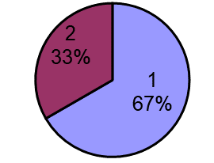
Utilising all the available data
Holdout procedure
Dilemma
After evaluation
Two thirds of data for training (1)
The remaining data, i.e. one third, for testing (2)
The split could be different, e.g. 80% training, 20% testing
The larger the training data the better the classifier
The larger the test data the more accurate the error estimate
All data may be used to build final classifier
Notes:
Some datasets have “known splits”

Slide 54
Holdout evaluation - stratification
Samples should be representative
Each class is represented with approximately equal proportions in both subsets
This is called stratified hold-out
Repeated holdout
Randomly select test set each iteration
Calculate average error rate
Can overlapping test sets be avoided?
Exploit test-train splits, but…

Slide 55
k-fold Cross-Validation
First step
dataset is split into k folds/partitions of equal size
Second step
each fold used as test set; remainder for training
Calculate errors over k folds
1
2
3
4
5
6
7
8
9
10
1
2
3
4
5
6
7
8
9
10
1
2
3
4
5
6
7
8
9
10
1
2
3
4
5
6
7
8
9
10
1
2
3
4
5
6
7
8
9
10
1
2
3
4
5
6
7
8
9
10

Slide 56
Standard Cross-Validation
Stratified ten-fold cross-validation
Ten-fold is known to give accurate estimate
9/10ths for training and 1/10th for testing x 10 (one per fold)
Stratification - each class is properly represented in each fold
“Properly” = in the same proportion as in the dataset
Stratification reduces the estimate’s deviation
Repeated stratified cross-validation
E.g. ten-fold cross-validation repeated ten times
Results averaged over 100 experiments (10 folds x 10 repetitions)
At each repetition, fold membership will change.
Can be computationally expensive
Reduces the variance

Slide 57


Leave-One-Out Testing
A particular form of cross-validation
number of folds = number of training instances
no random sampling involved
stratification is not possible
only one instance in the test set!
Makes maximum use of the data
test sets contain single instances
classifier is built n times when n training instances
n-1 instances in each training set
Very computationally expensive
Particularly for model builders
So best for small datasets

Slide 58
Bootstrap Estimation
Both Holdout and Cross-validation creates sample without replacement
instance cannot be selected again for a particular fold
i.e. duplicates not allowed in training set
Bootstrap uses sampling with replacement to form training set
n instance dataset is sampled n times with replacement for new dataset of n instances
new dataset is training set
instances from old dataset not in new training set are used for testing
training set has only ~63.2% of dataset in it
Dataset
n
n
k
n-k
Training
Testing

Slide 59
Bootstrap Estimation
Estimates on test data (holdout) are very pessimistic
trained on only ~63.2% of instances
compared to 90% with 10-fold CV
Combine with resubstitution (training set) error
Error = 0.632 * error_{test} + 0.368 * error_{training}
resubstitution error weight < test data error weight
Repeat experiments several times with different selections for training data
average results
Good way to estimate performance for very small datasets - but some disadvantages

Slide 60
Bootstrap why ~63.2%?
Given n instances
chance of picking an instance 1/n
so chance of not picking is (1- 1/n)
Multiply these probabilities for n picking opportunities
chance of an instance not being picked
(1 - 1/n)^{n} ≈ 0.368 = 36.8%
chance of being picked = (100 – 36.8)% = 63.2%

Slide 61
Contents
Why Evaluate classification models?
Experimental criteria
Training and test sets
Measures
Bias-variance trade-off
Experimental Design
Holdout
Cross-validation
Leave-one-out
Bootstrap
Other considerations
Statistical significance

Slide 62
Issues
Statistical significance
How likely it is that the result is not due to chance?
Coin tossing does not maintain 50:50 balance
Performance measures
Effectiveness (error rate, mean squared error)
Efficiency (CPU cycles)
Costs assigned to different types of errors
Medical false alarms are often less costly than a missed diagnosis
False security intrusion alert less costly than missed intrusion

Slide 63
Other issues - classification
% Accuracy is a measure of “goodness”
But there are other measures
Where the errors are may be key
E.g. Data about cows in heat. 97% of the data is about cows which are not in heat
So if classifier answers “no”, it will achieve a 97% accuracy
But it will be useless to a farmer!
E.g. Errors missing a true illness may be worse than errors where illness is diagnosed when patient is healthy
Distribution of errors may also be important.
Is the classifier’s performance better than the expert’s?
If current technology allows correct diagnosis of disease X 60% of the time, a classifier which diagnoses it correctly 68% of the time is good!

Slide 64
Example (Confusion Matrices)
Classed as
Classed as
 | a | b | c
a | 20 | 2 | 2
b | 1 | 23 | 2
c | 1 | 2 | 22
 | a | b | c
a | 24 | 0 | 0
b | 4 | 16 | 6
c | 0 | 0 | 25
10/75 % errors, evenly distributed
10/75 % errors, all in the classification of “b”

Slide 65
…example
Classed as
Classed as
 | a | b | c
a | 80 | 0 | 15
b | 0 | 90 | 0
c | 15 | 0 | 80
 | a | b | c
a | 80 | 15 | 0
b | 0 | 90 | 0
c | 0 | 15 | 80
30/280 errors, none for class “b”
30/280 errors, none in the classification of “b”
Provided we have a big enough test set, if classifier answers “b”, it is a “b” as no instances of other classes are classifier as “b”
If classifier answers “b”, it may, or may not be a “b” as 30/120 of “b” answers are errors

Slide 66
Contents
Why Evaluate classification models?
Experimental criteria
Training and test sets
Measures
Bias-variance trade-off
Experimental Design
Holdout
Cross-validation
Leave-one-out
Bootstrap
Other considerations
Statistical significance

Slide 67
Statistical significance
Suppose estimated error rate is 25%
Accuracy on test set 75%
How close to true error rate?
Depends on the amount of test data
You will be more confident if your estimate is based on a test set of 10,000 instances
rather than a test set of 10 instances
Prediction is just like tossing a biased coin
“heads” = success; “tails” = failure
a succession of independent events
Statistics provides confidence intervals for the true underlying proportion!

Slide 68
Confidence Intervals
60%
20%
20%
Mean
Deviation

Slide 69
Confidence Intervals
80%
10%
10%
Mean
Deviation

Slide 70
Confidence intervals
Give an indication of how close the true value may be to our estimate.
95% confidence often used.
An algorithm has an estimated (test) accuracy ± margin of error
E.g. 75% ± 5.5, i.e. an accuracy ∈ [69.5%, 80.5%]
Higher confidence level ➔ bigger margin of error ➔ wider interval
Interval for 80% confidence ⊂ Interval for 90% confidence
-ve margin of error
+ve margin of error
accuracy
Notes:
But it’s just tradition to use 95% confidence interval.
Is a subset.

Slide 71
Confidence Intervals
Error bars show confidence interval
Performance of 2 algorithms on 7 different datasets.
Is the purple algorithm better than the yellow algorithm?
Notes:
It looks like it is, but for most of the datasets and most of the models, it probably won’t be.

Slide 72
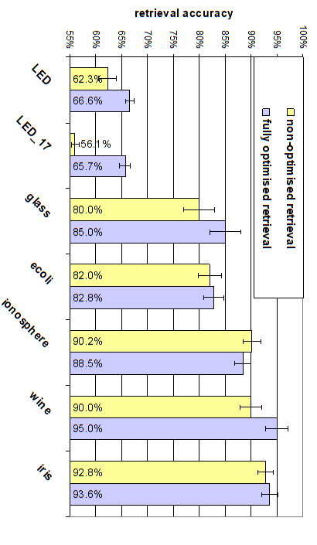
Notes:
It looks like it is, but for most of the datasets and most of the models, it probably won’t be.

Slide 73
Statistical significance
Calculate confidence intervals for the performance of algorithms to be compared – use desired confidence level (often 95%).
If 2 algorithms’ confidence intervals don’t overlap
The difference in performance is statistically significant at that level
The algorithm with the higher confidence interval values is said to perform better.
If confidence intervals overlap
The performance of the algorithms cannot be said to be different as the difference in performance is not statistically significant.

Slide 74
Confidence Intervals
Suppose two models A and B generate accuracies of 75% and 70%. Is A better than B?
What confidence do you wish?
Say 80%
Depends on size of test set!
If 100 text examples
A has true accuracy [69.5%,80.5%]
B has true accuracy [64.5%,75.5%]
No – at 80% confidence
If 1000 text examples
A has true accuracy [73.2%, 76.7%]
B has true accuracy [68.1%, 71.8%]
Yes – at 80% confidence
Overlapping intervals
Disjoint intervals

Slide 75
Summary
Evaluation on training data is over-optimistic
various alternative experimental designs
After any evaluation
all data may be used to build final classifier
There are a number of measures which can be used to evaluate models.
Metrics used for class prediction include: accuracy, error, precision, recall, F1-measure, sensitivity, specificity, ROC.
Experimental design requires careful consideration of assumptions made, outliers and the balance of the data.
Two stage evaluation: model tuning, final evaluation.
Results comparison should consider statistical significance

