Slide 1
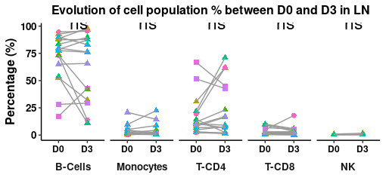
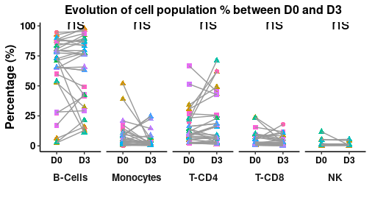
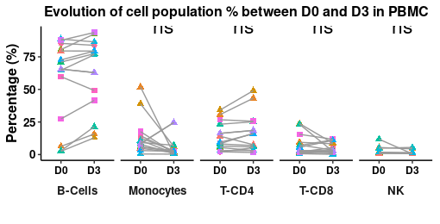
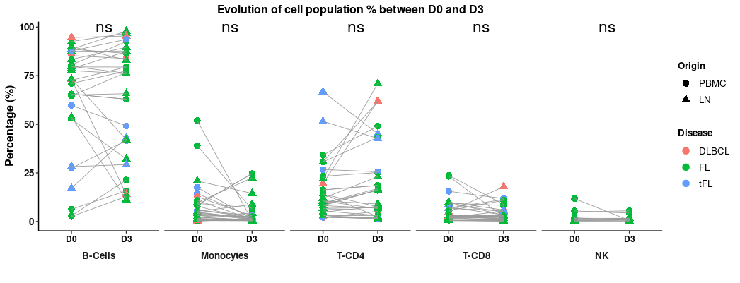
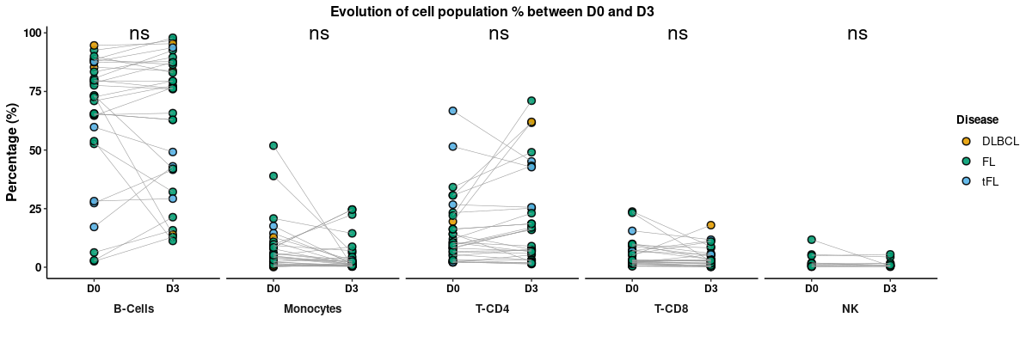
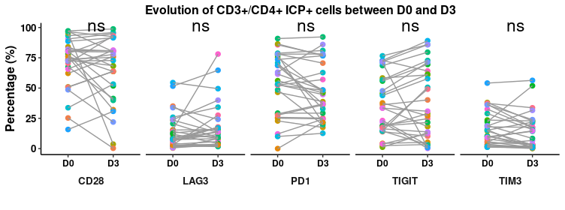
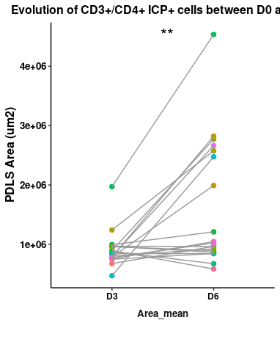

Slide 3
Heatmap Depletion par traitement

Slide 4
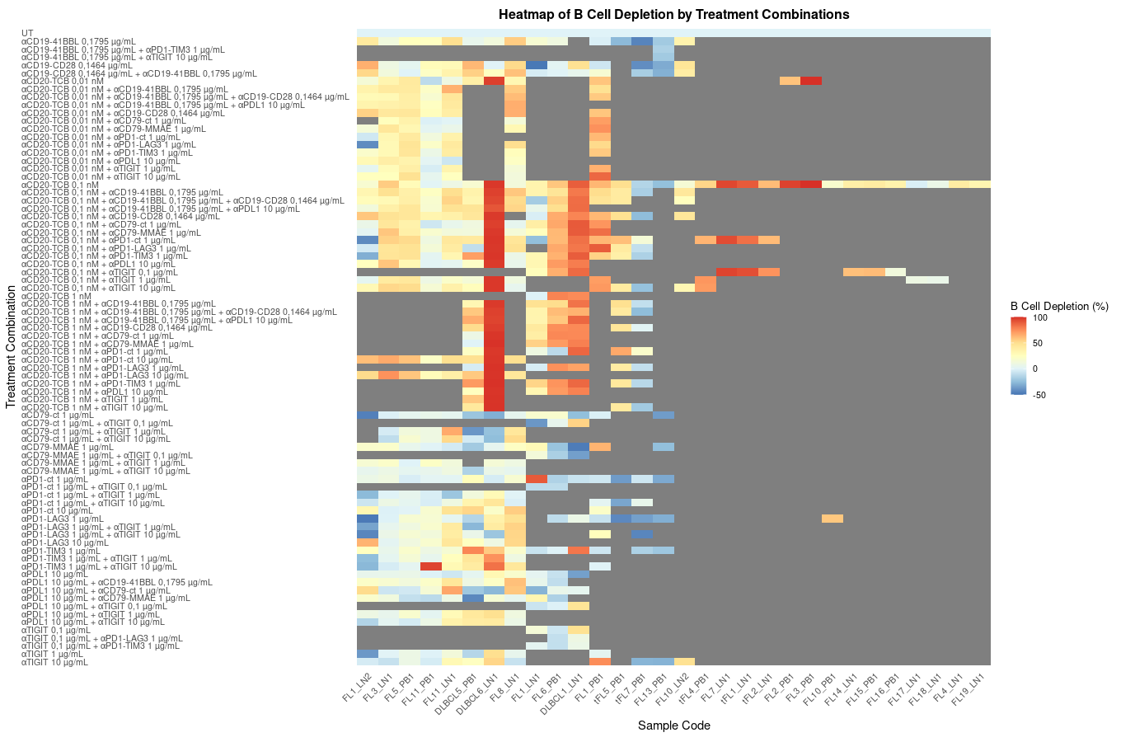

Slide 5
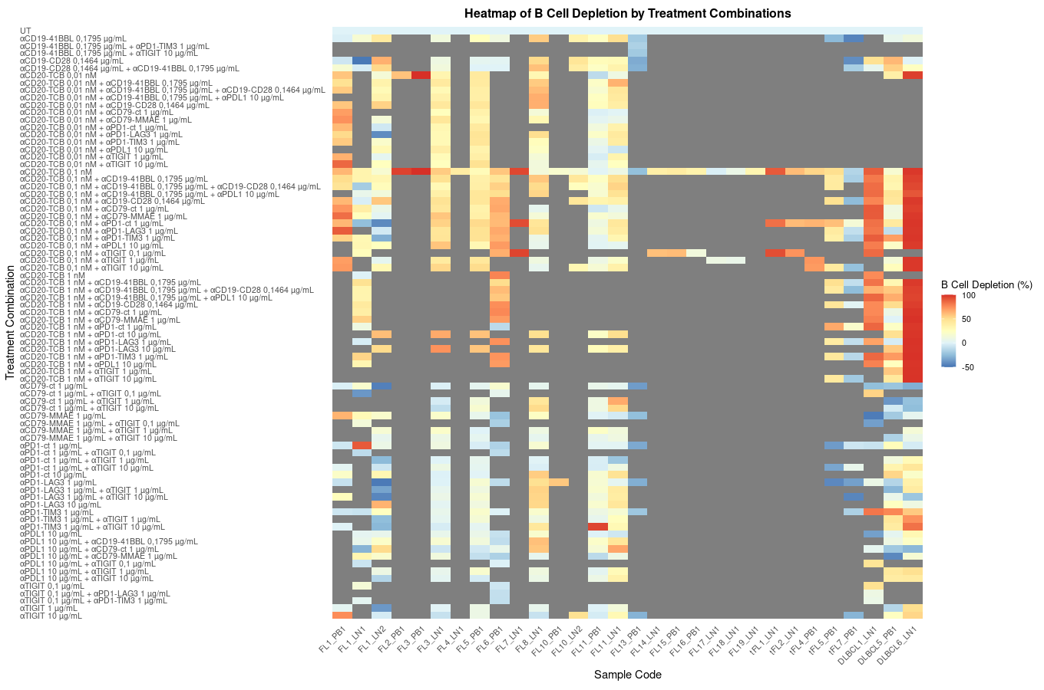
Meme Heatmap
Mais ordre alphabétique des samples

Slide 6
Correlation entre B Cell depletion et les paramètres à D6

Slide 7
Negative Correlation entre B Cell Depletion et differentes variable à D6, en prenant en compte tout les traitements
NB : pour les cytokines j’ai pas forcement toutes les datas
Variable | Correlation | P_Value
Per_CD22_total | -0.45391334 | 6.314652e-37
IL6 | -0.45264230 | 4.186704e-16
Count_CD22_CD10 | -0.43242892 | 2.621805e-33
Per_CD22_CD10_plus | -0.42718210 | 1.834607e-32
Count_CD22 | -0.41384383 | 2.216808e-30
Count_livecells | -0.39349042 | 2.225362e-27
Area_mean | -0.15343685 | 1.284793e-04
IL10 | -0.15222061 | 1.311132e-02
Per_CD22_CD10_moins | -0.05161855 | 1.722075e-01
Count_TGD | -0.04209438 | 5.857288e-01
IL8 | -0.01065848 | 8.613511e-01

Slide 8
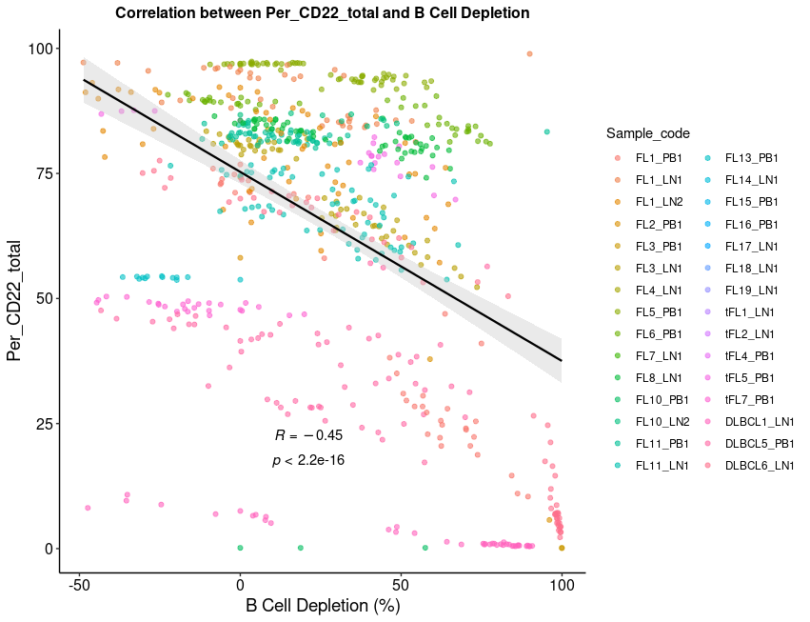
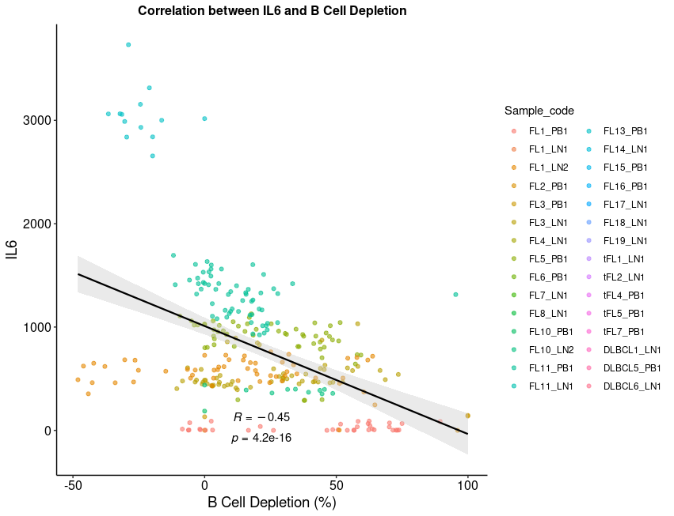
Par exemple, le pourcentage de CD22 a D6 ou la concentration d’IL6

Slide 9
Positive Correlation entre B Cell Depletion et differentes variable à D6, en prenant en compte tout les traitements
NB : pour les cytokines j’ai pas forcement toutes les datas
Variable | Correlation | P_Value
B_cell_depletion_CD22_CD10_plus | 0.95275371 | 0.000000e+00
Per_CD8 | 0.54533184 | 1.474955e-55
Per_CD107a_CD8 | 0.49457577 | 1.604103e-44
Per_NK | 0.49336745 | 2.986961e-38
Per_CD4 | 0.48570916 | 8.902683e-43
B_cell_depletion_total_glofi.x | 0.45890919 | 1.153213e-39
B_cell_depletion_total_glofi.y | 0.45890919 | 1.153213e-39
Per_CD107a_CD4 | 0.45044146 | 2.527601e-36
INFY | 0.42548851 | 5.939299e-09
B_cell_depletion_CD22_CD10_plus_glofi.x | 0.41034315 | 7.531455e-30
B_cell_depletion_CD22_CD10_plus_glofi.y | 0.41034315 | 7.531455e-30
Per_CD107a_NK | 0.35347562 | 3.683843e-17
Per_CD107a_CD4_normalized | 0.34577525 | 4.062390e-21

Slide 10
Positive Correlation entre B Cell Depletion et differentes variable à D6, en prenant en compte tout les traitements
Variable | Correlation | P_Value
Per_CD107a_CD8_normalized | 0.34154225 | 1.302442e-20
Count_CD8 | 0.34142494 | 1.344837e-20
MFI_CD107a_CD4_normalized | 0.33364882 | 3.822584e-19
GrzB | 0.30088977 | 4.253994e-07
MFI_CD107a_CD8_normalized | 0.27894902 | 1.279633e-13
TNFa | 0.27177002 | 3.639422e-06
MFI_CD107a_NK | 0.26278313 | 1.504051e-09
Roundness_mean | 0.22940980 | 2.112962e-05
MFI_CD107a_NK_normalized | 0.21027646 | 1.548574e-06
MFI_CD107a_CD8 | 0.16667617 | 1.248263e-05
Count_CD4 | 0.16538966 | 1.075272e-05
Per_CD107a_NK_normalized | 0.15248042 | 4.061954e-04
Count_NK | 0.12904600 | 1.509099e-03
MFI_CD107a_CD4 | 0.06121268 | 1.107591e-01

Slide 11
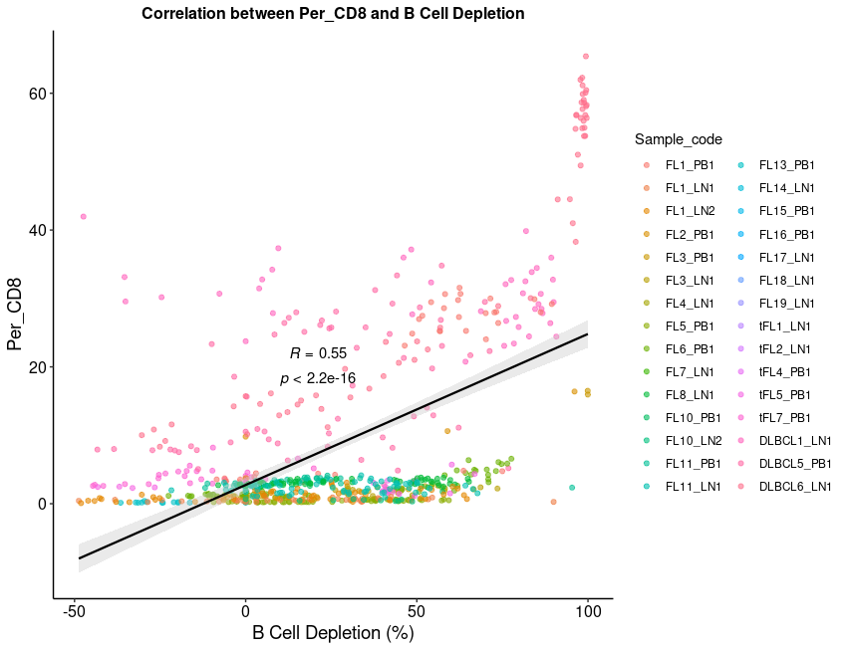
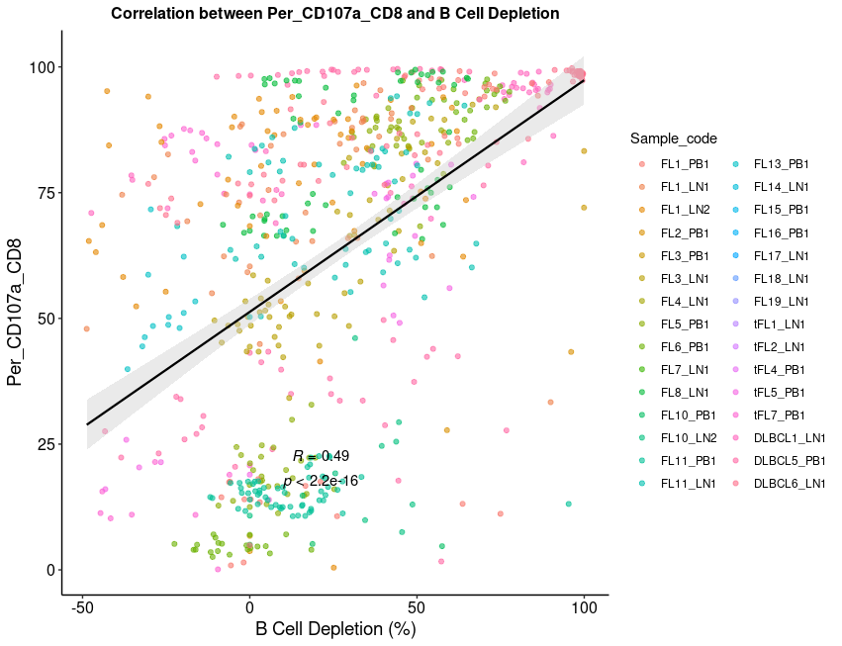
Par exemple, le pourcentage de CD8 à D6 ou le pourcentage de CD107a dans les CD8

Slide 12
Morphologie PDLS

Slide 13
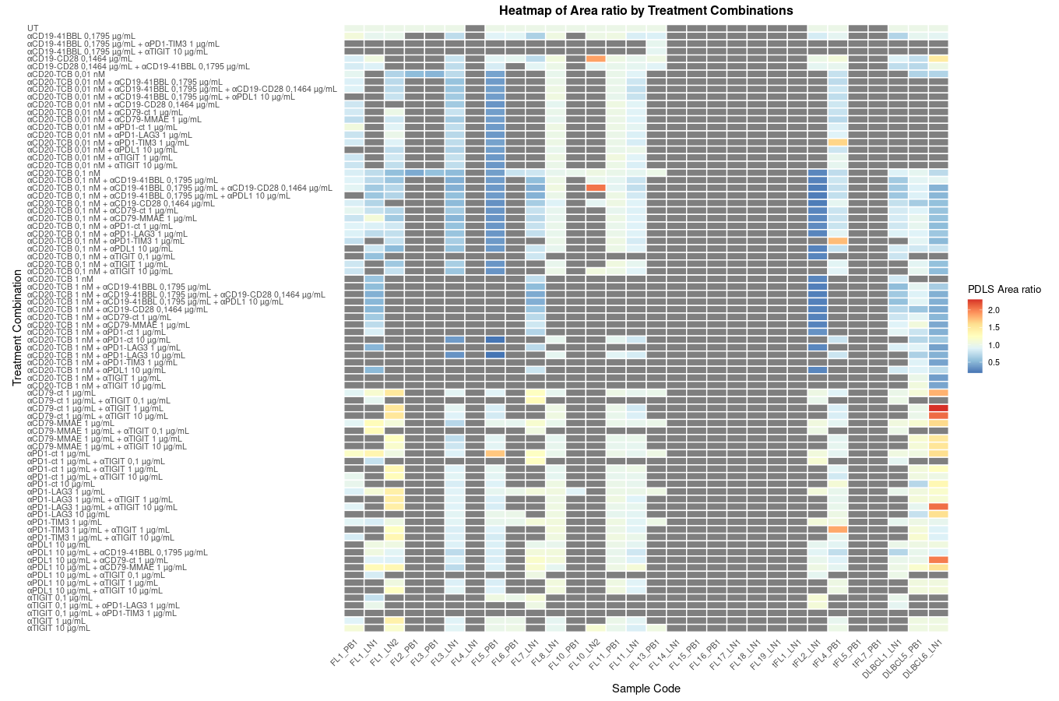
PDLS Area ratio = Area PDLS treated / Area PDLS UT )
Donc < 1, l’aire du PDLS a diminué suite au traitement
>1 l’aire du PDLS a augmenté suite au traitment

Slide 14
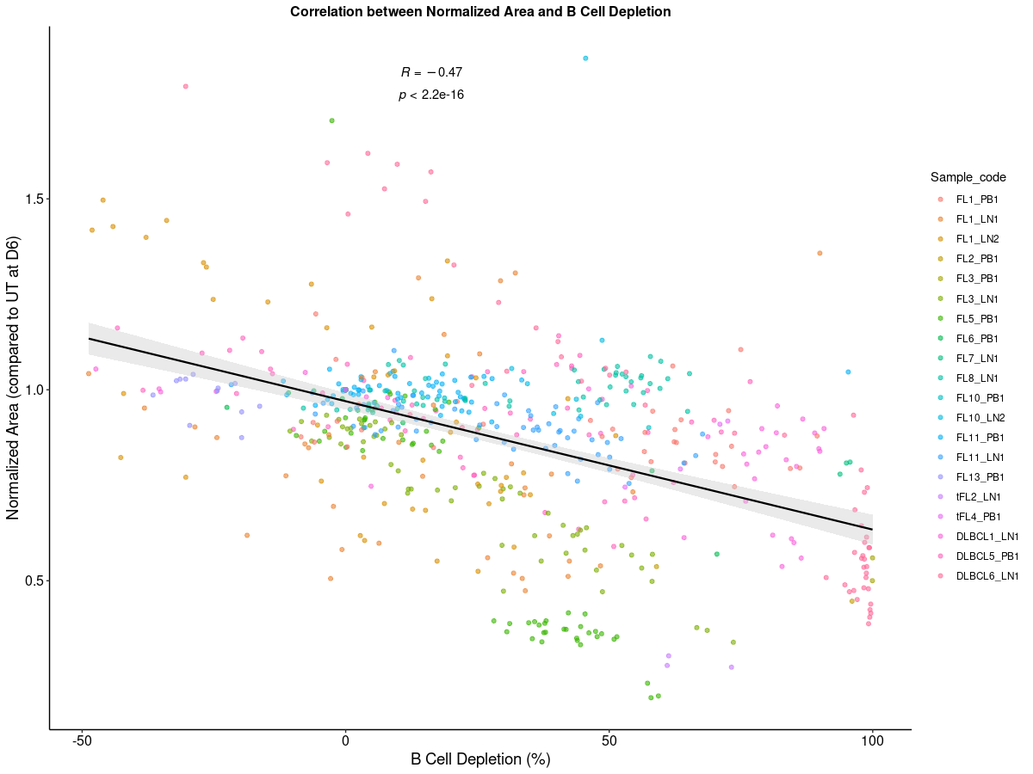
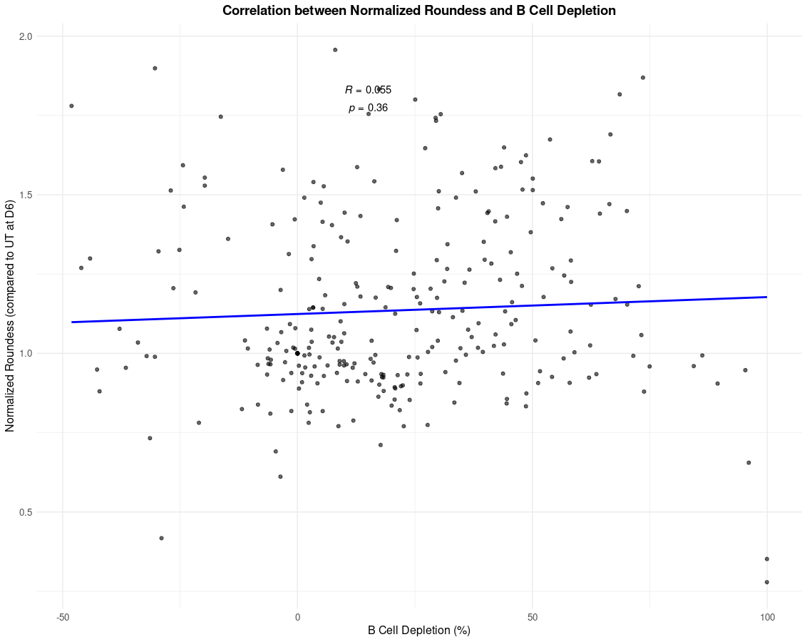
Correlation morphologie PDLS D6 :
A – Correlation entre (Area PDLS treated / Area PDLS UT ) et B_Cell_Depletion
B- Correlation entre (Roundness PDLS treated / Roundness PDLS UT) et B_Cell_Depletion

Slide 15
Exemple heatmap Cytokines

Slide 16
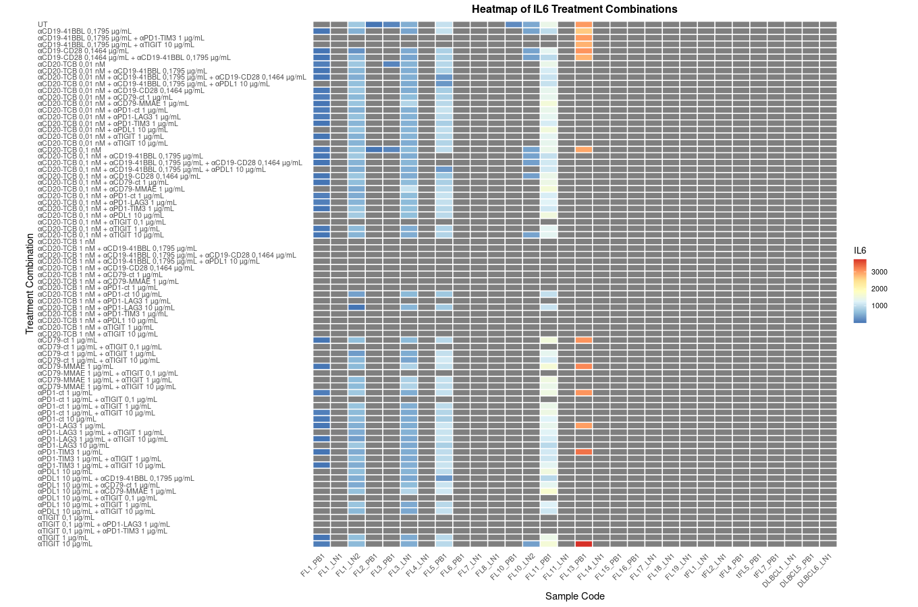

Slide 17
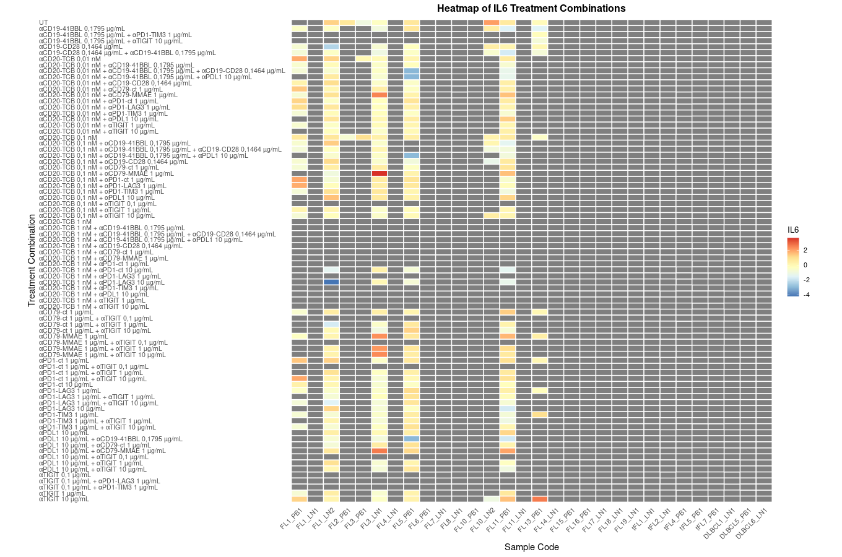
Z-score

Slide 18
Correlation entre ICP expression at D0 and B_Cell_Depletion

Slide 19
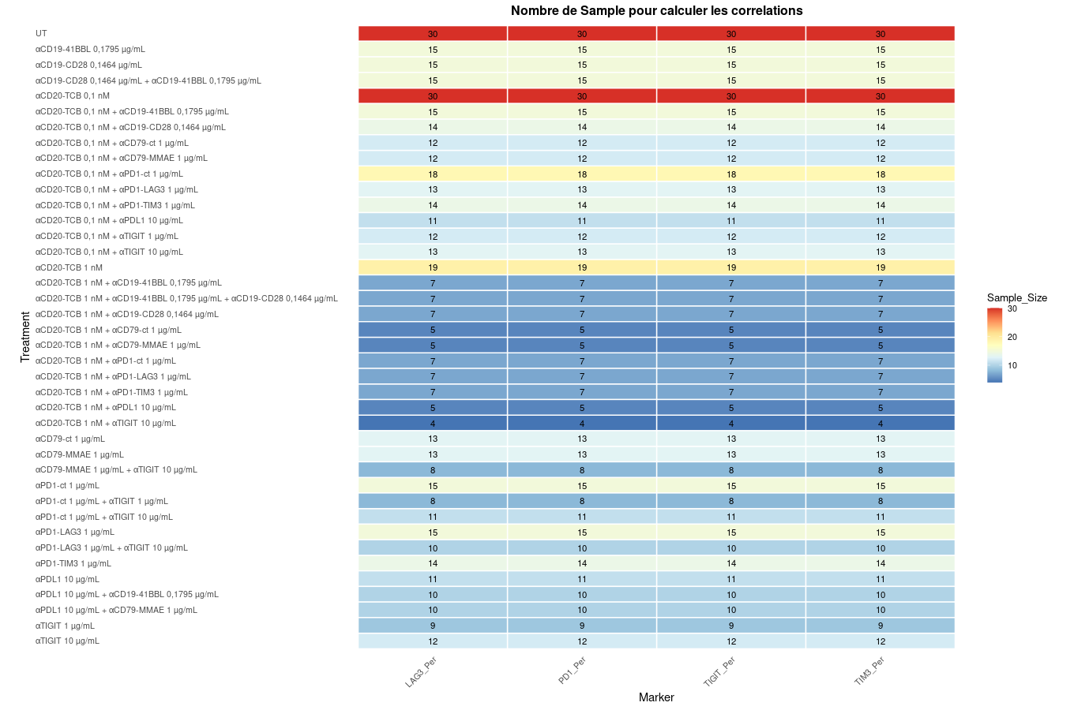

Slide 20
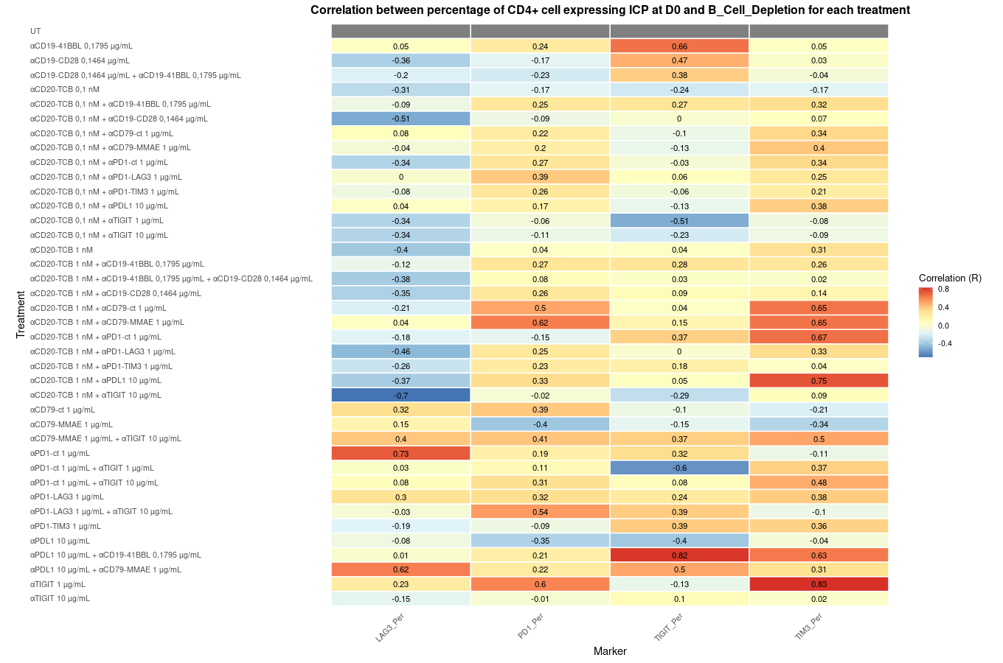

Slide 21
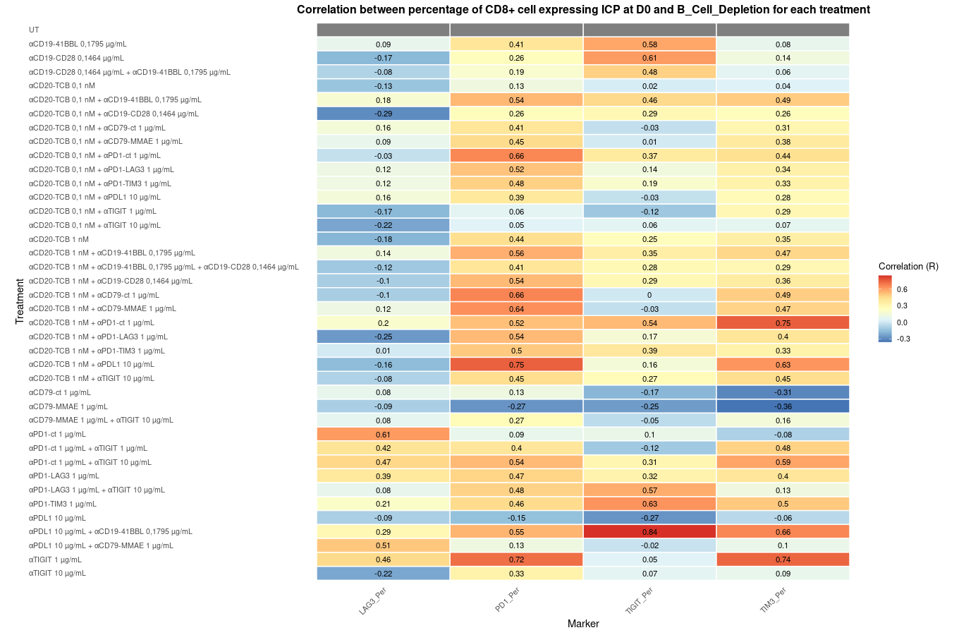

Slide 22
Correlation entre ICP expression at D0 and B_Cell_Depletion en retirant les Cd20neg

Slide 23
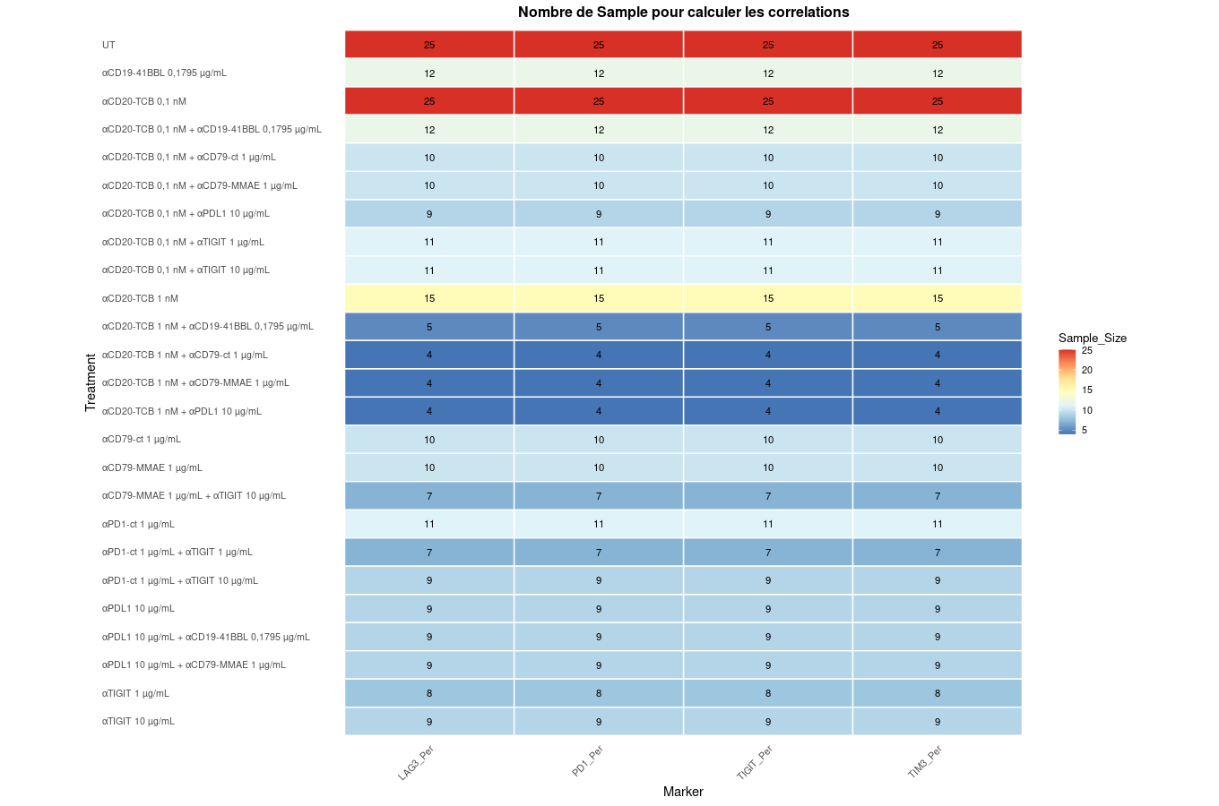

Slide 24
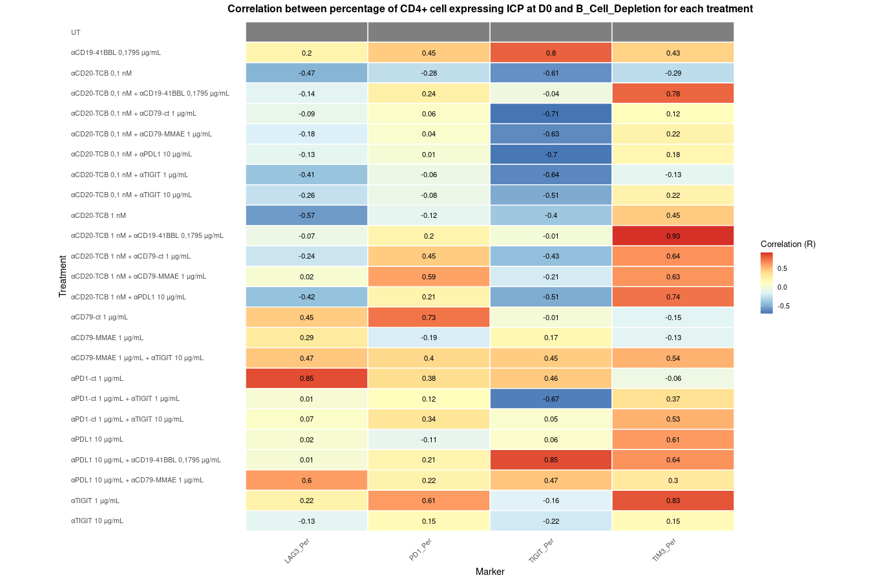

Slide 25
