Slide 1

CMR COLLEGE OF ENGINEERING & TECHNOLOGY
Kandlakoya, Medchal, Hyderabad - 501401
Department of Computer Science and Engineering
Hate Speech Detection
Batch No:35
P. Satwik 20H51A0571
P. Jagan 20H51A0519
D. Bhuvaneswar 20H51A05D9
Under the esteemed guidance of
Ms.E.Krishnaveni (Asst Professor)

Slide 2
Outline
Abstract
Introduction
Research Objective
Problem Definition
Project Scope and Limitations
Conclusion
References
Notes:
2

Slide 3
Abstract
Notes:
3

Slide 4
ABSTRACT
In today's digital age, the proliferation of hate speech and harmful content on the internet poses a significant threat to the well-being and inclusivity of online communities. To combat this growing problem, our project focuses on building a API for hate speech detection, utilizing cutting-edge artificial intelligence (AI) technologies. In this presentation, we delve into the development, significance, and impact of our website.
Our initiative aims to empower individuals, social media platforms, and online communities to take a stand against hate speech and foster a safer online environment. We will discuss the key components of our project, including data collection and labeling, AI model training, and the user-friendly interface that facilitates real-time hate speech analysis.

Slide 5
INTRODUCTION
Notes:
5

Slide 6
Introduction
So basically, as mentioned in the abstract our project focuses on detecting hate speech in social media and filtering them.
The major problem in existing solutions is limitation of usage and availability.
So, our project is, of course, it is another Hate Speech Detection model, but we are aiming to make it special by making it available to be imported for various customers into their apps.
We are harnessing the power of TensorFlow to train our model with the dataset to detect hatefulness.
We will then break down the words into a bag of words using NLP.
With the help of the DNN algorithm now we will decide if a speech can be classified as hateful or not.
Notes:
6

Slide 7
Research Objective
Notes:
7

Slide 8
Research objective
Development of a Specialized Model for hate speech detection.
To improve the accuracy of detecting hateful content on social media.
Enhance use friendliness of hate speech modules.
Contribute to the advancement of ethnicity over the social media.

Slide 9
Problem Definition
Notes:
9

Slide 10
Problem Definition
Problem Definition: In the context of our project, the problem is defined as the automatic identification and classification of hate speech and harmful content within text data on the internet.
Text Classification: The primary challenge is to develop a machine learning model capable of classifying text into categories: hate speech, non-hate speech, or ambiguous content.
Accuracy and Precision: Achieving high accuracy and precision in identifying hate speech while minimizing false positives is crucial. False positives could inadvertently censor non-offensive content.
Real-time Analysis: The system should provide real-time analysis, enabling swift response and moderation of harmful content.

Slide 11
EXISTING METHODS
Notes:
11

Slide 12
Existing Solutions:
Analysis of Existing Methods and Ideas:
S.no | Name/Purpose | Method | Drawbacks
1 | Leveraging Hate Speech Detection to investigate immigration related phenomena in Italy. | Collection of data from TWITA data source. SVM Classifier method with scikit learn linear model. | Does not work with universal languages like English.
2 | Hate Speech on Twitter | Collecting data from Twitter Streaming API. Using BOW(Bag of Words) model for representing text. Used a supervised learning model to detect Hate speech. | Cannot be extended to apps beyond Twitter because of the data collection model.
3 | Automated Hate Speech Detection on Twitter | Collection of data from Kaggle. Logistic Regression Classifier approach for hatefulness measurement. | Confined only to Twitter and cannot be imported into other apps.

Slide 13
4 | Hate Speech Detection using Multi Channel BERT | Collection of data from HatEval Dataset. Using a supervised learning model Bidirectional Encoder Representations from Transformers (BERT) to detect hateful content. | Confined to Spanish language only as HatEval only provides Spanish data.
5 | Twitter Dataset for hate speech detection and cyberbullying in Indonesian Language. | Collection of data from Twitter API A Latent Dirichlet Allocation (LDA) algorithm was used to classify the tweets and later used sentiment analysis to categorize them. | Confined only to Twitter and cannot be imported into other apps.
6 | Hate Speech Detection in Indonesian Language on Instagram Comment Section Using Maximum Entropy Classification Method | Collection of data from random Instagram posts reported for hate speech. the Maximum Entropy algorithm is trained with the optimized Part of Speech parameter TF IDF to extract the features like heatefulness. | Unreliable data source. Confined to only Instagram comment section and cannot be imported to other apps.

Slide 14
7 | SEMAR: An Interface for Indonesian Hate Speech Detection Using Machine Learning. | Data collected from random posts on Instagram, and Facebook. The classification task was performed using the Sckit-learn 3 supervised learning module to determine a text as safe or not safe. | Unreliable data source.
8 | HateSense: Tackling Ambiguity in Hate Speech Detection | The initial module of the system, takes each input comment as sanitized. The proposed system will utilize human reasoning techniques such as ontologies and fuzzy logics along with sentiment analysis in order to detect hate speech and deconstruct the ambiguity present. | Cannot be imported into different applications limiting usage.
9 | Token replacement‑based data augmentation methods for hate speech detection | Dataset not disclosed publicly. This method is the counter-fitted (synonym and antonym) word embedding. This is adapted from the Mrkšićs’ model. | Might change the meaning of sentence by word replacement.

Slide 15
10 | Bias Mitigation for Capturing Potentially Illegal Hate Speech | Data set from German Twitter posts with potential hate speech. Decision tree with hateful words for classification. | Unreliable data source No potential for self-learning since the system isn’t dynamic.

Slide 16
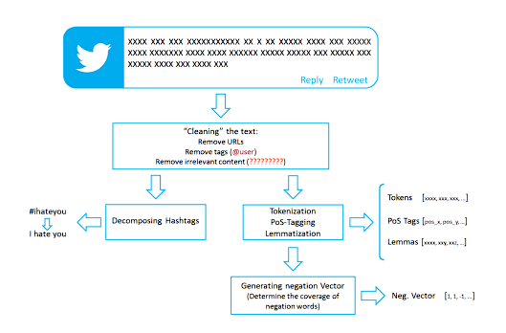
Existing Solutions:
Hate Speech on Twitter:
System Architecture:

Slide 17

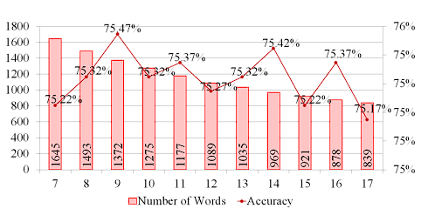
Existing Solutions:
Experimental Results:
Accuracy (Correct Predictions / All predictions) of the system is defined by its f1 score which is given as
Figure:
Classification accuracy (right axis) and number of words collected (left axis)

Slide 18
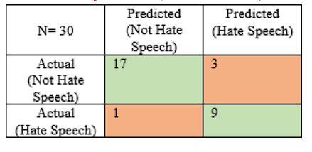
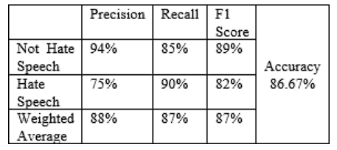
Existing Solutions:
Experimental Results:
Confusion Matrix:
Classification Report:

Slide 19
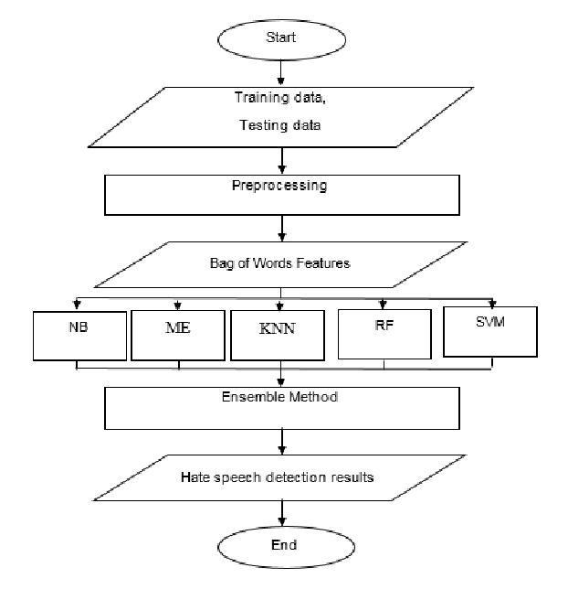
Existing Solutions:
Implementation of Existing Ideas:
Accuracy & Results:
ME: 0.86 (8th idea)
KNN: 0.83 (6th idea)
SVM: 0.87 (1st idea)
LR: 0.86 (3rd idea)
BERT: 0.79 (4th idea)
LDA:0.85 (5th idea)
LR
ME
KNN
BERT
LDA

Slide 20
EXISTING SOLUTIONS:
MERITS:
Can handle data of various languages.
Can detect hatefulness.
Reduces online hate.
DEMERITS:
They are confined to a single system and cannot be used as an import.
They are confined to a single language and in most cases it isn’t English which is a globally accepted language.

Slide 21
Proposed Solution
Notes:
21

Slide 22
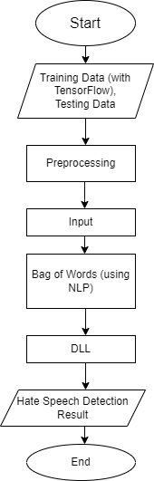
Proposed Solution:
Working of Solution:
Explanation:
Like any other ML Algorithm, our project starts with training and testing data. We will be using the TensorFlow module for this purpose rather than the standard libraries available in Python.
We will then be taking input from the user.
This input will be broken down into a bag of words using NLP.
Then we will be using a deep learning algo called DNN to classify the speech.
Then the result will be given to the user system.
DNN

Slide 23
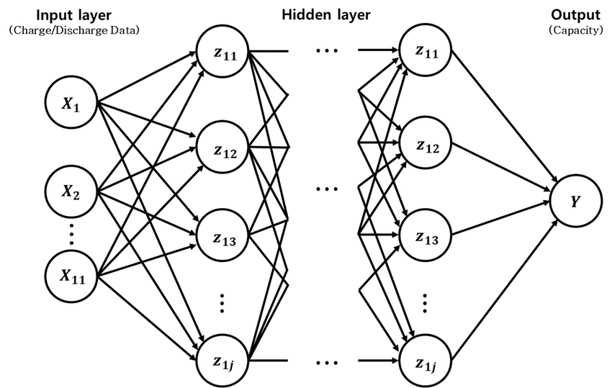
Proposed Solution:
About DNN Algorithm:
DNN stands for "Deep Neural Network," and it is a type of artificial neural network used in machine learning and deep learning.
Deep neural networks are designed to model complex patterns and representations in data, particularly when the data has multiple layers of abstraction.
Some areas where DNN can be used are:
Natural Language Processing
Image Processing
Visual Art Processing
Medical Image Analysis,etc.

Slide 24
Project scope and limitations
Notes:
24

Slide 25
Project scope and limitations
Project scope:
Detecting hate speech in social media.
Immediate text breakage.
Importing into various social media apps.
Flexibility of usage with different apps.
Limitations:
Untested algorithm.

Slide 26
Conclusion
Notes:
26

Slide 27
Conclusion
This project can be integrated into any website or social media app and can make the internet a safer place. It works on the DNN algorithm and helps break down a speech into hateful or not.
With that information, the user can decide what action needs to be taken next.
This way we plan on reducing the hatefulness in social media making the world a safer place.

Slide 28
References

Slide 29
References
IEEE TRANSACTIONS BASE PAPERS.
DNN DOCUMENTATION.

Slide 30
Thank You!

