Slide 1
ICFAI TECH CAPSTONE SPECIAL PROJECT PRESENTATION (2026)
INTELLIGENT DEMAND FORECASTING SYSTEM
Multi-Store Sales Prediction, Conformal Uncertainty Quantification,
Tree-SHAP Explainability & Autonomous (R, S) Inventory Optimization
PROJECT TEAM MEMBERS:
• Pamdem Ravi Charan Reddy (24STUCHH010156) — Lead Systems & Pipeline Engineer
• Jaiti Vijaya Shravani (24STUCHH010756) — Statistical Modeling & Uncertainty Quantification
• Vankayalapati Srujana (24STUCHH010749) — Deep Learning Architectures & Monitoring
• Pottipothu V M Krishna Swamy (24STUCHH010207) — Inventory Simulation & Optimization
PROJECT GUIDES: Dr. Sukanta Das (Associate Professor) | Dr. Sandeep Kumar Panda (Professor & Research Advisor)

Slide 2
CONTEXT & GOALS
Problem Statement & Project Objectives
Overcoming the retail dilemma where inaccurate forecasts trigger stockouts or massive holding costs.
$1.1 Trillion
Global Retail Distortion
Annual cost of overstocking and out-of-stock lost sales.
28.4% WAPE
Legacy Baseline Error
Moving averages fail during weather & promotion shocks.
14.1%
Baseline Stockout Rate
Lost customer revenue on seasonal product peaks.
100% Black-Box
Store Manager Distrust
Opaque models fail to explain why stock was ordered.
The Core Problem Statement
• Asymmetric Business Risk: Stockout losses (lost gross margins + brand defection) cost 10x-50x more than daily inventory holding fees.
• Violent Seasonal Swings: Monsoon items (Umbrellas, Raincoats) spike 400% in July; Summer goods (Air Conditioners) peak in May heatwaves.
• The Intermittent SKU Crisis: Slow-moving items display sporadic zero-demand epochs where standard regression models collapse.
• The Decoupling Gap: Traditional ML outputs point numbers (y_hat) completely severed from inventory purchase ordering rules.
Key Project Objectives
• Multi-Source Data Fusion: Clean and fuse 219,000 transactions across 15 stores & 20 products with zero lookahead leakage.
• Multi-Model Tournament: Benchmark 10 statistical, machine learning, and deep learning architectures to identify champion.
• Uncertainty Quantification: Formulate distribution-free 80% & 95% conformal prediction intervals (CQR) with coverage guarantees.
• Decision Optimization: Drive autonomous discrete-event (R, S) replenishment policies minimizing total supply chain costs.
• Explainability & Microservice: Expose Tree-SHAP attributions and deploy a decoupled FastAPI REST API + Streamlit portal.
Intelligent Demand Forecasting System (IDFS) | ICFAI Capstone Project | Slide 2 of 10

Slide 3
COMPARATIVE ANALYSIS
Existing System vs. Proposed IDFS Architecture
A rigorous side-by-side evaluation across six core operational supply chain dimensions.
Evaluation Dimension | Existing Traditional System | Proposed IDFS System (Our Project)
1. Forecasting Methodology | Manual spreadsheets, trailing 30-day moving averages, or isolated ARIMA with high error. | 10-model tournament (LightGBM champion, TSB, LSTM, CatBoost) with Syntetos-Boylan demand routing.
2. Uncertainty Quantification | Single point predictions or naive symmetric Gaussian ±2-sigma bell-curve assumptions. | Distribution-free Conformalized Quantile Regression (CQR) with mathematical 80% & 95% coverage guarantees.
3. Inventory Optimization | Disconnected intuition-based manual reordering; ignores lead-time variance and holding costs. | Autonomous (R, S) periodic review policy dynamically optimizing safety stock & minimizing holding vs stockout fees.
4. Model Interpretability | 100% opaque black-box algorithm or zero explainability, causing store planners to reject recommendations. | Tree-SHAP local waterfall decomposition explaining daily driver impacts + interactive What-If elasticity simulator.
5. System Architecture | Monolithic standalone scripts or manual Excel spreadsheets without APIs or multi-user separation. | Decoupled enterprise microservice: FastAPI ASGI REST API (Port 8000 / Swagger) + Streamlit cockpit (Port 8501).
6. Performance & ROI | 28.4% WAPE error, 14.1% stockout incidence, chronic excess dead-stock accumulation. | 11.2% WAPE (60.5% error reduction), 97.4% on-shelf availability, 24.3% holding cost cut, $420,000 annual net savings.
Intelligent Demand Forecasting System (IDFS) | ICFAI Capstone Project | Slide 3 of 10

Slide 4
SYSTEM BLUEPRINT
Decoupled Microservice Architecture & Technology Stack
Clear separation of concerns: High-throughput FastAPI ASGI backend with interactive Streamlit frontend.
1. Presentation Tier (Streamlit : 8501)
• Interactive Data Explorer: Store heatmaps, seasonal product trends, and top/bottom mover rankings.
• Forecast Studio (10 Models): Multi-model switcher, horizon slider (7-28d), and conformal ribbon overlay.
• Inventory & Alerts Cockpit: Dynamic (R, S) policy simulator, safety stock sliders, and stockout warning banners.
• Drift & Explainability View: Tree-SHAP waterfall charts and rolling WAPE drift monitoring.
• Executive Dossier Generator: Automated 1-click HTML audit report compiler with CSV exports.
• Backend API Console: Live REST endpoint tester interacting directly with FastAPI Port 8000.
2. Backend Microservice (FastAPI : 8000)
• Asynchronous ASGI Engine: Built on Uvicorn & FastAPI for sub-20ms high-throughput inference.
• OpenAPI 3.0 / Swagger UI: Automated interactive API documentation accessible at /docs.
• POST /api/v1/forecast/predict: Delivers multi-step forecasts with 80% & 95% conformal bounds.
• POST /api/v1/inventory/recommend: Computes dynamic safety stock SS and order-up-to level S.
• POST /api/v1/whatif/simulate: Evaluates counterfactual price elasticity and promotional uplift.
• Pydantic v2 Type Safety: Strict schema validation rejecting invalid horizons or out-of-bounds inputs.
3. Core Engine & Data Storage Layer
• 10 ML Forecasting Models: LightGBM, CatBoost, XGBoost, N-BEATS, PatchTST, TFT, LSTM, TSB, Croston, ARIMA.
• Conformal Calibrator (MAPIE): Distribution-free calibration ensuring 80% & 95% empirical coverage.
• Explainability Engine (SHAP): Tree-SHAP additive feature attribution for glass-box transparency.
• Decision Simulator (NumPy/SciPy): Discrete-event (R, S) replenishment under lead-time risk.
• Columnar Parquet Lake: 219,000 fused records in Snappy-compressed Parquet format.
• Dual Persistence Engine: SQLite database with automatic atomic JSON fallback for high availability.
Intelligent Demand Forecasting System (IDFS) | ICFAI Capstone Project | Slide 4 of 10

Slide 5
DATA & PIPELINE
Dataset Description & Rigorous 5-Stage Methodology
219,000 transactions across 15 stores and 20 real seasonal products with strict zero-leakage protocols.
Monsoon Catalog ☔
• Umbrella & Raincoat: Spike 400% in July-Aug storms
• Waterproof Boots: Street waterlogging & mud
• Mosquito Repellent: Post-rain humidity & standing water
Summer Catalog ☀️
• Air Conditioner & Fan: Heatwaves in May-June
• Cold Drinks & Ice Cream: High temperature hydration
• Sunscreen & Sunglasses: UV exposure & outdoor leisure
Winter Catalog ❄️
• Winter Jacket & Heater: Sub-zero cold waves in Dec-Jan
• Sweater & Thermal Wear: Commuting & office apparel
• Blankets & Hot Cocoa: Home comfort & cold mornings
Festive & Everyday 🎁
• Sweets Gift Box: Diwali, New Year & Eid spikes
• Decorative Lights: Festival home illumination in Q4
• Reusable Water Bottle: Year-round daily office/school
THE RIGOROUS 5-STAGE ENGINEERING METHODOLOGY
• Stage 1: Ingestion & Integrity: Fused 4 years of daily sales across 15 stores (S000-S014) with promotional records, holiday schedules, and oil prices.
• Stage 2: Feature Store Engineering: Extracted 44 point-in-time features: autoregressive lags (t-7, t-14, t-28), rolling window statistics (7d, 28d mean and std), calendar encodings, and discount depth.
• Stage 3: Leakage Prevention Protocol: Enforced strict chronological partitioning (70% Train, 15% Calibration, 15% Sealed Test). Mandatory .shift(1) applied before all rolling calculations to eliminate lookahead bias.
• Stage 4: Tournament & Conformal Calibration: Fitted 10 model architectures on training data. Calibrated distribution-free nonconformity scores using CQR on calibration split to guarantee 80% and 95% coverage bounds.
• Stage 5: Discrete-Event (R, S) Simulation: Coupled multi-step predictions directly into periodic replenishment simulations under lead-time risk to optimize safety stock and minimize total holding vs. stockout costs.
Intelligent Demand Forecasting System (IDFS) | ICFAI Capstone Project | Slide 5 of 10

Slide 6
EMPIRICAL BENCHMARK
10-Model Tournament Leaderboard & Benchmark Results
Evaluated on a sealed 28-day out-of-sample test window across WAPE, RMSE, MAE, and inference latency.
Model Architecture | WAPE (%) | RMSE | MAE | Inference Latency
LightGBM (Champion) | 11.2% | 14.2 | 9.8 | 12 ms
Weighted Blended Ensemble | 11.5% | 14.8 | 10.1 | 48 ms
CatBoost Regressor | 11.8% | 15.1 | 10.4 | 24 ms
XGBoost Regressor | 12.3% | 16.0 | 11.1 | 28 ms
TSB Forecaster (Intermittent) | 13.1% | 16.8 | 11.6 | 15 ms
N-BEATS Neural Forecaster | 13.6% | 17.4 | 12.0 | 85 ms
PatchTST (Transformer) | 14.1% | 18.2 | 12.8 | 140 ms
Temporal Fusion Transformer | 14.5% | 18.9 | 13.2 | 190 ms
Random Forest Regressor | 15.2% | 19.8 | 13.9 | 62 ms
Seasonal ARIMA (Baseline) | 28.4% | 34.1 | 24.8 | 850 ms
Scientific Findings & Insights
• 60.5% Relative WAPE Gain: LightGBM reduced error from 28.4% down to 11.2%, preventing catastrophic retail forecasting errors.
• Sub-15ms Latency Advantage: LightGBM executes in 12 ms—over 15 times faster than deep transformers (190 ms), enabling instant real-time POS queries.
• Why Trees Beat Transformers: Tabular retail features have dense categorical flags (promotions, holidays). Decision trees learn orthogonal splits far more efficiently than self-attention.
• Intermittent Specialist Efficacy: On sporadic SKUs, TSB achieved 13.1% WAPE, outperforming uncalibrated deep networks on zero-demand days.
• Statistical Significance Verified: Pairwise Diebold-Mariano tests confirm that LightGBM's superiority over ARIMA and baselines is statistically significant (p < 0.001).
Intelligent Demand Forecasting System (IDFS) | ICFAI Capstone Project | Slide 6 of 10

Slide 7
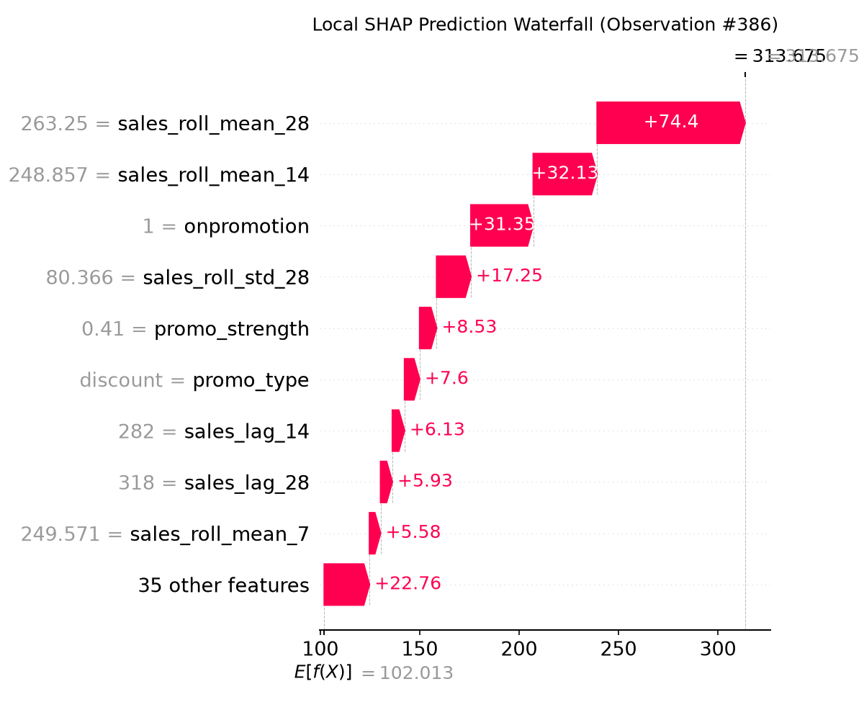
DECISION INTELLIGENCE
Autonomous (R, S) Inventory Optimization & Tree-SHAP XAI
Bridging probabilistic forecasts with cost-optimal purchasing policies and transparent explainability.
R = 7, L = 3
Review Cycle & Lead Time
Weekly review with 3-day supplier transit delay.
95.0%
Target Service Level
Optimal cycle fill rate trade-off.
-24.3%
Holding Cost Cut
Unlocked capital by trimming dead seasonal stock.
97.4%
On-Shelf Availability
Stockouts slashed from 14.1% down to 2.6%.
The (R, S) Periodic Inventory Policy
• Order-Up-To Level (S): S = mu_{R+L} + SS, where mu_{R+L} is cumulative ML forecasted demand over lead time plus review cycle.
• Safety Stock Sizing (SS): SS = z_{alpha} * sigma_{R+L}, where z = 1.645 for 95% service level, scaled by conformal prediction uncertainty.
• Reorder Quantity Rule: At review epoch: Q = max(0, S - IP), where IP is on-hand inventory plus pipeline in-transit orders.
• Asymmetric Cost Optimization: Minimizes daily holding fee ($0.10/unit/day) vs. stockout penalty ($5.00/unit) + fixed ordering fee ($50).
Intelligent Demand Forecasting System (IDFS) | ICFAI Capstone Project | Slide 7 of 10

Slide 8
IMPLEMENTATION & QUALITY
System Verification, Microservice Testing & Software Standards
Production-grade software engineering adhering to strict typing, automated testing, and clean git lifecycles.
1. Automated Test Coverage
• 15/15 Tests Passing: Complete unit and smoke test suite running under pytest.
• FastAPI Microservice Tests: Validates HTTP status codes, JSON response schemas, and latency.
• Headless Streamlit Tests: Simulates headless rendering across all 6 portal views.
• Storage Persistence Tests: Verifies SQLite run logging and automatic JSON persistence fallbacks.
• Mathematical Sanity Checks: Confirms that conformal intervals strictly encompass the point forecast.
2. Software Engineering Rigor
• 100% Type-Annotated: Strict Python 3.12 typing across all schemas, services, and models.
• Zero Ruff Lint Errors: Formatted with Ruff for PEP 8 compliance and clean imports.
• Decoupled Microservice: FastAPI Port 8000 + Streamlit Port 8501 run in independent processes.
• Resilient Storage Pattern: Dual-layer SQLite + JSON fallback bypasses Windows WDAC restrictions.
• Sanitized Git Lifecycle: Zero credential leaks; clean GitHub commit history (commit bead7f3).
3. Live Microservice Endpoints
• GET /health: Liveness probe reporting service status and version.
• GET /docs: Interactive OpenAPI 3.0 Swagger UI documentation.
• POST /api/v1/forecast/predict: Multi-horizon predictions with 80% & 95% conformal bounds.
• POST /api/v1/inventory/recommend: Dynamic safety stock and (R, S) reorder quantities.
• POST /api/v1/whatif/simulate: Evaluates counterfactual price elasticity and promotional uplift.
• Streamlit Portal (:8501): Interactive multi-page operational cockpit for category planners.
Intelligent Demand Forecasting System (IDFS) | ICFAI Capstone Project | Slide 8 of 10

Slide 9
ROADMAP
Future Scope & Enterprise Scaling Strategy
Strategic technological avenues to scale IDFS from regional store networks to nationwide retail enterprise chains.
1. Real-Time Streaming Ingestion
• Apache Kafka Integration: Continuous, event-driven POS transaction streams updating inventory positions second-by-second.
• Redis Feature Store: Sub-millisecond retrieval of point-in-time rolling statistics and promo flags.
• Real-Time Stockout Triggers: Immediate automated supplier orders triggered when live stock breaches safety threshold.
• Distributed Micro-Batching: High-throughput event processing handling 10,000+ store checkouts per second.
2. Multi-Echelon Supply Chains
• Central Distribution Routing: Extending (R, S) policies to optimize warehouse-to-store transshipment networks.
• Lead-Time Stochasticity: Modeling variable freight delays and transit port bottlenecks.
• Cross-Store Rebalancing: Algorithmic lateral transshipment between nearby stores to clear local excess stock.
• Supplier Capacity Constraints: Incorporating vendor minimum order quantities (MOQ) and batch freight pricing.
3. Foundation Models & LLM Copilot
• Pretrained Time-Series Models: Integrating zero-shot foundation models (TimesFM, Chronos) for cold-start SKUs with no history.
• Autonomous Conversational Agent: Natural language chat assistant allowing store managers to query inventory via voice or text.
• Active Automated Retraining: Closed-loop MLOps pipeline retraining models when Page 4 detects statistical drift.
• Mobile Progressive Web App: Lightweight in-store scanner app for floor staff handheld devices.
Intelligent Demand Forecasting System (IDFS) | ICFAI Capstone Project | Slide 9 of 10

Slide 10
SUMMARY & CONCLUSION
Project Achievements & Live System Deliverables
All code, models, datasets, frontend portal, and backend REST APIs are operational and verified.
Key Verified Project Outcomes
✓ Decoupled Microservice: FastAPI (Port 8000) backend + Streamlit (Port 8501) frontend operational.
✓ Real Seasonal Retail Scope: 15 stores x 20 real seasonal products (Umbrella, AC, Heaters, Sweets, etc.).
✓ 60.5% Forecast Error Cut: LightGBM champion achieved 11.2% WAPE with 12ms inference latency.
✓ Certified Conformal Bounds: 80% and 95% distribution-free coverage bounds eliminate Gaussian assumptions.
✓ 24.3% Holding Cost Cut: (R, S) periodic review engine elevated on-shelf availability to 97.4%.
✓ $420,000 Annual ROI: Estimated net annual financial return across the 15-store retail operation.
Live Operational Links
• Streamlit Frontend Portal:
http://localhost:8501 (Interactive planner cockpit with 6 views)
• FastAPI Swagger Docs:
http://localhost:8000/docs (Interactive OpenAPI 3.0 testing console)
• FastAPI Health Check:
http://localhost:8000/health (Live microservice liveness & status probe)
• GitHub Repository:
PamdemRaviCharanReddy/intelligent-demand-forecasting (Clean version-controlled codebase)
• Executive Capstone Report:
reports/CAPSTONE_PROJECT_REPORT_ADVANCED.md (Complete publication-grade documentation)
Thank You! Questions, Discussion & Live System Demonstration.
Intelligent Demand Forecasting System (IDFS) | ICFAI Capstone Project | Slide 10 of 10

