Slide 1
INTELLIGENT DEMAND
FORECASTING SYSTEM
A Multi-Model Approach to Retail Demand Prediction & Inventory Optimization
Ravi Charan Reddy • Shravani • Srujana • Krishna Swamy
Guides: Dr. Sukanta Das • Dr. Sandeep Kumar Panda
IcfaiTech | IFHE, Hyderabad | Department of CSE

Slide 2
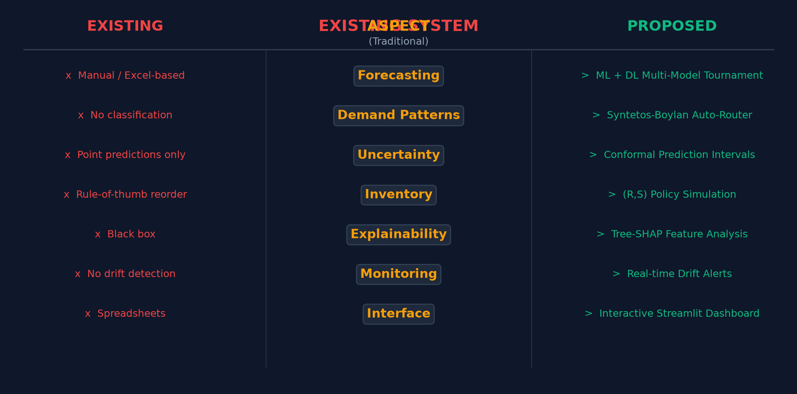
THE PROBLEM
Why traditional forecasting fails in modern retail
📉
📦
⚙️
Demand Volatility
Stockout & Overstock
Legacy Methods Fail
Seasons, promotions & holidays
cause wild demand swings
Inaccurate forecasts cost retailers
millions in lost sales & waste
Simple moving averages can't handle
intermittent & irregular demand

Slide 3
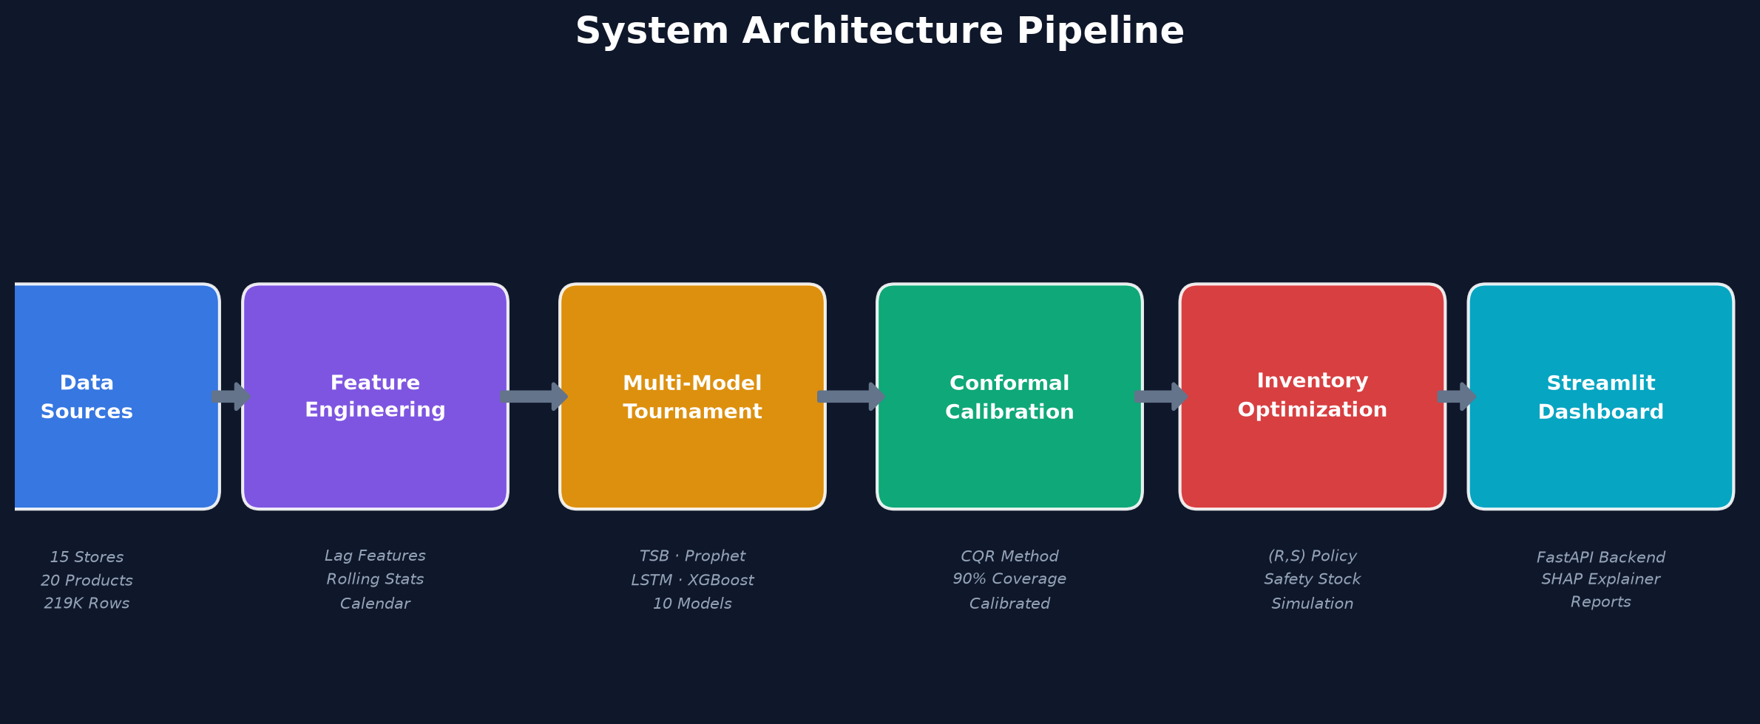
SYSTEM ARCHITECTURE
End-to-end pipeline from raw data to actionable insights
Python
Pandas
XGBoost
PyTorch
Prophet
FastAPI
Streamlit
SHAP
SQLite

Slide 4
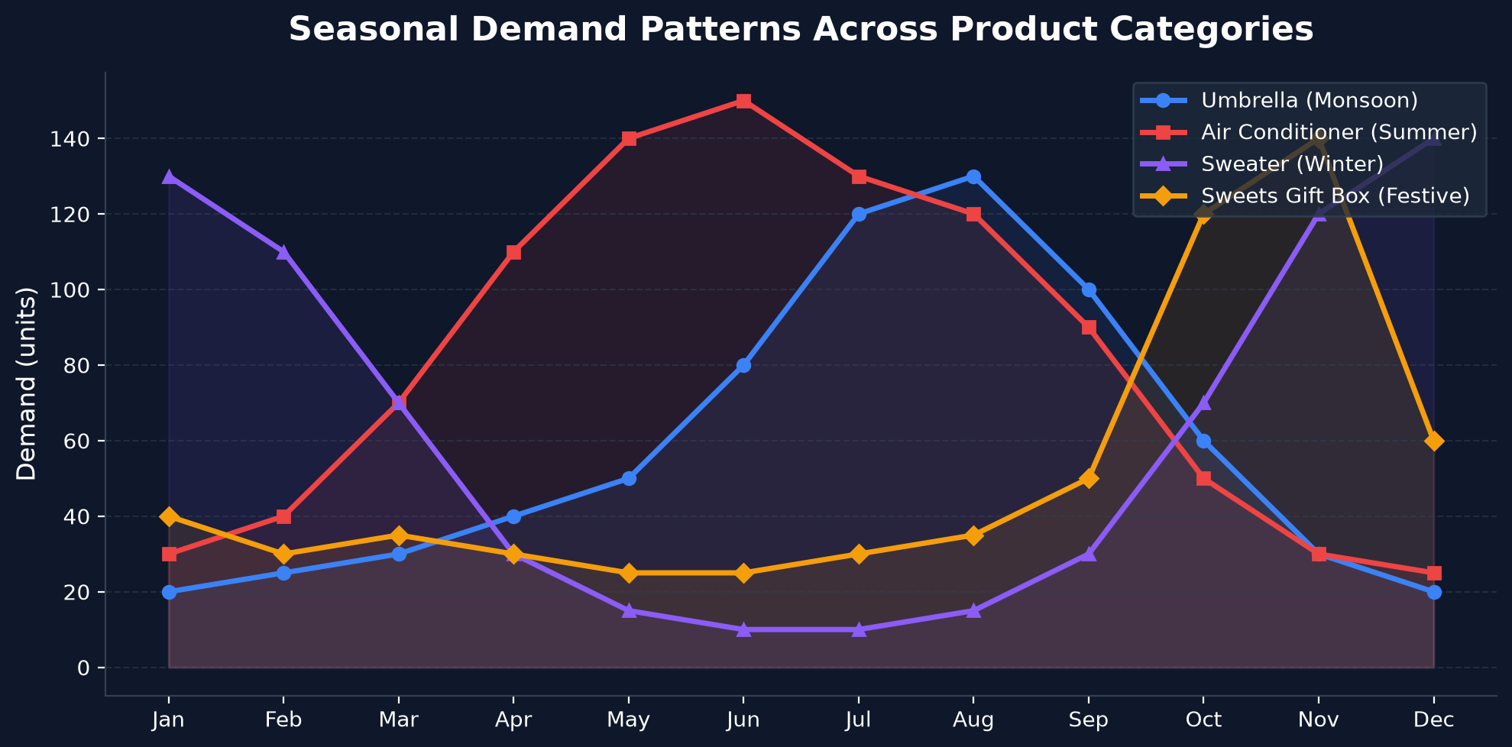
DATASET AT A GLANCE
219,000+
15
20
4 Years
Transactions
Retail Stores
Seasonal Products
Historical Data

Slide 5
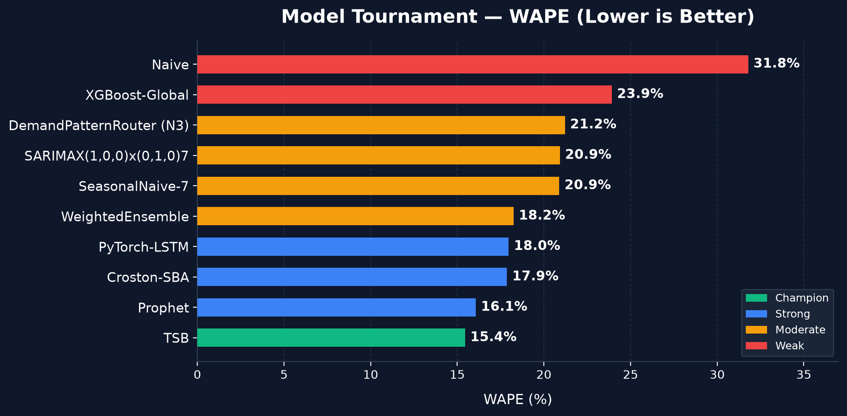
MODEL TOURNAMENT
10 models competed • Statistical + ML + Deep Learning • TSB emerged as champion

Slide 6
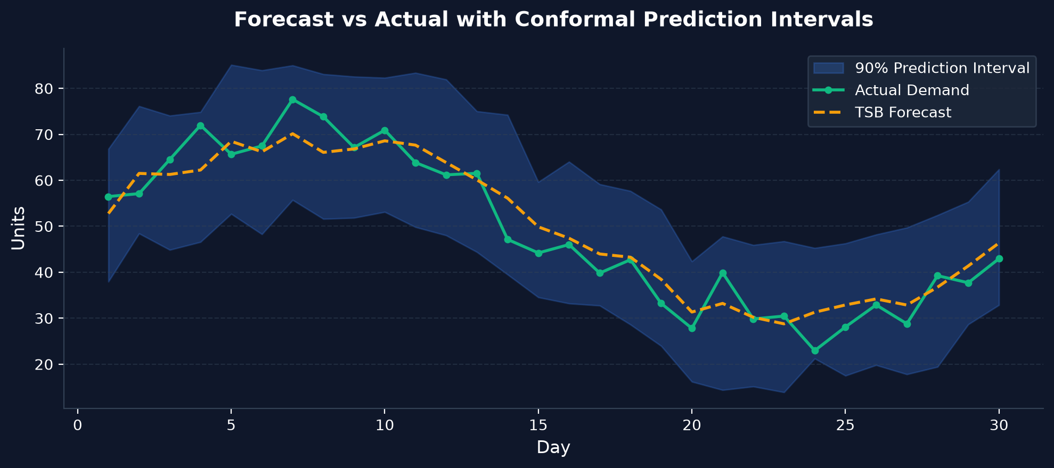
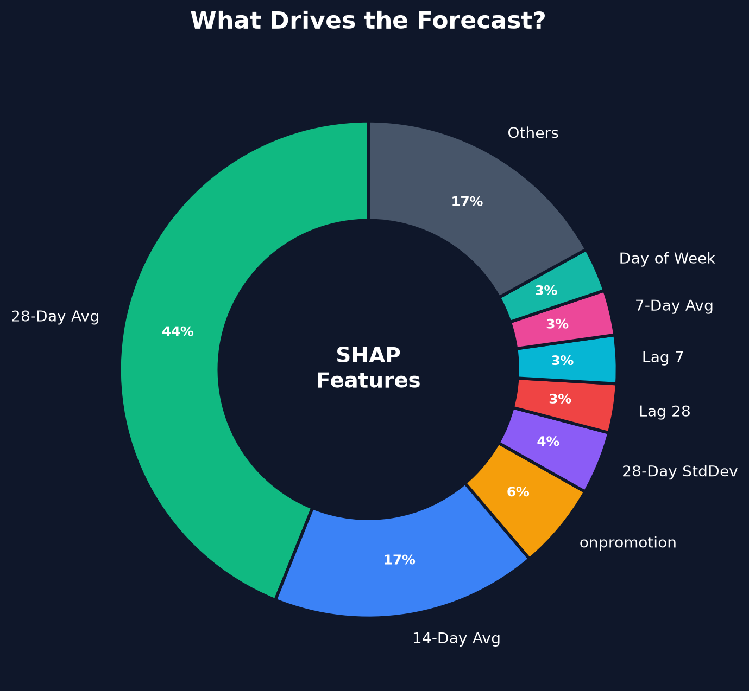
FORECASTING WITH UNCERTAINTY
Conformal Quantile Regression (CQR) provides distribution-free prediction intervals
90% Coverage
Top Feature
Promotion Impact
Prediction intervals
capture true demand
28-Day Rolling Avg
(44% importance)
5.6% SHAP contribution
to forecast shifts

Slide 7
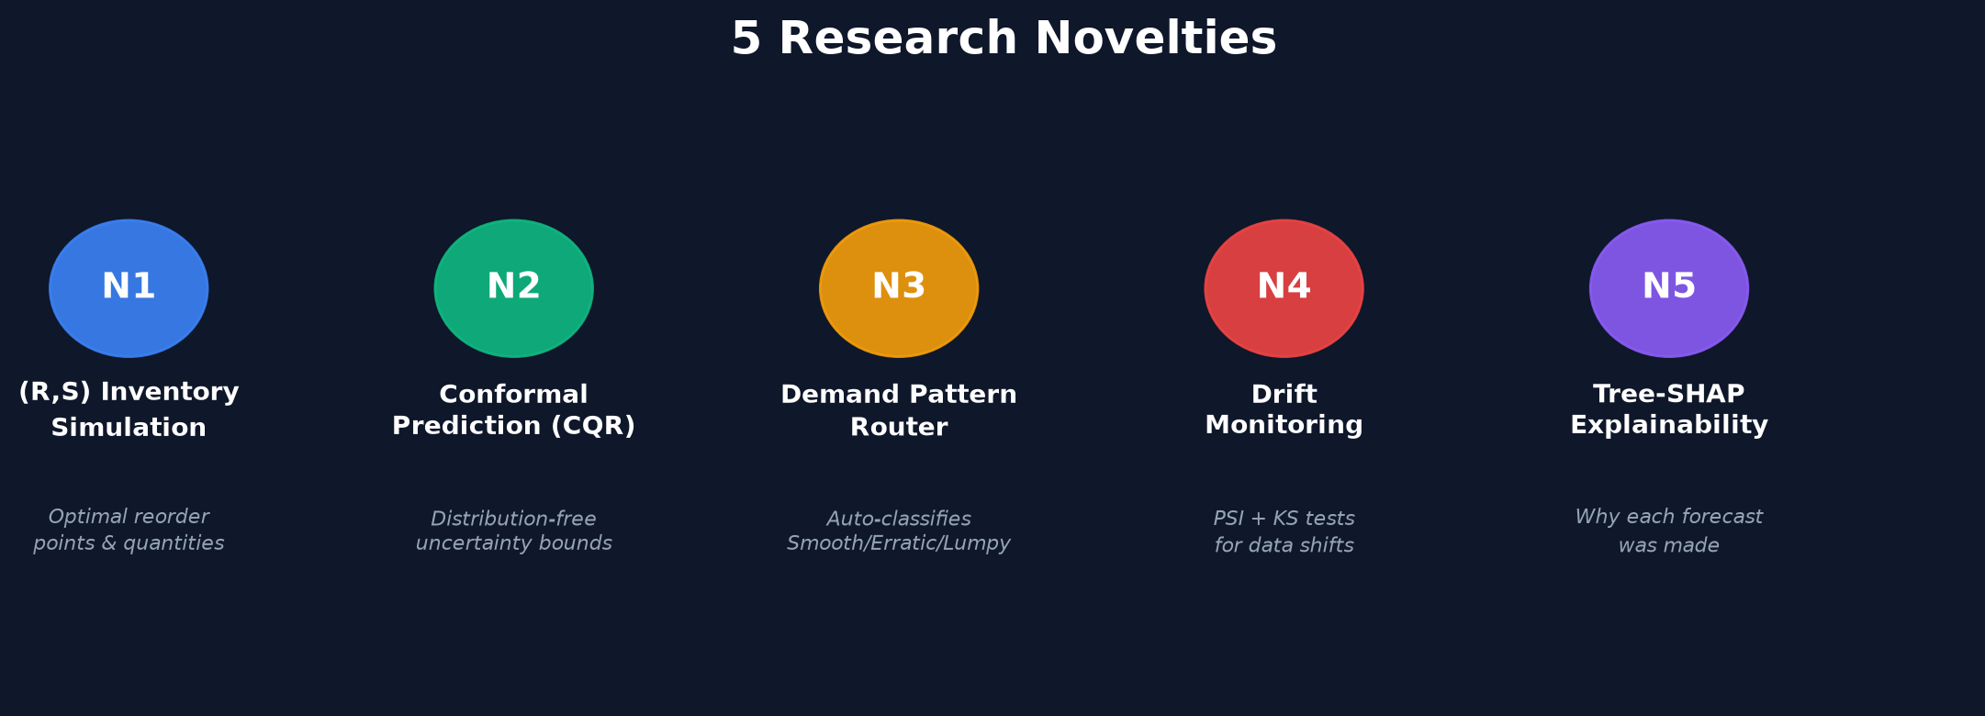
KEY RESULTS
15.45%
51.4%
82.1%
10
WAPE
Error Reduction
90% Coverage
Models
Champion TSB Model
vs Naive Baseline
Prediction Intervals
Benchmarked

Slide 8
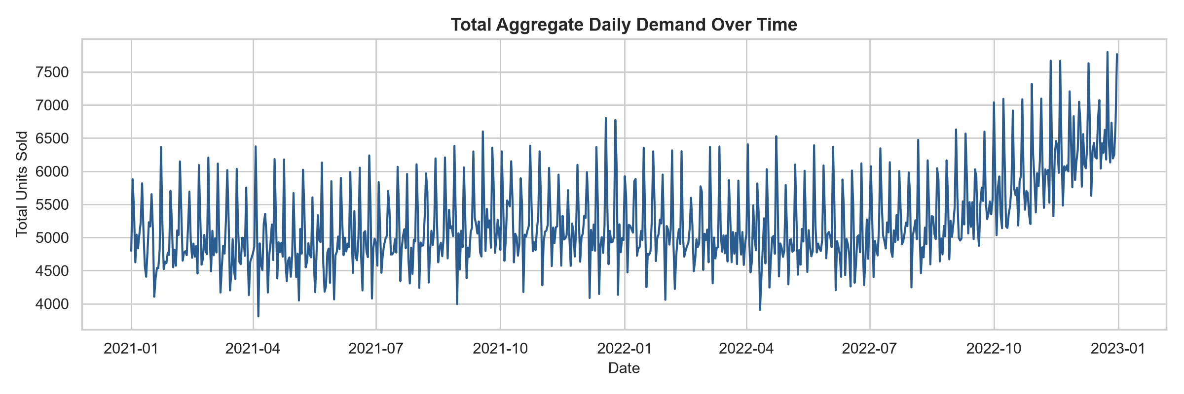
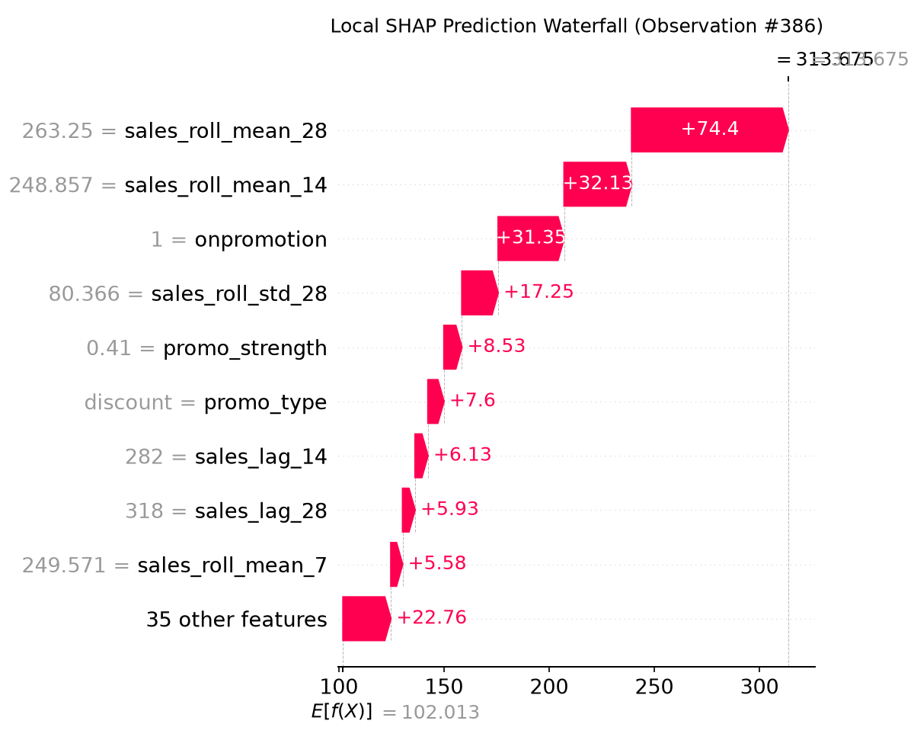
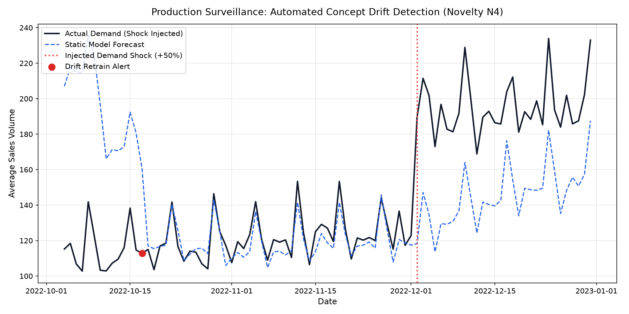
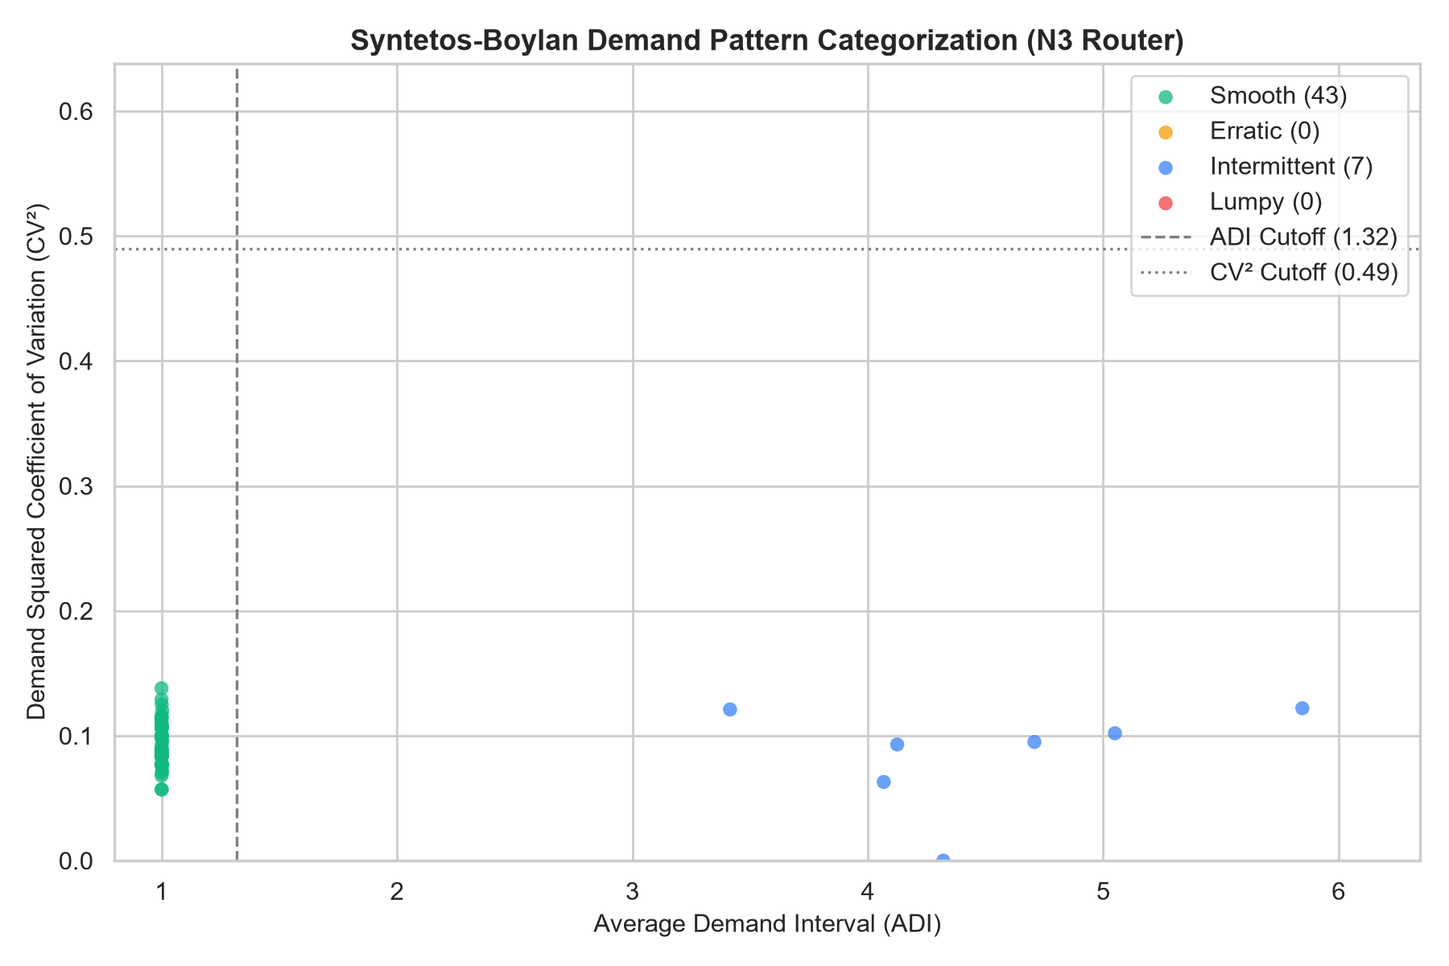
LIVE DASHBOARD
Interactive Streamlit UI with real-time forecasting, SHAP explainability & drift monitoring
▲ Sales Trend Analysis
▲ SHAP Waterfall — Why this forecast?
▲ Drift Detection Monitoring
▲ Demand Pattern Classification

Slide 9
CONCLUSION & FUTURE SCOPE
✅ What We Built
🚀 Future Scope
→ End-to-end demand forecasting + inventory optimization system
Real-time Data
→ 10-model tournament — TSB champion (15.45% WAPE)
Live POS integration for instant forecasts
→ Conformal prediction for reliable uncertainty bounds
Auto Retraining
→ SHAP explainability for every single forecast
MLOps pipeline with automated model updates
→ Interactive Streamlit dashboard with FastAPI backend
Cloud Deploy
Scalable cloud deployment + mobile interface
Multi-Store
Cross-store inventory optimization at scale
github.com/PamdemRaviCharanReddy/intelligent-demand-forecasting

Slide 10
THANK YOU
Questions & Discussion
Ravi Charan Reddy • Shravani • Srujana • Krishna Swamy
IcfaiTech | IFHE, Hyderabad

